Slide 1
XGBOOST
P : 080 4928 5000 | E : enquiry@acadgild.com

Slide 2
BIAS, VARIANCE AND ENSEMBLE METHODS
Bias is an error from erroneous assumptions in the learning algorithm. Models with high bias tend to be simpler, but underfit training data, failing to capture important regularities in the data.
Variance is an error from sensitivity to small fluctuations in the training data. High variance can cause a model to model the random noise in the training data.
Bias-Variance tradeoff is a central problem in supervised learning. We would like to both capture the regularities in the data and generalize well.
Ensemble methods use multiple learning algorithms to get better predictive performance than could be obtained using the single algorithms alone.
Boosting combines many "weak" (high bias) models in an ensemble that has lower bias than the individual models, while bagging combines "strong" learners in a way that reduces their variance.

Slide 3
BOOSTING
Boosting involves incrementally (sequentially) building an ensemble by training each new model instance to emphasize the training instances that previous models mis-classified.
Boosting combines multiple “weak learners” (whose performance is only slightly better than random guessing) to create a stronger learner.
Weak learners are weighted in a way that is related to their accuracy.
The data is also reweighted so that misclassified samples, for example have higher weight than those that were correctly classified so that the other learners will focus on these samples.
There are different boosting algorithms – AdaBoost, xgboost, BrownBoost, LogitBoost, etc. Only algorithms that are provable boosting algorithms in the probably approximately correct learning formulation can accurately be called boosting algorithms.
Xgboost is a software library which provides a framework for gradient boosting in several languages.

Slide 4
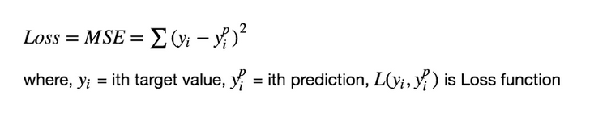
GRADIENT BOOSTING
Produces an ensemble of weak prediction models, typically decision trees.
Builds the model stage-wise and generalizes by allowing optimization of a differentiable loss function.
Boosting algorithms are iterative functional gradient descent algorithms. That is, algorithms that optimize a cost function over function space by iteratively choosing a function (weak hypothesis) that points in the negative gradient direction.
The idea is to minimize the sum of the squared errors.

Slide 5
GRADIENT BOOSTING, UNDER THE HOOD
Fit a model F₁(x) to the data.
Fit a model h₁(x) to the residuals, h₁(x) = y – F₁(x)
Create a new model, F₂(x) = F₁(x) + h₁(x)
M such models are built such that the loss function for the samples in each leaf is minimized. An optimal value for M can be determined using cross-validation, where the predictions made by the model are checked with test data.
Gradient Descent: Used to find the parameters of a function that minimizes the cost function. It starts off with initial values for the co-efficients. The cost of the co-efficients is calculated by plugging the co-efficients into the function and calculating the cost. The derivative of the cost and find the delta = derivative(cost), such that the co-efficients can be updated to co-efficient = co-efficient – (alpha * delta), where alpha is a learning rate that specifies how much the co-efficients can change on each update. The process is repeated till the cost is zero or close-enough to it.

Slide 6
XGBOOST PACKAGE - PYTHON
Data Interface:
Uses a DMatrix data structure.
DMatrix is a internal data structure that used by XGBoost which is optimized for both memory efficiency and training speed.
It is possible to load data from:
Pandas dataframe
Numpy array
Scipy array
CSV file
Other formats
To load data from a pandas DataFrame to a Dmatrix: dtrain = xgb.DMatrix(data, label=label)
where, data is the dataframe that contains the predictor variables.
label is the dataframe that contains the target variables.

Slide 7
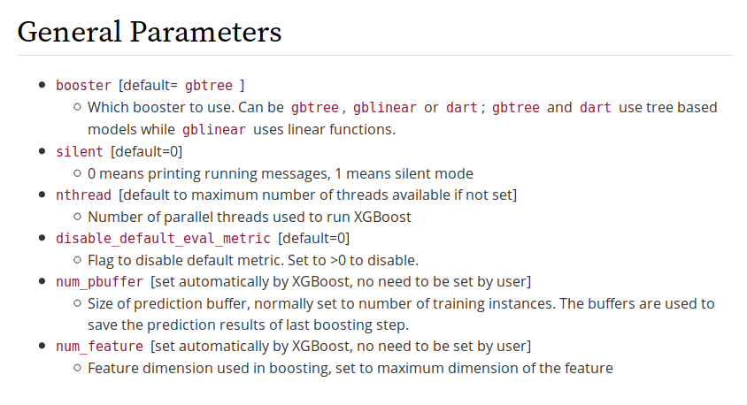
XGBOOST PACKAGE – GENERAL PARAMETERS

Slide 8
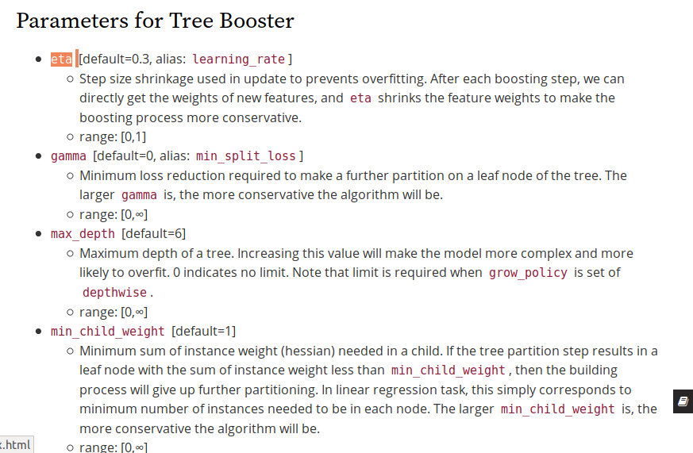
XGBOOST PACKAGE – TREE BOOSTER PARAMETERS

Slide 9
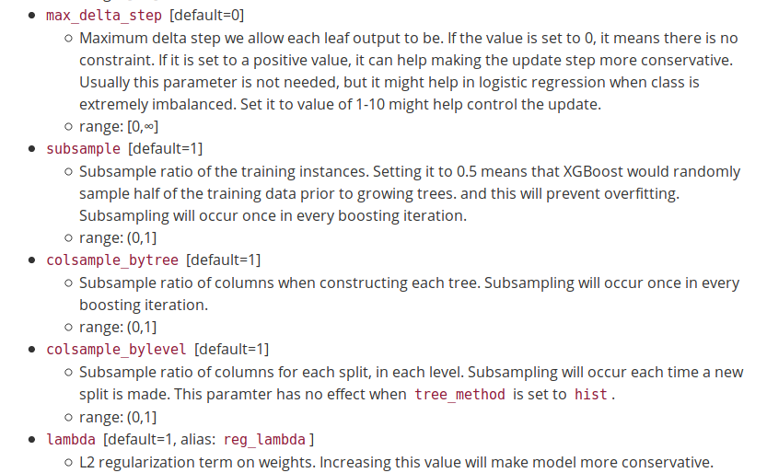
XGBOOST PACKAGE – TREE BOOSTER PARAMETERS

Slide 10
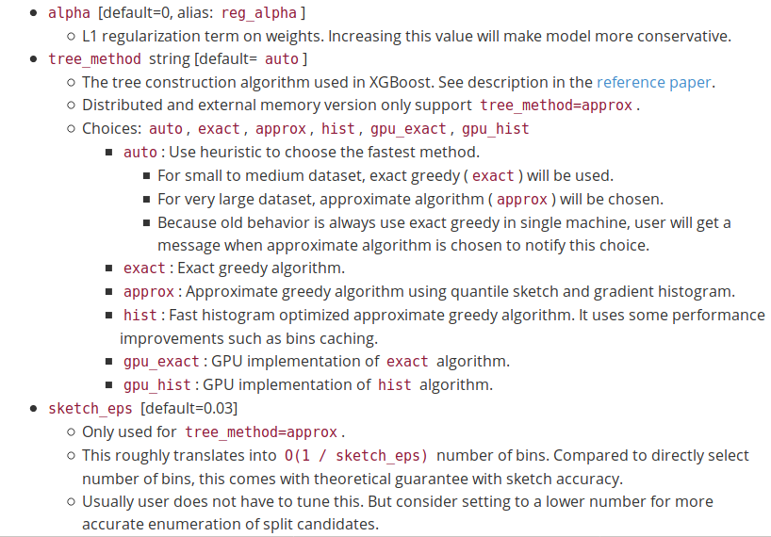
XGBOOST PACKAGE – TREE BOOSTER PARAMETERS

Slide 11
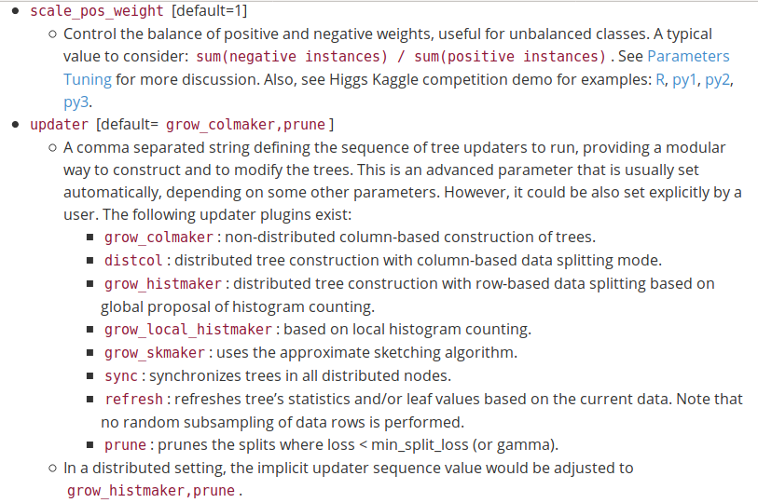
XGBOOST PACKAGE – TREE BOOSTER PARAMETERS

Slide 12
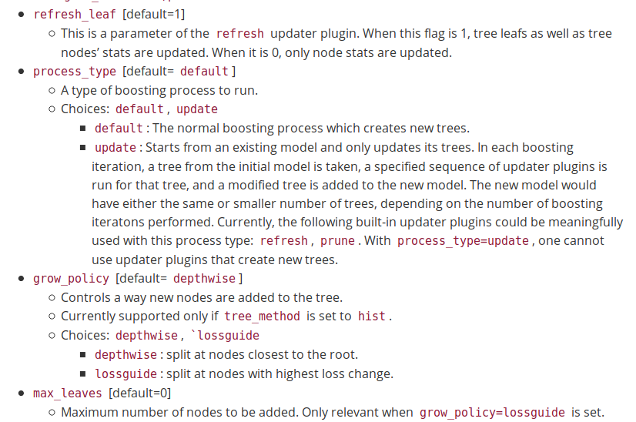
XGBOOST PACKAGE – TREE BOOSTER PARAMETERS

Slide 13
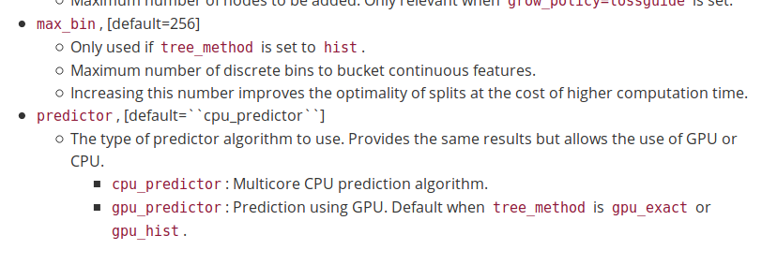
XGBOOST PACKAGE – TREE BOOSTER PARAMETERS

Slide 14
XGBOOST PACKAGE – TREE BOOSTER PARAMETERS

Slide 15
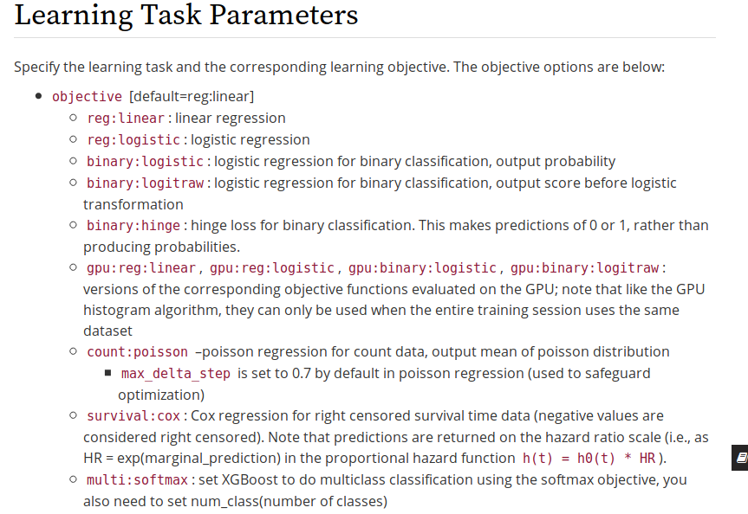
XGBOOST PACKAGE – LEARNING TASK PARAMETERS

Slide 16
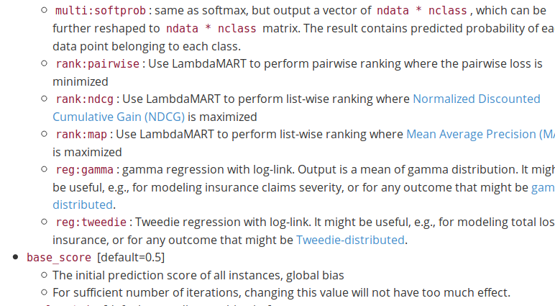

XGBOOST PACKAGE – LEARNING TASK PARAMETERS

Slide 17
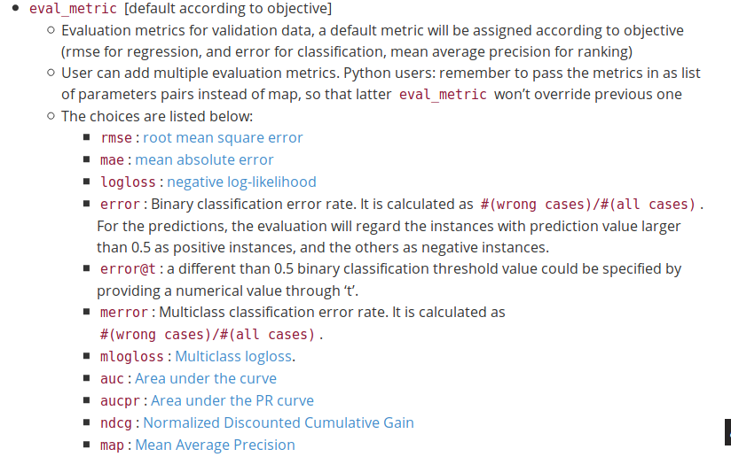
XGBOOST PACKAGE – LEARNING TASK PARAMETERS

Slide 18
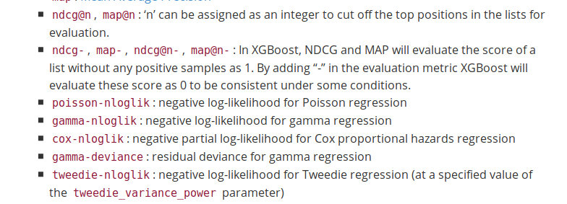
XGBOOST PACKAGE – LEARNING TASK PARAMETERS

Slide 19
THE DATASET
http://archive.ics.uci.edu/ml/datasets/Housing
Rim - per capita crime rate by town.
Zn - proportion of residential land zoned for lots over 25,000 sq.ft.
Indus - proportion of non-retail business acres per town.
Chas - Charles River dummy variable (= 1 if tract bounds river; 0 otherwise).
Nox - nitrogen oxides concentration (parts per 10 million).
Rm - average number of rooms per dwelling.
Age - proportion of owner-occupied units built prior to 1940.
Dis - weighted mean of distances to five Boston employment centres.
Rad - index of accessibility to radial highways.
Tax - full-value property-tax rate per $10,000.
Ptratio - pupil-teacher ratio by town.
Black - 1000(Bk - 0.63)^2 where Bk is the proportion of blacks by town.
Lstat - lower status of the population (percent).
Medv - median value of owner-occupied homes in $1000s.

Slide 21
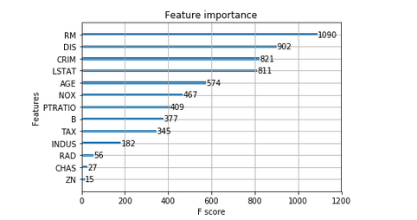
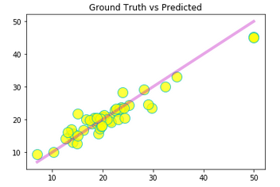

Slide 22
THANK YOU

