Slide 1
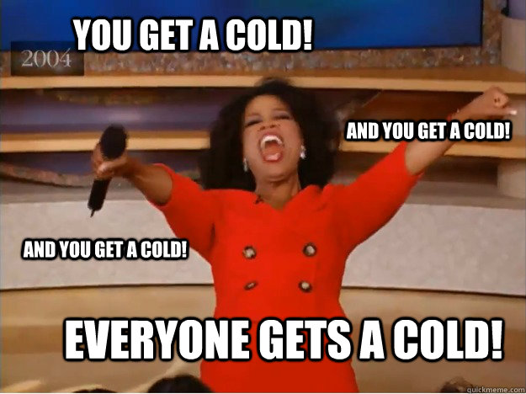
Sicko Search Group 9
Riley Dickens
Monica Eisinger
Nafisa Mostofa
Aaron True

Slide 2
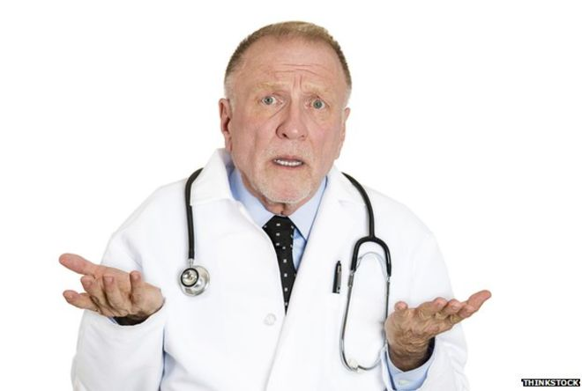
Purpose and Motivation
For those sickly among who need a one-stop shop for diagnoses and specialist research for treatment.
Purpose: To Help Sick People Get Better
Finding out what they have
Finding out who can help
Finding out where they can get the help they need
Motivation: Make Life Easier
Being an adult is hard
Making doctor appointments is a pain
Our app is trying to make this easier for everyone.

Slide 3


Better Than the Alternatives
WebMD/Medscape
Doctor on Demand
Only provides a diagnosis based on your symptoms
No link to an actual doctor that can help
No face-to-face interaction with your doctor
Sicko Search
Extends the usefulness of websites like WebMD and Medscape by letting users find specialists to treat their disease
You get an in person doctor’s visit where you get to see the person who is treating you
Combines multiple apps into one for a more streamlined experience

Slide 4
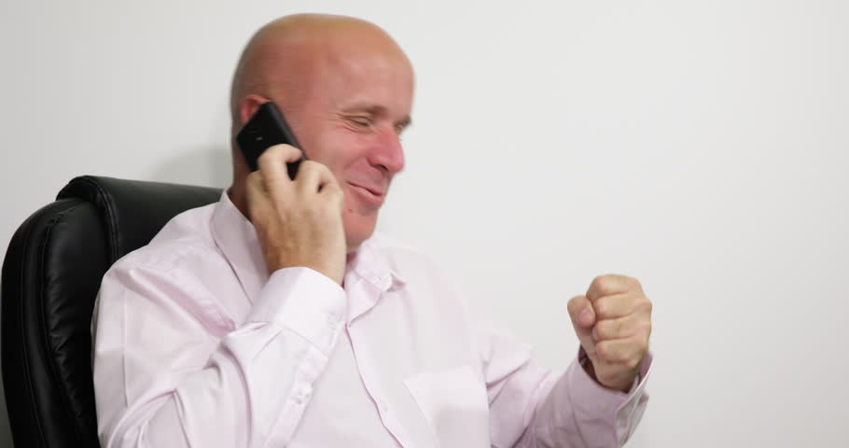
Core Features
Search for your disease by entering the symptoms you are experiencing
Find specialists in your area that can treat your disease
Find where to go to see these specialists
Schedule a doctor’s appointment by calling the phone number provided

Slide 5


Technologies
Programming Language: Swift
IDE: XCode
Database Connection: SQLite

Slide 6
Primary Algorithms
Calculating the percentage match of diseases based on the symptoms entered by the user
Uses the symptoms/disease database
Takes the user symptoms input and matches it to corresponding diseases
Sorts the top 5 diseases by most frequent to least frequent match
Calculating the distance of the user to the specialist’s offices
Takes the user’s location as a latitude/longitude
Takes the specialist office location as a latitude/longitude
Uses the Haversine formula to get the distance between the two in miles

Slide 7
Plans for the Future / Improvements
We originally wanted the specialist’s website to be viewable from the app as well, but due to limitations with the associated database this feature wasn’t able to be implemented.
We originally also wanted a rating system that could help the user choose which specialist they could go see.
We would like to design a Sicko Search logo and other visuals to go into the app to make it more unique and visually appealing.
More memes

