Slide 1
Older Adult Protective Services Performance Analysis: Visual Comparisons Presented by: Monica Tuttle

Slide 2

Background
Employed at DHS (different office) – interested in human services
Pursuing certificate in Data Analytics
Data Project – generate compelling inquiry questions and analyze/visualize the data

Slide 3
Introduction
Data import and clean-up
Questions for analysis
Import from Data Warehouse
Removed duplicates
Removed supervisor entries
How long do investigations take depending on the agency or allegation type?
What are the reasons why cases aren’t closed within 20 days?
Notes:
Protective Services Investigators enter data into SAMS/WellSky, and this information is ultimately stored in our local data warehouse
Hovik obtained raw dataset for me – initially 10913 data points.
Data spans the beginning of 2019 to end of 2021
Bulk of data clean-up involved removing duplicates and supervisor entries
Clean-up resulted in
7379 data points for agency comparison
9214 data points for allegations
Assumption behind these questions is that length of investigation is a metric for performance

Slide 4
Measures of Center
Median:
middle value when a data set is ordered from least to greatest
*Not sensitive to outliers
Mean/Average:
adding all numbers in a data set and then dividing by the number of values in the set
*Sensitive to outliers
Notes:
We want to consider what are called the measures of center. Measures of center generally tell us about the middle, or center, of a distribution. The measures of center we’ll focus on are the mean and median.
Median represents the mid-point of the data set while the mean represents the central gravity of the data set. Mean is also sensitive to outliers, so comparing the two can give us a sense of the variation of data points.

Slide 5
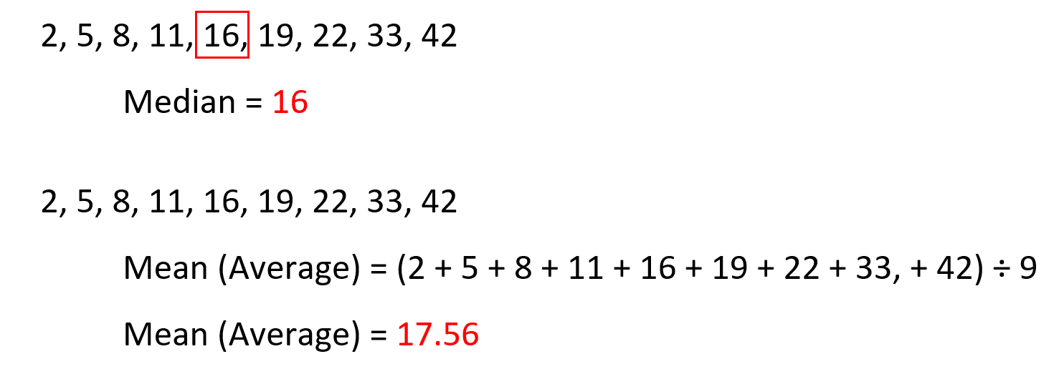

Slide 6
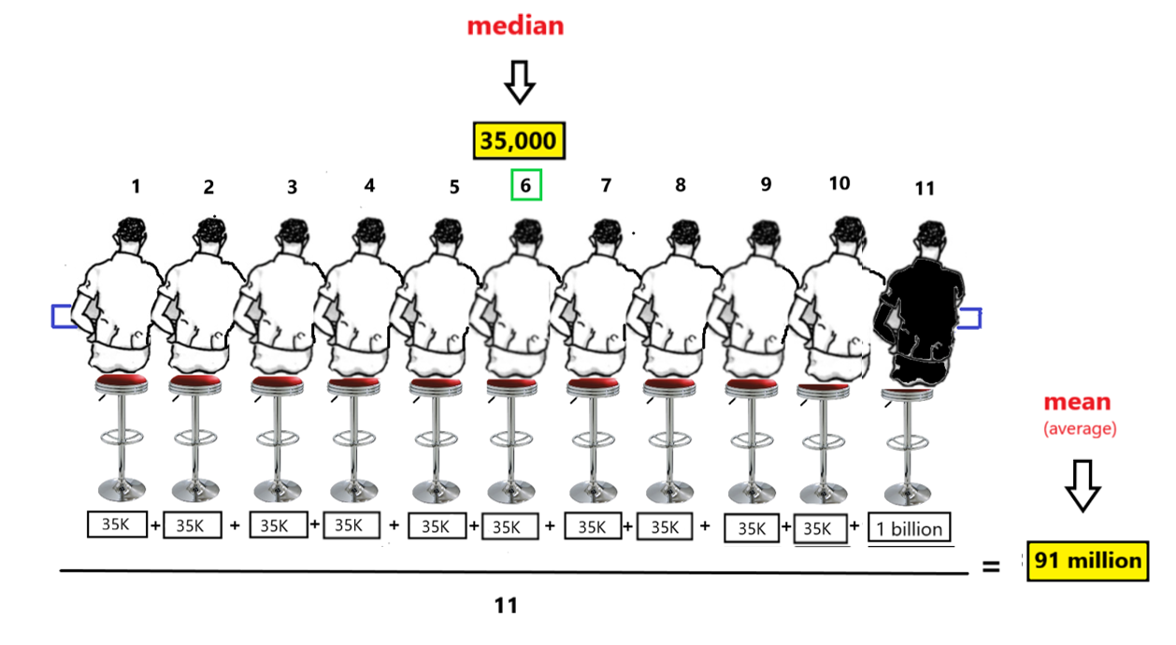
Bill Gates walks into a bar...
Notes:
Charles Wheelan’s book “Naked Statistics: Stripping the Dread from the Data”
10 guys in a Seattle bar, same income of $35,000 – what’s the median income? What’s the average income before Bill Gates walks in?
Bill Gates walks in with an income of 1 billion (for the sake of argument) – what’s the mean/average income?
What’s the point of this exercise? Demonstrating that mean is sensitive to outliers. Median is not sensitive to outliers.
Both mean and median are useful in their own right. Comparing the two in charts will give us a sense of the center, but also the spread of the data.

Slide 7
How long does it take for each agency to complete investigations?

Slide 8
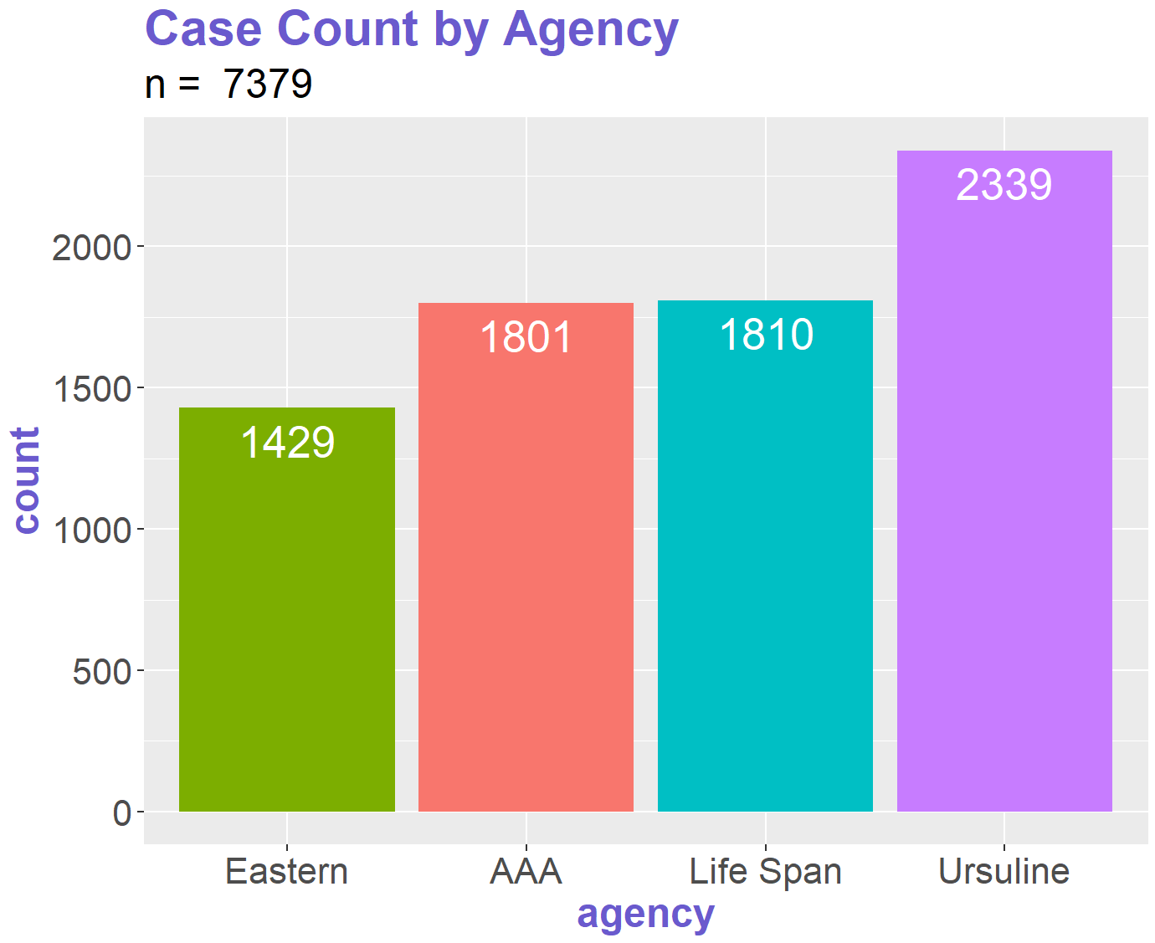
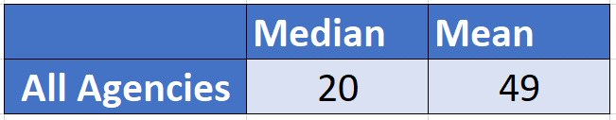
Notes:
N=7379 reflects removal of records without either a start date or end date, thus not allowing the ability to calculate the difference in days for these records.

Slide 9
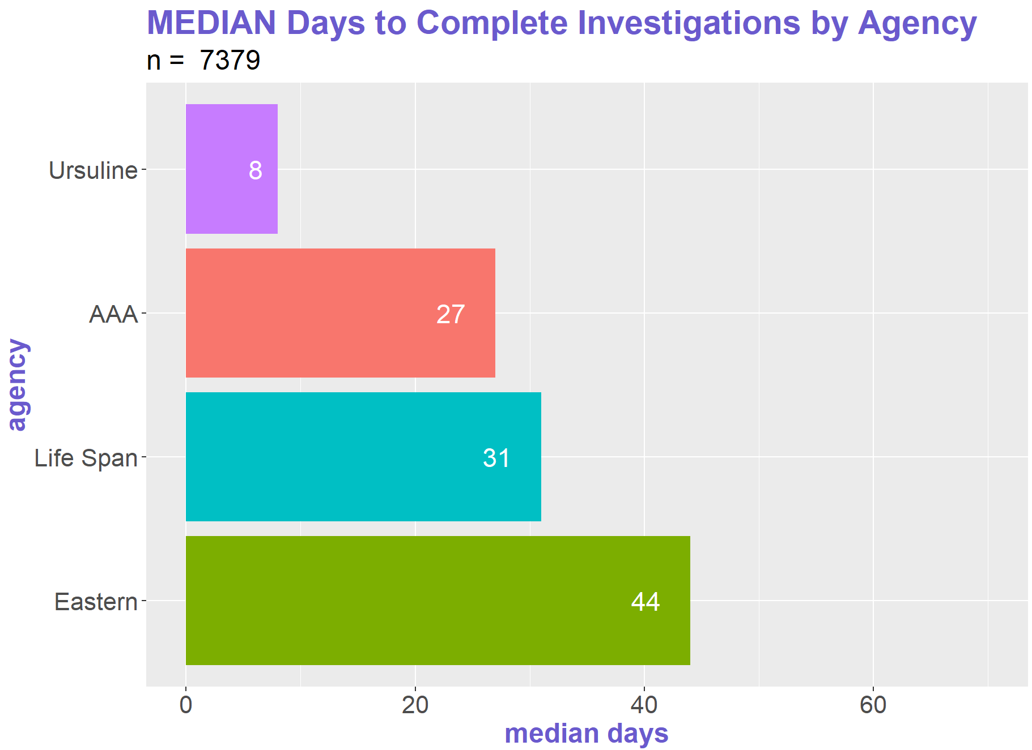

Slide 10
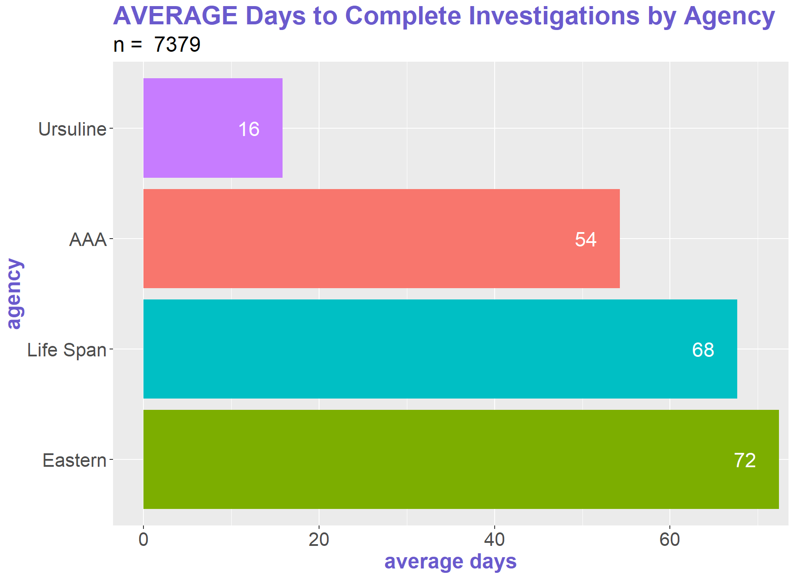

Slide 11


Slide 12
How long does it take to complete investigations based on allegation type?

Slide 13
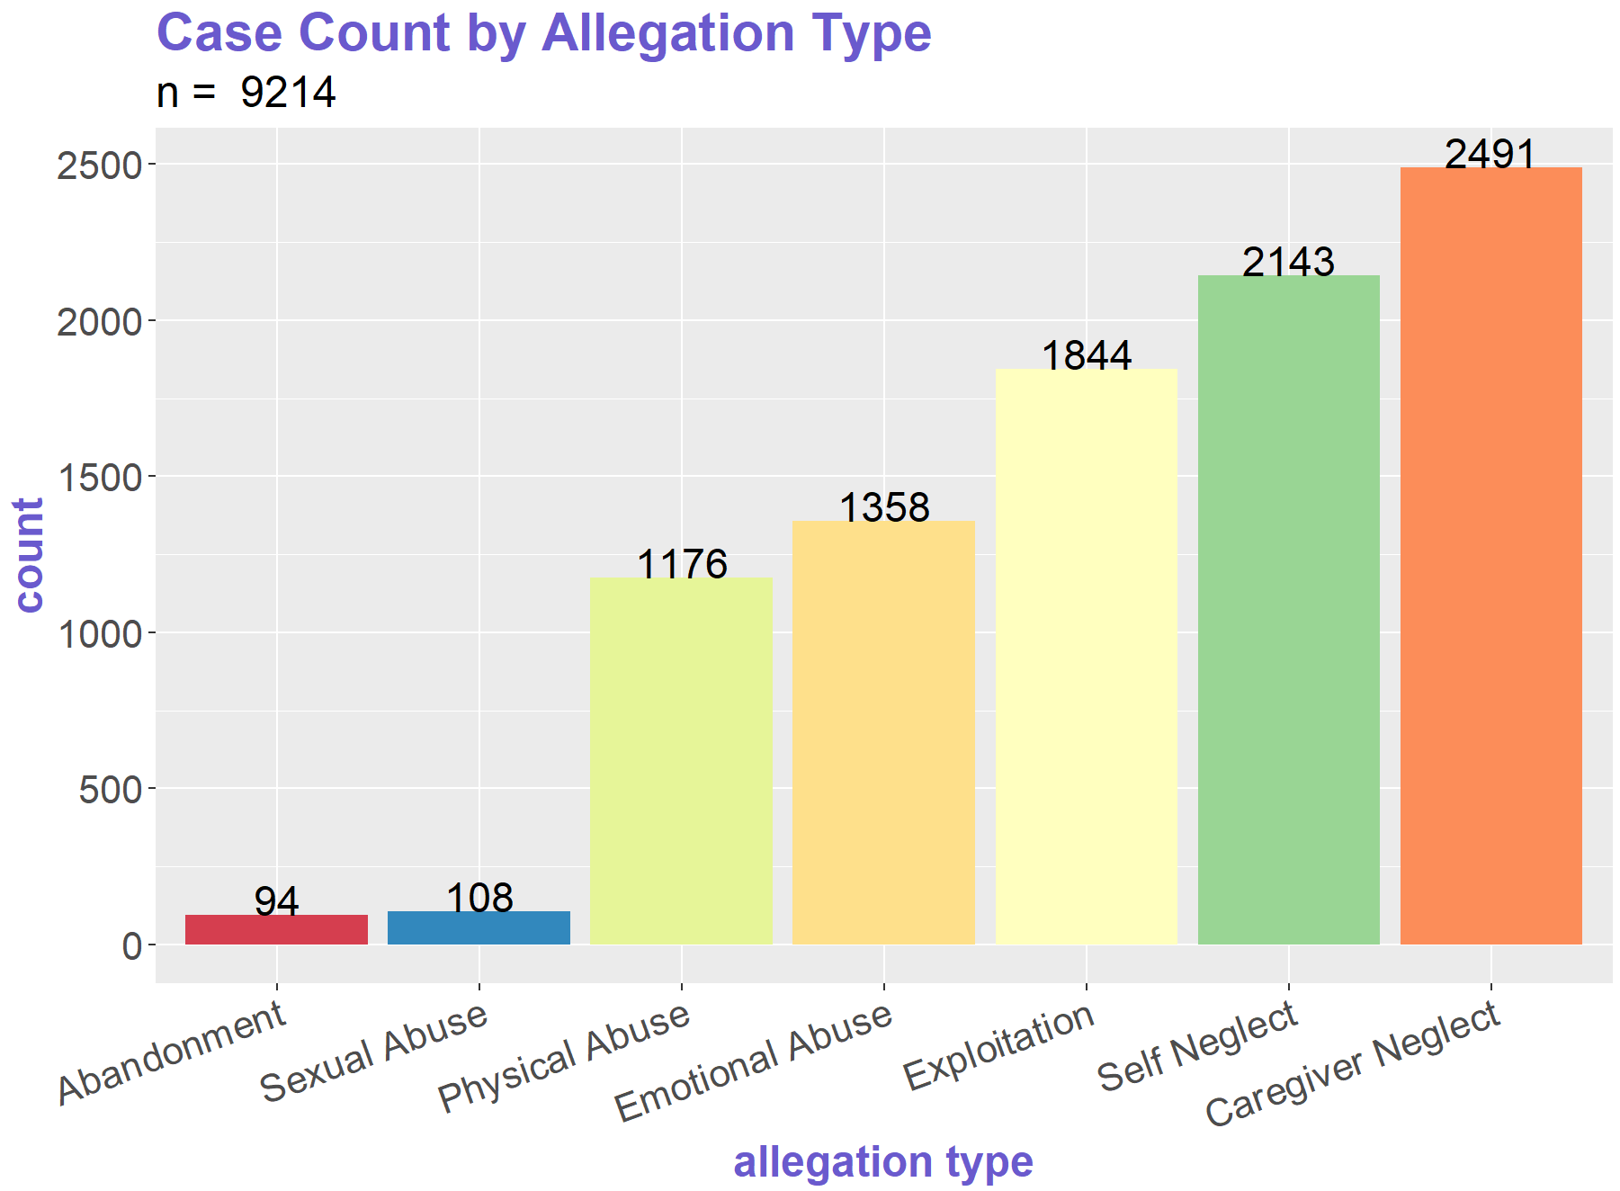
Notes:
N = 9214 reflects breaking out of multiple values in one column into separate columns and making separate records to account for each allegation

Slide 14
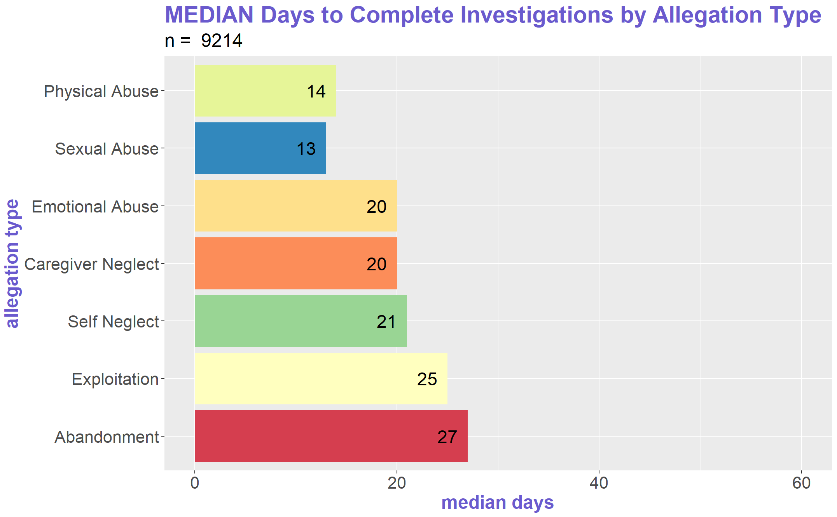

Slide 15
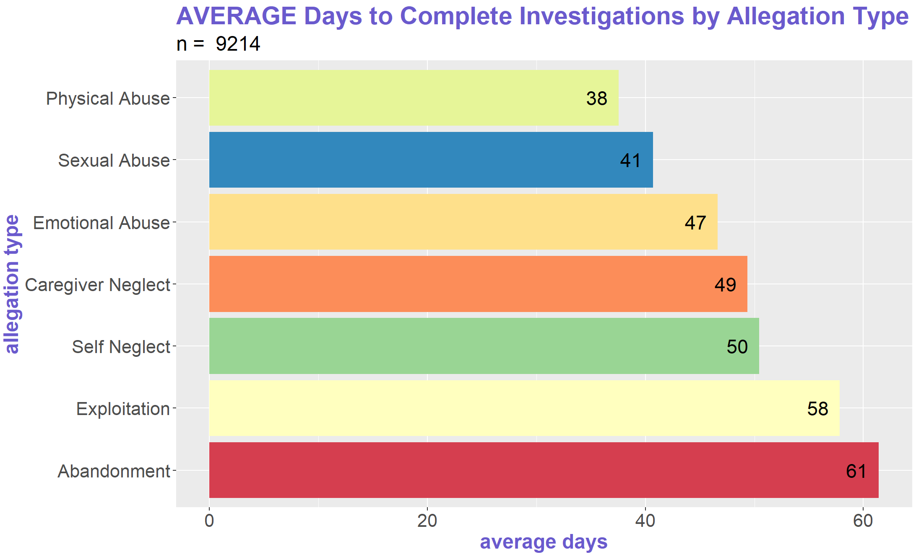

Slide 16

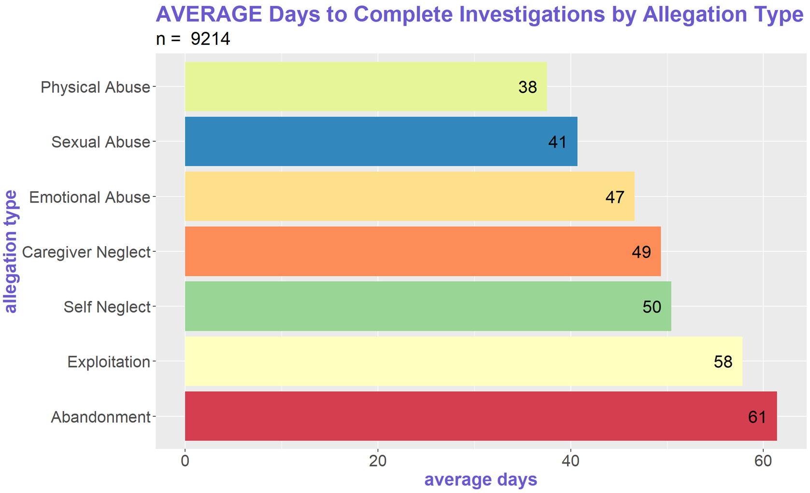

Slide 17
How long do investigations take depending on the agency and allegation type?

Slide 18
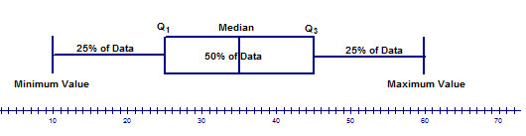
Putting it all together: box plots
What a box plot shows:
Notes:
“A box and whisker plot is defined as a graphical method of displaying variation in a set of data. In most cases, a histogram analysis provides a sufficient display, but a box and whisker plot can provide additional detail while allowing multiple sets of data to be displayed in the same graph.
(https://asq.org/quality-resources/box-whisker-plot)

Slide 19
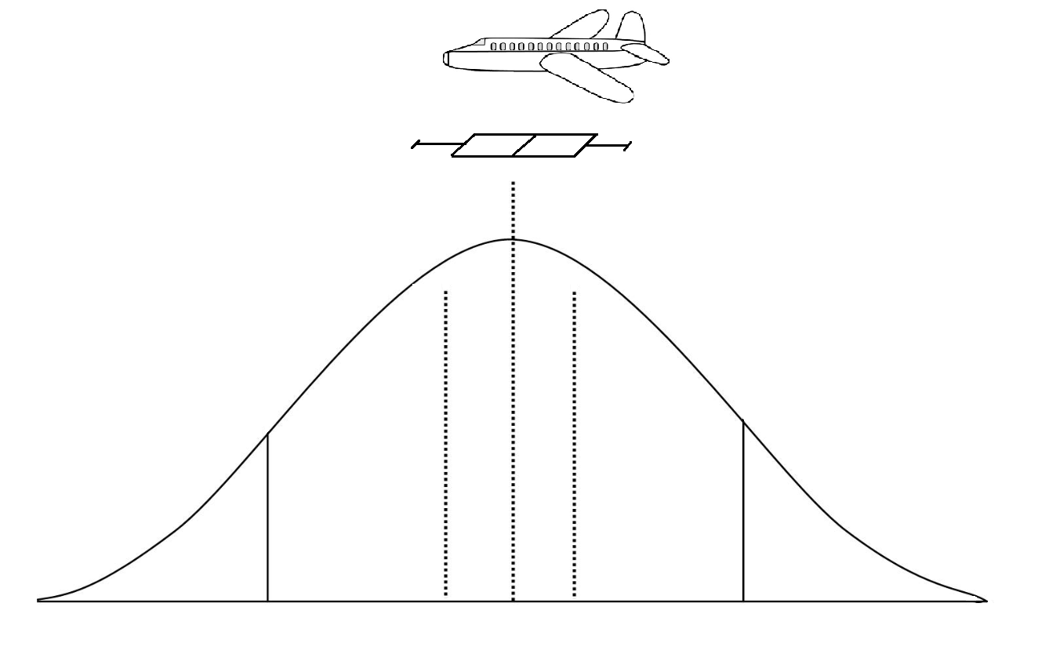
Box plots: an aerial view of the data set

Slide 20
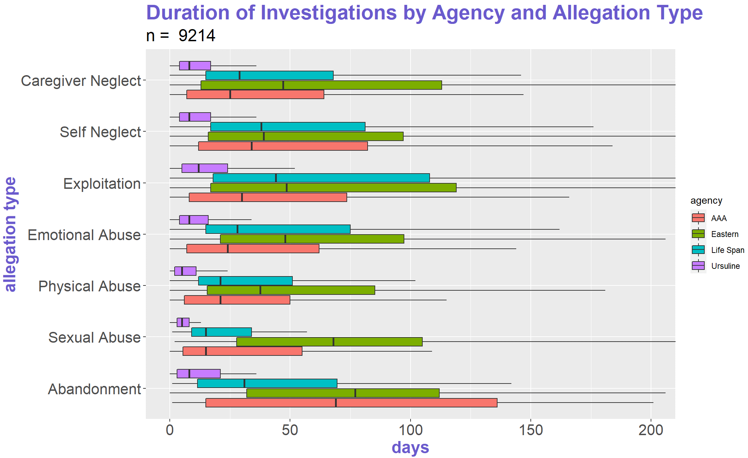

Slide 21
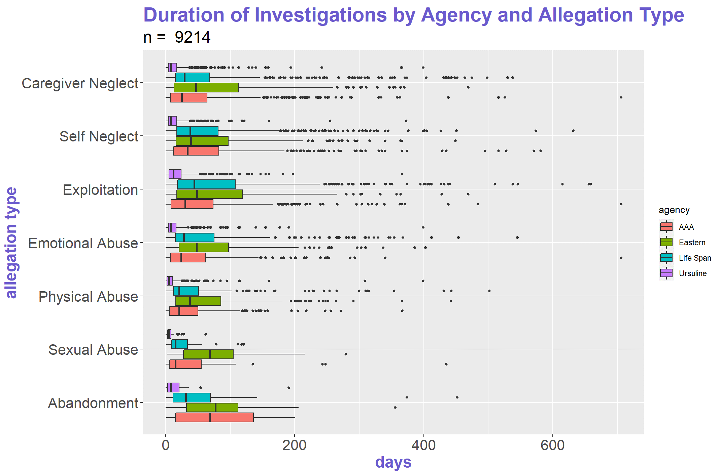

Slide 22
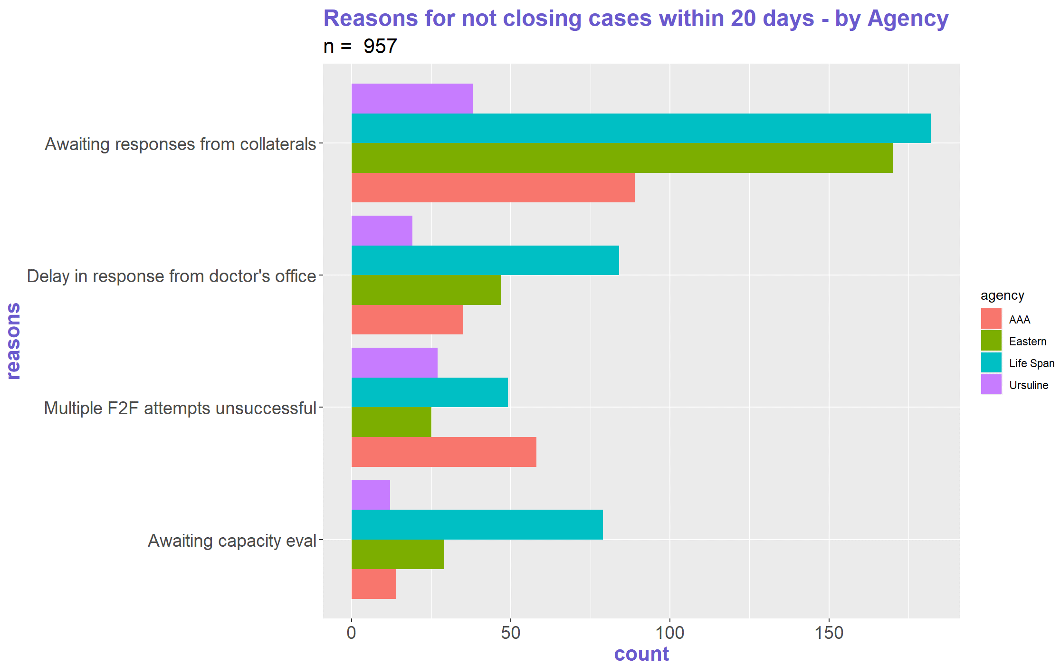

Slide 23
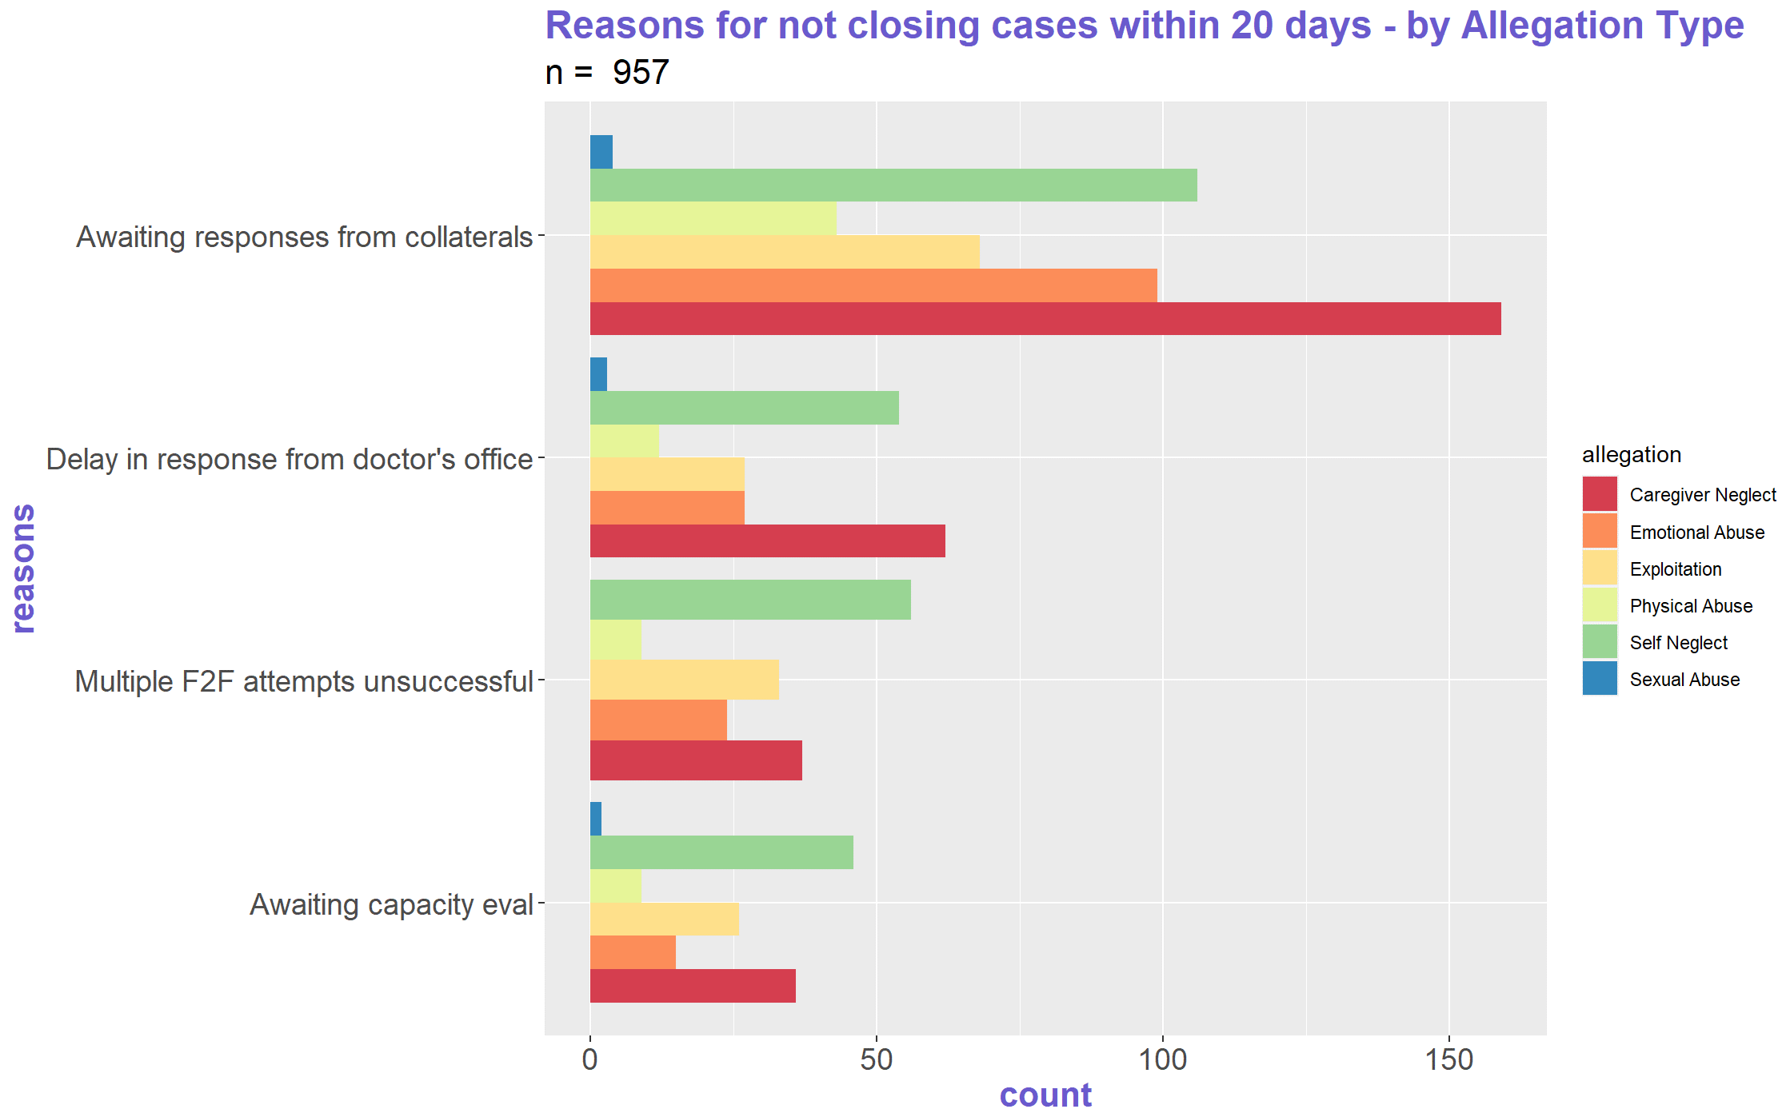

Slide 24
Conclusion
Conclusion:
Some agencies are waiting longer on information needed to complete investigations – why is that?
Food for thought:
Gather more data on self-reported reasons for not closing cases within 20 days
Conclusion:
Agency performance does not seem to be contingent upon allegation types
Food for thought:
Further investigate who expedites the flow of information into the agency

Slide 25
Acknowledgements
Brian Bell, Aging Analytics Manager
Hovhannes Nahapetyan, Data Analyst
Liz McDermott, Analyst
Amber Farr, Senior Leader, Program and Provider Services
Paula Shubock, Professor of Computer Information Technology (CCAC)

Slide 26
Thank You

