Slide 1
Weather Monitoring System
IOT Project CSE 220
Prof Mohammed Mujeer
MONICA KONDUR 20181COM0077

Slide 2
INTRODUCTION
Weather forecasts are made by collecting quantitative data about the current state of the atmosphere on a given place and using scientific understanding of atmospheric processes to project how the atmosphere will evolve on that place.
Therefore Weather Monitoring system using IoT is proposed to help user gather information about weather anywhere in real time.

Slide 3
PROBLEM STATEMENT
The Problem found in most of the weather monitoring system provides only the present condition of a particular field which will not provide the exact condition of the particular city or particular place. The main problems in ordinary method were that devices are very much expensive and don’t have that much data measuring accuracy.
Limited way for user to know about temperature of there area in specific.

Slide 4
OBJECTIVE
The aim of weather monitoring system is to detect, record and display various weather parameters such as temperature ,humidity and rain.
To develop a weather monitoring system that can help user plan their day to day activities.
To design a facility that can help user to access data anywhere in real time

Slide 5
Components Required
Nodemcu ESP8266 board
Rain sensor
DHT11 sensor
LDR sensor
LCD
I2C module
Breadboard
Jumper wires

Slide 6
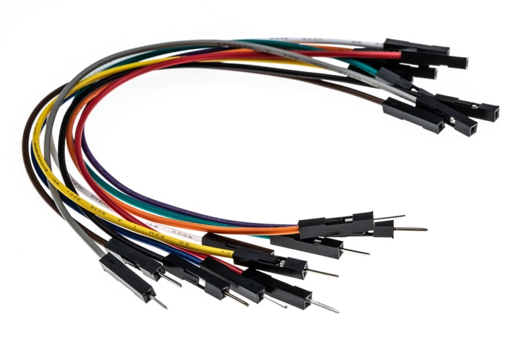
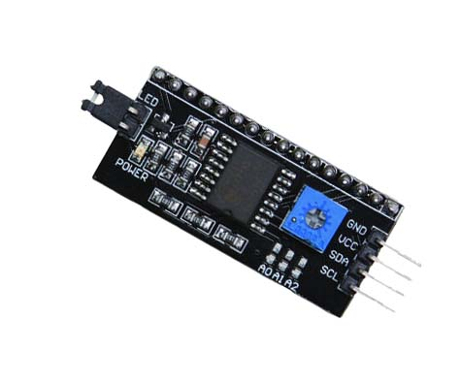
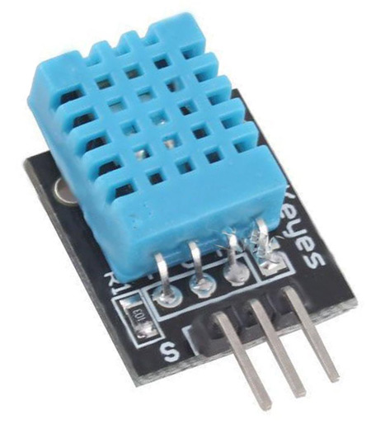
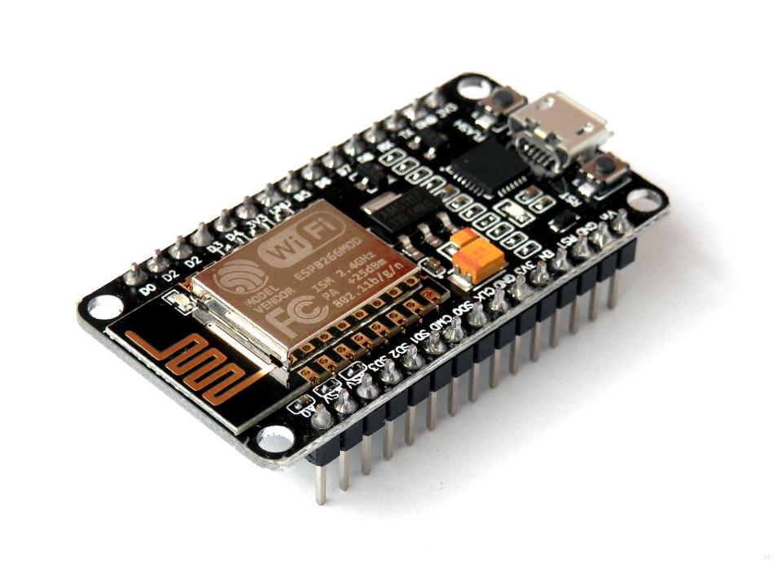
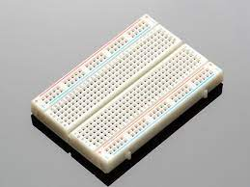
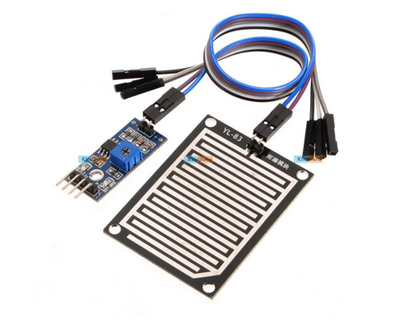
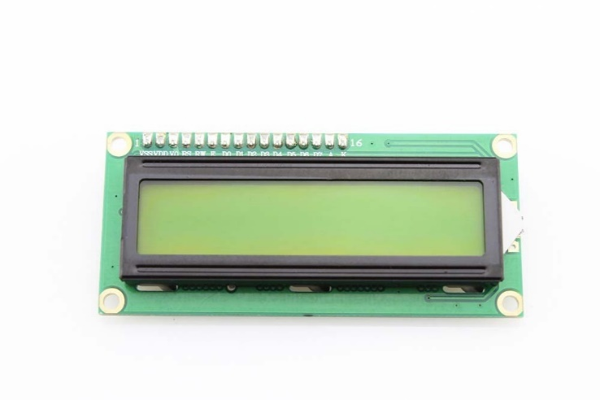
Nodemcu ESP8266
I2C module
DHT11 sensor
Wires
Rain sensor
LCD
Breadboard

Slide 7
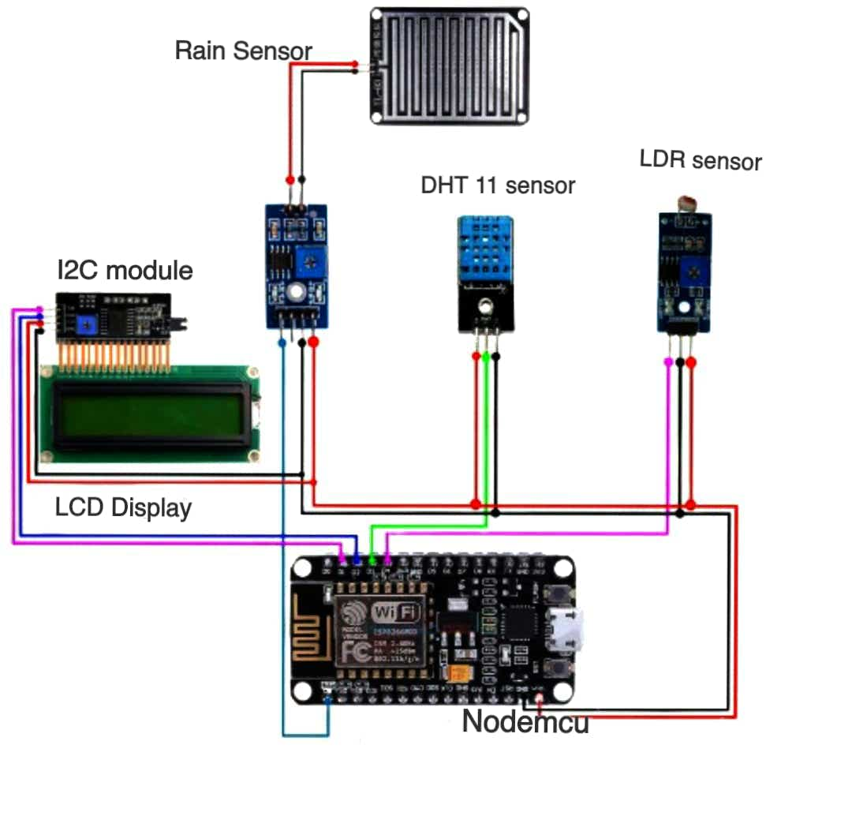
CIRCUIT DIAGRAM

Slide 8
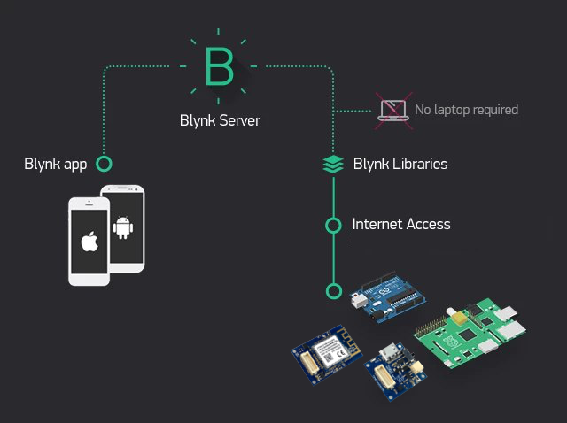

Slide 9
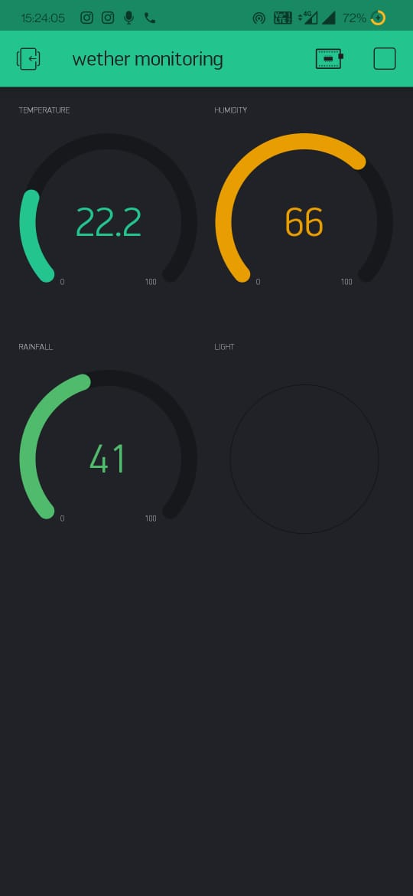

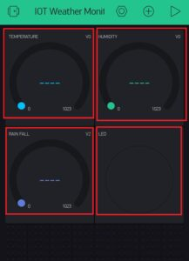
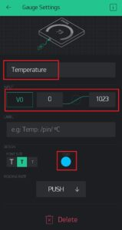

Slide 10
APPLICATIONS
Save time with instant notifications and alerts
Productivity improvement with advanced analytics
Accessibility from remote locations

Slide 11
THANK YOU

