Slide 1
Predict the Severity of a Traffic Accident IBM Data Science Professional Certificate
Monica
LinkedIn | GitHub
9 October 2020

Slide 2
Data Source
Part of an example dataset in IBM Data Science Professional Certificate
Can be downloaded from my GitHub repository https://github.com/monica110394/Coursera_Capstone
Variable Selection
'SEVERITYCODE', 'ADDRTYPE', 'COLLISIONTYPE', 'PERSONCOUNT', 'PEDCOUNT', 'PEDCYLCOUNT', 'VEHCOUNT', 'JUNCTIONTYPE', 'SDOT_COLCODE', 'INATTENTIONIND’, 'UNDERINFL', 'WEATHER', 'ROADCOND', 'LIGHTCOND', 'SPEEDING', 'ST_COLCODE', 'HITPARKEDCAR’
Target variable: 'SEVERITYCODE’
Feature Engineering
Null Values are detected
Attributes are removed that have most of the values as null
Records are dropped that had missing values
Number of rows: 182895
Number of Columns: 15
'SEVERITYCODE', 'ADDRTYPE', 'COLLISIONTYPE', 'PERSONCOUNT','PEDCOUNT', 'PEDCYLCOUNT', 'VEHCOUNT', 'JUNCTIONTYPE', 'SDOT_COLCODE', 'UNDERINFL', 'WEATHER', 'ROADCOND', 'LIGHTCOND', 'ST_COLCODE', 'HITPARKEDCAR'

Slide 3
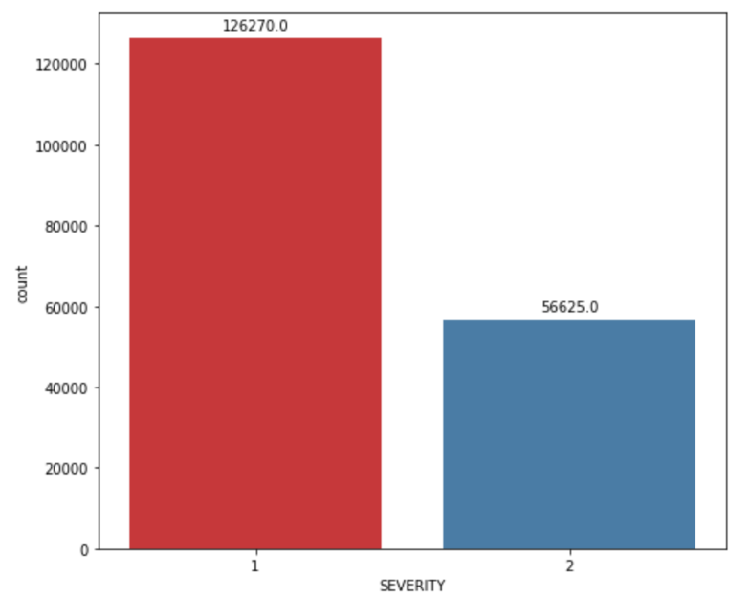
Label Encoding (categorical variables)
'ADDRTYPE’
'COLLISIONTYPE’
'JUNCTIONTYPE’
'SDOT_COLCODE’
'UNDERINFL’
'WEATHER’
'ROADCOND’
'LIGHTCOND’
'ST_COLCODE’
'HITPARKEDCAR’
Numerical variables
'PERSONCOUNT’
'PEDCOUNT’
'PEDCYLCOUNT’
'VEHCOUNT'
Balancing dataset:
Unbalanced dataset can cause the prediction to be skewed
Dataset is balanced by down sampling the category that has greater number of samples
In this case it is 'SEVERITYCODE’=1

Slide 4
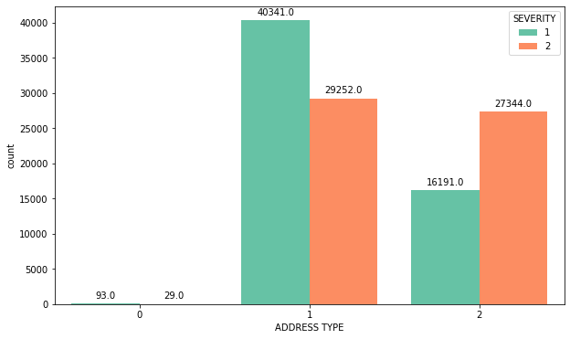
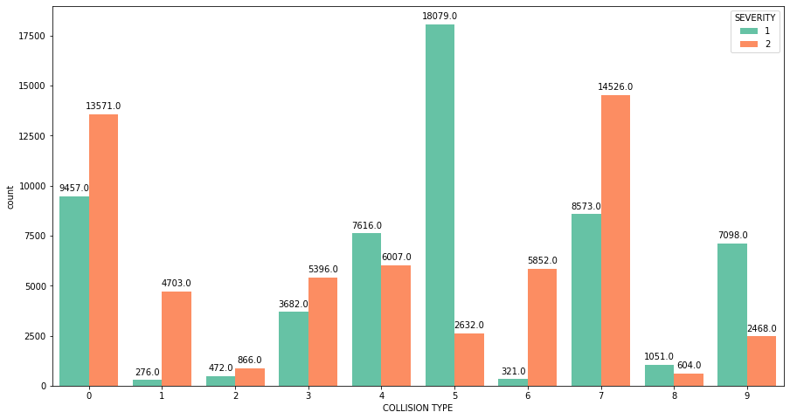
Exploratory Data Analysis (categorical variables)

Slide 5
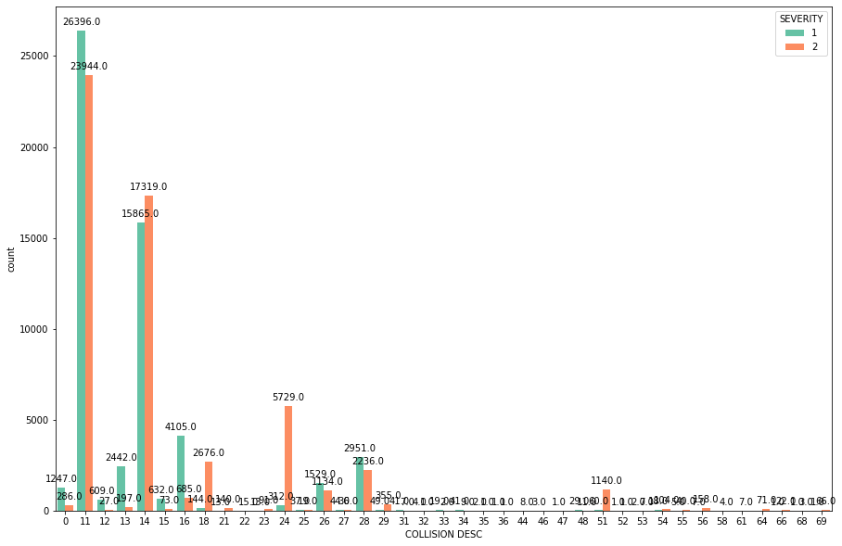
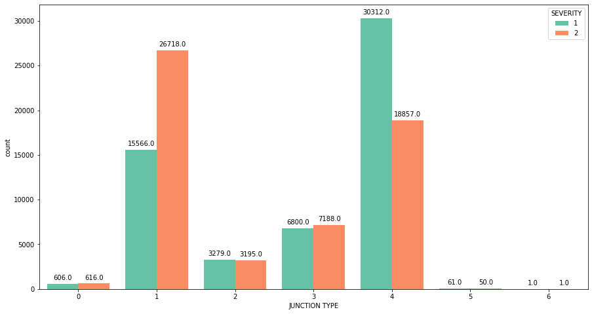

Slide 6
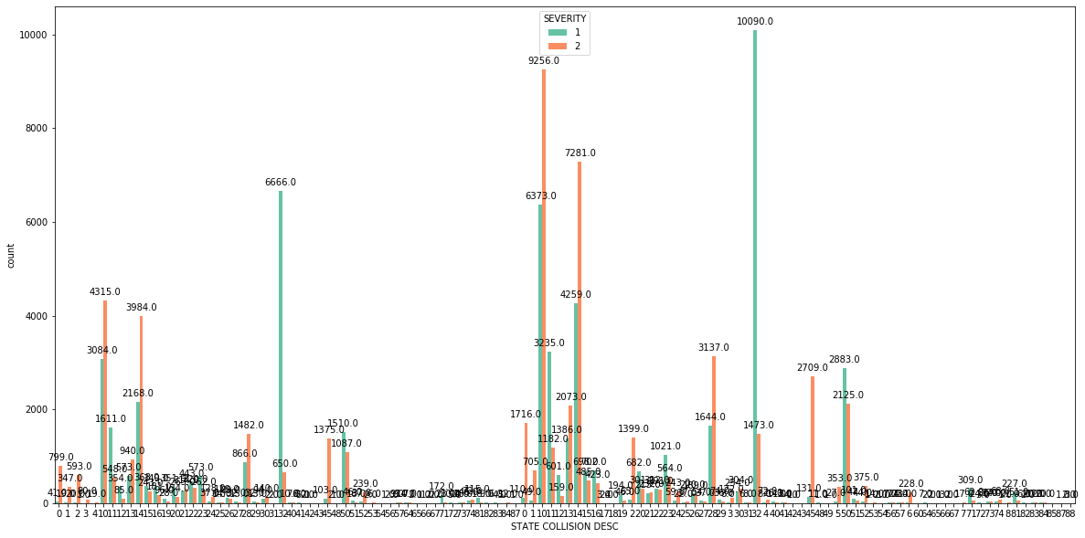
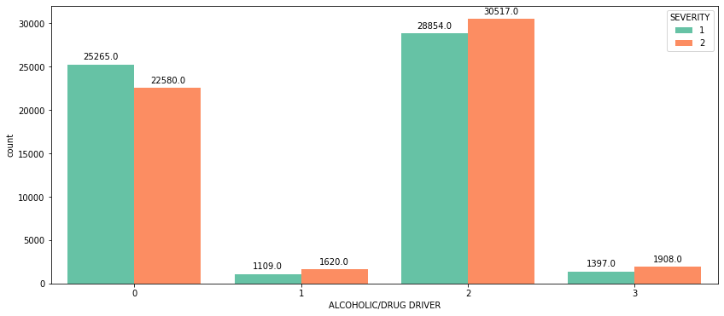

Slide 7
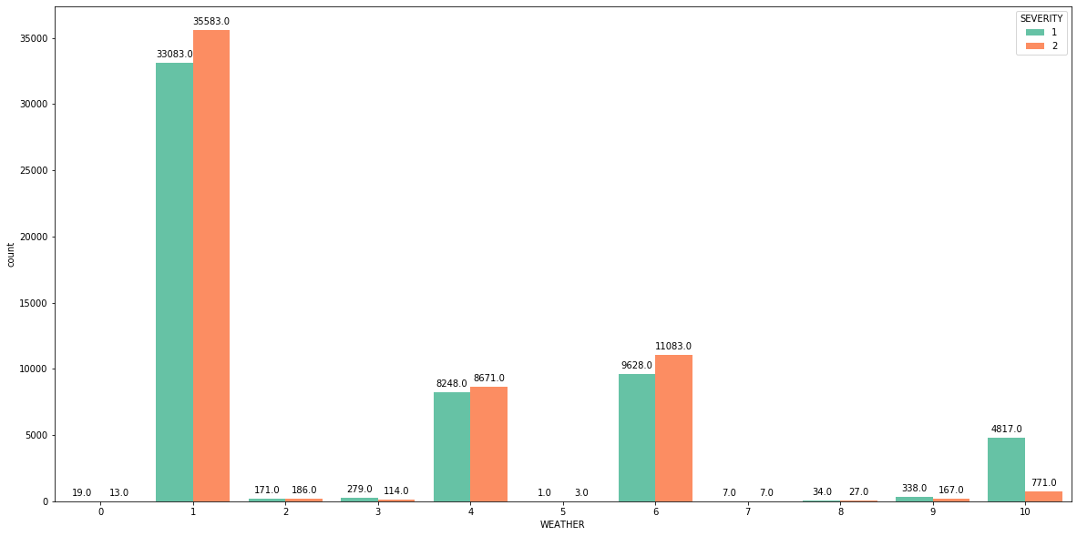
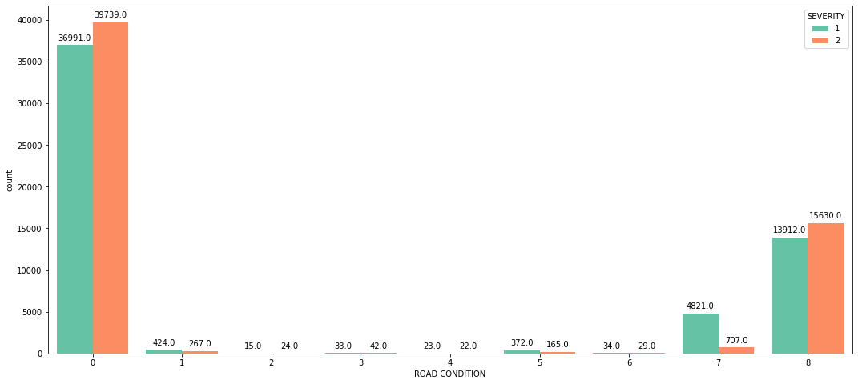

Slide 8
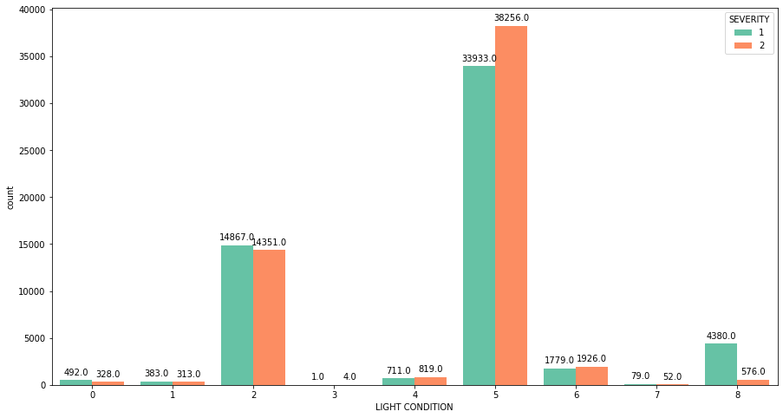
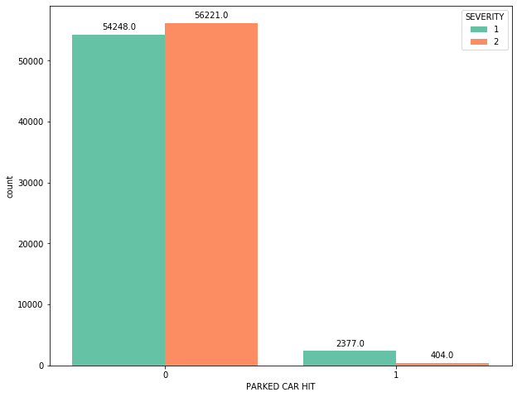

Slide 9
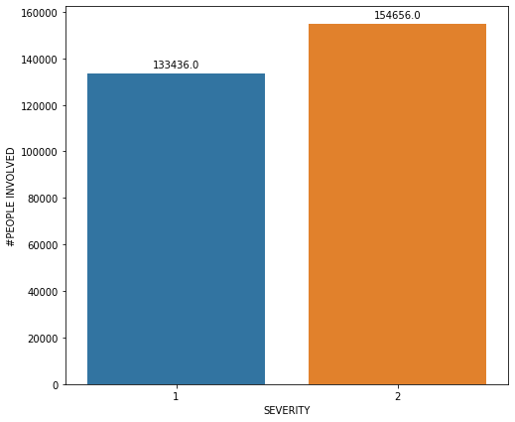
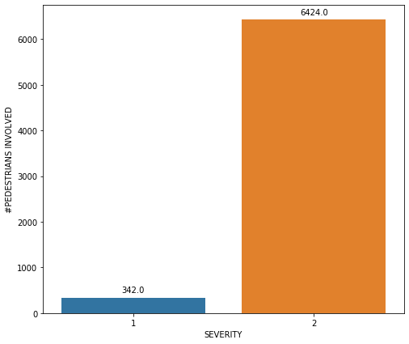
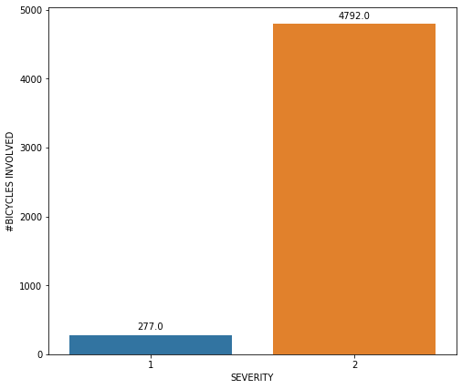
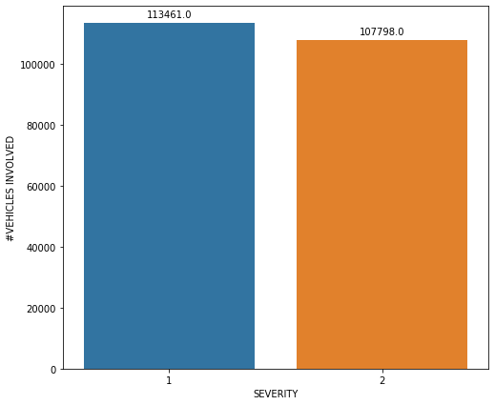
Exploratory Data Analysis (numerical variables)

Slide 10
Data Preparation
Normalize the feature set
from sklearn import preprocessing
X = preprocessing.StandardScaler().fit(features).transform(features)
Dataset split into train and test sets
Train set: (90600, 14) (90600,)
Test set: (22650, 14) (22650,)

Slide 11
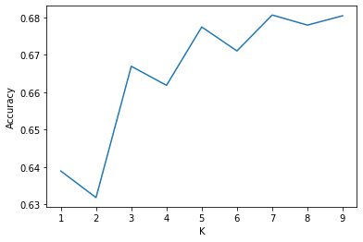
K Nearest Neighbours
The best accuracy score achieved was 0.6806 with k=7
KNeighborsClassifier(algorithm='auto', leaf_size=30, metric='minkowski', metric_params=None, n_jobs=None, n_neighbors=7, p=2, weights='uniform’)
Train set Accuracy: 0.7195
Test set Accuracy: 0.6806

Slide 12
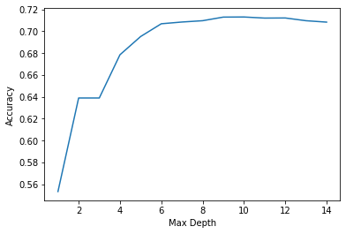
Decision Tree
The best accuracy score achieved was 0.6806 with max_depth = 10
DecisionTreeClassifier(ccp_alpha=0.0, class_weight=None, criterion='entropy', max_depth=10, max_features=None, max_leaf_nodes=None, min_impurity_decrease=0.0, min_impurity_split=None, min_samples_leaf=1, min_samples_split=2, min_weight_fraction_leaf=0.0, presort='deprecated', random_state=None, splitter='best’)
Train set Accuracy: 0.7183
Test set Accuracy: 0.7128

Slide 13
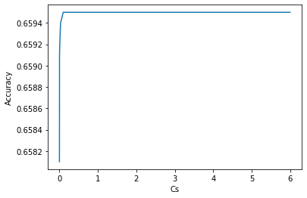
Logistic Regression
The best accuracy score achieved was 0.6806 with C=0.1
LogisticRegression(C=0.1, class_weight=None, dual=False, fit_intercept=True, intercept_scaling=1, l1_ratio=None, max_iter=100, multi_class='auto', n_jobs=None, penalty='l2', random_state=None, solver='liblinear', tol=0.0001, verbose=0, warm_start=False)
Train set Accuracy: 0.6591
Test set Accuracy: 0.6595

Slide 14
Results
Jaccard Index
F1 Score
Precision Score
Recall Score
ROC
In this problem, lower false positive rate is less important than higher true positive rate. In other words, it is more important to properly predict the high-severity accident properly, if there is room for doubt it is better to prevent.
Log Loss (Logistic Regression only)

Slide 15
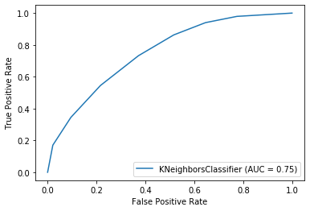
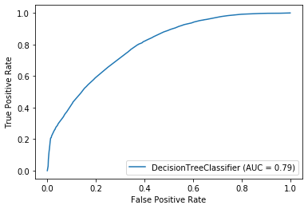
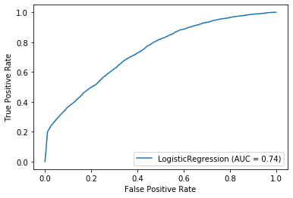
Algorithm | Jaccard | F1 Score | Precision | Recall | AUC (ROC) | Log Loss
KNN | 0.6806 | 0.6797 | 0.6991 | 0.6284 | 0.75 | NA
Decision Tree | 0.7128 | 0.7104 | 0.7582 | 0.6207 | 0.79 | NA
Logistic Regression | 0.6595 | 0.6585 | 0.6417 | 0.7144 | 0.74 | 0.5899
Decision Tree is the best classifier out of the three with the best Jaccard Index 0.71, best F1 Score 0.75 and best AUC 0.79

