Slide 1
RShiny Project
H1b Filings from 2011-2016
Analytics | Visualization | Prediction
Group: abraca-data
Harsh Sheth
Monica

Slide 2
Objective of Our Project
Analysis of H1B filings over the year
Visualizing data to draw insights and answer frequently asked questions
Predicting the approval rate of H1B application based on decision tree algorithm

Slide 3
Data Variables
Application ID
Case Status
Employer Name
SOC_Name (Standard Occupational Classification)
Job Title
Prevailing Wage
Worksite (City & State)
Latitude and Longitude Value

Slide 4

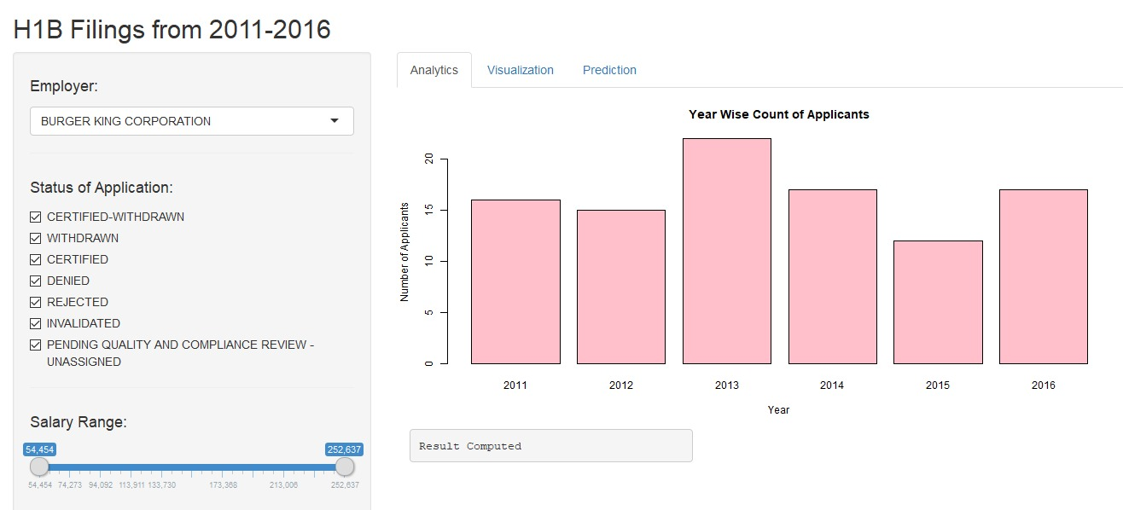
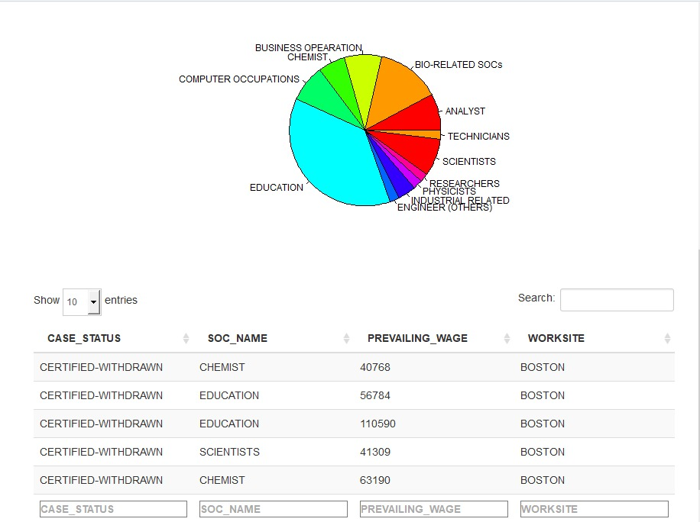
Analysis of H1b Filings (Rshiny App Panels)

Slide 5
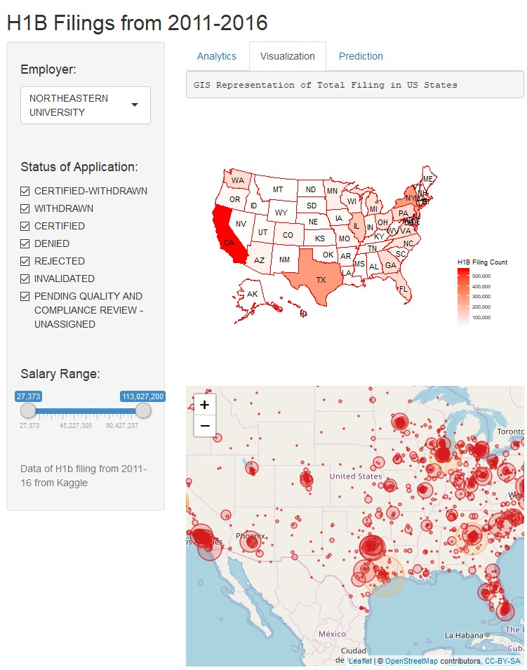
GIS representation of Total Filings - US State Wise

Slide 6
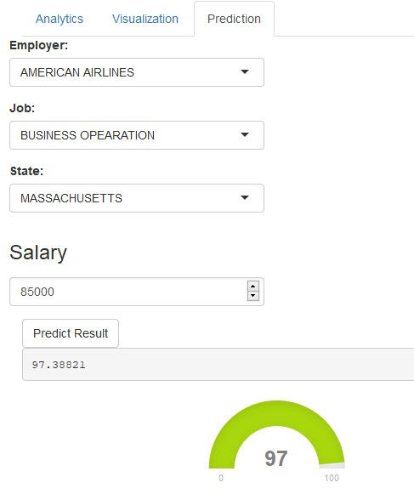
Prediction Model

Slide 7
References
Links from Web
https://www.kaggle.com/nsharan/h-1b-visa/kernels
https://www.tutorialspoint.com/r/r_pie_charts.htm
https://machinelearningmastery.com/non-linear-classification-in-r-with-decision-trees/
https://shiny.rstudio.com/gallery/
https://medium.com/data-design/visiting-categorical-features-and-encoding-in-decision-trees-53400fa65931
https://stackoverflow.com/questions/

Slide 8
Q&A
Thanks!

