Slide 1
Unit OS2: Operating System Principles
2.5. Lab Manual

Slide 2
Copyright Notice © 2000-2005 David A. Solomon and Mark Russinovich
These materials are part of the Windows Operating System Internals Curriculum Development Kit, developed by David A. Solomon and Mark E. Russinovich with Andreas Polze
Microsoft has licensed these materials from David Solomon Expert Seminars, Inc. for distribution to academic organizations solely for use in academic environments (and not for commercial use)

Slide 3
Roadmap for Section 2.5.
Lab experiments investigating:
Process Execution
Object Manager & Handles
Interrupt Handling
Memory Pools Labs
System Threads
System Processes
Notes:
These Labs include experiments investigating the overall architectural concepts of the Windows operating system. Students are expected to carry out Labs in addition to studying the learning materials in Unit OS2.
A thorough understanding of the concepts presented in Unit OS2: Operating System Principles is a prerequisite for these Labs.
These concepts are explained in Chapter 2 and 3 of Windows Internals 4th edition.

Slide 4
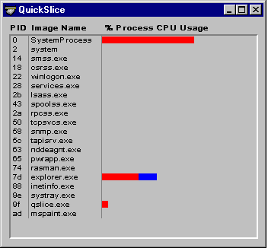
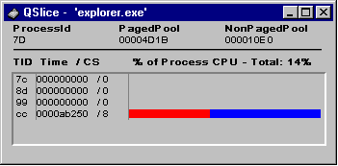

Thread Activity with QuickSlice
Fastest way to find CPU hogs
Red=Kernel, Blue=User mode
Double-click on a process to see a per-thread display for that process
Sum of threads’ bars for a process represents all of the process’s time, not all CPU time
Screen snapshot from:
Resource Kit | QuckSlice
Notes:
Lab objective: Viewing Thread Activity with QuickSlice
QuickSlice (gslice.exe) gives a quick, dynamic view of the proportions of system and kernel time that each process currently running on your system is using. On line, the red part of the bar shows the amount of CPU time spent in kernel mode, and the blue part shows the user-mode time.
The total of all bars shown in the QuickSlice window should add up to 100 percent of CPU time. To run QuickSlice, click the Start button, choose Run, and enter Qslice.exe (assuming the Windows 2000 resource kit is in your path). For example, try running a graphics-intensive application such as Paint (Mspaint.exe). Open QuickSlice and Paint side by side, and draw squiggles in the Paint window.
For additional information about the threads in a process, you can also double-click on a process (on either the process name or the colored bar).

Slide 5
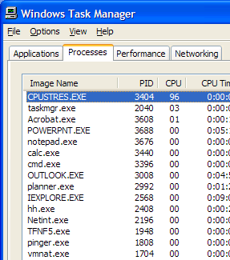
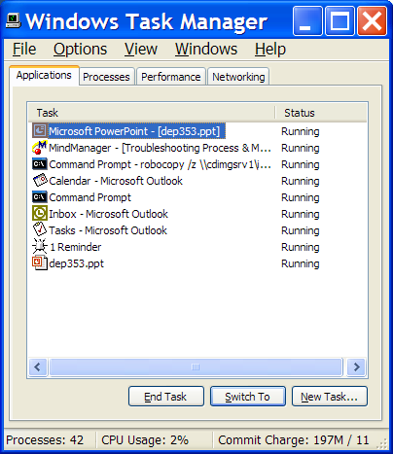
Process Info with Task Manager
Processes tab: List of processes
Applications tab: List of top level visible windows
“Running” means waiting for window messages
Right-click on a window and select “Go to process”
Notes:
Lab objective: Viewing Process Information with Task Manager
The built-in Windows Task Manager provides a quick list of the processes running on the system. You can start Task Manager in one of three ways:
press Ctrl+Shift+Esc,
right-click on the taskbar and select Task Manager, or
press Ctrl+Alt+Delete and click the Task Manager button. Once Task Manager has started, click the Processes tab to see the list of running processes. Notice that processes are identified by the name of the image of which they are an instance. Unlike some objects in Windows, processes can’t be given global names.
To display additional details, choose Select Columns from the View menu and select additional columns to be added.
Although what you see in the Task Manager Processes tab is clearly a list of processes, what the Applications tab displays isn’t as obvious. The Applications tab lists the top-level visible windows on all the desktops in the interactive window station. (By default, there are two desktop objects—you can create more by using the Windows CreateDesktop function.) The Status column indicates whether or not the thread that owns the window is in a Windows message wait state. “Running” means the thread is waiting for windowing input; “Not Responding” means the thread isn’t waiting for windowing input (for example, the thread might be running or waiting for I/O or some Windows synchronization object).

Slide 6
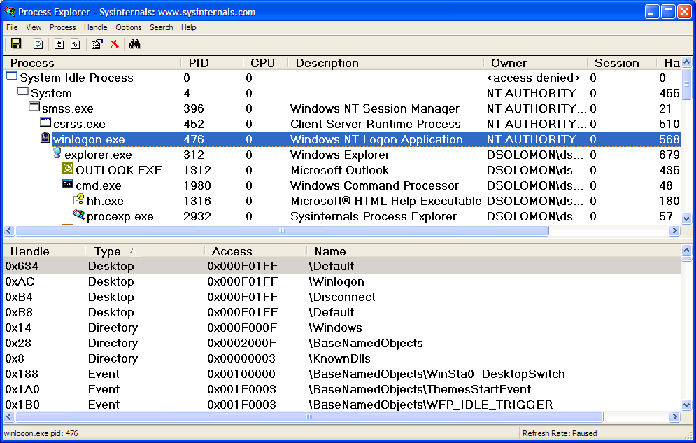
Process Details with Process Explorer
“Super Task Manager”
Shows full image path, command line, environment variables, parent process, security access token, open handles, loaded DLLs & mapped files
Notes:
Lab objective: Viewing Process Details with Process Explorer
When Process Explorer starts, it shows by default the process list on the top half and the open handles for the currently selected process on the bottom half. It also shows the image description, company name, and full path if you hover the mouse pointer over the process name.
Note: the first time you run Process Explorer, you will receive a message that symbols are not currently configured. Just press OK. If properly configured, Process Explorer can access symbol information to display the symbolic name of the thread start function and functions on its call stack (available by double-clicking on a process and clicking on the Threads tab). This is useful for identifying what threads are doing within a process. To access symbols, you must have the Windows Debugging Tools installed. Then click on Options, choose Configure Symbols, and fill in the appropriate Symbols path. For more information on configuring use of the symbol server, see http:// www.microsoft.com/whdc/ddk/debugging/symbols.mspx.

Slide 7
The Process Explorer tool
Run Process Explorer & maximize window
Run Task Manager – click on Processes tab
Arrange windows so you can see both
Notice process tree vs flat list in Task Manager
If parent has exited, process is left justified
Sort on first column (“Process”) and note tree view disappears
Sort Process column 2 more times and tree view returns
Can also Click on View->Show Process Tree or press CTRL+T to bring it back
Notice description and company name columns
Hover mouse over image name to see full path
Right click on a process and choose “Google”
Notes:
Lab objective: Get yourself familiar with the Process Explorer tool
Here are a few steps to walk you through some basic capabilities of Process Explorer:
Turn off the lower pane by deselecting View, Show Lower Pane.
Notice that processes hosting services are highlighted by default in pink. Your own processes are highlighted in blue.
Hover your mouse pointer over the image name for processes, and notice the full path displayed by the ToolTip.
Click on View, Select Columns, and add the image path.
Sort on the process column, and notice the tree view disappears. (You can either display tree view or sort by any of the columns shown.) Click again to sort from Z to A. Then click again and the display returns to tree view.
Deselect View, Show Processes From All Users to show only your processes.
Go to Options, Difference Highlight Duration, and change the value to 5 seconds. Then launch a new process (anything), and notice the new process highlighted in green for 5 seconds. Exit this new process, and notice the process is highlighted in red for 5 seconds before disappearing from the display. This can be useful to see processes being created and exiting on your system.
Finally, double-click on a process and explore the various tabs available from the process properties display.

Slide 8
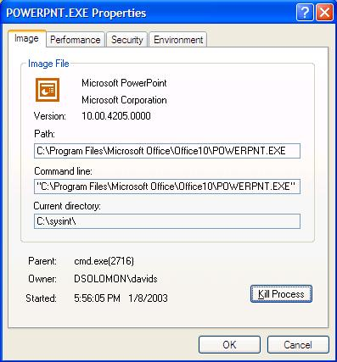
Image Information
Double click on Explorer.exe to bring up process properties
Image tab:
Description, company name, version (from .EXE)
Full image path
Command line used to start process
Current directory
Parent process
User name
Start time
Notes:
Lab objective: Study Image Information with Process Explorer
Where is full path. What if process gets same pid as previous process? DO first process’ children get forcibly adopted? No.
Do “notepad fred” to show command-line arguments. Shortcut might pass arguments.
Names used in performance tab much more logical than task manager.
Security: useful for telling what groups the process belongs to. Definitive list.
Explain privileges. Example: change system time. Double click on time applet and look at it in process explorer. See rundll32.exe. If double-click on it and look at command-line, last argument is timedate.cpl. Look at security and find that the time privilege is on.
Environment tab: sometimes input to scripts or apps. PATH is one of the more important. Inherited from parent. Set DAVID=brilliant. Run paintbrush and look at it’s environment. But not in others.
Services: talk about troubleshooting them later.

Slide 9
Viewing the Process Tree
1. Look at process hierarchy with TLIST /T
Start a Windows command prompt, then run Notepad from command prompt, then look at TLIST /T output
Exit the command prompt and notice “orphan” process with TLIST /T
2. Task Manager:
Applications tab: find the process that owns a window (right mouse click on window title)
Process tab: add a few additional columns: Virtual Memory size, Handle count, Thread count
Windows: add I/O counters; right click on a process & notice “end process tree” option
Notes:
Lab objective: Viewing the Process Tree
One unique attribute about a process that most tools don’t display is the parent or creator process ID. You can retrieve this value with the Performance tool (or programmatically) by querying the Creating Process ID. The Tlist.exe tool (in the Windows Debugging Tools) can show the process tree by using /t switch.
The list indents each process to show its parent/child relationship. Processes whose parents aren’t alive are left-justified (as is Explorer.exe in the preceding example) because even if a grandparent process exists, there’s no way to find that relationship. Windows maintains only the creator process ID, not a link back to the creator of the creator, and so forth.
To demonstrate the fact that Windows doesn’t keep track of more than just the parent process ID, follow these steps: 1. Open a Command Prompt window. 2. Type start cmd (which starts a second Command Prompt). 3. Bring up Task Manager. 4. Switch to the second Command Prompt. 5. Type mspaint (which runs Microsoft Paint). 6. Click the intermediate (second) Command Prompt window. 7. Type exit. (Notice that Paint remains.) 8. Switch to Task Manager. 9. Click the Applications tab. 10. Right-click on the Command Prompt task, and select Go To Process. 11. Click on the Cmd.exe process highlighted in gray. 12. Right-click on this process, and select End Process Tree. 13. Click Yes in the Task Manager Warning message box.
The first Command Prompt window will disappear, but you should still see the Paintbrush window because it was the grandchild of the Command Prompt process you terminated; and because the intermediate process was terminated, there was no link between the parent and the grandchild.

Slide 10
Viewing the Base HALs
Windows 2000/XP/2003 HALs (see \windows\driver cache\i386\driver.cab)
Hal.dll Standard PC (uniprocessor)
Halacpi.dll ACPI PC (uniprocessor)
Halapic.dll APIC PC (uniprocessor)
Halaacpi.dll APIC ACPI PC (uniprocessor)
Halmps.dll Standard PC (multiprocessor)
Halmacpi.dll ACPI PC (multiprocessor)
Win2000 only:
Halborg.dll Silicon Graphics (multiprocessor)
WinXP only:
Halsp.dll Compaq SystemPro (multiprocessor)
Additional NT4 HALs (see Knowledge Base article 156358)
Halast.dll AST Manhattan SMP
Halcbus.dll Corollary C-bus Architecture
Halmca.dll IBM PS/2 or other Micro Channel-based PC
halmpsm.dll Micro Channel Multi Processor PC
Halncr.dll NCR System 3000 Model 3360/3450/3550
Haloli.dll Olivetti LSX5030/40
Halwyse7.dll Wyse Series 7000i Model 740MP/760MP
Hal486c.dll Standard PC with C-Step i486
Notes:
Lab objective: Viewing the Base HALs Included with Windows
To view the HALs included with Windows, open the file Driver.cab in the appropriate architecture-specific folder underneath \Windows\Driver Cache.
(For example, for x86 systems, the file name is \Windows\Driver Cache\i386\Driver.cab.) Scroll down to the files beginning with “Hal” and you will see the HAL DLLs.

Slide 11
Determining Which HAL You’re Running
Selected at installation time
See \windows\repair\setup.log to find out which one
Can select manually at boot time with /HAL= in boot.ini
Windows distribution
CD-ROM:\i386
Boot Partition:
\windows\System32
NTOSKRNL.EXE,
NTKRNLPA.EXE,
NTKRNLMP.EXE,
NTKRPAMP.EXE
HAL.DLL
HALACPI.DLL
…etc.
Windows Setup
NTOSKRNL.EXE
NTKRNLPA.EXE HAL.DLL
(see \windows\repair\setup.log)
Notes:
Lab objective: Determining Which HAL You’re Running
There are two ways to determine which HAL you’re running:
Open the file \Windows\Repair\Setup.log, search for Hal.dll, and look at the filename after the equals sign. This is the name of the HAL on the distribution media extracted from Driver.cab.
In Device Manager (right-click on the My Computer icon on your desktop, select Properties, click on the Hardware tab, and then click Device Manager), look at the name of the “driver” under the Computer device type.

Slide 12
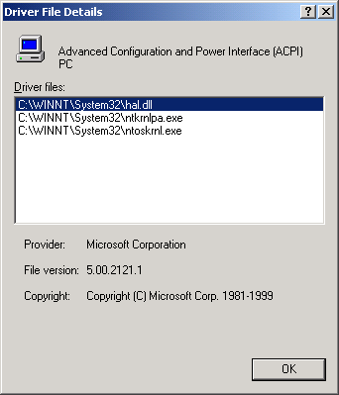
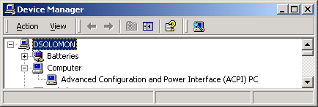
Determine the HAL
Can also see by viewing the “device drivers” for the Computer
Go to Control Panel->System – Hardware tab
Click on “Device Manager”
Click on “Computer”
Right click/Properties on “driver” for PC
Screen snapshot from:
Control Panel | System | Hardware |
Device Manager | Computer properties |
Driver Details
Notes:
Lab objective: Determining the HAL
Open the System properties (either by selecting System from Control Panel or by right-clicking the My Computer icon on your desktop and selecting Properties).
Click the Hardware tab.
Click Device Manager.
Expand the Computer object.
The node underneath indicates the HAL (e.g. ACPI).
To see the driver files involved in supporting the “computer” device, double-click the child node underneath Computer.
Click the Driver tab.
Click Driver Details.

Slide 13
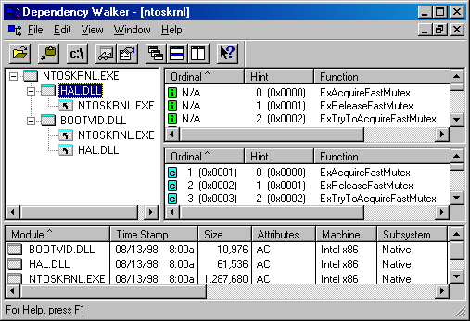
Examining NTOSKRNL & HAL Image Dependencies
Tool: Dependency Walker (Depends.Exe in Resource Kit & Platform SDK)
Allows viewing of image->DLL relationships, imports, and exports
NTOSKRNL.EXE
Executive and Kernel
HAL.DLL
Hardware Abstraction Layer - interface to hardware platform
BOOTVID.DLL
Boot video driver
Added in Win2000
KDCOM.DLL
Kernel debugger communication code
Notes:
Lab objective: Viewing NTOSKRNL and HAL Image Dependencies
You can view the relationship of the kernel and HAL images by examining their export and import tables using the Dependency Walker tool (Depends.exe), which is contained in the Windows Support Tools and the Platform SDK. To examine an image in the Dependency Walker, select Open from the File menu to open the desired image file.
Notice that Ntoskrnl is linked against the HAL, which is in turn linked against Ntoskrnl. (They both use functions in each other.) Ntoskrnl is also linked against Bootvid.dll, the boot video driver that is used to implement the GUI startup screen. On Windows XP and later, you will see an additional DLL, Kdcom.dll, in the list. This contains kernel debugger infrastructure code that used to be part of Ntoskrnl.exe. For a detailed description of the information displayed by this tool, see the Dependency Walker help file (Depends.hlp).

Slide 14
Installed Device Drivers
Separate loadable modules (drivername.SYS)
Linked like .EXEs
Typically linked against NTOSKRNL.EXE and HAL.DLL
Only one version of each driver binary for both uniprocessor (UP) and multiprocessor (MP) systems…
… but drivers call routines in the kernel that behave differently for UP vs. MP Versions
Defined in registry
Same area as Windows services (t.b.d.) - differentiated by Type value
Several types:
“ordinary”, file system, NDIS miniport, SCSI miniport (linked against port drivers), bus drivers
More information in I/O subsystem section
To view loaded drivers, run drivers.exe
Also see list at end of output from pstat.exe – includes addresses of each driver
To view installed drivers:
System properties->Hardware Tab->Device Manager
Msinfo32->Software Environment->System Drivers
Notes:
Lab objective: Viewing the Installed Device Drivers
You can list the installed drivers by running Msinfo32.exe (click Start->Run and then enter Msinfo32). Then expand Software Environment and open System Drivers. Alternatively, you list the currently loaded device drivers with the Drivers utility (Drivers.exe in the Windows 2000 resource kits) or the Pstat utility (Pstat.exe in the Windows XP Support Tools, Windows Server 2003 Support Tools, Windows 2000 resource kits, and the Platform SDK).

Slide 15
Peering into Undocumented Interfaces
Exported symbols
Functions and global variables Microsoft wants visible outside the image (e.g. used by device drivers)
About 1500 symbols exported
Ways to list:
Dependency Walker (File->Save As)
Visual C++ “link /dump /exports ntoskrnl.exe”
Global symbols
Over 9000 global symbols in XP/Server 2003 (Windows NT 4.0 was 4700)
Many variables contain values related to performance and memory policies
Ways to list:
Visual C++: “dumpbin /symbols /all ntoskrnl.exe” (names only)
Kernel debugger: “x nt!*”
Module name of NTOSKRNL is “NT”
Notes:
Lab objective: Peering into Undocumented Interfaces
Examining the names of the exported or global symbols in key system images (such as Ntoskrnl.exe, Hal.dll, or Ntdll.dll) can be enlightening—you can get an idea of the kinds of things Windows can do versus what happens to be documented and supported today. Of course, just because you know the names of these functions doesn’t mean that you can or should call them—the interfaces are undocumented and are subject to change. We suggest that you look at these functions purely to gain more insight into the kinds of internal functions Windows performs, not to bypass supported interfaces.
For example, looking at the list of functions in Ntdll.dll gives you the list of all the system services that Windows provides to user-mode subsystem DLLs versus the subset that each subsystem exposes. Although many of these functions map clearly to documented and supported Windows functions, several are not exposed via the Windows API. (See the article “Inside the Native API” from www.sysinternals.com.)
Conversely, it’s also interesting to examine the imports of Windows subsystem DLLs (such as Kernel32.dll or Advapi32.dll) and which functions they call in Ntdll.
Another interesting image to dump is Ntoskrnl.exe—although many of the exported routines that kernel-mode device drivers use are documented in the Windows DDK, quite a few are not. You might also find it interesting to take a look at the import table for Ntoskrnl and the HAL; this table shows the list of functions in the HAL that Ntoskrnl uses and vice versa.
Table 2-7 in Windows Internals, 4th edition lists most of the commonly used function name prefixes for the executive components. Each of these major executive components also uses a variation of the prefix to denote internal functions—either the first letter of the prefix followed by an i (for internal) or the full prefix followed by a p (for private). For example, Ki represents internal kernel functions, and Psp refers to internal process support functions.

Slide 16
Image Subsystem Type
Look at subsystem startup information in registry
Using EXETYPE, look at subsystem types for:
\windows\system32\notepad.exe, cmd.exe, csrss.exe
Notes:
Lab objective: Viewing the Image Subsystem Type
You can see the image subsystem type by using either the Exetype tool in the Windows 2000 Resource Kit or the Dependency Walker tool (Depends.exe) in the Windows Support Tools and Platform SDK. For example, notice the image types for two different Windows images, Notepad.exe (the simple text editor) and Cmd.exe (the Windows command prompt):
C:\>exetype \Windows\system32\notepad.exe File "\Windows\system32\notepad.exe" is of the following type: Windows NT 32 bit machine Built for the Intel 80386 processor Runs under the Windows GUI subsystem
C:\>exetype \Windows\system32\cmd.exe File "\Windows\system32\cmd.exe" is ofthe followingtype: Windows NT 32 bit machine Built for the Intel 80386 processor Runs under the Windows character-based subsystem
This shows that Notepad is a GUI program while Cmd is a console or character-based program. And although the output of the Exetype tool implies there are two different subsystems for GUI and character-based programs, there is just one Windows subsystem. Also, Windows isn’t supported on the Intel 386 processor (or the 486 for that matter)—the text output by the Exetype program hasn’t been updated.

Slide 17
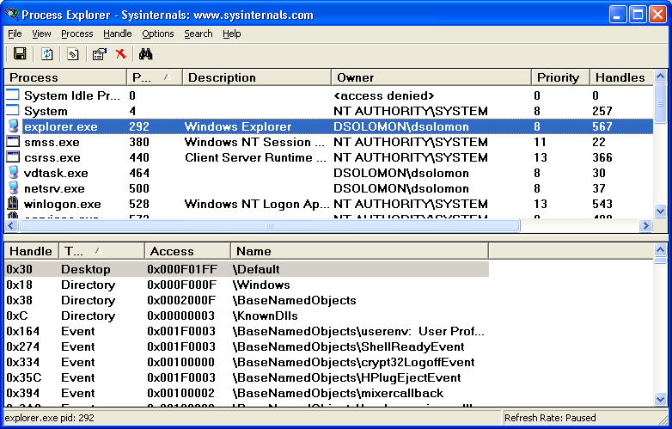
Viewing Open Handles
Process Explorer (GUI version) or handle (character cell version) from www.sysinternals.com
Uses a device driver to walk handle table, so doesn’t need Global Flag set
Notes:
Lab objective: Viewing Open Handles
Run Process Explorer, and make sure the lower pane is enabled and configured to show open handles. (Click on View, Lower Pane View, and then Handles). Then open a command prompt and view the handle table for the new Cmd.exe process. You should see an open file handle to the current directory.
If you then change the current directory with the CD command, you will see in Process Explorer that the handle to the previous current directory is closed and a new handle is opened to the new current directory. The previous handle is highlighted briefly in red, and the new handle is highlighted in green. The duration of the highlight can be adjusted by clicking Options and then Difference Highlight Duration.
Process Explorer’s differences highlighting feature makes it easy to see changes in the handle table. For example, if a process is leaking handles, viewing the handle table with Process Explorer can quickly show what handle or handles are being opened but not closed. This information can assist the programmer to find the handle leak.

Slide 18
Experiment with Handle-tool
Handle View
Suggestion: sort by type or path column
Objects of type “File” and “Key” are most interesting for general troubleshooting
By default, shows named objects
Click on Options->Show Unnamed Objects
Solve file locked errors
Use the search feature to determine what process is holding a file or directory open
Can even close an open files (be careful!)
Understand resources used by an application
Files
Registry keys
Detect handle leaks using refresh difference highlighting
Can also view the state of synchronization objects (mutexes, semaphores, events)
Notes:
Lab objective: Experiment with Handle-tool
You can also display the open handle table by using the command line Handle tool from www.sysinternals.com. For example, note the following partial output of Handle examining the handle table for a Cmd.exe process before and after changing the directory:
C:\>handle -p cmd.exe
Handlev 2.2 Copyright(C)1997-2004 MarkRussinovich Sysinternals - www.sysinternals.com ------------------------------------------------------------ cmd.exe pid:3184BIGDAVID\dsolomon b0:File C:\
C:\>cd windows
C:\WINDOWS>handle -p cmd.exe
Handlev 2.2 Copyright(C)1997-2004 MarkRussinovich Sysinternals - www.sysinternals.com ------------------------------------------------------------ cmd.exe pid:3184BIGDAVID\dsolomon b4:File C:\WINDOWS

Slide 19
Maximum Number of Handles
Run Process Explorer, and click View and then System Information. Open a command prompt.
Run the testlimit -h
When Testlimit fails to open a new handle, it will display the total number of handles it was able to create.
If the number is less than approximately 16 million, you are probably running out of paged pool before hitting the theoretical per-process handle limit.
kill the testlimit process by closing the command-prompt window; thus closing all the open handles.
Notes:
Lab objective: Creating the Maximum Number of Handles
The test program Testlimit from www.sysinternals.com/windowsinternals.shtml has an option to open handles to an object until it cannot open any more handles. You can use this to see how many handles can be created in a single process on your system. Because handle tables are allocated from paged pool, you might run out of paged pool before you hit the maximum number of handles that can be created in a single process.
To see how many handles you can create on your system, follow these steps:
Download the Testlimit zip file from the link just mentioned, and unzip it into a directory.
Run Process Explorer, and click View and then System Information. Notice the current and maximum size of paged pool. (To display the maximum pool size values, Process Explorer must be configured properly to access the symbols for the kernel image, Ntoskrnl.exe.) Leave this system information display running so that you can see pool utilization when you run the Testlimit program.
Open a command prompt.
Run the Testlimit program with the “-h” switch (do this by typing testlimit –h). When Testlimit fails to open a new handle, it will display the total number of handles it was able to create. If the number is less than approximately 16 million, you are probably running out of paged pool before hitting the theoretical per-process handle limit.
Close the command-prompt window; doing this will kill the Testlimit process, thus closing all the open handles.

Slide 20
Viewing Open Handles with Kernel Debugger
If looking at a dump, use !handle in Kernel Debugger (see help for options)
lkd> !handle 0 f 9e8 file
processor number 0 Searching for Process with Cid == 9e8 Searching for handles of type file
PROCESS 82ce72d0 SessionId: 0 Cid: 09e8 Peb: 7ffdf000 ParentCid: 06ec
DirBase: 06602000 ObjectTable: e1c879c8 HandleCount: 430. Image: POWERPNT.EXE …
0280: Object: 82c5e230 GrantedAccess: 00120089
Object: 82c5e230 Type: (82fdde70) File ObjectHeader: 82c5e218
HandleCount: 1 PointerCount: 1
Directory Object: 00000000 Name: \slides\ntint\new\4-systemarchitecture.ppt {HarddiskVolume1}
Notes:
Lab objective: Viewing the Handle Table with the Kernel Debugger
The !handle command in the kernel debugger takes three arguments: !handle <handleindex><flags><processid>
The handle index identifies the handle entry in the handle table. (Zero means display all handles.) The first handle is index 4, the second 8, and so on. For example, typing !handle 4 will show the first handle for the current process. The flags you can specify are a bitmask, where bit 0 means display only the information in the handle entry, bit 1 means display free handles (not just used handles), and bit 2 means display information about the object that the handle refers to.
The following command displays full details about the handle table for process ID 0x408:
kd> !handle0 7408 processor number0 Searching for Process with Cid==408 PROCESS 865f0790 SessionId:0Cid:0408 Peb:7ffdf000 ParentCid: 01dc DirBase:04fd3000 ObjectTable: 856ca888 TableSize: 21. Image: i386kd.exe Handle Table at e2125000 with 21 Entries in use 0000:free handle 0004:Object: e20da2e0 GrantedAccess:000f001f Object: e20da2e0 Type:(81491b80)Section ObjectHeader: e20da2c8 HandleCount:1 PointerCount:1 0008:Object: 80b13330 GrantedAccess:00100003 Object: 80b13330 Type:(81495100)Event ObjectHeader: 80b13318 HandleCount:1 PointerCount:1

Slide 21
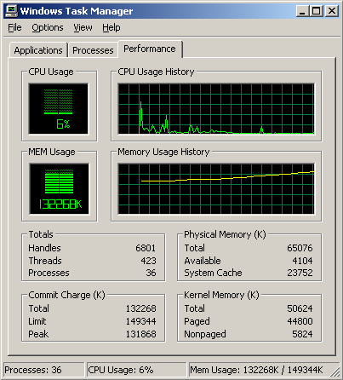
Troubleshooting a Pool Leak
Run NotMyFault and select “Leak Pool”
(available from http://www.sysinternals.com /files/notmyfault.zip)
Allocates paged pool buffers and doesn’t free them
Stops leaking when you select “Stop Leaking”
Notes:
Lab objective: Troubleshooting a Pool Leak
In this experiment, you will fix a real paged pool leak on your system so that you can put to use the techniques described in the previous section to track down the leak. The leak will be generated by the NotMyFault tool, which you can download from www.sysinternals.com/windowsinternals.shtml.
When you run NotMyFault.exe, it loads a device driver Myfault.sys and presents the following dialog box:
Click the Leak Pool button. This causes NotMyFault to begin sending requests to the Myfault device driver to allocate paged pool. NotMyFault will continue to do this until you click the Stop Leaking button. Note that the paged pool is not released even when you close the program; the pool is permanently leaked until you reboot the system.
While the pool is leaking, first open Task Manager and click on the Performance tab. You should notice Paged Pool climbing. You can also check this with Process Explorer’s System Information display. (Click on Show and then System Information.)
To determine the pool tag that is leaking, run Poolmon and press the “b” key to sort by the number of bytes. Press “p” twice so that Poolmon is showing only paged pool. You should notice the pool tag “Leak” climbing to the top of the list. -- Press Stop Leaking !
Run Strings (from www.sysinternals.com) to look for driver binaries that contain the pool tag “Leak”: Strings \windows\system32\drivers\*.sys | findstr Leak

Slide 22
Determining the Maximum Pool Sizes
Three options:
Poolmon (in Support Tools and Device Driver Kit)
Kernel Debugger !Poolused command
Driver Verifier (in Windows 2000 and later)
Notes:
Lab objective: Determining the Maximum Pool Sizes
Because paged and nonpaged pool represent a critical system resource, it is important to know when you’re nearing the maximum size computed for your system so that you can determine whether you need to override the default maximum with the appropriate registry values. The pool-size performance counters report only the current size, however, not the maximum size.
So you don’t know when you’re reaching the limit until you’ve exhausted pool. (As noted earlier, future versions of Windows might support dynamically sized pools. Therefore, the need to check the pool maximums might no longer be necessary in the future.) You can obtain the pool maximums by using either Process Explorer or live kernel debugging. To view pool maximums with Process Explorer, click on View, System Information.

Slide 23
Mapping a System Thread to a Device Driver
Generate network file access activity, for example: “dir \\computername\c$ /s”
System process should be consuming CPU time
Open System process process properties
Go to Threads tab
Sort by CPU time and find thread(s) running
Determine what driver these are in
Notes:
Lab objective: Mapping a System Thread to a Device Driver
In this experiment, we’ll see how to map CPU activity in the System process to the responsible system thread (and the driver it falls in) generating the activity. This is important because when the System process is running, you must go to the thread granularity to really understand what’s going on. For this experiment, we will generate system thread activity by generating file server activity on your machine. (The file server driver, Srv.sys, creates system threads to handle inbound requests for file I/O. See Chapter 13 for more information on this component.)
Open a command prompt.
Do a directory listing of your entire C drive using a network path to access your C drive. For example, if your computer name is COMPUTER1, type “dir \\computer1\c$ /s”. (The /s switch lists all subdirectories.)
Run Process Explorer, and double-click on the System process.
Click on the Threads tab.
Sort by the CSwitch Delta (context switch delta) column. You should see one or more threads in Srv.sys running.
If you see a system thread running and you are not sure what the driver is, press the Module button, which will bring up the file properties.

Slide 24
Identifying System Threads in the System Process
To really understand what’s going on, must find which driver a thread “belongs to”
With standard user-mode tools:
PerfMon: monitor %Processor time for each thread in System process & determine which thread(s) are running
Pviewer: get “Start address” (address of thread function) of running thread(s)
Pstat: find which driver thread start address falls in
Look for what driver starts near the thread start address
Notes:
Lab objective: Identifying System Threads in the System Process
You can see that the threads inside the System process must be kernel-mode system threads because the start address for each thread is greater than the start address of system space (which by default begins at 0x80000000, unless the system was booted with the /3GB Boot.ini switch). Also, if you look at the CPU time for these threads, you’ll see that those that have accumulated any CPU time have run only in kernel mode.
To find out which driver created the system thread, look up the start address of the thread (which you can display with Pviewer.exe) and look for the driver whose base address is closest to (but before) the start address of the thread. Both the Pstat utility (at the end of its output) as well as the !drivers kernel debugger command list the base address of each loaded device driver.
To quickly find the current address of the thread, use the !stacks 0 command in the kernel debugger.

Slide 25
Solitaire as a Service
Create a service to run Sol.exe
Sc create dumbservice binpath= c:\windows\system32\sol.exe
Start the service
Use the GUI, or type “sc start dumbservice”, or “net start..”
Quickly run Process Explorer and look at handle table for sol.exe
Notice name of Windowstation object
Open services.msc; mark service “Allow Service to Interact with Desktop”
Start the service again and in Process Explorer, look at handle table for sol.exe
Notice name of Windowstation object
Notes:
Lab objective: Run Solitare as a Service
If you have a program that you want to run as a service, you need to modify the startup code to conform to the requirements for services outlined in this section. If you don’t have the source code, you can use the SrvAny tool in the Windows resource kits. SrvAny enables you to run any application as a service. It reads the path of the service file that it must load from the Parameters subkey of the service’s registry key.
When SrvAny starts, it notifies the SCM that it is hosting a particular service, and when it receives a start command, it launches the service executable as a child process. The child process receives a copy of the SrvAny process’s access token and a reference to the same window station, so the executable runs within the same security account and with the same interactivity setting as you specified when configuring the SrvAny process. SrvAny services don’t have the share-process Type value, so each application you install as a service with SrvAny runs in a separate process with a different instance of the SrvAny host program.

Slide 26
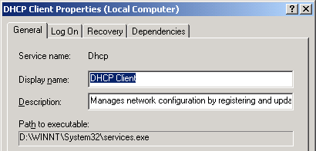
Listing Installed Services
Not always a 1-to-1 mapping
Some service processes contain more than one service
Conserves virtual memory, reduces boot time
This is up to the developer of the service
Service properties displayed through Control Panel (services.msc) show name of .EXE
But not which process the services is running in
Notes:
Lab objective: Listing Installed Services
To list the installed services, select Administrative Tools from Control Panel, and then select Services. To see the detailed properties about a service, right-click on a service and select Properties. Notice that the Path To Executable field identifies the program that contains this service. Remember that some services share a process with other services—mapping isn’t always one to one.

Slide 27
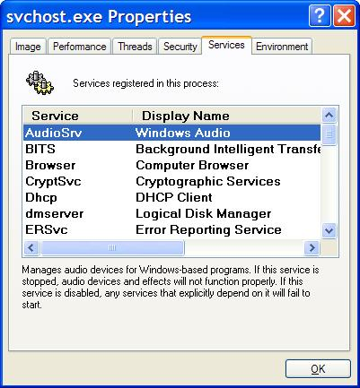
Viewing Service Details Inside Service Processes
Tlist /S (Debugging Tools) or Tasklist /svc (XP/2003) list internal name of services inside service processes
Process Explorer shows more: external display name and description
Notes:
Lab objective: Viewing Service Details Inside Service Processes
Process Explorer highlights processes hosting one service or more. (You can configure this by selecting the Configure Highlighting entry in the Options menu.) If you double-click on a service-hosting process, you will see a Services tab that lists the services inside the process: the name of the registry key that defines the service, the display name seen by the administrator, and the description text for that service (if present).

Slide 28
Viewing Services Running Inside Processes
Open a command prompt
Type “tasklist /svc”
Find the Svchost.exe process with the most services inside it
In Process Explorer, double click on that Svchost.exe process
Click on Services tab
Notice extra details about each service displayed by Process Explorer
Notes:
Lab objective: Viewing Services Running Inside Processes
The Process Explorer utility that you can download from www.sysinternals.com shows detailed information about the services running with processes. Run Process Explorer and view Services tabs on the process properties dialog box for the following processes: Services.exe, Lsass.exe, and Svchost.exe. Several instances of SvcHost will be running on your system, and you can see the account in which each is running by adding the Username column to the Process Explorer display or by looking at the Username field on the Image tab of a process’s Process Properties dialog box.
The information displayed by Process Explorer includes the service name, display name, and service description, if it has one, which Process Explorer shows beneath the service list when you select a service.

Slide 29
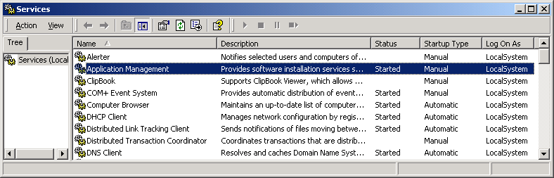
Service Configuration & Control Tools
To view & control services:
Control Panel->Administrative Tools->Services
No option to add/remove – done at install/uninstall time
Notes:
Lab objective: Experiment with Service Control Tools
Net start/stop – local system only
Sc.exe (built in to XP/2003; also in Win2000 Resource Kit)
Command line interface to all service control/configuration functions
Works on local or remote systems
Psservice (Sysinternals) – similar to SC
Other tools in Resource Kit
Instsrv.exe – install/remove services (command line)
Srvinstw.exe – install/remove services (GUI)
Why are service creation tools included in Reskit?
Because Reskit comes with several services that are not installed as services when you install the Reskit

