Slide 1
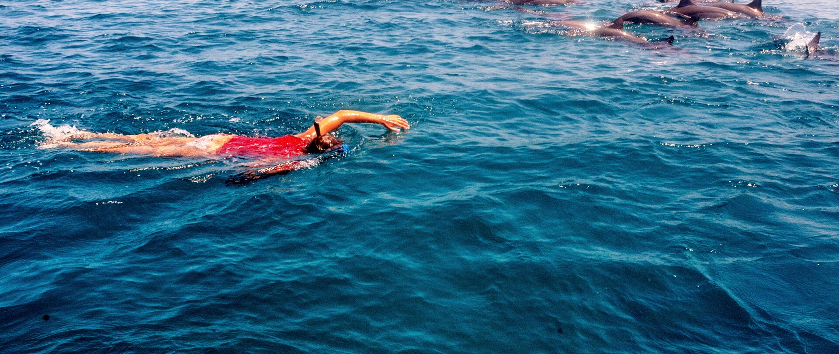
A/B test brainstorm
The Hustlers
Digital - Hustlers
23 March

Slide 2
Agenda - a free format brainstorm for test ideas – we want to end the session with a backlog of ideas to improve conversion
Set the scene
A couple of examples
Idea capturing
How do we prioritize

Slide 3

Some structure in the free format – way more categories possible
Clarity
Are there areas on the website app where we can decrease #numbers?
Is all information needed?
What is the minimum that needs to be mentioned?
Do we have (external) examples of clear pages?
Are there areas that we want to highlight as we expect it to be attractive?
Low hanging fruit
What call to action text (button) do we want to test?
It might actually work!
Psychology & persuasion
How can we integrate these theories better?

Slide 4
Maybe too early for today – but how do we prioritise?

Slide 5
Appendix : Idea dump Michiel
1. Clarity -> test whether a page with less numbers and figures on this page (https://www.ing.com.au/home-loans.html) leads to more Starts. This can be done by exchanging the rate part for the steps to apply;
Increase $3K cashback offer;
Overview of three options -> do we want to boost one of the three? Lets add something most chosen etc;
Add USP’s max three with green checkmarks rather than too much tax;
Rather than apply now add a secondary link: read more, find out/ calculate now;
Highlight how quick the application process is somewhere;
Andras idea: tweak button text: rather than start application something like “Find out more” etc;
Should we test the effect of awards at all

