Slide 1
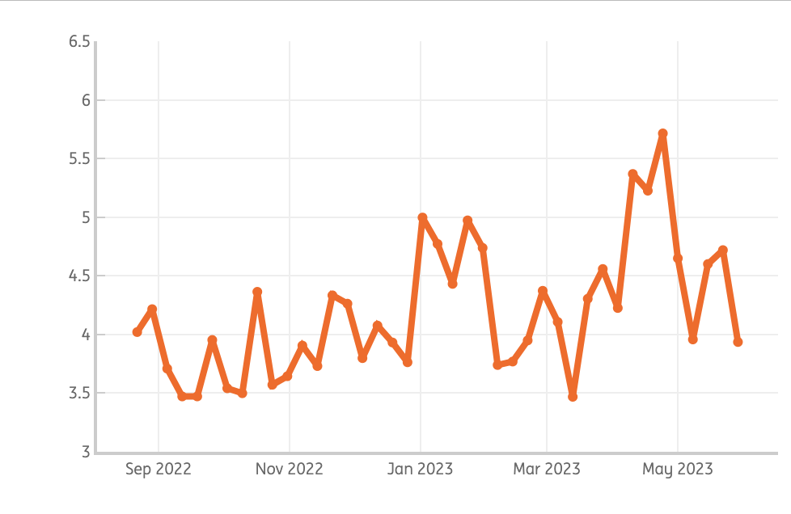
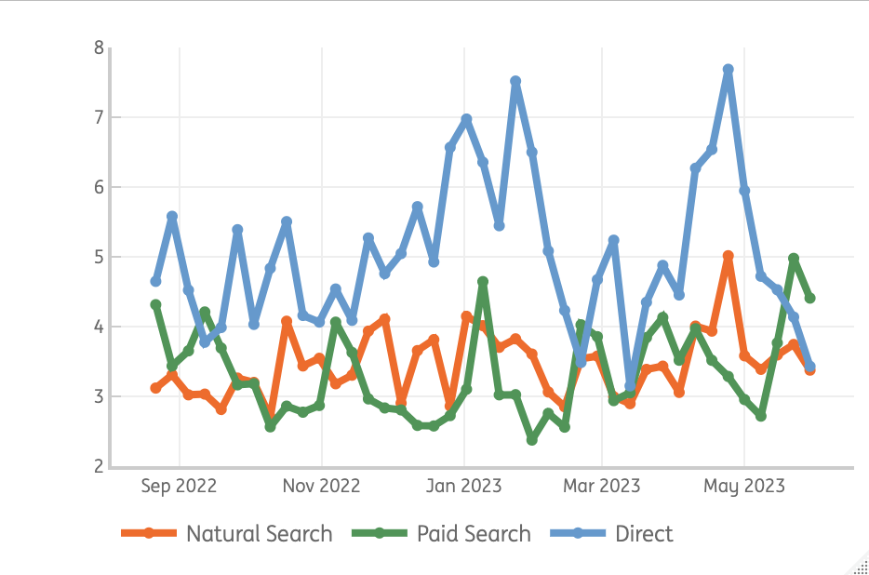
Start application has shown a decline since 3 weeks – the peak in April seems to be driven mainly via direct traffic
Start application evolution (visits start flow/ visits PP)
Start application evolution * source
Despite the long term upward trend, conversion seems to decline in the recent weeks
Traffic has shown a consistent development, with a dip in January as exception, so we try to clarify the decleaning conversion trend.
The peak in conversion in april seems to be driven by direct traffic

Slide 2
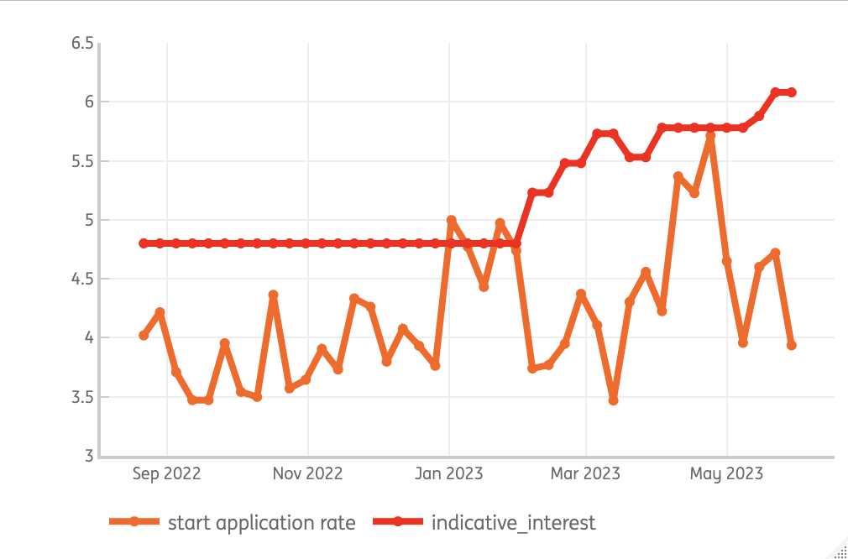
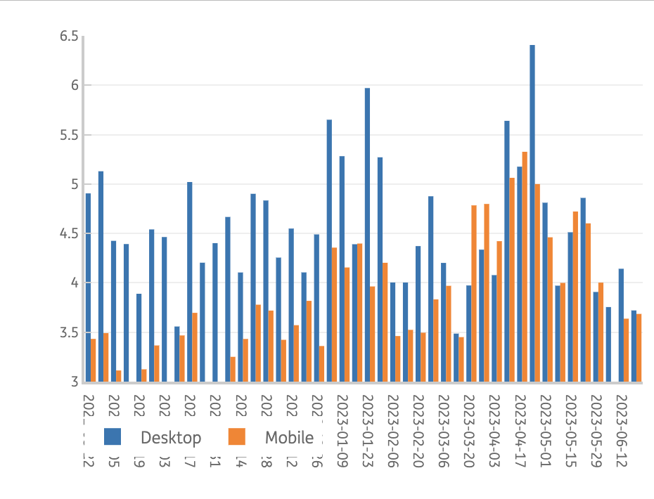
Start application does not seem to be impacted by rate changes – even though there are too little data points to draw hard conclusions
Start application evolution (visits start flow/ visits PP)
Start application evolution * device
One of the hypothesis is that rate changes might impact the start application rate negatively.
The rate change above is indicative, as of Feb -> it seems that as ling as the rates are stable (April) conversion is not impacted.
Correlation shows actually zero relation between rate changes and start application (P 0.02).
Start application for mobile has shown an uplift since April.
Whereas desktop seems to outperform mobile, there has been a more equal diviation since April.
There is just one week in April (24) where start application for desktop specifically peaks.

