Slide 1
Digital conversion – no device & NTBvsETB split
 | Product view | Product CTA click | Product page CTR | App start | App completed | End to end apply conversion
Product | 959928 | 245076 | 4325017377 | 141700 | 79815 | 0.418713326
Savings Maximiser | 187642 | 91432 | 49% | 84743 | 51440 | 27%
Orange Everyday | 335423 | 77288 | 23% | 43660 | 23097 | 7%
Personal Term Deposit | 80721 | 16440 | 20% | 12019 | 4985 | 6%
superannuation | 20990 | 1376 | 7% | 1278 | 293 | 1%
Motorcycle Insurance | 685 | 351 | 51% | 0 | 0 | 0%
Pet Insurance | 1439 | 637 | 44% | 0 | 0 | 0%
Health Insurance | 4740 | 1921 | 41% | 0 | 0 | 0%
Home and Contents Insurance | 8629 | 4692 | 54% | 0 | 0 | 0%
Car Insurance | 12976 | 7690 | 59% | 0 | 0 | 0%
Fixed Rate | 13383 | 1254 | 9% | 0 | 0 | 0%
Mortgage Simplifier | 17305 | 2016 | 12% | 0 | 0 | 0%
Orange Advantage | 22218 | 2026 | 9% | 0 | 0 | 0%
Orange One Low Rate Platinum | 33302 | 1520 | 5% | 0 | 0 | 0%
Orange One Low Rate Classic | 66779 | 10037 | 15% | 0 | 0 | 0%
ING Personal Loan | 73696 | 13184 | 18% | 0 | 0 | 0%
Savings Accelerator | 80000 | 13212 | 17% | 0 | 0 | 0%
Total amount of self service activities in the app
Source: Adobe, 2023 YTD

Slide 2
Digital conversion – no device split
quarter | NewvsCurrent | Credit Card | Home Loans | Orange Everyday | Personal Loan | Savings Maximiser | Superannuation
2022 Q4 | Customer | 59% | 18% | 28% | 34% | 91% | 14%
2022 Q4 | Customer&N2B | NA | NA | NA | NA | NA | NA
2022 Q4 | N2B | 32% | 12% | 23% | 63% | 12% | 25%
2023 Q1 | Customer | 45% | 17% | 30% | 29% | 77% | 9%
2023 Q1 | Customer&N2B | NA | NA | NA | NA | NA | NA
2023 Q1 | N2B | 28% | 13% | 25% | 68% | 16% | 18%
2023 Q2 | Customer | 0% | 0% | 15% | 0% | 76% | 5%
2023 Q2 | Customer&N2B | NA | NA | NA | NA | NA | NA
Source: Adobe -> as reported in QPC

Slide 3
Cross sell Sales (Moniek)
October 2019
YY22 and FY23 YTD
New to bank v existing split by product
New to bank v existing split overall
Source: digital sales report (tableau)
Product | 2022 Total Sales | NTB / XBUY (%) | 2023 Total Sales | NTB / XBUY (%)
Credit card | 10859 | 6% | 12688 | 7%
Current account | 128180 | 65% | 141635 | 66%
Mortgages | 1761 | 8% | 1692 | 7%
Personal loan | 6523 | 8% | 6311 | 7%
Personal Term Deposit | 18292 | 13% | 20691 | 12%
Savings Accounts | 11996 | 17% | 15681 | 14%
Savings Maximiser | 174067 | 38% | 188364 | 41%
Superannuation | 1854 | 43% | 1668 | 42%
Total | 353532 |  | 388730

Slide 4
Sales – broker channel excluded
year | Credit card | Current account | Mortgages | Personal loan | Personal Term Deposit | Savings Accounts | Savings Maximiser | Superannuation
2022 | 613 | 83781 | 146 | 541 | 2389 | 1988 | 66399 | 794
2023 YTD | 909 | 93744 | 119 | 425 | 2553 | 2161 | 76932 | 693
N2B
year | Credit card | Current account | Mortgages | Personal loan | Personal Term Deposit | Savings Accounts | Savings Maximiser | Superannuation
2022 | 10246 | 44399 | 1615 | 5982 | 15903 | 10008 | 107668 | 1060
2023 | 11779 | 47891 | 1573 | 5886 | 18138 | 13520 | 111432 | 975
Client
Total sales
year | ::unspecified:: | client | visitor
2022 | 14284 | 196881 | 156651
2023 | 16253 | 211194 | 177536

Slide 5
Top 20 self service activities in the app - last year vs YTD
 |  | 2022 | 2023
1 | Self Service Type | 212935594 | 123210109
2 | Transfer Money | 113394024 | 63473182 | 53% | 30%
3 | Pay Anyone | 54375491 | 30699224 | 26% | 14%
4 | Interest summary | 8093663 | 7097774 | 4% | 3%
5 | Search Transactions | 10969289 | 6417658 | 5% | 3%
6 | Pay Bill | 9321373 | 5081123 | 4% | 2%
7 | Benefits and rewards | 4457040 | 3027247 | 2% | 1%
8 | Edit scheduled payment | 2127611 | 1238262 | 1% | 1%
9 | Delete Payee | 1105666 | 706969 | 1% | 0%
10 | Updated account name | 825419 | 496411 | 0% | 0%
11 | Cancel scheduled payment | 646468 | 370619 | 0% | 0%
12 | Activate Card | 550941 | 363019 | 0% | 0%
13 | Download interim statement - Orange Everyday | 641874 | 301766 | 0% | 0%
14 | Changed account limit | 563127 | 290255 | 0% | 0%
15 | Download statement - Orange Everyday | 446098 | 233202 | 0% | 0%
16 | Enable Touch ID | 347671 | 185417 | 0% | 0%
17 | Pay Anyone create scheduled recurring | 298440 | 183644 | 0% | 0%
18 | Pay Bill create scheduled one off | 356443 | 182031 | 0% | 0%
19 | Confirmed Details for KYC | 251833 | 179113 | 0% | 0%
20 | Overseas notification | 189283 | 163214 | 0% | 0%

Slide 6
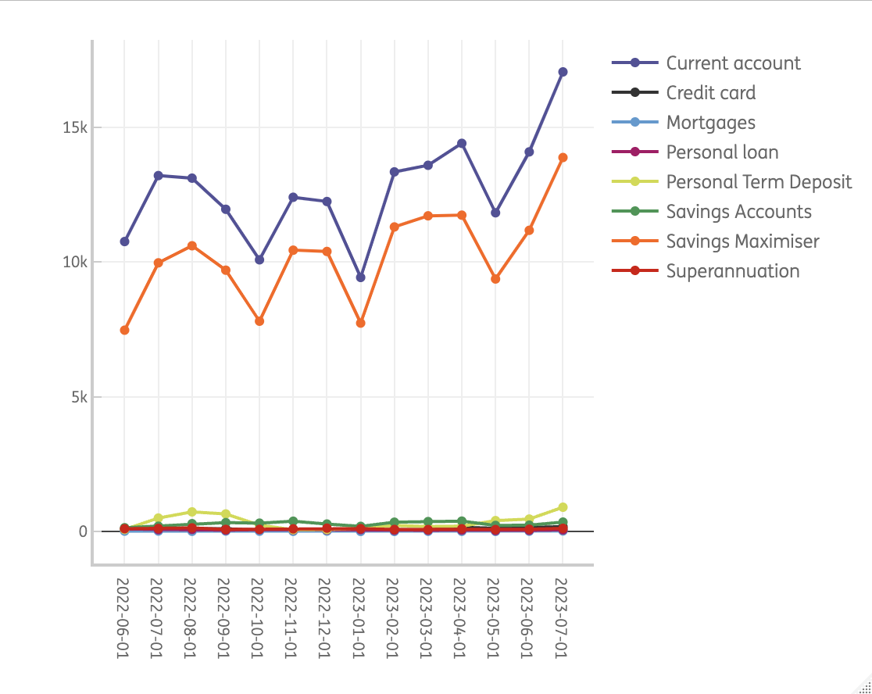
Sales N2B – assumption: total sales, without broker network. If not correct, easy to tweak
month_Date | Credit card | Current account | Mortgages | Personal loan | Personal Term Deposit | Savings Accounts | Savings Maximiser | Superannuation
01/06/2022 | 99 | 10762 | 22 | 102 | 84 | 149 | 7475 | 112
01/07/2022 | 78 | 13209 | 25 | 77 | 508 | 206 | 9973 | 122
01/08/2022 | 110 | 13114 | 17 | 88 | 736 | 299 | 10606 | 143
01/09/2022 | 111 | 11959 | 25 | 60 | 660 | 339 | 9700 | 86
01/10/2022 | 62 | 10085 | 19 | 79 | 243 | 319 | 7808 | 90
01/11/2022 | 72 | 12405 | 15 | 67 | 75 | 390 | 10442 | 108
01/12/2022 | 81 | 12247 | 23 | 68 | 83 | 286 | 10395 | 133
01/01/2023 | 84 | 9431 | 13 | 80 | 130 | 200 | 7738 | 115
01/02/2023 | 102 | 13346 | 11 | 56 | 232 | 354 | 11304 | 85
01/03/2023 | 80 | 13591 | 17 | 56 | 193 | 377 | 11717 | 81
01/04/2023 | 166 | 14405 | 16 | 62 | 206 | 394 | 11741 | 110
01/05/2023 | 127 | 11829 | 13 | 46 | 413 | 235 | 9374 | 82
01/06/2023 | 160 | 14088 | 20 | 54 | 470 | 244 | 11179 | 94
01/07/2023 | 190 | 17054 | 29 | 71 | 909 | 357 | 13879 | 126
Source: daily sales CI

Slide 7
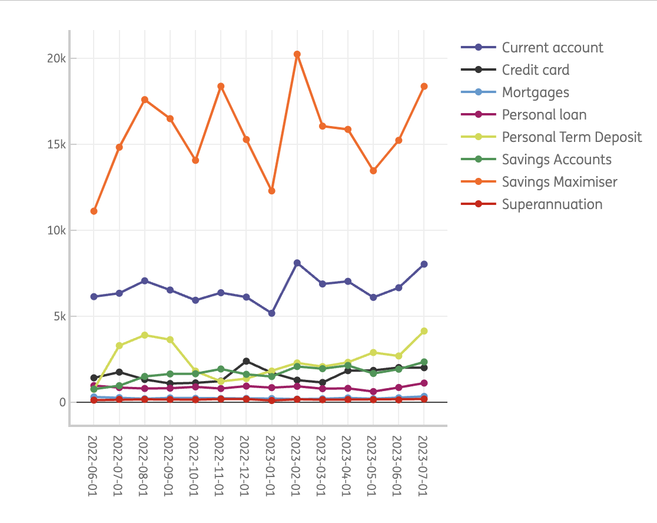
Sales client – assumption: total sales, without broker network. If not correct, easy to tweak
month_Date | Credit card | Current account | Mortgages | Personal loan | Personal Term Deposit | Savings Accounts | Savings Maximiser | Superannuation
01/06/2022 | 1407 | 6129 | 297 | 955 | 744 | 752 | 11101 | 110
01/07/2022 | 1741 | 6326 | 256 | 841 | 3282 | 952 | 14818 | 155
01/08/2022 | 1313 | 7051 | 194 | 788 | 3891 | 1489 | 17585 | 156
01/09/2022 | 1078 | 6514 | 241 | 804 | 3628 | 1634 | 16479 | 151
01/10/2022 | 1114 | 5920 | 213 | 882 | 1799 | 1646 | 14055 | 137
01/11/2022 | 1218 | 6356 | 204 | 785 | 1198 | 1922 | 18364 | 177
01/12/2022 | 2375 | 6103 | 210 | 927 | 1361 | 1613 | 15266 | 174
01/01/2023 | 1701 | 5163 | 204 | 837 | 1803 | 1483 | 12278 | 90
01/02/2023 | 1274 | 8092 | 170 | 915 | 2275 | 2066 | 20228 | 159
01/03/2023 | 1137 | 6866 | 192 | 777 | 2060 | 1940 | 16045 | 137
01/04/2023 | 1825 | 7019 | 241 | 797 | 2311 | 2127 | 15855 | 149
01/05/2023 | 1840 | 6086 | 192 | 609 | 2880 | 1661 | 13449 | 137
01/06/2023 | 2006 | 6647 | 246 | 847 | 2679 | 1909 | 15218 | 128
01/07/2023 | 1996 | 8018 | 328 | 1104 | 4130 | 2334 | 18359 | 175
Source: daily sales CI

Slide 8
Total sales – all channels without product split
month_Date | year | month | ::unspecified:: | client | visitor
01/06/2022 | 2022 | 6 | 2233 | 21495 | 18805
01/07/2022 | 2022 | 7 | 2346 | 28371 | 24198
01/08/2022 | 2022 | 8 | 2191 | 32467 | 25113
01/09/2022 | 2022 | 9 | 2100 | 30529 | 22940
01/10/2022 | 2022 | 10 | 1935 | 25766 | 18705
01/11/2022 | 2022 | 11 | 1736 | 30224 | 23574
01/12/2022 | 2022 | 12 | 1743 | 28029 | 23316
01/01/2023 | 2023 | 1 | 1805 | 23559 | 17791
01/02/2023 | 2023 | 2 | 2779 | 35179 | 25490
01/03/2023 | 2023 | 3 | 1991 | 29154 | 26112
01/04/2023 | 2023 | 4 | 2209 | 30324 | 27100
01/05/2023 | 2023 | 5 | 2107 | 26854 | 22119
01/06/2023 | 2023 | 6 | 2494 | 29680 | 26309
01/07/2023 | 2023 | 7 | 2868 | 36444 | 32615
Source: daily sales CI

Slide 9
Self service in native app
 | Jan-2023 | Feb-2023 | Mar-2023 | Apr-2023 | May-2023 | Jun-2023
Self Service Type | 18850504 | 17866855 | 20094710 | 18629768 | 19974210 | 19512570
Transfer Money | 9795636 | 9216236 | 10341125 | 9697005 | 10265219 | 9989918
Pay Anyone | 4571254 | 4448714 | 5069086 | 4672528 | 5017403 | 4908991
Search Transactions | 1052831 | 907761 | 992992 | 928225 | 1017098 | 992494
Interest summary | 946530 | 1019177 | 1189816 | 1030976 | 1170570 | 1213560
Pay Bill | 761744 | 761359 | 847396 | 744656 | 851564 | 798363
Benefits and rewards | 483404 | 405921 | 486015 | 456644 | 480951 | 490998
Edit scheduled payment | 215455 | 185413 | 197738 | 181992 | 194673 | 183645
Delete Payee | 106515 | 109117 | 119381 | 109073 | 112331 | 105249
Updated account name | 95065 | 78496 | 75802 | 68974 | 73374 | 71992
Activate Card | 64281 | 54835 | 57175 | 52011 | 58768 | 54252
Cancel scheduled payment | 61012 | 56365 | 60259 | 52991 | 58850 | 56925
Confirmed Details for KYC | 48803 | 23554 | 15931 | 32927 | 26180 | 23070
Download interim statement - Orange Everyday | 47079 | 44849 | 50612 | 42632 | 47141 | 46839
Changed account limit | 41817 | 41609 | 47514 | 41342 | 47692 | 49210
Download statement - Orange Everyday | 39355 | 34849 | 30547 | 38191 | 37811 | 30287
Pay Anyone create scheduled recurring | 31795 | 29842 | 32138 | 26057 | 26928 | 25425
Enable Touch ID | 30765 | 30113 | 30083 | 27086 | 28534 | 27393
Pay Bill create scheduled one off | 30423 | 28505 | 28020 | 27775 | 30185 | 25356
Transfer Money create scheduled recurring | 29182 | 24331 | 24682 | 21038 | 22284 | 21265
Apple pay verification | 23455 | 19792 | 20613 | 19091 | 20352 | 19776
Total amount of self service activities in the app

