Slide 1
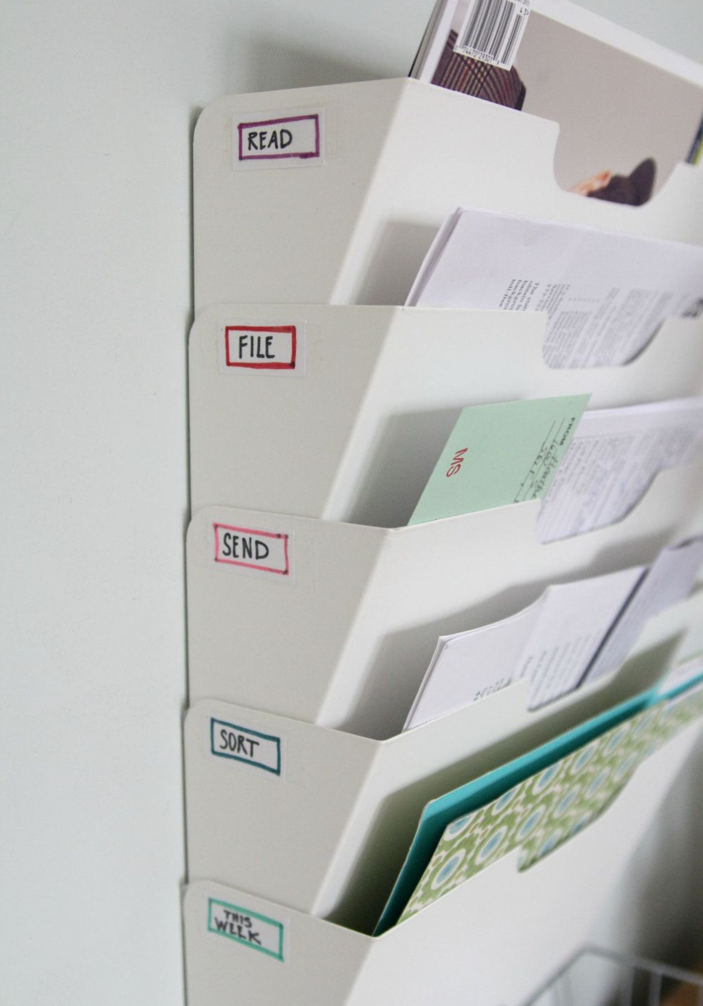
File Sort Explorer: Smart File Organization System
A Python & Streamlit-powered solution for automatic file organization and management.

Slide 2

Problem
🗂️ Messy Folders
⏱️ Wasted Time
Disorganized directories make it nearly impossible to locate files quickly.
Hours lost manually searching through cluttered file systems every week.
🚫 No Automation
Files pile up with no automatic organization to keep things in order.

Slide 3
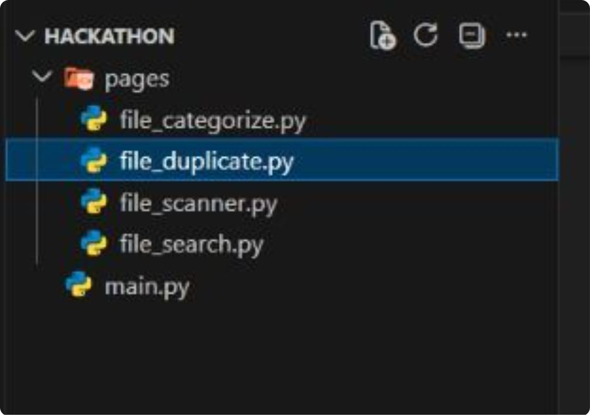
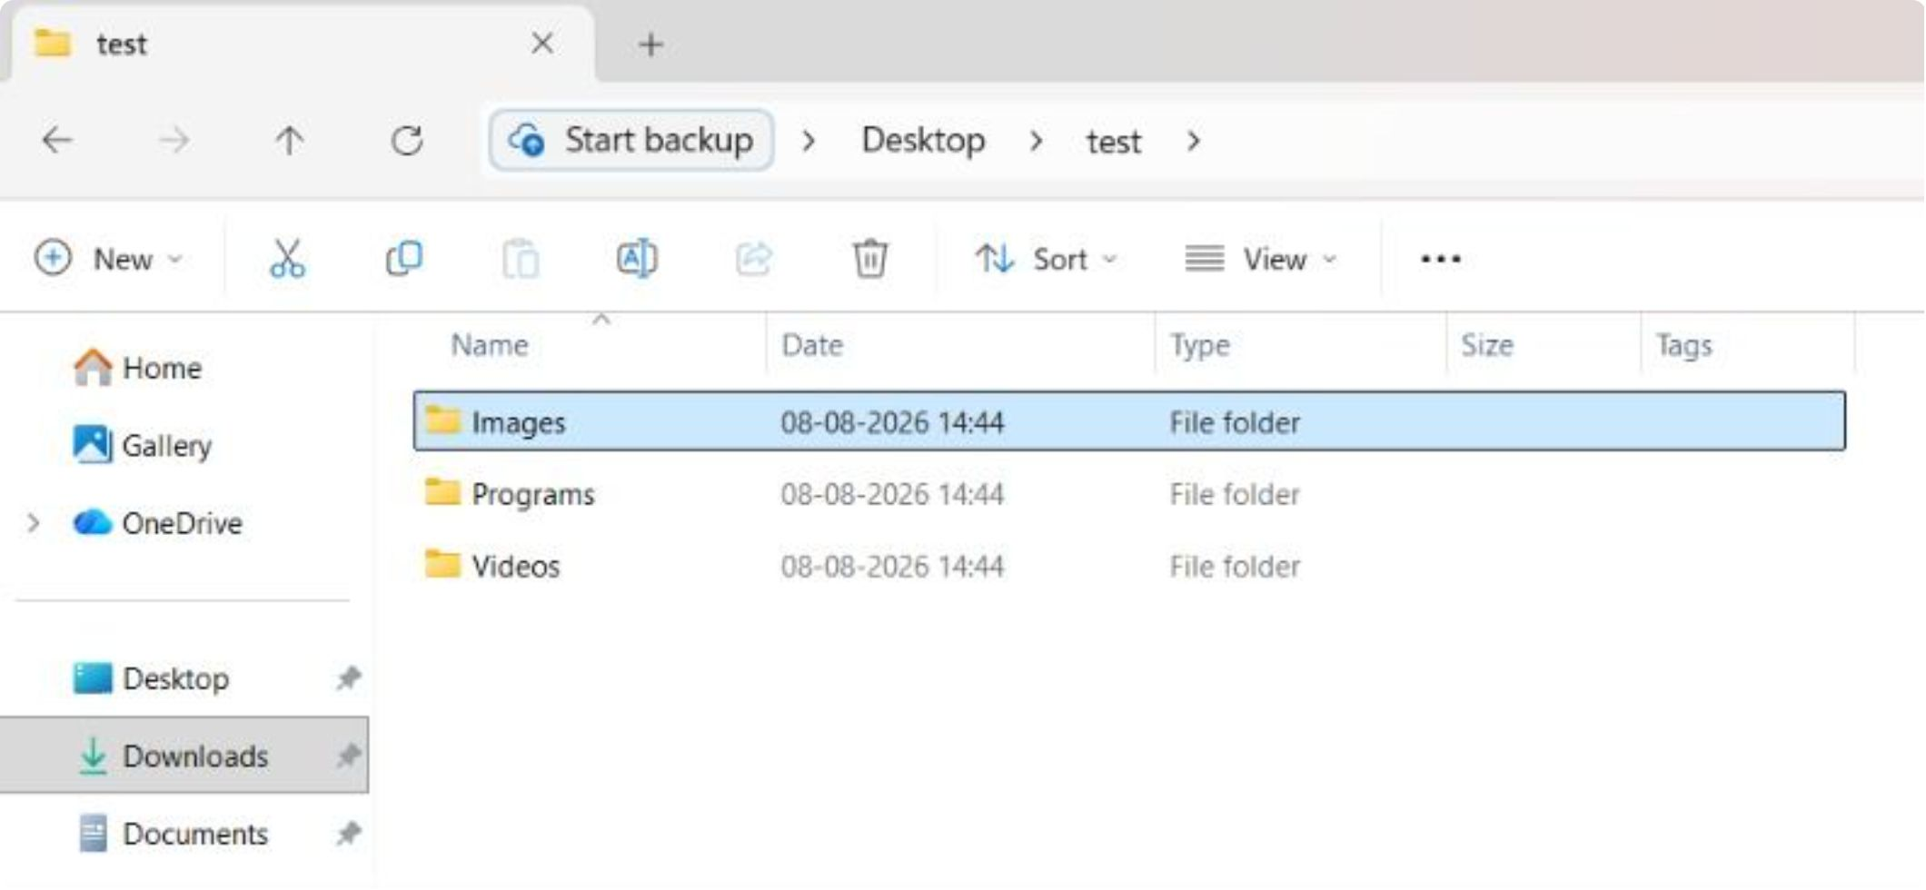
Solution
1
Organize Automatically
Files are sorted without any manual effort — just point and go.
2
Categorize by Type
Documents, images, videos, and more are grouped intelligently by file type.
3
Quick & Easy Access
Find what you need instantly with a clean, structured layout.

Slide 4






Technologies
Python
Streamlit
OS Module
Core logic powering the file scanning, categorization, and duplicate detection engine.
Provides the interactive, browser-based user interface with minimal setup required.
Handles all file system operations — reading, traversing, and managing directories.
Shutil
Hashlib
Send2Trash
move files to diff category Folders
To identify duplicate files using hash value
Saftely move deleted files to
Recycle bin(without Permenant Del)

Slide 5

Features
1
2
Upload Folder
Auto Categorization
Select any local folder to begin the organization process instantly.
Files are automatically sorted into categories based on their extensions.
3
4
Search Files
Duplicate Detection
Quickly locate any file across all categories with a built-in search tool.
Identifies duplicate files to help keep storage clean.
5
6
Delete Duplicates
Restore Deleted
deletes duplicate file
Restores deleted from temporary bin in case we need the file again.

Slide 6

Workflow
Upload Folder
Find Duplicates &
Implement changes into
Add a folder to start
Delete
Duplicates
main Folder
Analyse ,
Categorize
Restore Deleted Files
&
Search Files

Slide 7
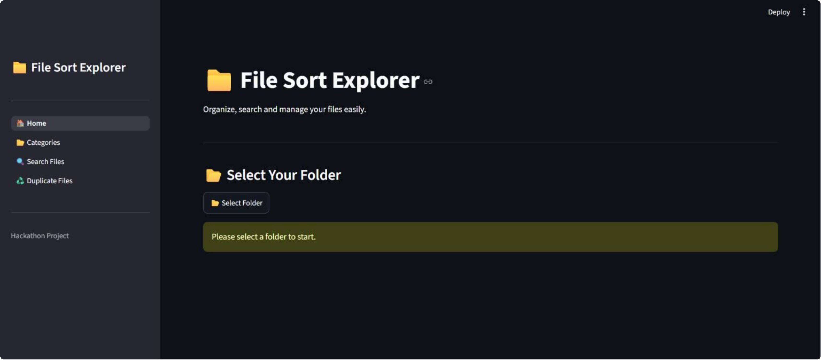

Slide 8

Design Highlights
Simple UI
Sidebar Navigation
Clean, uncluttered layout .
Easy access to all sections from a persistent sidebar.
Category View
Beginner Friendly
Browse files grouped by type in a structured display.
A beginner can understand and use this easily

Slide 9


Conclusion
Simple & Effective
A lightweight tool that solves a real, everyday problem without complexity.
Saves Time
Eliminates manual sorting so users can focus on what matters most.
Easy to Extend
Modular Python codebase makes it straightforward to add new features.

