Slide 1
Leave Scheduler System
Java • JDBC • MySQL • MVC Structure

Slide 2
Project Overview
A console-based Leave Management System
Built using Java, JDBC, MySQL
Features login, leave application, approvals
Admin & Employee modules

Slide 3
Project Architecture
Packages: cli, dao, model, service, util
Follows modular MVC-like approach
MySQL as backend database
JDBC for connectivity

Slide 4
System Modules
Employee Module
Admin Module
User Authentication
Leave Management
Leave Balance Tracking

Slide 5
Employee Features
Apply for leave
View applied leaves
View leave balance
Login/Logout

Slide 6
Admin Features
View all leave requests
Approve or Reject leave
Monitor system

Slide 7
Database Schema
users table (id, username, password, role, ct_balance)
leaves table (id, user_id, dates, reason, type, status)
Foreign key: user_id → users(id)

Slide 8
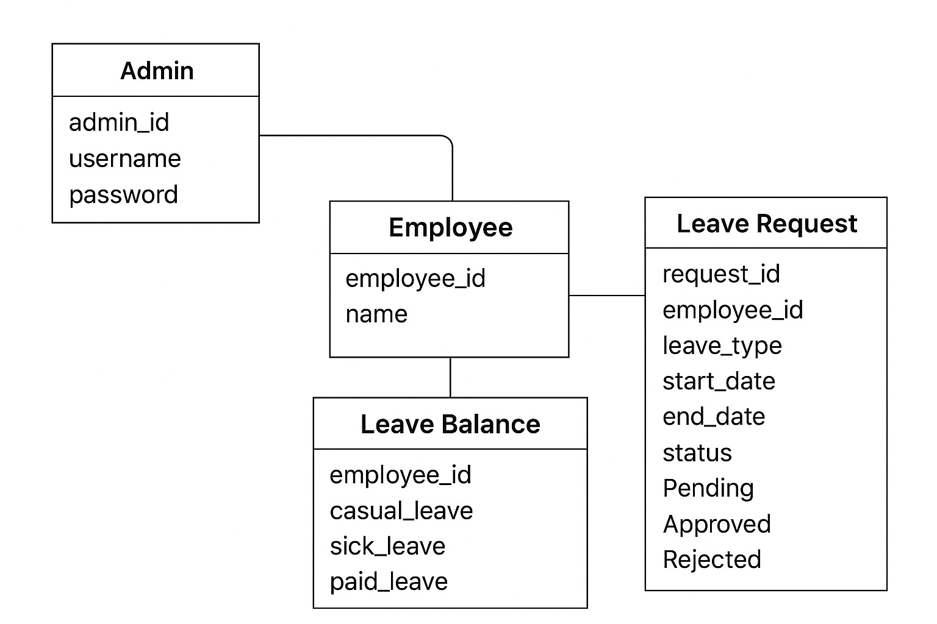
ER Diagram

Slide 9
Project Workflow
User registers/logs in
System identifies role (Admin/Employee)
Employee applies leave → stored in DB
Admin reviews & updates status
Employee tracks leave balance

Slide 10
Technologies Used
Java (Core Java, OOP, Packages)
JDBC
MySQL Database
Eclipse IDE
MySQL Connector JAR

Slide 11
How to Run
Import project in Eclipse
Add MySQL Connector JAR
Create DB using provided SQL script
Update DB credentials
Run MainApp.java

Slide 12
Thank You
Leave Scheduler System

