Slide 1

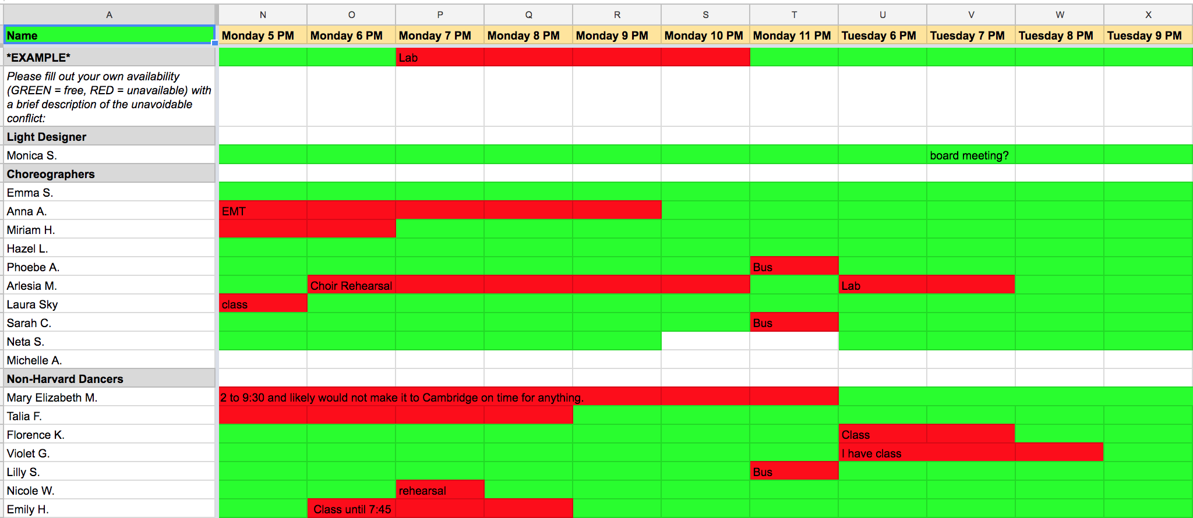
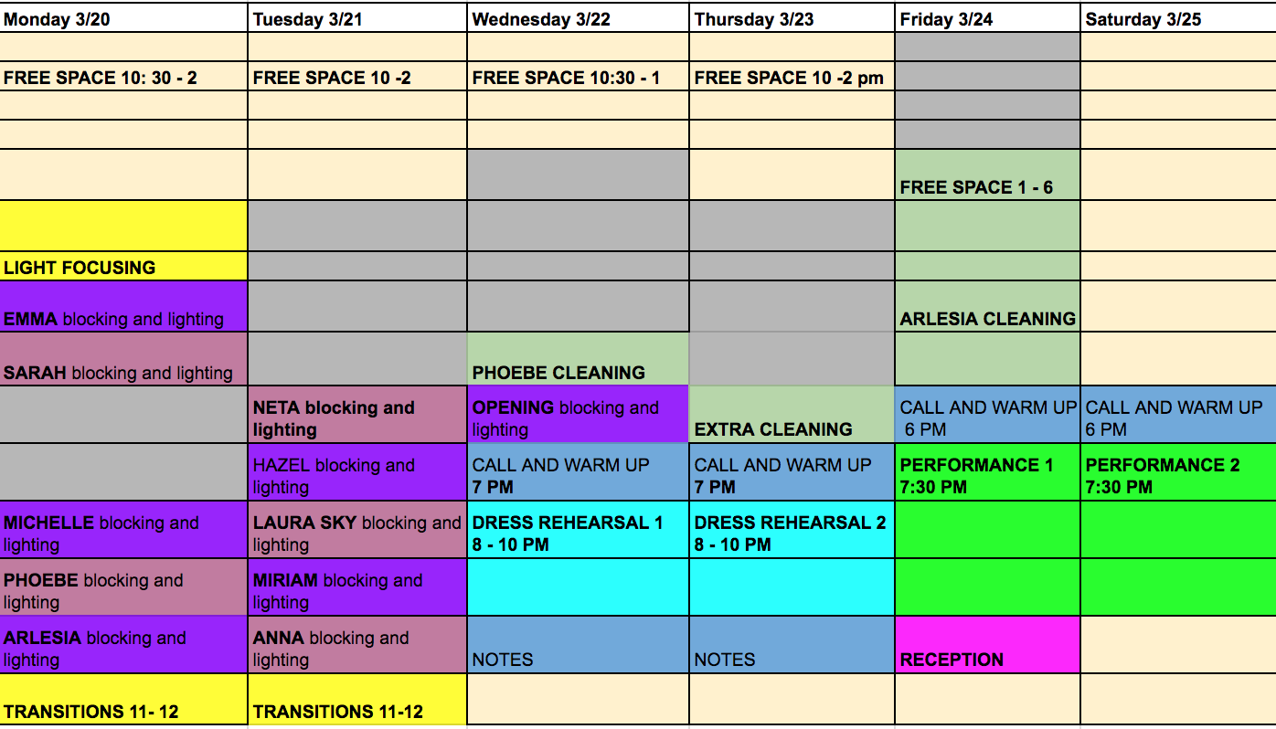
A CSP Rehearsal Scheduler
Monica Song
monicasong@college.harvard.edu
CS182
Fall 2017
INTRODUCTION
In this project, I create a rehearsal scheduler to automate the often tedious process of making a master tech week schedule, which requires working around 20 – 30 different student schedules. My scheduler delivers the optimal solution when possible and if not, utilizes various heuristics and probabilistic methods to approximate the best solution.
Scheduling tech week in the world of dance and theater is a major headache for producers. It requires booking back-to-back rehearsals in the theater space, making the most out of the stage prior to opening night.
The producer of the Harvard Ballet Company has always made the tech week schedule by looking at a spreadsheet of everyone’s availability and then through a method of trial-by-error, figuring out by hand the best time slots that work for the most people. However, one never knows if the final rehearsal schedule is optimal. Inevitably, there are always dancers and musicians who simply cannot make all their scheduled rehearsal times.
blah blah blah
DATA
I had 3 data sets to evaluation my model on, each one containing the dancer availabilities and tech week schedule of a performance by the Harvard Ballet Company:
Oz, Fall 2016
CityScapes, Spring 2017
In Passage, Fall 2017
Figure 2. Dancer availabilities for the week of 3/19 to 3/14 for choreographers and non-Harvard college dancers
CONCLUSION
APPROACH
The automatic CSP scheduler provides many advantages over the traditional method:
Much faster
Find optimal solution
Allows for flexibility
Provides many solutions
Easily customizable
In the future, I would like to implement a GUI for this program so that producers can run the scheduler without needing the code and dancers can enter their availability via a weblink. I would also like to add explore more randomized methods, since DFS can be time-consuming . Overall, I hope my project will be a useful piece of software that the Harvard Ballet Company can use for years to come.
Figure 1. Tech Week schedule from CityScapes (purple = rehearsals, grey = unavailable, blue = dress rehearsal)
I have made an automated tech week rehearsal scheduler that formulates tech week scheduling as a constraint satisfaction problem:
Variables: The hour-long slot of a choreographer’s rehearsal
Domains: The times that the stage is open
Constraints:
  Hard Constraints:
    Choreographer’s availability
  Soft Constraints (that can be relaxed if necessary):
    The dancers in the choreographer’s piece availability
    Non-Harvard college dancers have all their rehearsals scheduled on the same day
To find the best solution, I used:
Depth first search
MRV and LCV heuristic with backtracking
Stochastic gradient descent
To determine the best schedule, for each solution I evaluated its optimality by weighting the constraints it violated.
RESULTS
Dataset | Traditional Method | CSP Solver using DFS
Oz | Violations: 10 Score: 18 | Violations: 4 Score: 6
Cityscapes | Violations: 5 Score: 22 | Violations: 0 Score: 19
In Passage | Violations: 8 Score: 7 | Violations: 2 Score: 1
Note: We aim to minimize the score.
PROJECT RESOURCES
The CSP solver manages to find a much better solution compared to the manual way of creating the schedule. Furthermore, it is able to produce a solution in on average 0.003 seconds (while in my past experience with pen and paper, the process has taken at least 1.5 hours).
Not shown: the heuristic method works very well as well, achieving similar scores as DFS.
Lorterapong P, Ussavadilokrit M. Construction Scheduling Using the Constraint Satisfaction Problem Method. Journal Of Construction Engineering & Management [serial online]. April 2013;139(4):414-422. Available from: Academic Search Premier, Ipswich, MA.
Russell, Stuart; Norvig, Peter. Artificial Intelligence: A Modern Approach. Prentice Hall.

