Slide 1
Arrays vs arraylists, a review
Data Structures + Algorithms
Greenwich Academy
Dr. Monica Ortiz

Slide 2
Overview
Arrays
ArrayLists
A comparison

Slide 3
Arrays

Slide 4
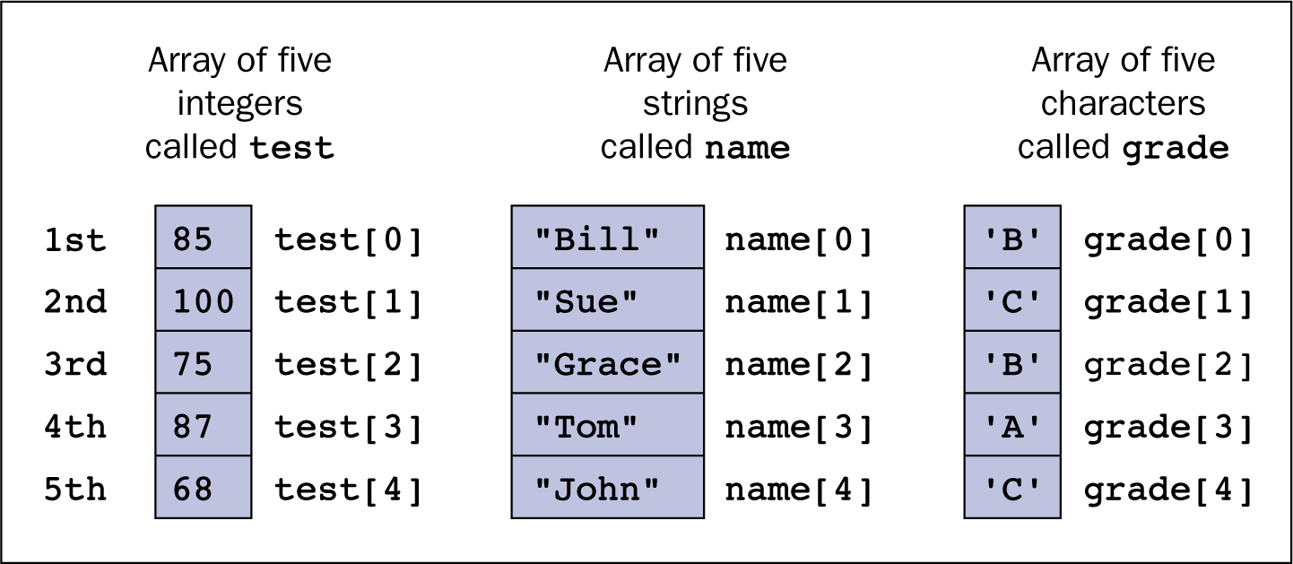
What are arrays?
A data structure represented by a contiguous set of elements in memory
Because of the contiguity, arrays support random-access : any element can be accessed directly without having to first access each previous element

Slide 5
Creating Arrays
Make arrays of any data type, primitive or Object
int[] <name> = new int[<num elements>];
String[] <name> = new String[<num elements>];
You can also make multidimensional arrays easily by adding more brackets
int[][] matrix = new int[<num rows>][<num columns>];
int[][] matrix = new int[<num rows>][]; matrix[0] = new int[<num cols in first row>];

Slide 6
Simple Array Problems
Arrays are data structures that allow us to group similar items together
So, we generally iterate over each item to:
give each item the same treatment
print each item
alter each item in a similar way
perform a collective task on all the elements
calculate an average
filter data in some way

Slide 7
Some useful methods
The Arrays class (must be imported!) contains a number of static methods that might come in handy
Arrays.equals
Tests whether two arrays contain the same values
Arrays.toString
Prints each value of an array to the terminal.
Arrays.deepToString won’t print reference addresses for non-primitive arrays
Arrays.copyOf
Makes a copy of an array into a new array (clones the array, doesn’t alias)

Slide 8
Things to remember…
Arrays are null after declaration (as with all reference types)
Indices start at 0, not 1
off-by-one errors
IndexOutOfBoundExceptions
Can’t resize unless you copy over to a new array

Slide 9
Mini-project: Random numbers and Benford’s Law
To start, generate 1000 random integers, each in the range [100,999].
How often would you expect the hundreds digit to be a 1? a 2? a 9?
Now, go ahead and find the actual proportions in your data set.
How do the proportions depend on the initial size of your dataset?
How we can detect fraud using computer science.

Slide 10
Mini-project: Random numbers and Benford’s Law
Random number generators generally use a uniform distribution
Many processes in reality produce exponential distributions
from Wikipedia.org
How we can detect fraud using computer science.
from Wikipedia.org

Slide 11
Mini-project: Random numbers and Benford’s Law
Turns out that humans tend to use uniform distributions when they make up numbers.
Where is this useful?
macroeconomics
Turns out Greece probably lied in documents they gave to the EU when they joined.
genomics
How large are eukaryotic genomes compared to prokaryotic genomes?
scientific fraud
You can use Benford’s Law to see if scientific studies may be fraudulent
many other areas!
https://testingbenfordslaw.com
How we can detect fraud using computer science.

Slide 12
Mini-project: Random numbers and Benford’s Law
Record numbers, starting with 1, where each number is multiplied by 1.1 to get the next number.
What is the proportion of numbers starting with 1? with 2? with 9?
What might affect these proportions?
multiplication factor?
range of numbers you examine?
Design code and a couple of methods to test these two theories.
How we can detect fraud using computer science.

Slide 13
ArrayLists

Slide 14
What are ArrayLists?
An ArrayList is a data structure that provides more flexibility than arrays
not a fixed size
can add, delete, print elements directly
Like arrays, they are random-access because they contain an array within the ArrayList object itself
Also called an “enhanced array”

Slide 15
Creating ArrayLists
Make arrays of any Object data type
ArrayList<String> list = new ArrayList<String>();
List<String> alsoAList = new ArrayList<String>();
If you want to store primitives, you must use a wrapper class
List<Integer> nums = new ArrayList<Integer>();
List<Double> alsoNums = new ArrayList<Double>();

Slide 16
Some useful methods
add: add a new element to the list
boolean add(Object obj)
boolean add(int index, Object obj)
get: access an element of the list
Object get(int index)
set: replace a specific element of the list
Object set(int index, Object obj)

Slide 17
Some useful methods
remove: delete an element from the list
Object remove(int index)
boolean remove(Object obj) [removes first instance]
size: reports number of elements in list
int size()
indexOf: finds and returns index containing specified element or -1
int indexOf(Object obj)

Slide 18
Mini-project: Write a MyList class
Should implement each of the previously described methods
Is there anything else that would be nice to implement? Bonus features?
Implement the features of ArrayLists in your very own custom class!

Slide 19
Things to remember…
ArrayLists’ size changes when you add or remove something from the list
ArrayLists resize when necessary, generally by increasing the size in groups of 5 to:
take up less memory
not have to resize each and every time there is an addition
Be careful when using the 1-arg remove method with wrapper classes. Must manually wrap those values if using Integers. Otherwise, auto-wrapping will work.

Slide 20
Mini-project: Ranked-choice Voting
Ranked-choice voting is a way of counting ballots that takes into account people’s preferences for a number of candidates instead of one candidate.
There are a few methods, but we will model the single transferable vote method
Who uses this?
Australia (for all elections)
Ireland
Maine
San Francisco, CA; Cambridge, MA
Many other countries and US cities
Standard voting or Ranked-choice voting? Which would you choose?

Slide 21
Mini-project: Ranked-choice Voting
First, let’s model a single ballot
What does it need?
list of names in order of preference
be able to get preferred candidate
delete an eliminated candidate

Slide 22
Mini-project: Ranked-choice Voting
Next, we have to be able to tally all the votes together
Let’s create a TallyVotes class
What does it need?
votes array or List
assemble all the ballots together
run a single round and eliminated loser in all ballots
continue running each round until a majority is reached by a single candidate or there is a tie between only two candidates

Slide 23
Mini-project: Ranked-choice Voting
Finally, let’s run a couple of simulations!
Let’s say that each line of the following represents a voter’s choices, ranked. Use this to create Ballots for each of 8 voters:
A | D | C | B
A | C | B | D
B | D | C | A
C | D | B | A
C | B | A | D
A | C | D | B
D | C | B | A
B | C | A | D

Slide 24
Mini-project: Ranked-choice Voting

Slide 25
Comparing Arrays and ArrayLists

Slide 26
 | Arrays | ArrayLists
Number of elements? | .length (an attribute) | .size() (a method)
Object structure? | A set of contiguous references of a given data type | An object with an array, plus a set of methods to access different information about the array
What can the data structure hold? | Primitives or reference types | Reference types ONLY
How to access index? | Directly by indexing into array | Indirectly using the get method
How to initialize? | Initializer list or indexing into each element | With an array, another list, or add method

Slide 27
Relative efficiency of arrays and ArrayLists
To add an element, which is faster?
”faster” means which should take fewer steps
To remove an element, which is faster?
To locate and return an element, which is faster?
TRICK QUESTION. Because ArrayLists contain arrays, they are bound by the same processing steps. Therefore, they are equivalent for most processes.

