Slide 1
RECURSION
Data Structures + Algorithms
Greenwich Academy
Dr. Monica Ortiz

Slide 2
Overview
What are recursive algorithms?
What are they good for?
Practice
Project: infix and postfix notation calculator

Slide 3
What is a recursive algorithm?

Slide 4
What is recursion?
self-recursive method
A recursive process is one that repeats in a self-similar way.
Could be:
self-recursive
mutually recursive
method 1
method 2

Slide 5
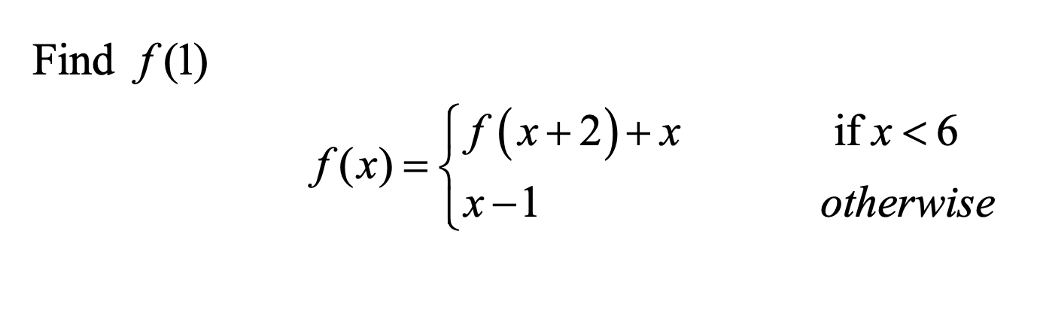
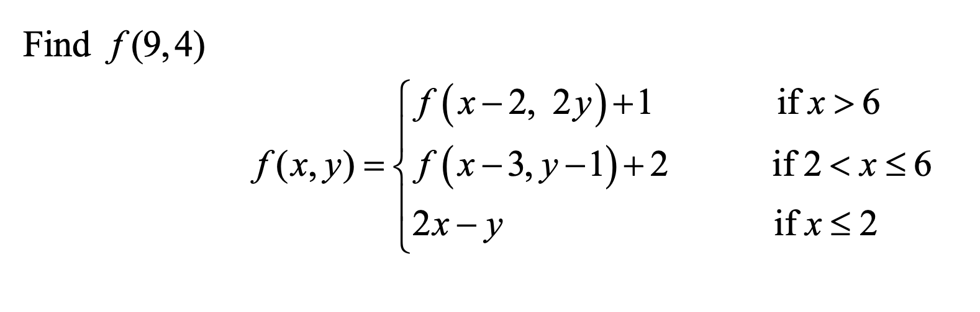
We’ve already done this though!
Think about the math problems we’ve done with ACSL

Slide 6
How would we code this?
public static int foo(int x){
if(x < 6){
return foo(x+2) + x;
}
else{
return x-1;
}
}

Slide 7
How about this one?
public static int foo(int x, int y){
if(x > 6){
return foo(x-2,2*y) + 1;
}
else if (x > 2 && x <= 6){
return foo(x-3, y-1) + 2;
}
else if (x <= 2){
return 2*x – y;
}
}
Notes:
Translate directly from the mathematical form.

Slide 8
Now, figure out how to code these iteratively (i.e., with a loop)
Notes:
What is hard about doing this?

Slide 9
SO, what is recursion good for?
Some problems lend themselves well to recursion
When you can break a problem into a smaller, similar problem
When it isn’t immediately clear what the next step (or value) will be
There is a sense that all will work out if there is guaranteed to be an end and if you have self-contained the next steps
don’t forget the base case

Slide 10
practice problems

Slide 11
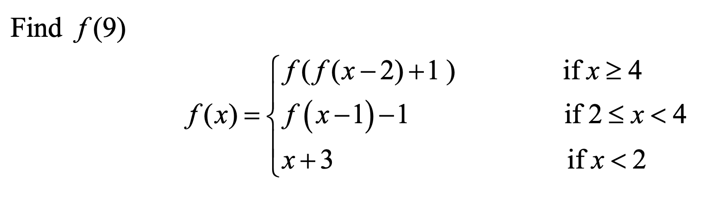
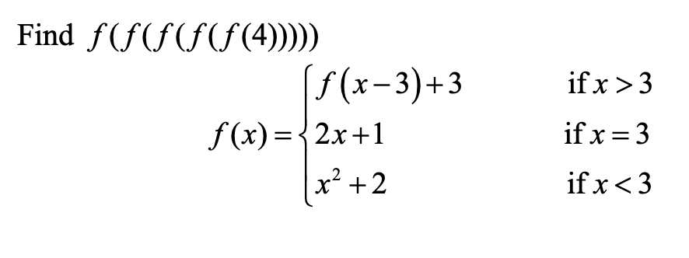
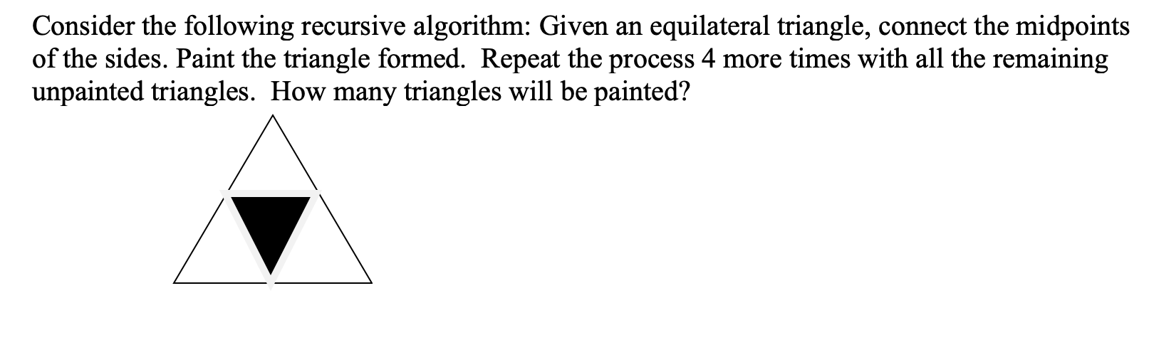
Mathematical recursion
Write functions to mimic the following mathematical functions

Slide 12
Towers of Hanoi
Objective:
move the tower from the left side to the right side
Rules:
you can move only one ring at a time
you cannot move a ring that is larger on top of a ring that is smaller
What is the base case?
What is the recursive step(s)?
(cue: “ugh.”)

Slide 13
Directory Crawler
public static void directoryCrawl(File f, int indentLevel)
Some useful File methods:
.isDirectory(): returns true if it’s a folder instead of a file
listFiles(): returns the contents of a directory in an array with inner files and/or directories as the elements
getName(): returns the name of a file (no contents)
Let’s print out all files within a directory…and files within any directories that exist within that directory…and any files within any directories that exist within that directory…

Slide 14
Evaluating prefix and postfix expressions
Here you will be writing two methods that take in a String and output an integer
public static int evalPrefix(String in)
public static int evalPostfix(String in)
To start, take each of the expressions below and, with a partner, think about the steps you take in evaluating each expression
prefix: ^ + * 2 4 / 8 4 2
postfix: 2 4 * 8 4 / + 2 ^
Prefix => operator goes before the operands
Postfix => operator goes after the operands

Slide 15
Evaluating prefix and postfix expressions
What is the repeated step that you perform to evaluate the expression?
What is the immediate next step?
When do you know you’re done?
Prefix => operator goes before the operands
Postfix => operator goes after the operands

Slide 16
Evaluating prefix and postfix expressions
What is the pattern that you are looking for?
prefix: operator, operand, operand
postfix: operand, operand, operator
Pattern and Matcher classes will be of use!
both found in java.regex package
Pattern: Pattern.compile(<reg exp>)
Matcher: p.matcher(String input)
Prefix => operator goes before the operands
Postfix => operator goes after the operands

Slide 17
Evaluating prefix and postfix expressions
For prefix, we are looking for the first instance of two numbers preceded by a space
“ [0-9]+ [0-9]+”
For postfix, we are looking for the last instance of two numbers succeeded by a space
“[0-9]+ [0-9]+ ”
Once you have identified the pattern, then you can search for the pattern through the input String and peruse the matches
Pattern p = Pattern.compile(regex);
Matcher m = p.matcher(equation);
Prefix => operator goes before the operands
Postfix => operator goes after the operands

Slide 18
Evaluating prefix and postfix expressions
for prefix, we want the first match
if(m.find()){
// get first match int startInd = m.start(0);
int endInd = m.end(0);
// etc, etc, etc
}
Let’s think through the pseudocode

Slide 19
Evaluating prefix and postfix expressions
for postfix, we want the last match, so have to use a while loop and exit only when you have found the last match
while (m.find()){
startInd = m.start();
endInd = m.end() + 1;
}
Let’s think through the pseudocode

Slide 20
SUMMARY

Slide 21
Why use recursion?
Recursion can simplify algorithms by zeroing in on the immediate next step only. It is often easier to see how something works and accomplish something in fewer lines of code than an iterative parallel.

