Slide 1
Java
Training

Slide 2
Project -1
Java-JDBC-MySQL
A movie review application allows users to review and rate movies.
The movies could be an existing movie in the application or they may add a new movie.
The application also allows them to browse and search for movies so that they view the reviews of the same.
Menu driven
Database (MySQL)
11:
Sunil Kumar
Raju Roy
Aman Mittal
Manan Garg
Rupal Goyal
Ramavatar Kaswan
Harsh Singh
Bhawesh
Rajeev Ranjan
Akash Kumar
B Dhanush Prabhu

Slide 3
Project
Artifacts:
● Movie - A Movie consists of the following information
○ Title – Up to 100 Characters
○ Summary – Up to 500 Characters
○ Cast - List of Names each upto 50 Characters
○ Genre - List of Tags each upto 20 Characters.
● Review - A textual review of a movie, up to 500 Characters.
Rating - A numbered rating between 1-5, both inclusive.
● User – Registered users for giving review
○ ID
○ Name
○ Email-id

Slide 4
Project
Functional Requirements:
1. User: Any person can add a new movie entry.
2. User: Any person can edit an existing movie entry.
3. User: Any person can add a review to a movie.
4. User: Any person can rate a movie.
5. Any person can view a list of movies from a genre.
6. Any person can view a list of top 10 movies overall or from a genre.
7. Any person can search for a movie by name or/and by genre.
8. Any person can view details of a movie, see its summary, cast, genre, reviews.

Slide 5
Tables
Create table movie (movie_id INT Auto_increment NOT NULL Primary Key, movie_name varchar(100) Not Null, Summary varchar(500), cast varchar(200), Genre varchar(200), Average_rating float, user_id int, FOREIGN KEY (user_id) REFERENCES users(user_id) );
Create table review (review_id INT Auto_increment NOT NULL Primary Key, movie_id int not Null, Review varchar(500), user_id int, FOREIGN KEY (user_id) REFERENCES users(user_id) )
Create table rating (rating_id INT Auto_increment NOT NULL Primary Key, movie_id int not Null, Rating int , user_id int, FOREIGN KEY (user_id) REFERENCES users(user_id))
Create table users(user_id int Auto_increment NOT NULL Primary Key, user_name varchar(100) Not Null, email_id varchar(100) Not Null Unique )

Slide 6
Future of The Project – 1 is:

Slide 7
Project-2
Compiler: replicate kind of Javac
>java myJavac anyfile.java
This generates anyfile.clas
(Simulate the real type bytecodes)

Slide 8
Project - 3
Java-JDBC-MySQL
Employee Management System (You are using currently):
Replicate the same in Menu driven architecture.
Login
Leave
Sal
Tax
Apply for trainings
Skills
Inter project Transfer
Referrals
Code of conduct
HR Calls
Info Messages
…
2:
Shreeram Goyal
Lakshya Upadhyay

Slide 9
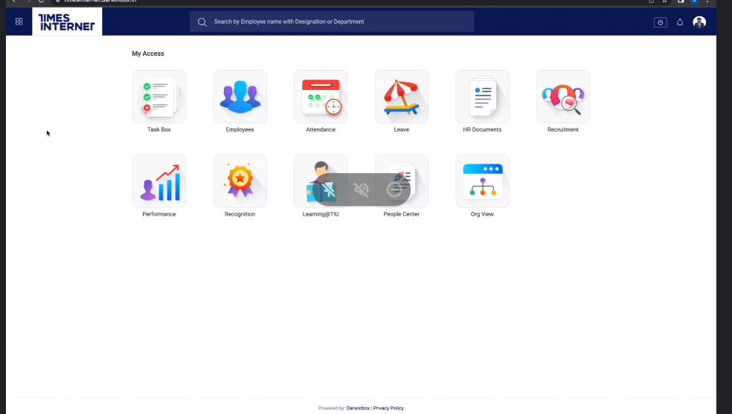
Module Names

Slide 10
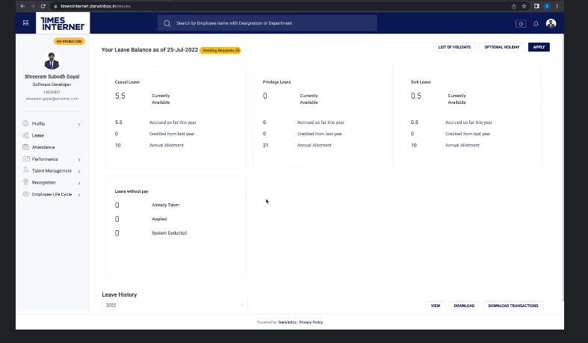
Sub menu for each module

Slide 11
Thank You
End of Projects

