Slide 1
AI-Powered Customer Support System
Project Presentation

Slide 2
Project Overview
This project builds an intelligent AI system that can automatically understand and respond to customer queries. It uses Natural Language Processing and transformer models to detect user intent, analyze sentiment, retrieve relevant knowledge, and generate helpful responses.

Slide 3
Objectives
• Automate customer support responses
• Understand customer intent from text queries
• Detect customer sentiment (emotion)
• Retrieve relevant knowledge using vector search
• Generate AI-based responses for users

Slide 4
Dataset
Dataset: Zendesk Customer Support Dataset
Total records: ~50,000
Sample used: 25,000
Key columns: query, intent, sentiment, product_group, plan, priority

Slide 5
Data Preprocessing
• Selected relevant columns
• Renamed query column to text
• Filtered important intents and sentiments
• Text cleaning (lowercase, remove symbols)
• Saved cleaned dataset for model training

Slide 6
Exploratory Data Analysis
EDA was performed to understand customer data.
Visualizations created:
• Sentiment distribution
• Intent distribution
• Intent vs Sentiment
• Query length distribution

Slide 7
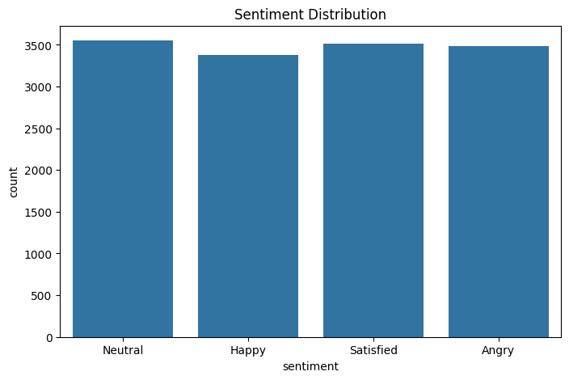
EDA –sentiment distribution

Slide 8
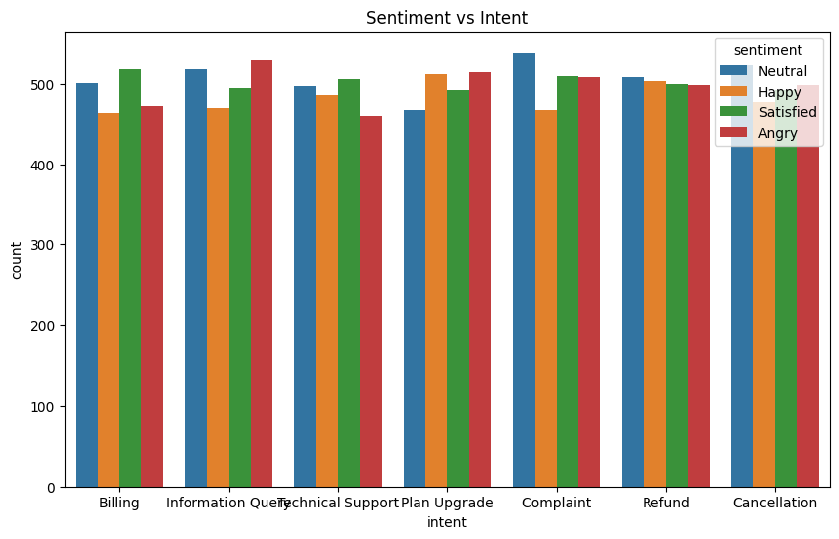
Sentiment vs intent

Slide 9
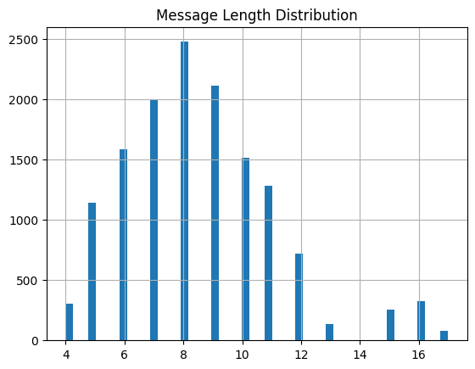
Message length distribution

Slide 10
Intent Classification Model
Model Used: DistilBERT (HuggingFace Transformers)
Purpose: Identify the type of customer request.
Examples:
• Billing issue
• Technical support
• Refund request
• Plan upgrade
• Cancellation

Slide 11
Sentiment Analysis
Sentiment model detects the customer's emotional state.
Classes:
• Angry
• Neutral
• Happy
• Satisfied
This helps prioritize urgent or negative customer issues.

Slide 12
Vector Database & Retrieval
FAISS vector database is used to store support documents.
Sentence Transformers convert text into embeddings.
System retrieves the most relevant support information
based on semantic similarity.

Slide 13
Response Generation
The system uses GPT‑2 to generate responses.
Steps:
1. User query processed
2. Relevant document retrieved
3. Context passed to GPT‑2
4. AI generates final response

Slide 14
Training output
Epoch | Training Loss | Validation Loss | Accuracy
1 | 0.000894 | 0.000547 | 1.000000
2 | 0.000289 | 0.000173 | 1.000000
3 | 0.000190 | 0.000116 | 1.000000

Slide 15
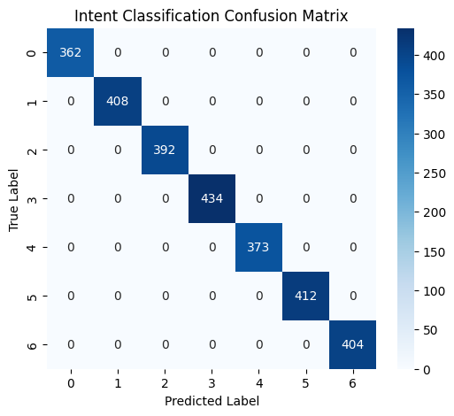
Intent classification confusion matrix

Slide 16
System Output
User Query: 'I want to cancel my subscription'
Predicted Intent: Cancellation
Sentiment: Neutral
AI Response: Instructions to cancel subscription
User Query: 'My internet is not working'
Intent: Technical Support
Sentiment: Angry
AI Response: Troubleshooting steps

Slide 17
Project Architecture
User Query → Text Processing → Intent Classification → Sentiment Analysis → Vector Embedding → FAISS Search → Knowledge Retrieval → GPT‑2 Response → Streamlit Interface

Slide 18
Conclusion
The project demonstrates how NLP, transformer models, vector databases, and generative AI can be combined to build an intelligent automated customer support assistant. The system improves response efficiency and reduces manual support workload.

