Slide 1
Driver Drowsiness Detection using Deep Learning
* AI-Based Driver Fatigue Monitoring System
Using CNN and MobileNetV2

Slide 2
Introduction
Driver fatigue is a major cause of road accidents worldwide.
When drivers become sleepy, their reaction time decreases.
AI and computer vision can detect fatigue automatically.

Slide 3
Problem Statement
Many accidents occur due to sleepy drivers.
Traditional monitoring systems are not always reliable.
This project develops an automated deep learning system to detect drowsiness.

Slide 4
Project Objectives
Detect driver drowsiness using deep learning.
Analyze eye closure and yawning patterns.
Classify driver state using facial images.
Improve driver safety using AI monitoring.

Slide 5
Dataset Description
The dataset contains driver facial images.
Four classes are used for classification:
• Open (Eyes open)
• Closed (Eyes closed)
• Yawn
• No_yawn

Slide 6
Data Preprocessing
Images resized to 224x224.
Normalization applied.
Data augmentation techniques used:
Rotation, Zoom, Flipping, Brightness adjustments.

Slide 7
Deep Learning Model
Two models used:
1. CNN (Convolutional Neural Network)
2. MobileNetV2 Transfer Learning
MobileNetV2 improves accuracy and reduces training time.

Slide 8
CNN Architecture
Convolution Layers extract image features.
Pooling layers reduce dimensionality.
Fully connected layers perform classification.
Dropout reduces overfitting.

Slide 9
Transfer Learning - MobileNetV2
MobileNetV2 is a pretrained deep learning model.
It was trained on ImageNet dataset.
We reuse learned features for driver fatigue detection.

Slide 10
System Architecture
Input Image → Preprocessing → CNN / MobileNetV2 Feature Extraction → Dense Layers → Driver State Prediction

Slide 11
Model Training
Optimizer: Adam
Loss Function: Categorical Crossentropy
Batch Size: 32
Image Size: 224x224

Slide 12
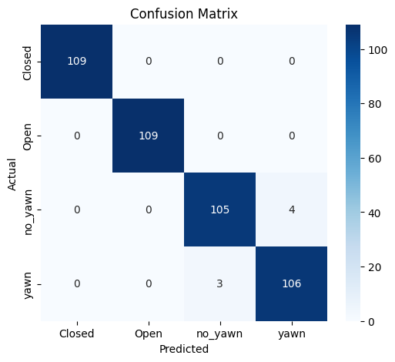
Confusion matrix

Slide 13
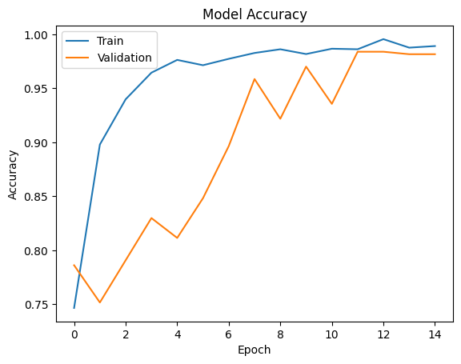
Model Graph
Training and validation accuracy during model training.

Slide 14
Results
Class | Precision | Recall | F1-Score | Support
Closed | 1.00 | 1.00 | 1.00 | 109
Open | 1.00 | 1.00 | 1.00 | 109
No_yawn | 0.97 | 0.96 | 0.97 | 109
Yawn | 0.96 | 0.97 | 0.97 | 109
Accuracy |  |  | 0.98 | 436
Macro Avg | 0.98 | 0.98 | 0.98 | 436
Weighted Avg | 0.98 | 0.98 | 0.98 | 436

Slide 15
Streamlit Dashboard
A Streamlit dashboard was developed for visualization.
It allows users to upload driver images.
The model predicts driver state instantly.
The dashboard also shows graphs and prediction results.

Slide 16
Conclusion
Key achievements:
Built CNN and MobileNetV2 models
Achieved high prediction accuracy
Implemented fatigue detection based on facial features
Can be integrated into real-time vehicle safety systems

