Slide 1

Presentation On Peer-to-Peer Protocol
INDIAN INSTITUTE OF TECHNOLOGY ROORKEEROORKEE – 247667
Submitted to: Submitted by:
Dr. P Sateesh Kumar Alamjot Singh (18535002)
Assistant Professor Anjana KK (18535005)
Dept. of CSE Ashish Mahawal (18535008)
IIT Roorkee L Rahul Kiran (18535015)
Monica Jangpangi (18535018)

Slide 2
Content
Introduction
Peer to peer paradigm
Gnutella protocol
Implementation
Local Node Architecture
P2P Communication Using HTTP
Working
Future Aspects

Slide 3
INTRODUCTION
Peer-to-peer (p2p) systems are the ordinary PC-users that have something valuable to share.
Each node in a Peer-to-Peer network acts as both a client and server.
Nodes are called “Servents”.
It may be network capacity, CPU-cycles or storing capacity.
These p2p nodes could locate other nodes, share files, and take part in distributed computing.
Communication is done with the help of five message types: PING, PONG, QUERY, QUERYHIT, PUSH.

Slide 4
Peer to peer paradigm
P2p majorly can be distilled into three concepts:
decentralization, self-organization and resource-sharing.
The locality and connectivity of the nodes.
Results in two sets of p2p criteria for classifying protocols and applications.
One emphasizes locality and connectivity of the nodes which does not consider the direct communication between nodes to be a constituting feature of the concept of p2p. The other gives prominence to decentralization, self-organization and direct communication between nodes.

Slide 5
Gnutella protocol
All nodes have routing function. ping and query messages are used to register and search the nodes in the network respectively replies with pong or query hit message respectively through the same nodes those forwarded from source node.
In order to avoid traffic in network, modern Gnutella protocol forwards the ping messages to the nodes that do not have addresses in pong cache.

Slide 6
Implementation
Elements of the Local P2P node.
A P2P node consists of 3 structural entities:
1)The Node
2)The Command-line user Interface.
3)Data structures to store information about files, messages and peers.
Command-line user Interface – Using various python libraries and act as a user-interface.
Data Structures – Two Data Structure used :-
1) - File repository
2) - Peer table
Node - Node receive messages from both the network and the user interface. Act both as client, server and route various messages to another node.

Slide 7
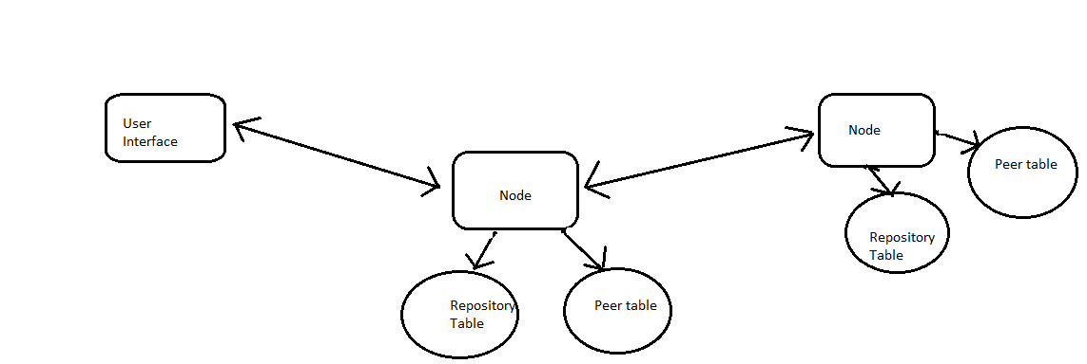
LOCAL NODE ARCHITECTURE

Slide 8

P2P Communication using HTTP

Slide 9
WORKING
Our node is implemented using sockets in python. A socket is one endpoint of a two-way communication link between two programs running on the network. A socket is bound to a port number.
We start our gnutella network by starting a primary node, we will call it node A. We then start user interface and another node which we will call node B. We then connect both user interface and node B to node A.

Slide 10
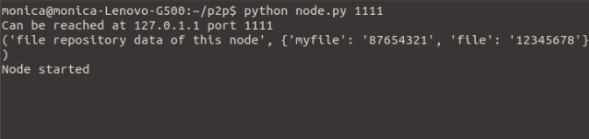
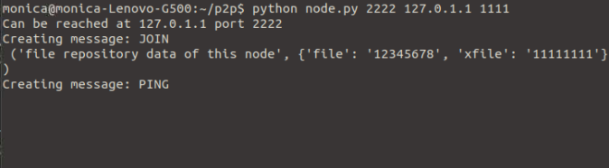
Screenshots

Slide 11
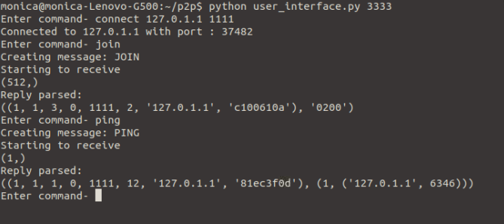
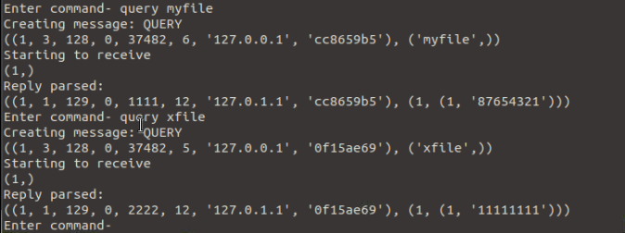

Slide 12
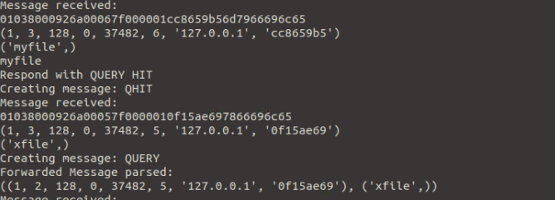
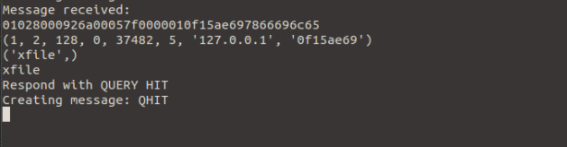

Slide 13
Future Aspects
Since the user interface can connect to any node if it knows the address and port number of the node interface, the user interface can be used to send requests and download files without uploading anything. This is similar to the working of a web-based system.
In Future they are working on developing a web-based node, which uses HTTP as the communication protocol between P2P nodes.

