Slide 1
Emotion-based Classification of Music using Lyrics and Audio
Domain : Machine Learning
PROJECT GUIDE : Mrs.R.L.Jasmine
CO – GUIDE : Dr.R.Geetha Ramani
Monica Jawahar (2017115619) B.Tech IT – 8th Semester

Slide 2
Introduction
Music, as one of the main carriers of people’s emotion, communication and information sharing, has been greatly improved in transmission speed and the field.
Music is also processed by the lower, sensory levels of the brain, making it impervious to later memory distortions.
Music Emotion Recognition(MER) and Music Information Retrieval (MIR) are challenging fields of study addressed in musicology, cognitive science, etc.
Deeper analyses of music feature and emotions can help people psychologically.
Perhaps songs, lyrics and chords are their own forms of saying hello, goodbye, or to presumably reinforce the unsilent silence we wish others could understand.

Slide 3
Key components of music
Lyrics and Audio
Lyric features can be extracted from text data using NLP while audio features can be extracted from audio data using various tools.
Moreover, users’ emotional responses to music change from person to person as music’s nature is complex.
In the music industry, the demands for music retrieval attract lots
of people to explore.

Slide 4
Problem Definition
With the development of audio recognition and research, attention has been paid to the field of music classification
To classify emotions of music, most papers have used either audio or lyrics feature.
Music has lyrics and audio. These components has features for music emotion classification.
There is no proper emotion detection model to label the musical tracks into different emotions based on both audio and lyrics efficiently.
Mostly only the classification models are changed to achieve better accuracy and result.

Slide 5
Literature Survey
TITLE | AUTHORS | PUBLICATION DETAILS | PROBLEM ADDRESSED | METHODOLOGIES | PROS | CONS | FUTURE WORK
Novel audio features for music emotion recognition | Renato Panda, Ricardo Malheiro and Rui Pedro Paiva | IEEE, Transactions on affective computing, Conference paper, 2018 | Advancing the state of the art by proposing novel emotionally relevant audio features. | SVM Accuracy- 76.4% | 1) Novel features in audio increased accuracy by 9% 2)The best result was obtained with 29 novel features and 71 baseline features. | 1) SVM methods don’t provide classification on how musical features influence emotion. | Better algorithms and models can be used to analyse audio and classify music with more accuracy.
Research on Music Emotion Classification Based on Lyrics and Audio | Wanglei Shi, Shuang Feng | IEEE, 3rd IAEAC Conference 2018 | The combination of multiple classification methods can give higher accuracy | Audio- LFSM (BP neural network) Accuracy- 88.70% | Combination of different types of emotion recognition methods provides a new idea. | 1)Only one classification method is used for each feature | Improving accuracy by exploring different models.

Slide 6
TITLE | AUTHORS | PUBLICATION DETAILS | PROBLEM ADDRESSED | METHODOLOGIES | PROS | CONS | FUTURE WORKS
Audio-based deep music emotion recognition | Tong Liu, Li Han, Liangkai Ma, and Dongwei Guo | AIP Conference Proceedings 2018 | The experiment conducted to outperform traditional machine learning methods with CNN. | SVM CNN Using Spectrogram Accuracy-72.4% | CNN and SVM are used to compare accuracy of both methods. | Due to high computational complexity of deep learning, values are not optimal. | Emotion labels of all the clips of the song can be used to improve accuracy
Music Emotions Recognition Based on (audio) Feature Analysis | C. Lv, S. Li and L. Huang | IEEE conference paper, CISP-BMEI - 2018 | Features from audio files are extracted to classify emotions with AV model | SVM CNN (with Vector Space Model) Accuracy-88.2% | Used Spectrogram, MFCC, Chirplet and combination of above mentioned | 1)Spectrogram images weren’t easy to analyse. | The accuracy of the model can be improved

Slide 7
TITLE | AUTHORS | PUBLICATION DETAILS | PROBLEM ADDRESSED | METHODOLOGIES | PROS | CONS | FUTURE WORKS
Music Emotion Classification based on Lyrics-Audio using Corpus based Emotion | Fika Hastarita Rachman, Riyanarto Sarno, Chastine Fatichah | International Journal of Electrical and Computer Engineering (IJECE), 2018 | Combination of audio and lyrics features are used to classify emotions with help of corpus | Extract: MIR Toolbox and Psysound Model: SVM Random forest method* Naive bayes method Accuracy-56.8% | 1)12 features used- 11 audio+1 lyrics 2)Uses corpus based classification | Results of lyric features are worse than the ones with audio feature | Improving accuracy by exploring different models.

Slide 8
Limitations
No well-developed emotion model for emotion description of both audio and lyrics.
Most of the projects/paper change the classification model for higher accuracy and better results while not preprocessing methods or features.
Users’ emotional responses to music change from person to person as music’s nature is complex.
Artificial labeling based on musical emotion requires high cost and lot of time consumption

Slide 9
Novelty
Two-level classification system based on music genre and music feature by
a) Audio
b) Lyrics
Various preprocessing methods will be used to classify emotions with various methods to achieve better accuracy and results.
Used valence-arousal value to classify emotions, not manual or artificial labelling of emotions

Slide 10
Motivation
In the music industry, the demands for music retrieval attract lots
of people to explore.
Unlike video or image processing, there are fewer significant music features with strong link to the emotion perception.
Moreover, users’ emotional responses to music change from person to person as music’s nature is complex.

Slide 11
Objective
The main objective of this project is to build a better model for Music Emotion Recognition(MER) using both lyrics and audio data.
Compare various preprocessing methods, feature engineering technique and apply various classification models to lyrics and audio data.
Compare various features of lyrics and audio data then apply different classification model.
To classify the music into 4 classes of emotion based on Russell’s V-A model:
Sad
Angry
Happy
Relaxed/ Calm

Slide 12
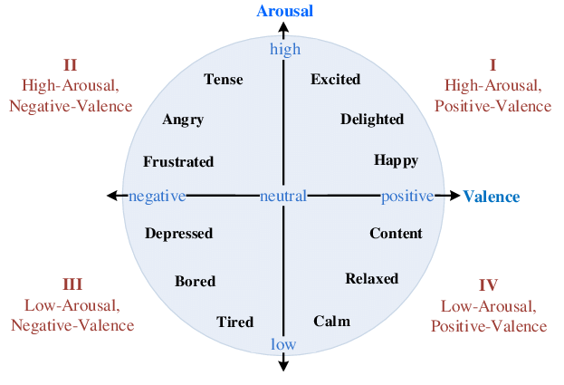
Russell's VA Model

Slide 13
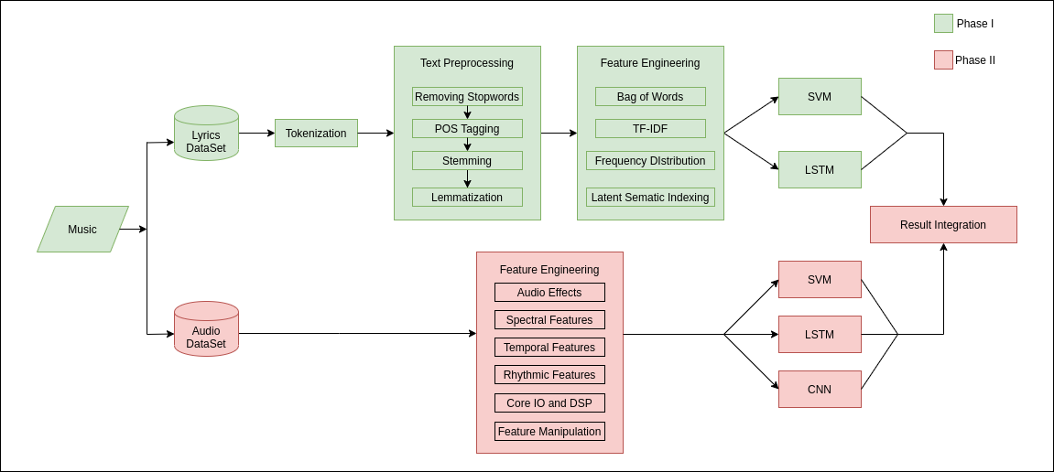
Architecture Diagram

Slide 14
Challenges Faced
Construction and collection of data set
Audio has a lot of copyright issues so we had to mail many authors of papers for which we didn’t receive any response. Later, used various legal sites to get audio but got various parts of the audio where our accuracy and results weren’t great. Finally, using in-built python API and libraries, we fetched all audios.
Deciding which features to use, feature engineering and classification model to use
Among the plenty of technics and models, we had to choose the ones which gives us maximum accuracy and better results without using the same methods from paper.

Slide 15
Project Flow For Phase II
Obtain Audio Dataset :
Using Deezer API and librosa
Features to be extracted :
Audio Effects
Spectral features
Temporal features
Rhythmic features
Core IO and DSP
Feature Manipulation
Models used:
SVM
LSTM
CNN

Slide 16
Web Scraping Module
In this approach, the initial data set was taken from https://github.com/deezer/deezer\_mood\_detection\_dataset.
Input: Deezer ID of the song as mentioned in excel.
Process: a API query will be created as a request and the audio will be scrapped from the response.
Output: Audio of the song stored in the separate file.

Slide 17
Code Snippet
for rowNumber in range(1,10247):
deezer = str(ws.cell(row=rowNumber,column=1).value)
deezer = str(int(float(deezer)))
URL = "https://api.deezer.com/track/"+deezer
r = requests.get(url = URL)
te = r.json()
mp3 = te['preview']
if(mp3!=""):
r = requests.get(mp3)
filename = deezer+".mp3"
path = 'path'+filename
with open(path,'wb') as f:
f.write(r.content)

Slide 18
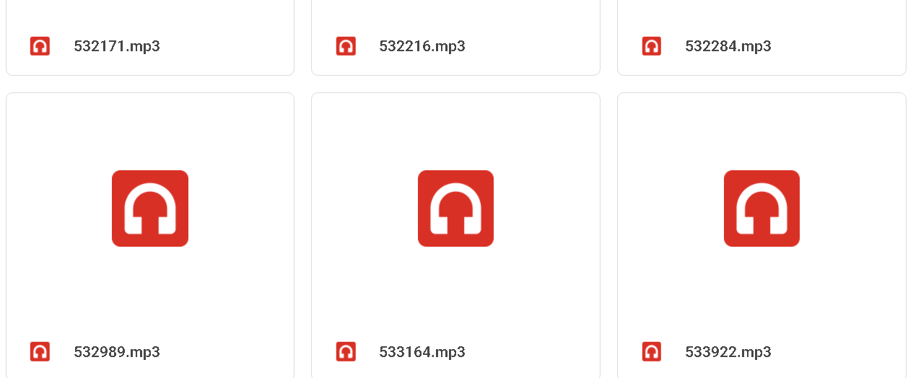
Output of web scraping

Slide 19
Visualization of audio data
Spectrogram
MFCC
Melspectrogram
Frequency Domain
Band Energy Ratio (BER)
Spectral bandwidth
Spectral Centroid
Time domain
Zero Cross Rate (ZCR)
Root Mean Square (RMS)

Slide 20
Feature Extraction Module
The data provided of audio cannot be understood by the models directly.
So, to convert them into an understandable format feature extraction is used.
Feature extraction is required for classification and prediction algorithms.

Slide 21
Audio Effects
Feature Manipulation
Harmonic | The simultaneous combination of notes and the ensuing relationships of intervals and chords.
Percussive | The sounds we perceive when 2 objects are colliding without same pitch
MFCC Delta | The dynamics of the power spectrum is the trajectory of MFCC over time Where delta feature does local estimate of the derivative of the input data along the selected axis.

Slide 22
Rhythmic features
Temporal features
Tempo | The rate of speed or pace of the musical pulse. (grave, largo, adagio, andante, allegro, vivace) which is beats per minute.
Beats | Regular pulsation; a basic unit of length in musical time.
Root Mean Square | Used to characterize the “average” of continuous varying signals such as audio, electrical signals, sound, etc kind of continuous signal
Zero Crossing Rate | The rate of sign-changes of the signal during the duration of a particular frame.

Slide 23
Core IO and DSP
Spectral features
Frames | Converts frame counts to time (seconds). The result depends on the value of the fps attribute or parameter.
Chroma short term fourier transform | A fourier-related transform used to determine the sinusoidal freq and phase content of local sections of a signal as it changes over time.
Chroma Chroma Energy Normalized | CENS is that taking statistics over large windows smooths local deviations in tempo, circulation and musical ornaments such as trills and arpeggiated chords.
Chroma Constant-Q chromagram | Unlike stft but similar to mel scale the cqt uses a log spaced freq axis

Slide 24
Melspectrogram | A spectrogram with mel scale as its y scale. The result of some non-linear transformation of freq scale
MFCC | Mel freq cepstral coefficient of signal are a small set of features (10-12) which concisely describe the overall shape of a spectral envelope
Poly Features | The simultaneous use of several rhythmic patterns or meters. Get coefficients of fitting an nth-order polynomial to the columns of a spectrogram.
Tonnetz | This representation uses the method of 1 to project chroma features onto a 6-dimensional basis representing the perfect fifth, minor third, and major third each as two-dimensional coordinates.

Slide 25
Spectral bandwidth | The width of the band of light at one-half the peak maximum or full width at half max (FWHM)
Spectral rolloff | The frequency below which 90% of the magnitude distribution of the spectrum is concentrated.
Spectral contrast | Information on spectral peak, valley and difference over time, per frequency subband encoded in this.
Spectral centroid | The centre of gravity of the spectrum.

Slide 26
Code snippet
tempo, beats = librosa.beat.beat_track(y=y, sr=sr)
chroma_stft = librosa.feature.chroma_stft(y=y, sr=sr)
chroma_cq = librosa.feature.chroma_cqt(y=y, sr=sr)
chroma_cens = librosa.feature.chroma_cens(y=y, sr=sr)
melspectrogram = librosa.feature.melspectrogram(y=y, sr=sr)
rms = librosa.feature.rms(y=y)
cent = librosa.feature.spectral_centroid(y=y, sr=sr)
spec_bw = librosa.feature.spectral_bandwidth(y=y, sr=sr)

Slide 27
contrast = librosa.feature.spectral_contrast(S=S, sr=sr)
rolloff = librosa.feature.spectral_rolloff(y=y, sr=sr)
poly_features = librosa.feature.poly_features(S=S, sr=sr)
tonnetz = librosa.feature.tonnetz(y=y, sr=sr)
zcr = librosa.feature.zero_crossing_rate(y)
harmonic = librosa.effects.harmonic(y)
percussive = librosa.effects.percussive(y)
mfcc = librosa.feature.mfcc(y=y, sr=sr)
mfcc_delta = librosa.feature.delta(mfcc)
onset_frames = librosa.onset.onset_detect(y=y, sr=sr)
frames_to_time = librosa.frames_to_time(onset_frames[:20], sr=sr)

Slide 28
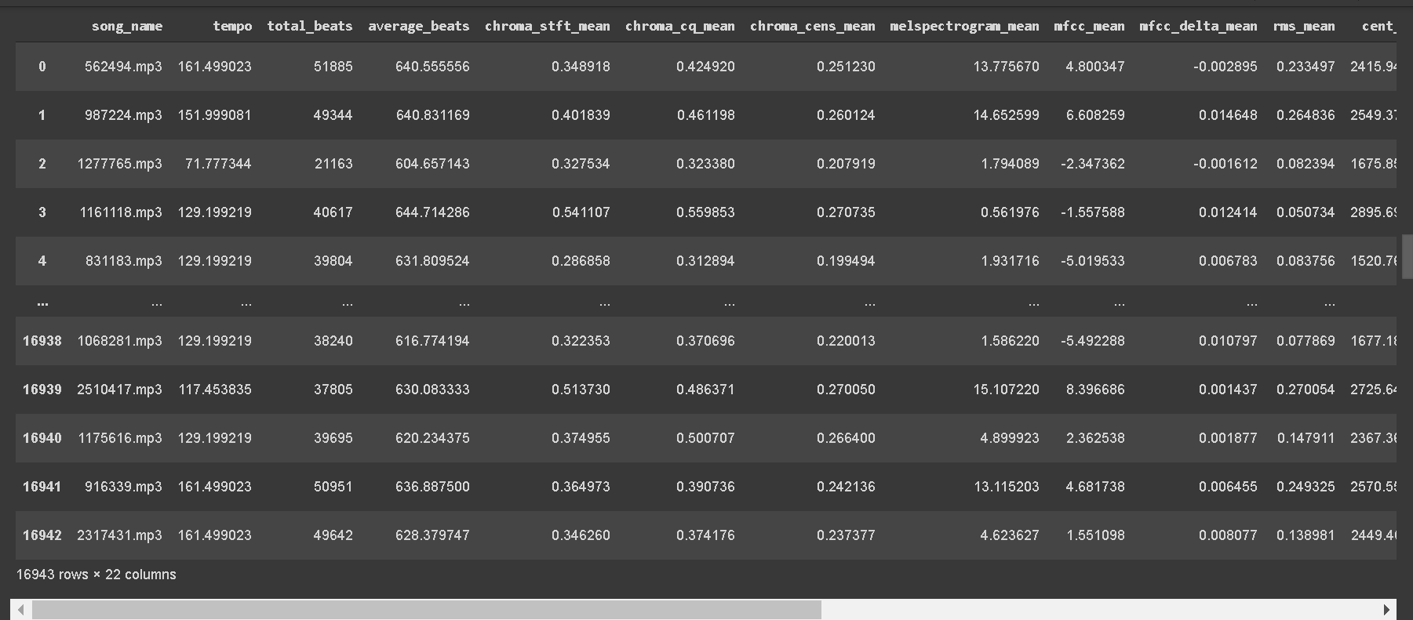
Output of feature engineering

Slide 29
Classification Models Module
In training and testing algorithm, we have used algorithms like SVM, LSTM and CNN.
The classifier produces a trained model with the help of feature vectors and training labels.
Using the trained model, the test feature vectors are classified and the accuracy is calculated.

Slide 30
Code snippet of SVM
from sklearn.model_selection import train_test_split
X_train= df.iloc[:,0:20]
Y_train = df.iloc[:,20:21].values
from sklearn.svm import SVC
classifier = SVC(kernel='rbf', random_state = 1)
classifier.fit(X_train,Y_train.ravel())
Y_pred = classifier.predict(X_train)

Slide 31
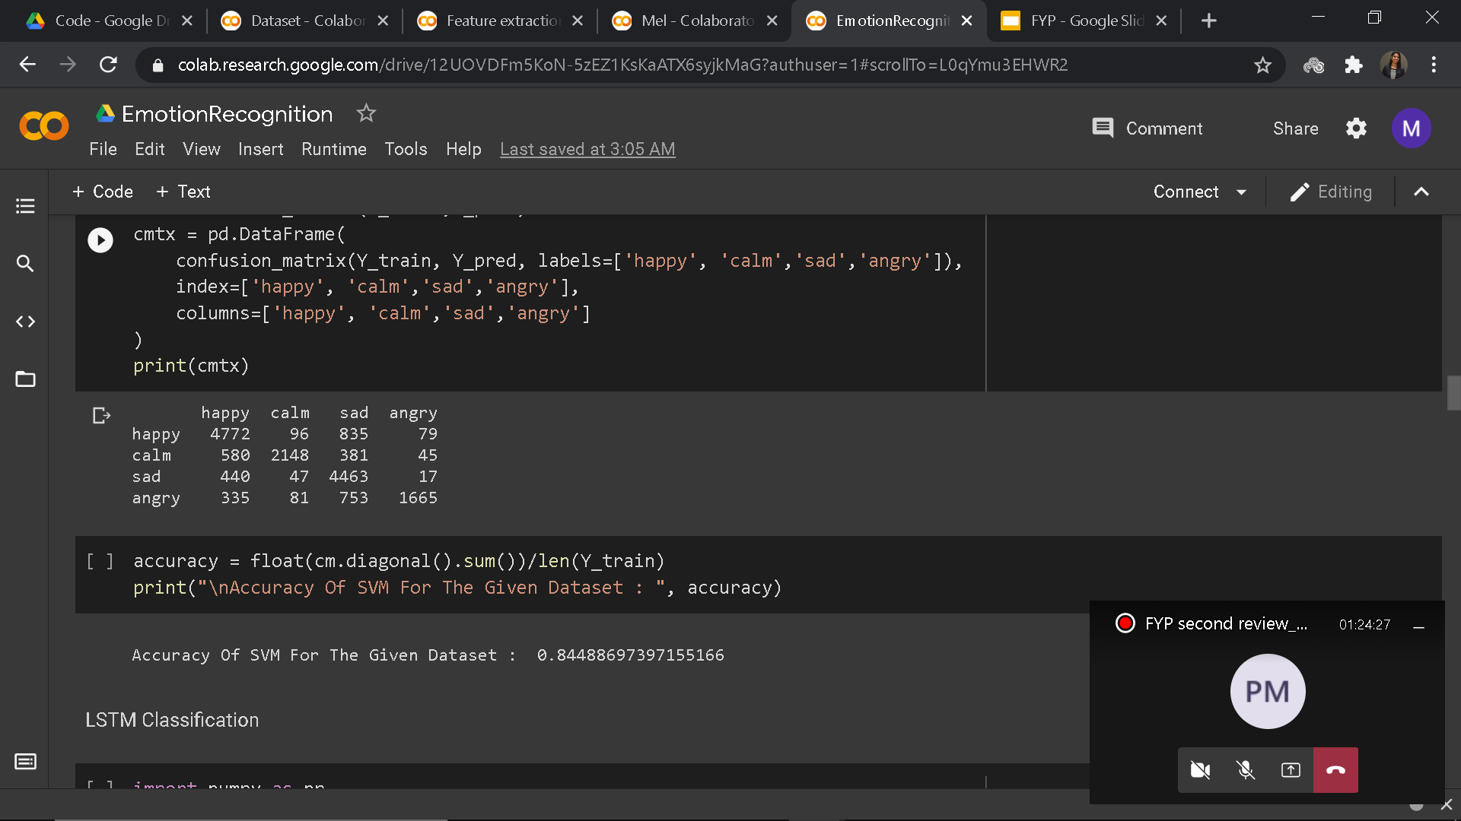
Confusion Matrix

Slide 32
Code snippet of LSTM
model = Sequential()
model.add(LSTM(units = 50, return_sequences = True, input_shape = (x_train.shape[1], 1)))
model.add(Dropout(0.2))
# Adding a many LSTM layer and Dropout layer
model.add(LSTM(units = 50, return_sequences = True))
model.add(Dropout(0.2))
# Adding the output layer
# For Full connection layer we use dense
# As the output is 1D so we use unit=1
model.add(Dense(units = 1))

Slide 33
model = Sequential()
model.add(Embedding(1500, embed_dim,input_length = 28))
#top_words, , input length
model.add(LSTM(lstm_out, dropout=0.2, recurrent_dropout=0.2))
model.add(Dense(2,activation='softmax'))
model.compile(loss = 'binary_crossentropy', optimizer='adam',metrics = ['accuracy'])
X_train, X_test, y_train, y_test = train_test_split(X,y, test_size = 0.15, random_state = 42)
model.fit(X_train, y_train,validation_data = (X_test,y_test),epochs = 10, batch_size=32)
model.evaluate(X_test,y_test)

Slide 34
Code snippet of CNN
model = tf.keras.Sequential([
tf.keras.layers.Conv2D(32, (3,3), padding='same', activation=tf.nn.relu,input_shape=(200, 200, 3)),
tf.keras.layers.MaxPooling2D((2, 2), strides=2),
tf.keras.layers.Conv2D(32, (3,3), padding='same', activation=tf.nn.relu),
tf.keras.layers.MaxPooling2D((2, 2), strides=2),
tf.keras.layers.Dropout(0.5),
tf.keras.layers.Flatten(),
tf.keras.layers.Dense(128, activation=tf.nn.relu),
tf.keras.layers.Dense(4, activation=tf.nn.softmax)
])

Slide 35
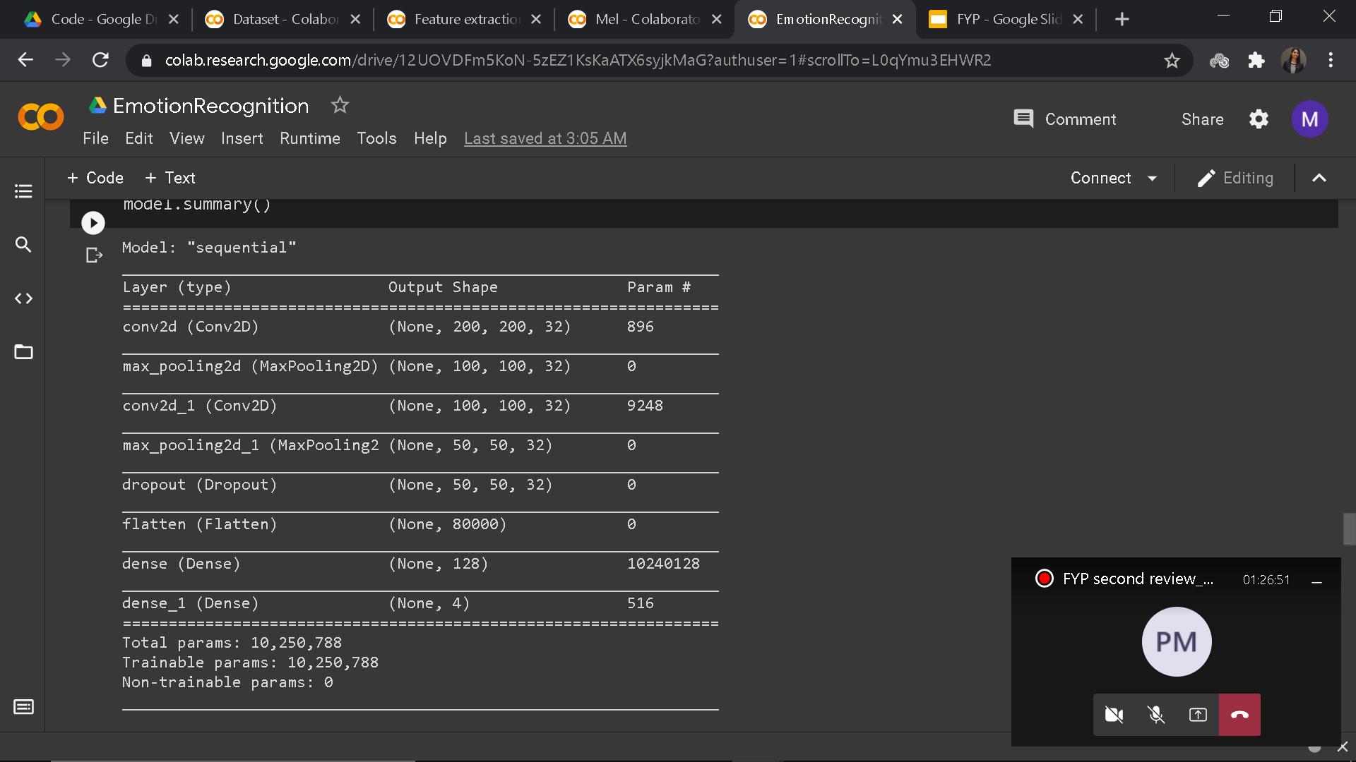
Summary

Slide 36
Result Integration Module
In Phase 1
Using lyrics of 16,943 english songs, emotions were classified.
In Phase 2
Using audio of same songs as used in phase 1, emotions were classified.
Now, results of both the phases will be integrated to get the accuracy of whole project with metrics to evaluate the project.

Slide 37
Code Snippet
ddoc = list(ddf['statement_clean'])
dvec = CountVectorizer()
dX = dvec.fit_transform(ddoc)
ddf1 = pd.DataFrame(dX.toarray(),columns=dvec.get_feature_names())
tfidf_transformer = TfidfTransformer()
dX_train= tfidf_transformer.fit_transform(ddf1)
dY_train = ddf.iloc[:,0].values
dclassifier = SVC(kernel='rbf', random_state = 1)
dclassifier.fit(dX_train,dY_train)
dY_pred = classifier.predict(dX_train)

Slide 38
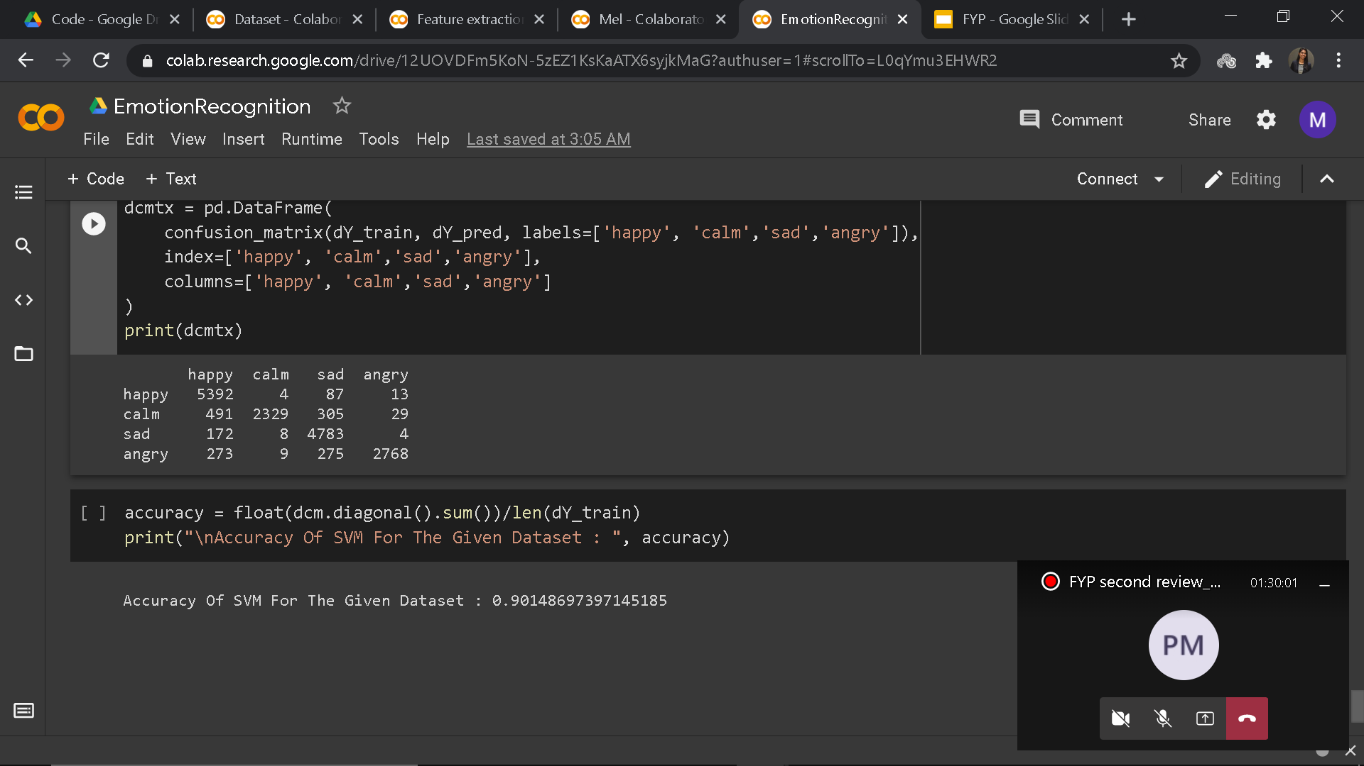
Confusion Matrix

Slide 39
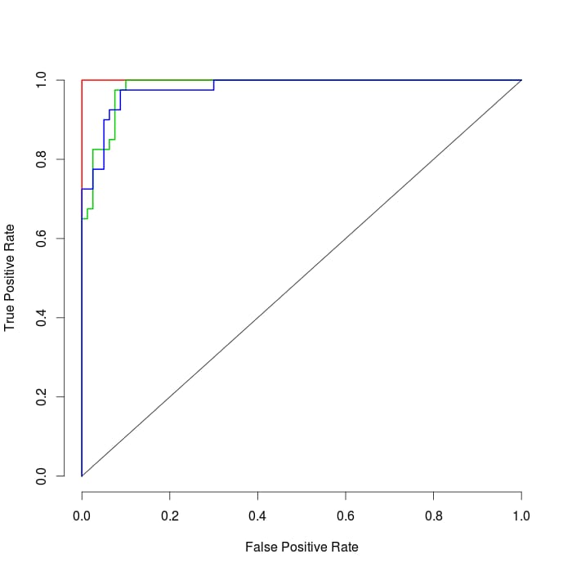
SVM
LSTM
CNN

Slide 40
Result
METHOD | ACCURACY
SVM | 84.48%
LSTM | 87.87%
CNN | 92.56%
RESULT INTEGRATION | 90.14%

Slide 41
Implementation Related Tools / Technologies
Input : Lyrics and Audio of Music
Output : Classifying emotion of Music
Details of IDE : Colab Notebook
Programming Languages used : Python

Slide 42
Future Work
This project can be used in music applications where songs can be grouped based on the emotion of the song to present to the user, music can be played accordingly. And also different kinds of predictions can be implemented in the future from this emotion classification.
The classifications can be improved with help of various other methods and models to classify emotions into more than four emotions also.

Slide 43
Roadmap
Phase II | Monica Jawahar | Hitesh Ram
Week 1-2 | Collecting and preparing dataset Deciding algorithm for audio
Week 3-4 | Extracting features from audio | Extracting features from audio
Week 5-6 | Implementing classification model on audio | Implementing classification model on audio
Week 7 | Result integration | Result integration

Slide 44
References
[1] Tong Liu, Li Han, Liangkai Ma and Dongwei Guo, “Audio-based deep music emotion recognition”, AIP Conference Proceedings 1967, 040021, 2018.
[2] Fika Hastarita Rachman, Riyanarto Sarno and Chastine Fatichah, ”Music Emotion Classification based on Lyrics-Audio using Corpus based Emotion”, International Journal of Electrical and Computer Engineering (IJECE), 2018.
[3] R. Panda, R. M. Malheiro and R. P. Paiva, "Novel audio features for music emotion recognition," in IEEE Transactions on Affective Computing, 2018.
[4] C. Lv, S. Li and L. Huang, "Music Emotions Recognition Based on Feature Analysis", 11th International Congress on Image and Signal Processing, BioMedical Engineering and Informatics (CISP-BMEI), Beijing, China, 2018.
[5] W. Shi and S. Feng, "Research on Music Emotion Classification Based on Lyrics and Audio", IEEE 3rd Advanced Information Technology, Electronic and Automation Control Conference (IAEAC), Chongqing, 2018.

Slide 45
[6]Ricardo Malheiro , Renato Panda , Paulo Gomes, and Rui Pedro Paiva, “Emotionally-Relevant Features for Classification and Regression of Music Lyrics“, IEEE Transactions on Affective Computing, 2018.
[7] Erion Cano, Maurizio Morisio, “MoodyLyrics: A Sentiment Annotated Lyrics Dataset”, ISMSI '17 - Proceedings of the 2017 International Conference on Intelligent Systems, Metaheuristics & Swarm Intelligence, 2017.
[8] C. V. Nanayakkara and H. A. Caldera, “Music Emotion Recognition with Audio and Lyrics Features”, International Journal of Digital Information and Wireless Communications (IJDIWC) 6(4): 260-273, The Society of Digital Information and Wireless Communications, 2016.
[9] C. Lin, M. Liu, W. Hsiung and J. Jhang, "Music emotion recognition based on two-level support vector classification", International Conference on Machine Learning and Cybernetics (ICMLC), Jeju, 2016.
[10] Ricardo Malheiro, Renato Panda, Paulo Gomes, Rui Pedro Paiva, “Music Emotion Recognition from Lyrics: A Comparative Study”, 6th International Workshop on Music and Machine Learning – MML ’2013 – in conjunction with the European Conference on Machine Learning and Principles and Practice of Knowledge Discovery in Databases – ECML/PKDD, 2013.

Slide 46
THANK YOU

