Slide 1
Sales Dashboard PBI- Changes
Drafted by: Meghana Patil
Drafted on: 02 Dec 2021
Required for Velocity customers

Slide 2
Project Details
Project ID | P011615
Description | Sales Dashboard PBI- Changes
Customer
Prepared by | Meghana
Date | 02 Dec 2021
Area | Effort in Man-days | Comment
Development
Testing
Project management

Slide 3
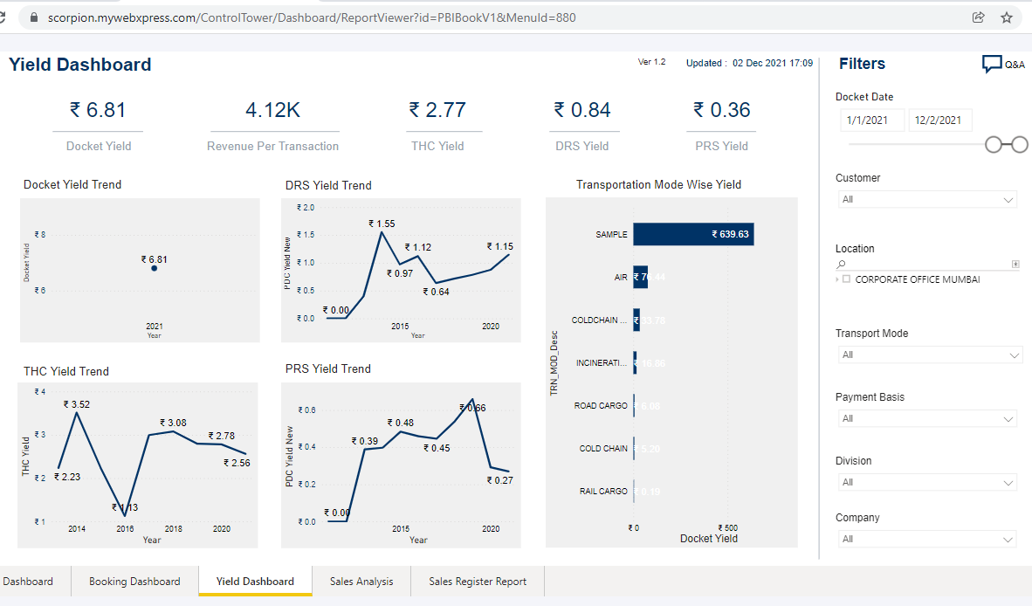
Yield Dashboard – Transport mode wise yield
Add filter : service type ( FTL/LTL)
Make Transport mode wise chart stack bar graph showing breakup of service type)

Slide 4
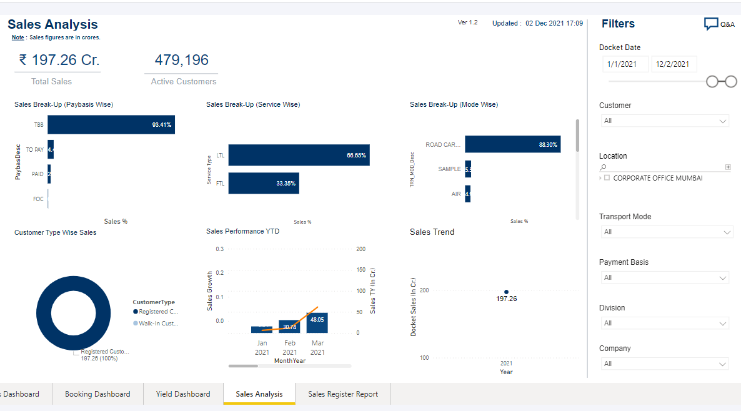
Sales Analysis – Active customers
Show distinct count of active customer

Slide 5
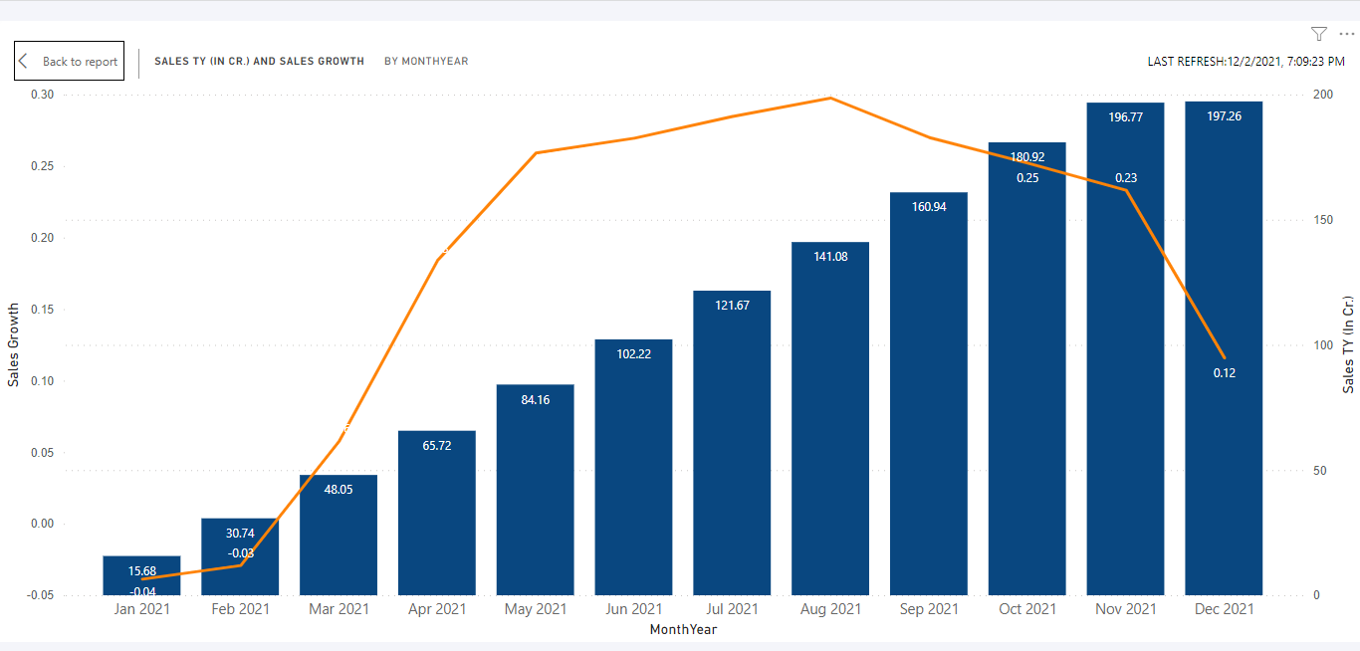
Sales analysis – Sales performance YTD
Change font color of trend data points
Change the YTD from calendar year to financial year

