Slide 1

JWT RS256 End-User Authentication/Authorization with djangorestframework Monica Marshall 04/26/2021

Slide 2
What is JWT?
JWT is a compact, URL-safe means of representing claims to be transferred between two parties.
JWTs claims are pieces of information asserted about a subject to be authorized to access web resources. Claims are authentication and authorization facts. For example, a JWT can contain a claim called “name” that asserts that the name of the user authenticating is "John Doe". Another claim could contain the John Doe’s role of “admin” with the value “true”.
Claims are stored in the payload portion of a JWT. Typically a payload will have non-sensitive user information (for example userid, email), an expiration date (exp), an issued at date (iat), a subject identifier (sub), the consumer of the token, an issuer (iss), the entity that creates and signs the token, such as the authentication server.
The claims in a JWT are URL-safe, Base64Url-encoded, as a JSON object.
A JWT is digitally signed using a JSON Web Signature (JWS) and/or encrypted using JSON Web Encryption (JWE).
A JSON Web Token (JWT) is self-contained. This means that it is small in size and it contains all information needed to allow or deny any given requests to an API.
In order to confirm that the JWT is valid we only need to look at the token itself. We don't have to contact a third-party service or keep JWTs in-memory between requests to confirm that the claim they carry is valid.
The information contained in a JWT can be verified and trusted because it is digitally signed.

Slide 3
JWT Token based Authn/Authz
In token based Authorization, the server creates a JWT with a secret and sends it to the client. The client stores the JWT (usually in local storage) and includes the JWT in the header with every request. The server then validates the JWT with every request from the client and sends a response.
The token is not saved by the server. It is created once and sent to the client. The server can promptly discard the token, because the client must send the token on every request and the token has all the necessary information for the server to verify the authenticity of the user and to verify whether the payload of the token has been tampered with.

Slide 4
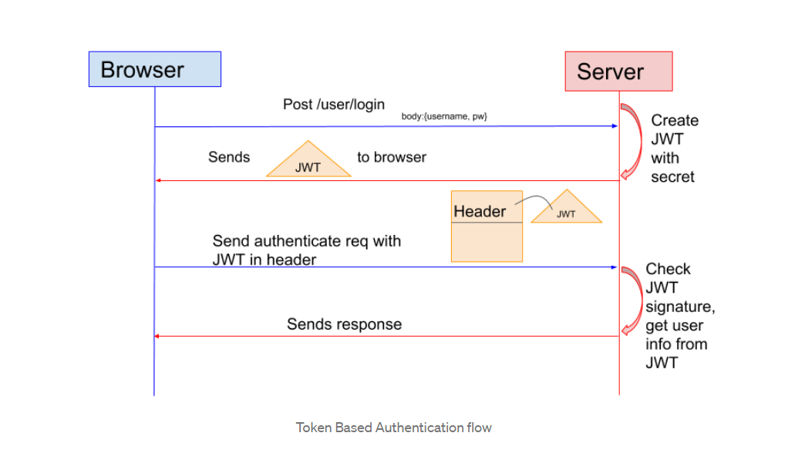
JWT Authn/Authz

Slide 5
What is a JWT made of?
A JWT is made of 3 parts: the Header, the Payload and the Signature. The 3 parts are separated by a dot.
Header: json object containing technical metadata information about the token itself. For example, this token uses the signature type RS256, the type of token is jwt, and it also has a kid (key Id).
Payload: In this case, the payload contains identification information about a given user, but in general, the payload could be anything else such as for example information about a bank transfer. There are no restrictions on the content of the payload, but it's important to know that a JWT is not encrypted. So any information that we put in the token is still readable to anyone who intercepts the token. Therefore it's important not to put in the Payload any user information that an attacker could leverage directly.
Signature: is a Message Authentication Code (or MAC). The signature is the hashed Base64url-encoded header together with the Base64url-encoded payload along with a secret, using the hashing algorithm specified in the header. The resulting hashed string is the digital signature of the token. Signatures are created using encryption and/or hashing algorithms. RS256 and HS256 are commonly used algorithms to create digital signatures. Istio uses the RS256 algorithm because it is more secure.

Slide 6
Signature creation with RS256
RS256 (stands for RSA Signature with SHA-256, Secure Hash Algorithm 256-bit). RS256 is an RSA Digital Signature Algorithm with SHA-256. RS256 is an Asymmetric Key Cryptography algorithm, which uses a pair of keys: a private key and a public key. The private key is used by the token issuer (authorization server) to create the digital signature on the token, and the public key is used by the application receiving the token to validate it. The identity provider uses the private (secret) key used to generate the signature. The consumer of the JWT, the application server, gets a public key to validate the signature.
RS256 uses the RSA encryption/decryption algorithm together with hashing while HS256 uses hashing only. Since encryption is slow and efficiency decreases with the size of the input, RS256 uses hashing first and encryption afterwards. The token issuer creates the signature by encoding the Header and the Payload with a base64url-encoder. Then the base64url-encoded header and payload are hashed with SHA-256, to obtain a unique representation of the input data that is much smaller than the actual data itself. Then the hashed output (header plus payload) is encrypted using the RSA private key, which gives us the RS256 digital signature. The signature is then appended as the third part of the jwt. The jwt created by the authorization server will look like this: base64url-encoded-header.base64url-encoded-payload. RS256- signature (note the 2 dots separating header, payload, signature).

Slide 7
Signature verification with RS256
Remember that the signature is the encrypted and hashed base64UrlEncoded header and base64UrlEncoded payload.
Remember that Hashing is irreversible, but encryption can be decrypted (in this case, with the public key).
Verification steps:
1. The header and the payload are hashed together with SHA-256.
2. The signature is decrypted using the public key to obtain the signature hash
3. The receiver compares the signature hash with the hash that is calculated based on the Header and the Payload
4. If the two hashes match the app server proves that the JWT was indeed created by the Authentication server.
Anyone could have calculated that hash, but only the Authentication server could have encrypted it with the matching RSA private key.

Slide 8
AUTH with JWT RS256 Demo
The djangorestframework-simplejwt library alone supplies three fundamental services:
get new token
refresh token
verify token
Get new token requires user account creation on the server prior to clients using the restful endpoints. Users must be manually registered with a username and password with the django user management framework.
The clients of the restful endpoints must authenticate with the JWT authorization service first since the JWT token is created based on a valid set of authentication credentials.

Slide 9
AUTH with JWT RS256 Demo
This demo shows the jwt security capabilities of the djangorestframework-simplejwt library in combination with 2 other jwt security libraries called: dj-rest-auth and django-allauth. By using dj-rest-auth and django-allauth and we avoid manual creation of user accounts.
dj-rest-auth and django-allauth supply the following urls:
register user
new user account verification
login
logout
reset password. Registration and verification of user accounts is based on a valid email (mandatory field).
The use of the 2 libraries removes the manual registration of users requiring a JWT token to access the protected resources on the server which is a prerequisite when using the djangorestframework-simplejwt alone.

Slide 10
Generate Public/Private Key Pair using ssh-keygen
The pyjwt package does not directly implement the cryptographic signing functions for the more advanced public-key signing algorithms, and instead depends on the cryptography package to provide those. So to use public-key signatures, the cryptography package needs to be installed:
(venv) $ pip install cryptography
The next step is to generate a public/private key set (usually called a "key pair") for the application to use.
(venv) $ ssh-keygen -t rsa -b 4096
The -t option to the ssh-keygen command defines the request for an RSA type key pair.
The -b option specifies a key size of 4096 bits, which is considered a very secure key length.
When you run the command you will be prompted to provide a filename for the key pair to be written to a specific directory on the server.
Then you will be prompted to enter a passphrase to protect the key (optional for added protection to the private key).

Slide 11
Generate Public/Private Key Pair using openssl
The first command generates the private key and stores it in a file, private-key.pem
The second command generates the public key from the private key and stores it in a file, public-key.pem
openssl genrsa -out private-key.pem 2048
openssl rsa -in private-key.pem -pubout -out public-key.pem

Slide 12
Package install in virtual environment
pip install django djangorestframework
pip install djangorestframework-simplejwt
pip install dj-rest-auth
pip install django-allauth
pip install cryptography
pip install psycopg2

Slide 13
Modify INSTALLED_APPS in settings.py
INSTALLED_APPS = [
'django.contrib.admin',
'django.contrib.auth',
'django.contrib.contenttypes',
'django.contrib.sessions',
'django.contrib.messages',
'django.contrib.staticfiles',
# Third-Party Apps
'rest_framework',
'rest_framework.authtoken',
'allauth',
'allauth.account',
'dj_rest_auth',
'dj_rest_auth.registration',
'django.contrib.sites',
# Local Apps (project's apps)
'hello',
'students',
]

Slide 14
Add DEFAULT_AUTHENTICATION_CLASSES and AUTHENTICATION_BACKENDS in settings.py
REST_FRAMEWORK = {
'DEFAULT_AUTHENTICATION_CLASSES': [
'rest_framework.authentication.TokenAuthentication',
'dj_rest_auth.jwt_auth.JWTCookieAuthentication',
],
}
AUTHENTICATION_BACKENDS = [
# allauth specific authentication methods, such as login by e-mail
'allauth.account.auth_backends.AuthenticationBackend',
# Needed to login by username in Django admin, regardless of allauth
'django.contrib.auth.backends.ModelBackend',
]

Slide 15
AUTH settings in settings.py
JWT_PUBLIC_KEY_PATH = './publicKey.pem'
JWT_PRIVATE_KEY_PATH = './privateKey.pem'
from datetime import timedelta
SIMPLE_JWT = {
'ACCESS_TOKEN_LIFETIME': timedelta(minutes=20),
'REFRESH_TOKEN_LIFETIME': timedelta(days=1),
'ROTATE_REFRESH_TOKENS': False,
'BLACKLIST_AFTER_ROTATION': True,
#'UPDATE_LAST_LOGIN': False,
'ALGORITHM': 'RS256',
#'SIGNING_KEY': SECRET_KEY,
'SIGNING_KEY': open(JWT_PRIVATE_KEY_PATH).read(),
#'VERIFYING_KEY': None,
'VERIFYING_KEY': open(JWT_PUBLIC_KEY_PATH).read(),
#'SIGNING_KEY': requests.get(JWT_PRIVATE_KEY_PATH).text,
#'VERIFYING_KEY': requests.get(JWT_PUBLIC_KEY_PATH).text,
'AUDIENCE': 'MpdbUsers',
'ISSUER': 'MpdbRestAPI',
'AUTH_HEADER_TYPES': ('Bearer'),
#'AUTH_HEADER_NAME': 'HTTP_AUTHORIZATION',
#'USER_ID_FIELD': 'id',
#'USER_ID_CLAIM': 'user_id',
'AUTH_TOKEN_CLASSES': ('rest_framework_simplejwt.tokens.AccessToken',),
'TOKEN_TYPE_CLAIM': 'token_type',
'JTI_CLAIM': 'jti',
'SLIDING_TOKEN_REFRESH_EXP_CLAIM': 'refresh_exp',
'SLIDING_TOKEN_LIFETIME': timedelta(minutes=5),
'SLIDING_TOKEN_REFRESH_LIFETIME': timedelta(days=1),
}

Slide 16
AUTH settings in settings.py (continued)
EMAIL_BACKEND = 'django.core.mail.backends.smtp.EmailBackend'
EMAIL_HOST = 'smtp.gmail.com'
#EMAIL_HOST = 'smtp.mail.yahoo.com'
EMAIL_USE_TLS = True
EMAIL_PORT = 587
#EMAIL_PORT = 465
EMAIL_HOST_USER = 'jwtdemoapp@gmail.com'
EMAIL_HOST_PASSWORD = 'jwtdemoapps@ula'
ACCOUNT_EMAIL_REQUIRED = True
ACCOUNT_AUTHENTICATION_METHOD = 'email'
ACCOUNT_EMAIL_VERIFICATION = 'mandatory'
ACCOUNT_CONFIRM_EMAIL_ON_GET = True
LOGIN_URL = 'http://localhost:8090/users/login'

Slide 17
Modify the projects urls.py
from django.contrib import admin
from django.urls import path
from django.conf.urls import include, url
from rest_framework_simplejwt import views as jwt_views
from students import views
from users import views
urlpatterns = [
path('admin/', admin.site.urls),
path('hello/', include('hello.urls')),
path('api/students/', include('students.urls')),
path('users/', include('users.urls')),
path('password-reset-confirm/<uidb64>/<token>/',
PasswordResetConfirmView.as_view(), name='password_reset_confirm'),
path('password-reset/', PasswordResetView.as_view()),
path('api/token/', jwt_views.TokenObtainPairView.as_view(), name='token_obtain_pair'),
path('api/token/refresh/', jwt_views.TokenRefreshView.as_view(), name='token_refresh'),
path('api/token/verify/', jwt_views.TokenVerifyView.as_view(), name='token_verify'),
]

Slide 18
Modify the users urls.py
from django.urls import path, re_path
from dj_rest_auth.registration.views import RegisterView, VerifyEmailView, ConfirmEmailView
from dj_rest_auth.views import LoginView, LogoutView
urlpatterns = [
path('account-confirm-email/<str:key>/', ConfirmEmailView.as_view()),
path('register/', RegisterView.as_view()),
path('login/', LoginView.as_view()),
path('logout/', LogoutView.as_view()),
path('verify-email/',
VerifyEmailView.as_view(), name='rest_verify_email'),
path('account-confirm-email/',
VerifyEmailView.as_view(), name='account_email_verification_sent'),
re_path(r'^account-confirm-email/(?P<key>[-:\w]+)/$',
VerifyEmailView.as_view(), name='account_confirm_email'),
]

Slide 19
Protect the Hello World resource views.py in Hello webapp
from django.shortcuts import render
from rest_framework.views import APIView
from rest_framework.response import Response
from rest_framework.permissions import IsAuthenticated
class HelloView(APIView):
logger.debug("In hello view")
permission_classes = (IsAuthenticated,)
def get(self, request):
content = {'message': 'Hello, World!'}
return Response(content)

Slide 20
Protect the students resource views.py in students webapp
from .models import Student
from rest_framework.generics import ListCreateAPIView, RetrieveUpdateDestroyAPIView
from .serializers import StudentSerializer
from rest_framework.permissions import IsAuthenticated
class StudentList(ListCreateAPIView):
logger.debug("In Student list")
permission_classes = (IsAuthenticated,)
queryset = Student.objects.all()
serializer_class = StudentSerializer
class StudentDetail(RetrieveUpdateDestroyAPIView):
permission_classes = (IsAuthenticated,)
queryset = Student.objects.all()
serializer_class = StudentSerializer

