Slide 1
Big Data graduation project Covid-19
Submitted by:
Monica Mourad 16p8223
Kirolos Raouf 16p8045

Slide 2
Outlines
INGESTION
STORAGE
PROCESSING
OOZIE WORKFLOW
VISUALIZATION

Slide 3
Ingestion
Big data ingestion gathers data and brings it into a data processing system where it can be stored, analyzed, and accessed. ... An effective data ingestion begins with the data ingestion layer. This layer processes incoming data, prioritizes sources, validates individual files, and routes data to the correct destination
In this project there was only 1 source of data “covid-19.csv” that was provided; this data set was uploaded into the Virtual Machine Cloudera following steps 1-3

Slide 4
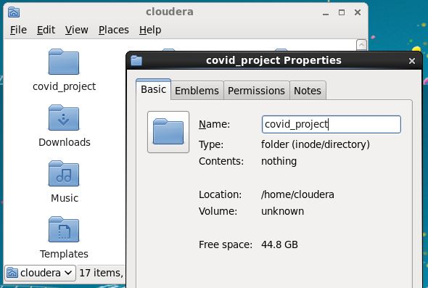
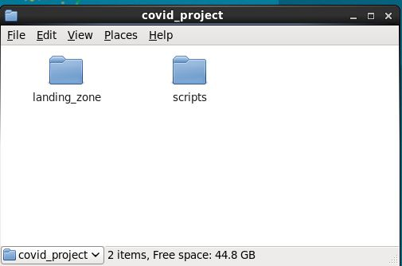
Step 1
Step 2

Slide 5
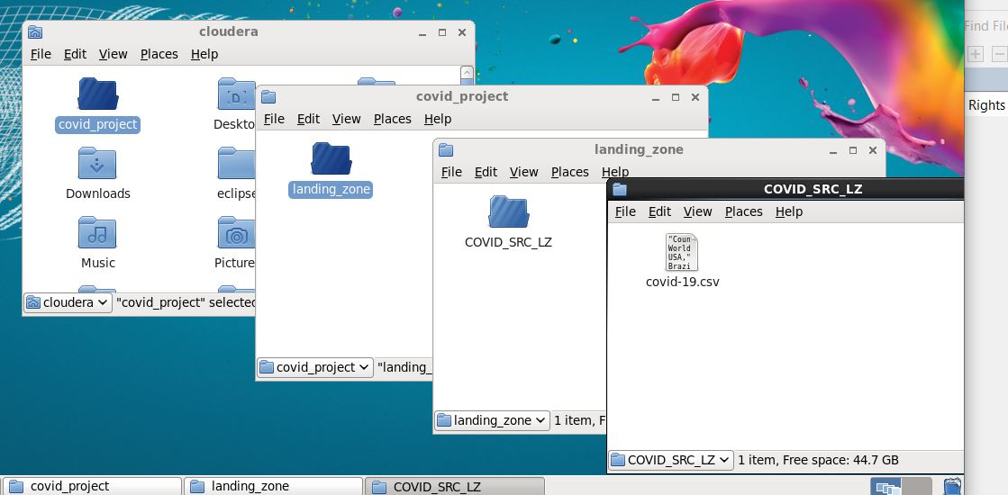
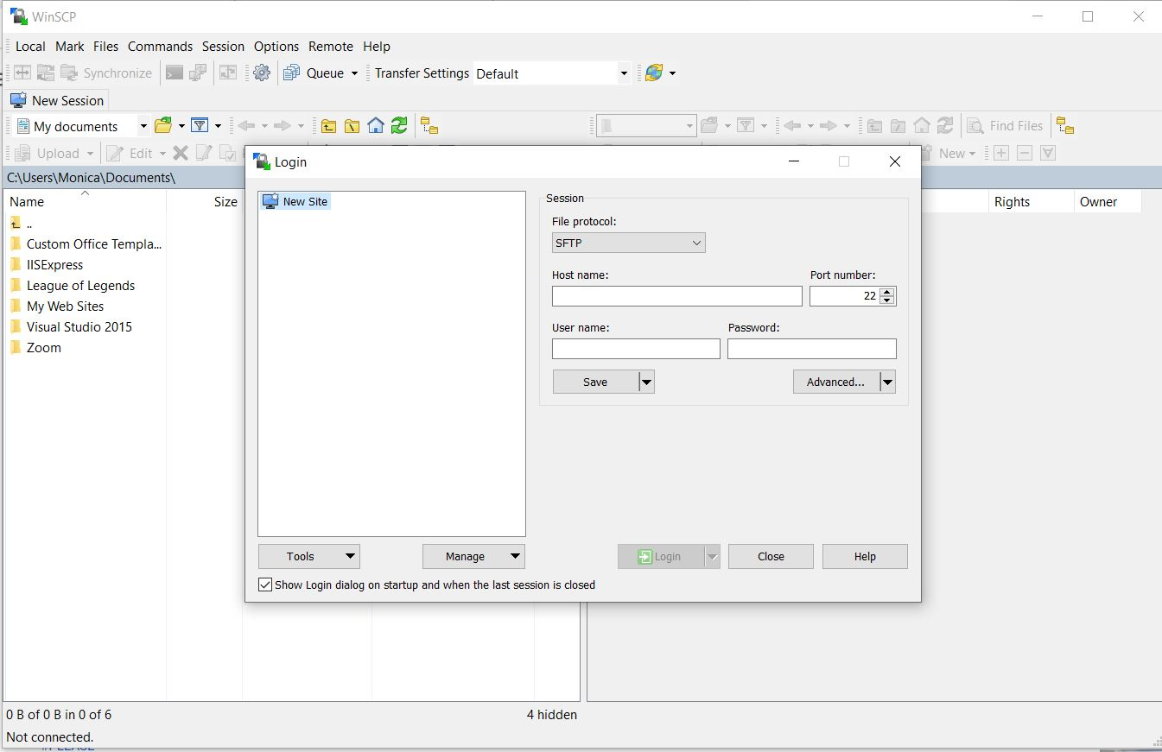
Step 3 a
Step 3 b

Slide 6
Storage
Big data storage is a storage infrastructure that is designed specifically to store, manage and retrieve massive amounts of data, or big data. Big data storage enables the storage and sorting of big data in such a way that it can easily be accessed, used and processed by applications and services working on big data
In this project we will use The Hadoop Distributed File System (HDFS) which is the primary data storage system used by Hadoop applications. The data was copied into HDFS file system through step 4

Slide 7
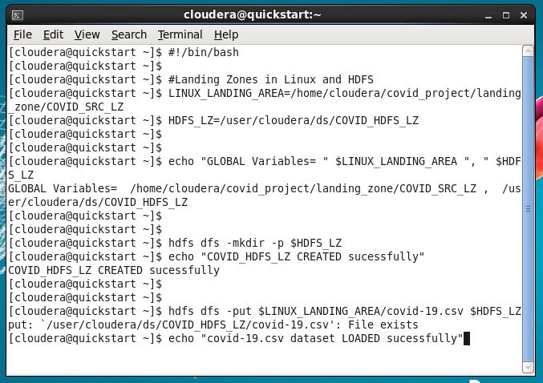
Step 4

Slide 8
Processing
Big data processing is a set of techniques or programming models to access large-scale data to extract useful information for supporting and providing decisions. In the following, we review some tools and techniques, which are available for big data analysis in datacenters.
In this project we used Hive which is a data warehouse infrastructure tool to process structured data in Hadoop. It resides on top of Hadoop to summarize Big Data, and makes querying and analyzing easy; this was done in step 6

Slide 9
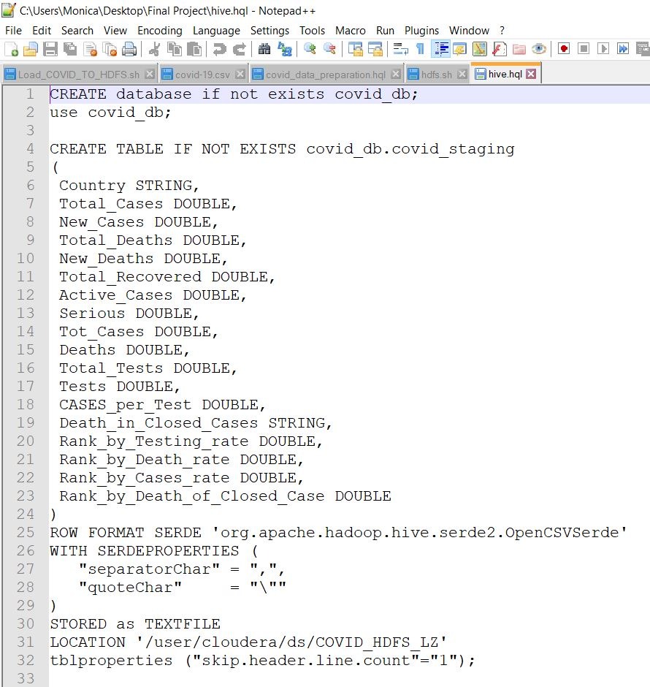
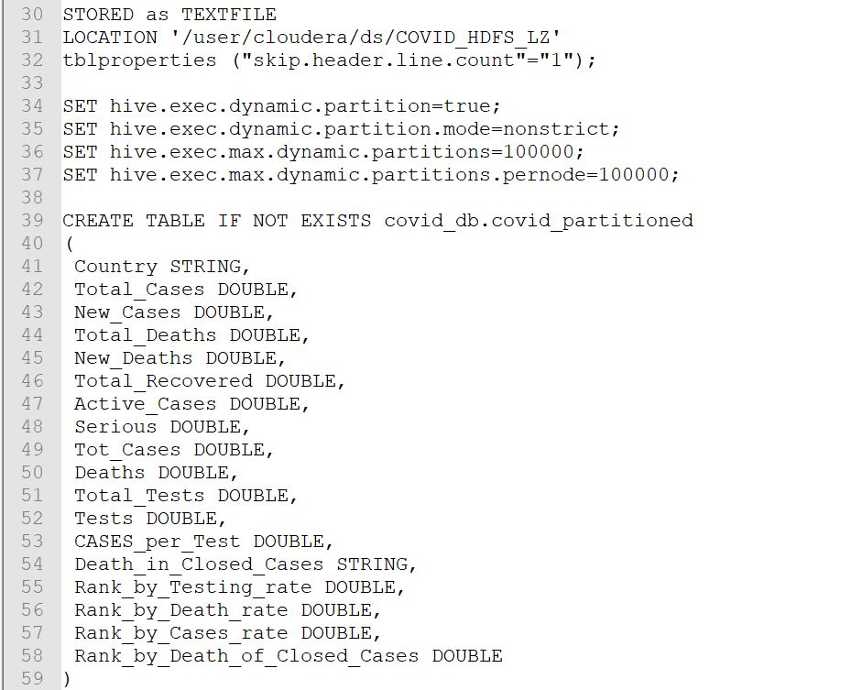
Step 6a
Step 6b

Slide 10
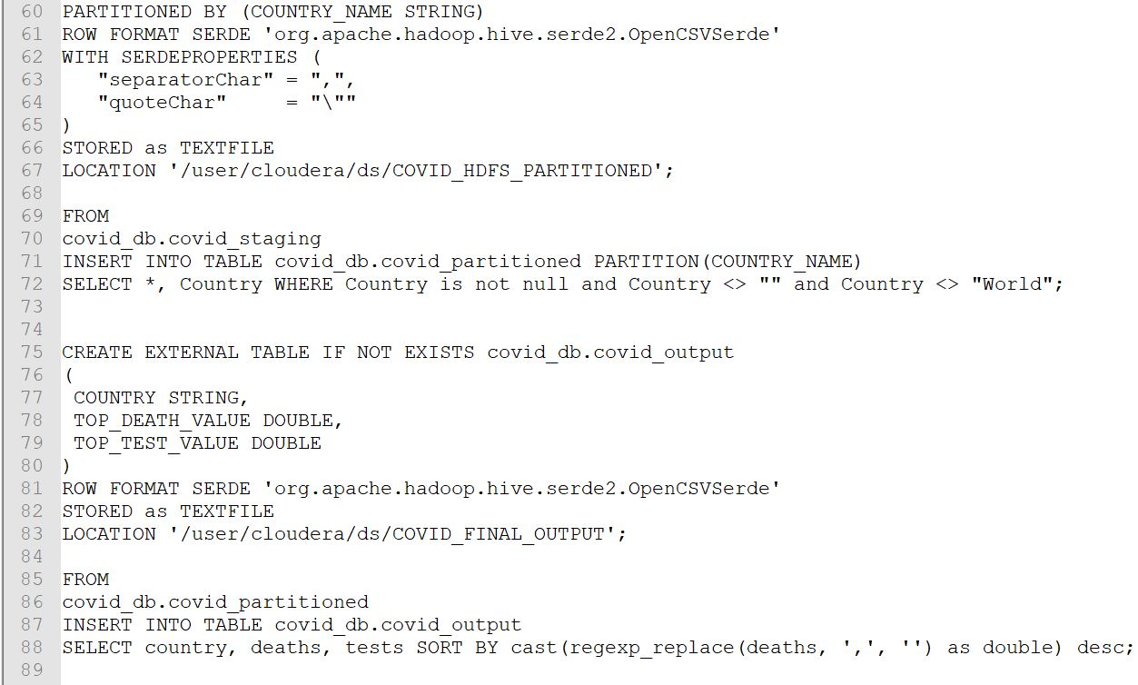
Step 6c

Slide 11
Oozie workflow
Apache Oozie is a server-based workflow scheduling system to manage Hadoop jobs. Workflows in Oozie are defined as a collection of control flow and action nodes in a directed acyclic graph. Control flow nodes define the beginning and the end of a workflow as well as a mechanism to control the workflow execution path.
The way it was set up can be seen in steps 7,8 and 9

Slide 12
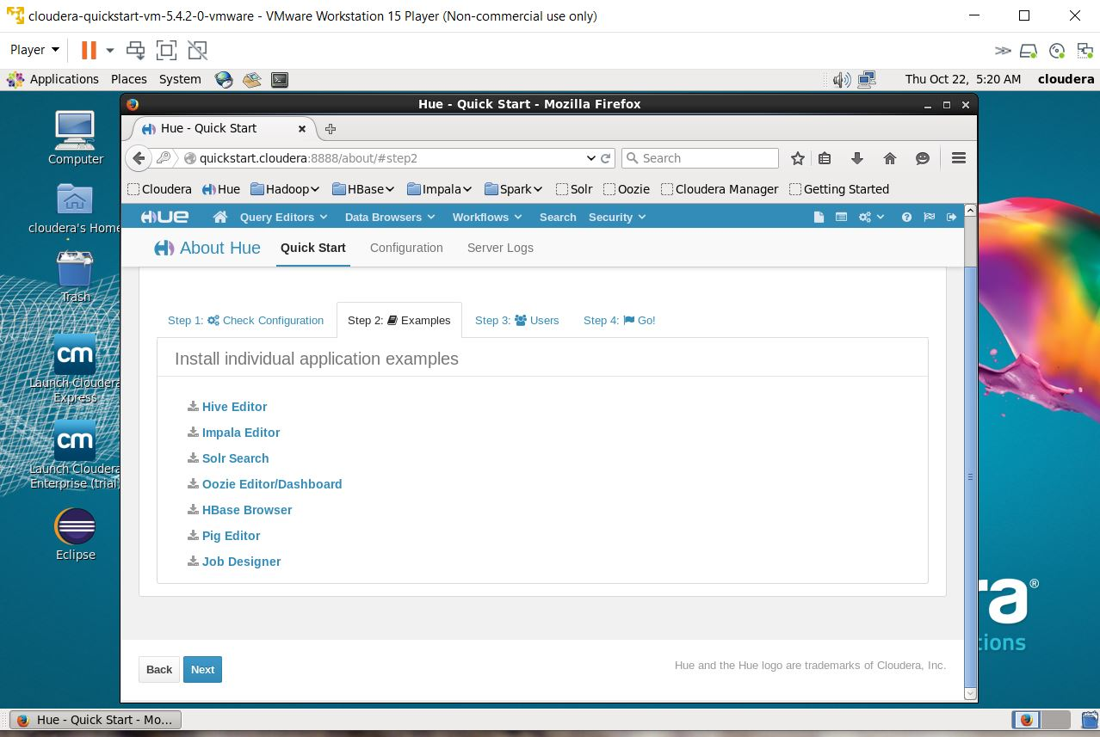
Step 7a

Slide 13
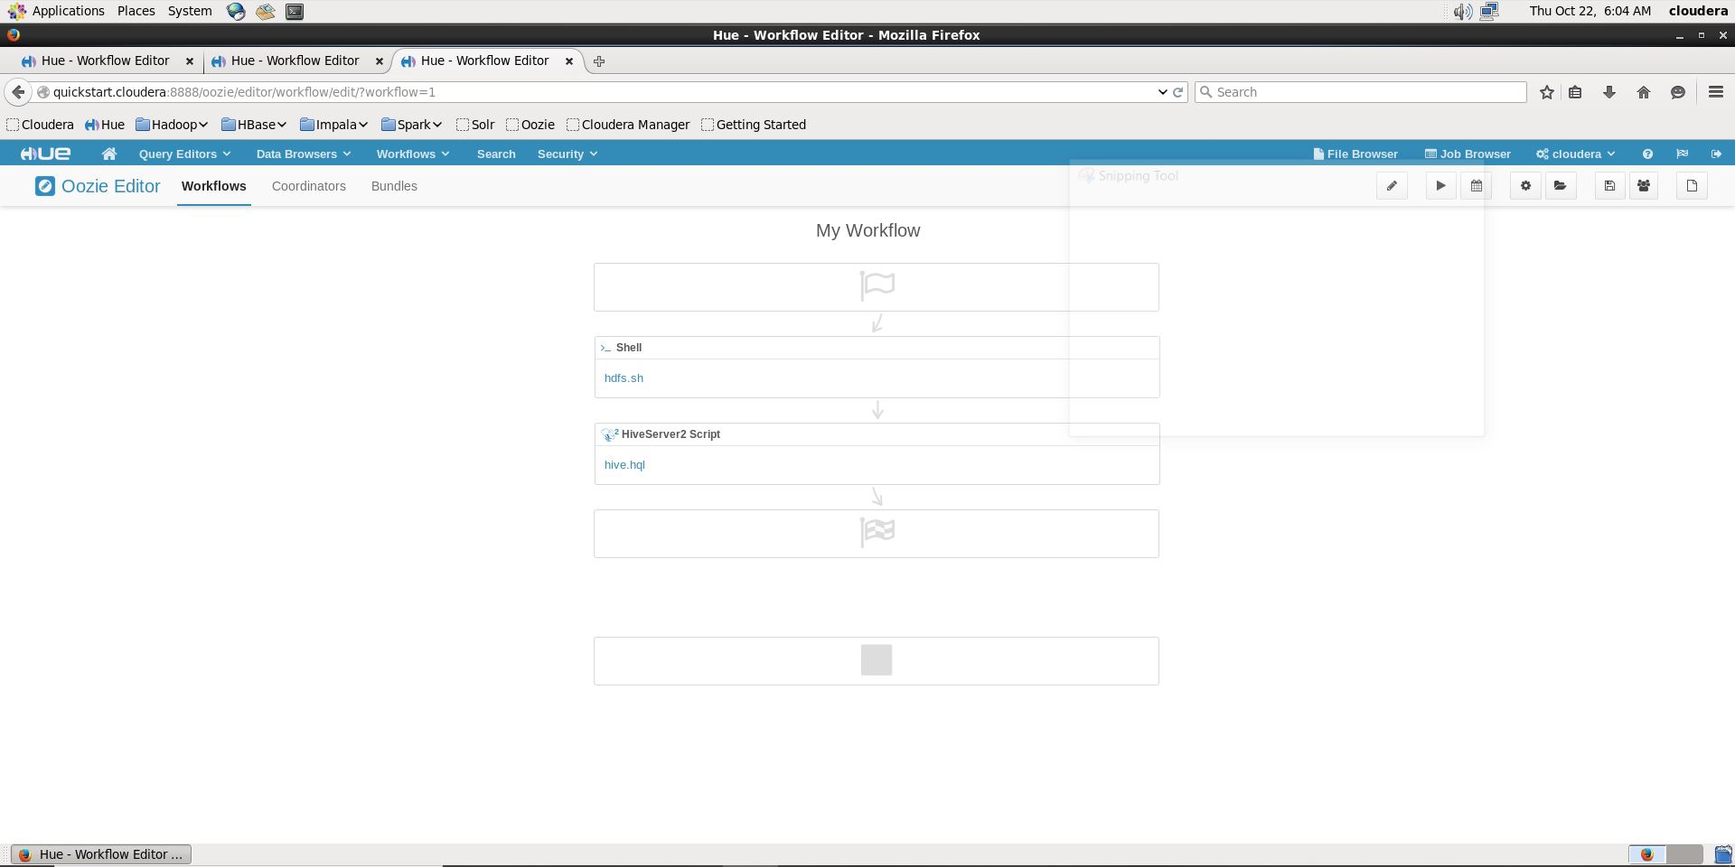
Step 7b

Slide 14
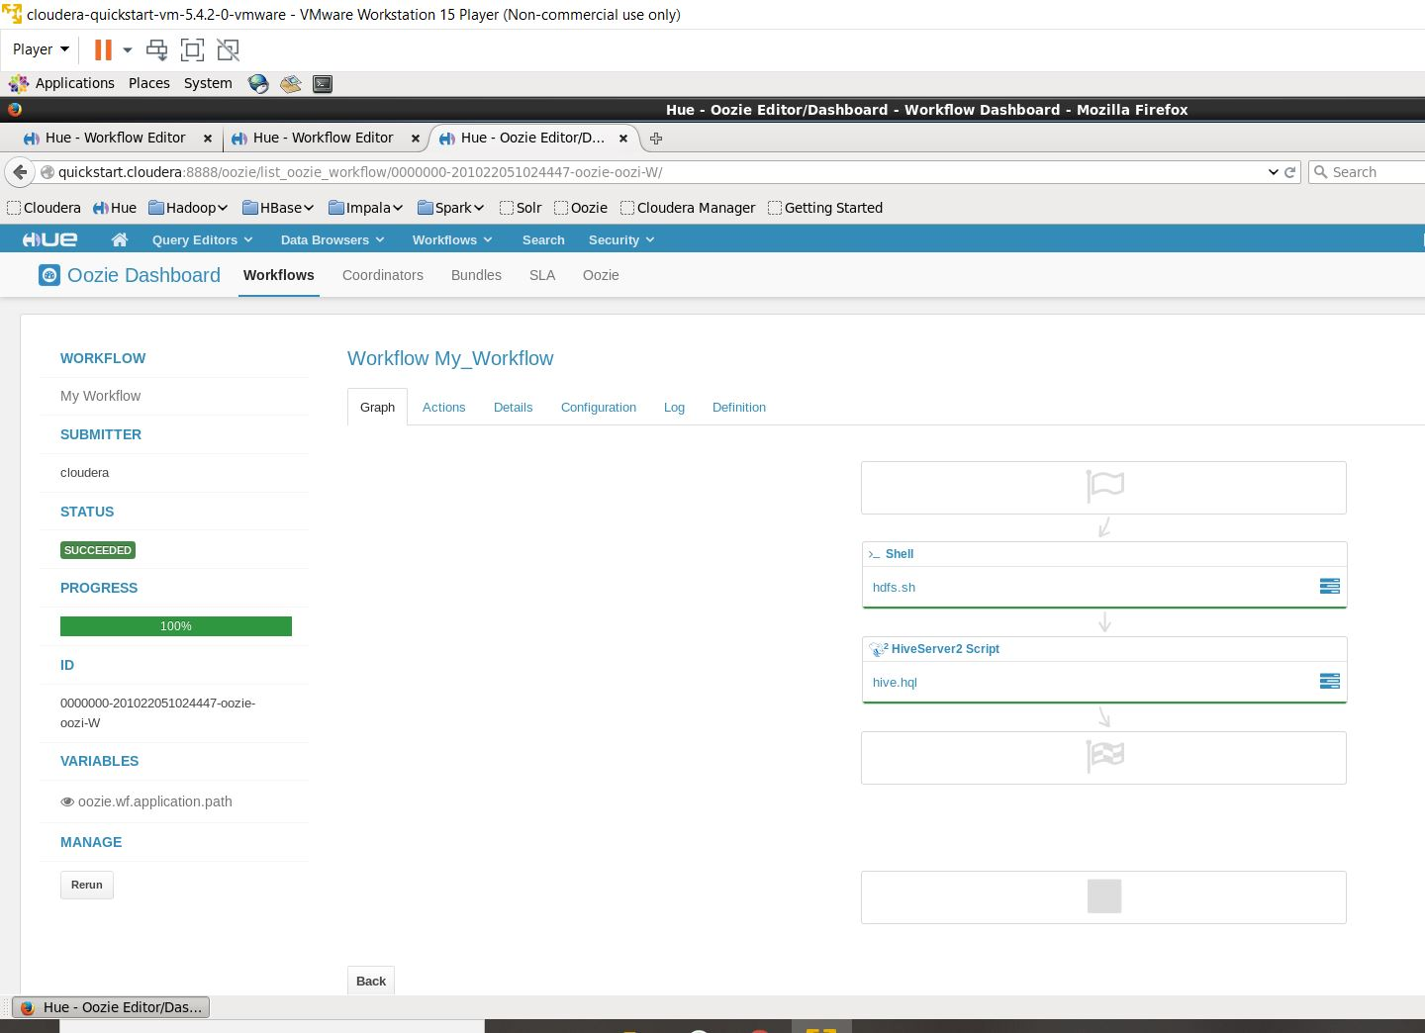
Step 8

Slide 15
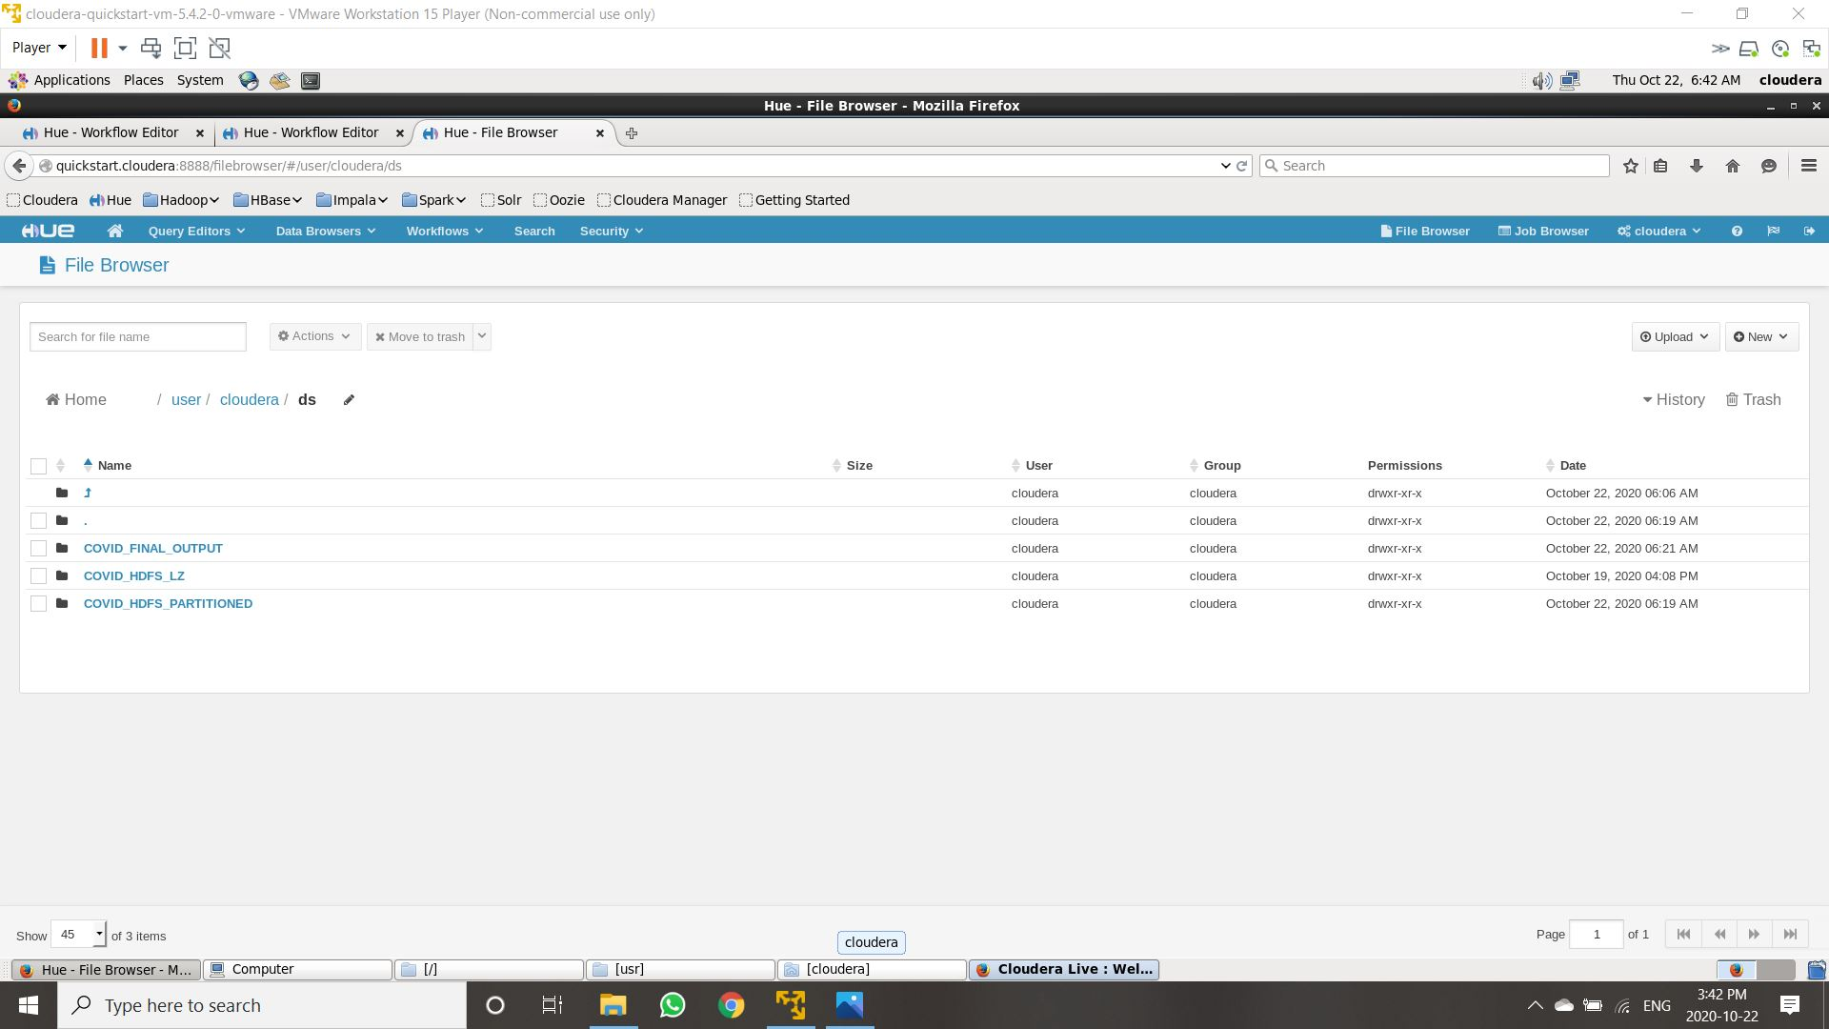
Step 9a

Slide 16
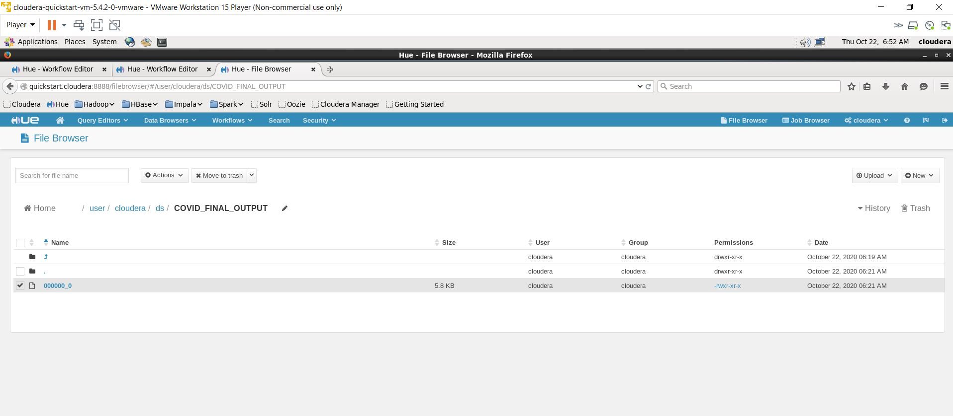
Step 9b

Slide 17
visualization
Data visualization is the graphical representation of information and data. By using visual elements like charts, graphs, and maps, data visualization tools provide an accessible way to see and understand trends, outliers, and patterns in data.
In this project we used Power BI which is a business analytics service by Microsoft. It aims to provide interactive visualizations and business intelligence capabilities with an interface simple enough for end users to create their own reports and dashboards
The following slide shows the visualizations obtained using Power Bi

Slide 18
