Slide 1
“The line between human and machine is blurring, and the consequences can be both fascinating and frightening.”
- Neil deGrasse Tyson

Slide 2

“The line between human and machine is blurring, and the consequences can be both fascinating and frightening.”
- Neil deGrasse Tyson

Slide 3


Slide 4
Themis is a cutting-edge AI service meticulously crafted to differentiate between genuine communications from high-security services like your bank and malicious AI-generated messages designed to deceive and exploit you.
Detection of AI and Malicious Impersonations
Behavioral Analysis and Cross-Referencing Verified Sources
Adaptive Learning

Slide 5




Slide 6
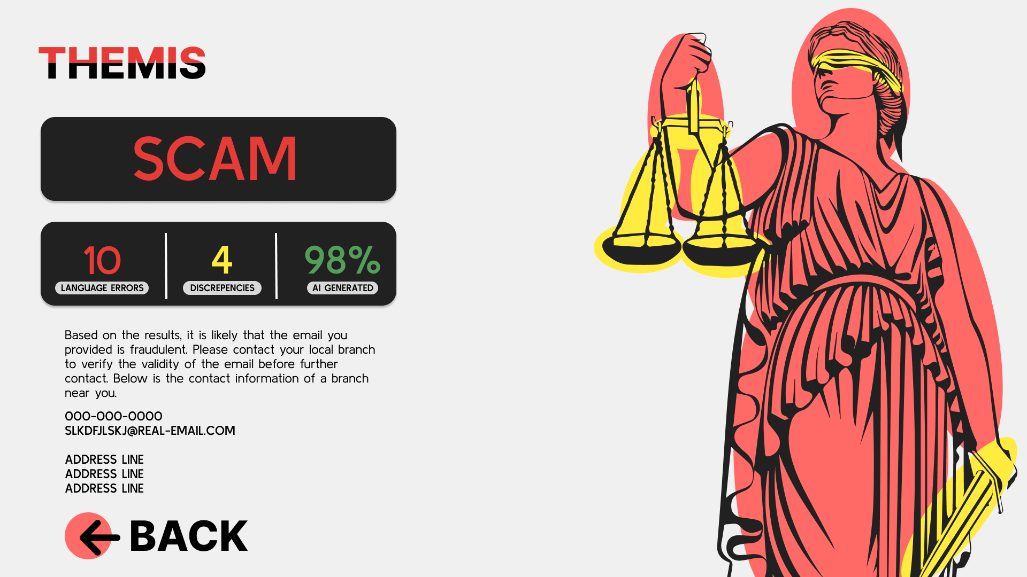

Slide 7
If only we had more time…
Implement ML Model to determine whether contents is fraud related
Cross-reference with verified sources
Enable user to upload either a screenshot or take a picture of a letter

Slide 8
What The Future Holds:
Recognize images, videos, and voice messages that were generated using deep fake technology
Create a risk analysis to keep user informed about what personal info has been compromised and is used against them for scams
Automatically create database to collect evidence for law enforcement

