Slide 1
Wireframes
UI design – GOF Rent-A-Car

Slide 2
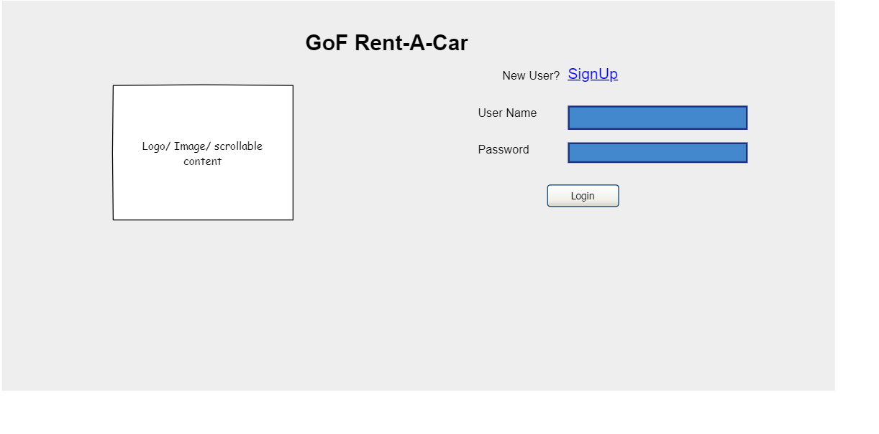
Login

Slide 3
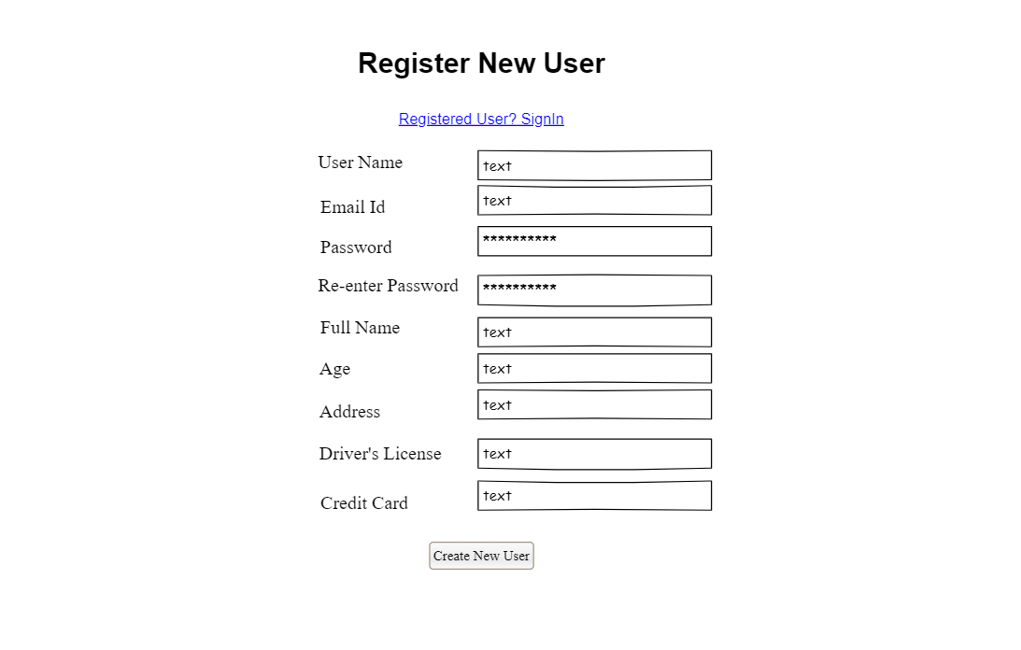
SignUp

Slide 4
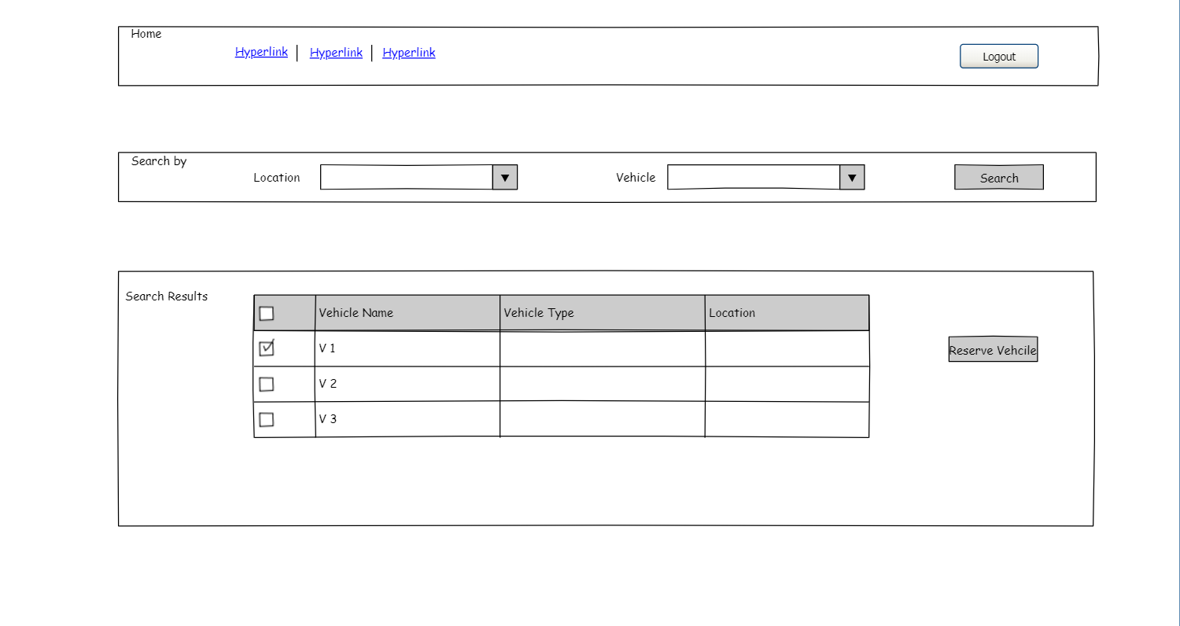
Home

Slide 5
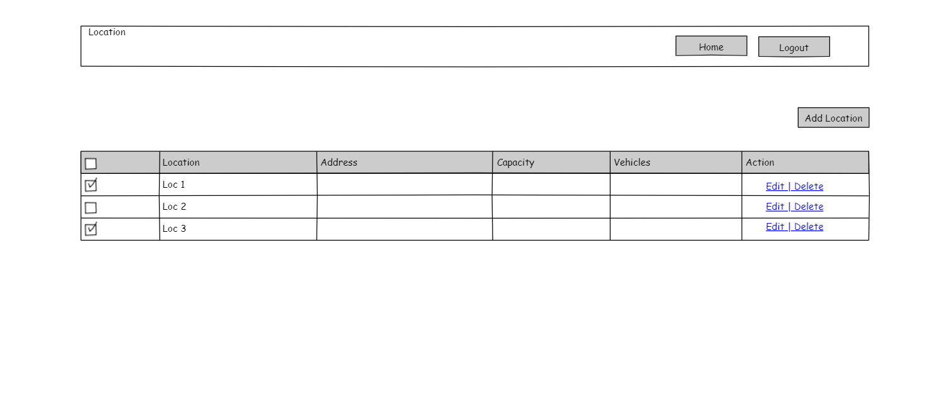
Location

Slide 6
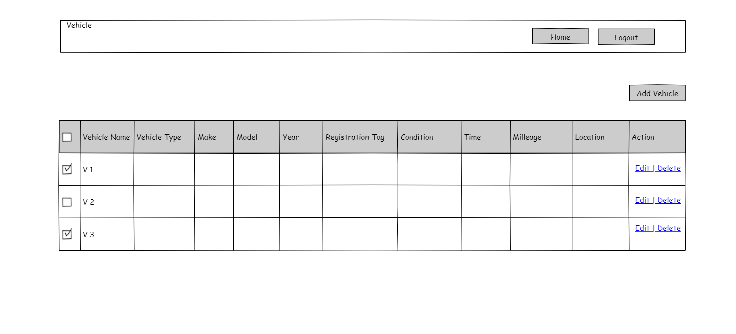
Vehicle

Slide 7
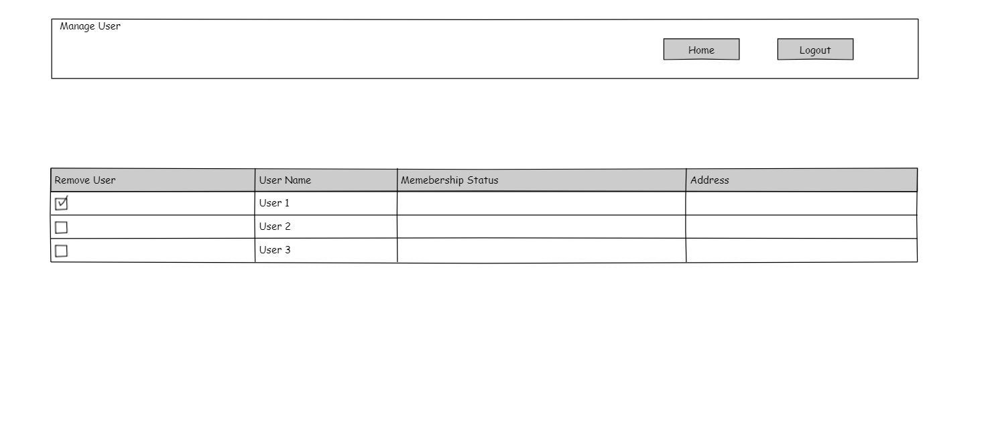
Manage User

Slide 8
Account

