Slide 1
Datatypes and –structures

Slide 2
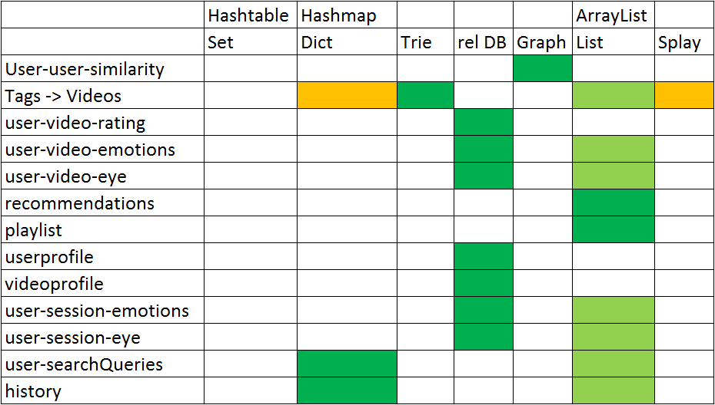

Slide 3
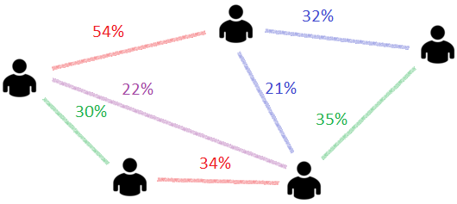
User-user-similarity: Graph
Graphs can be implemented in different ways
Allows us to find all „neighbours“ of a given user very quick

Slide 4
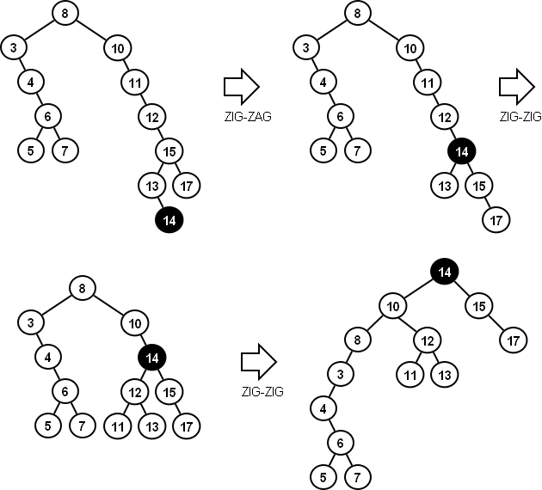
Tags (Alternative): Splay
Splay: Whenever you look at an Element, is is moved to top
Fast access to Elements, which have been used recently
Common Tags would be closer to the top

Slide 5
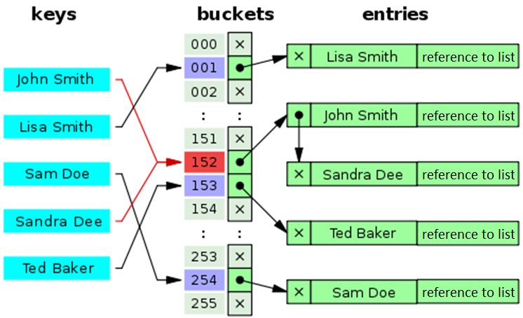
User-History & -Search-Queries: HashMap
Hashmaps are very fast - O(1)
Easy to implement in Python
Suitable for this purpose

