Slide 1
Working with the bci and eye-tracking data

Slide 2
Eye-Data
From the Eye-tracking devices we get the coordinates
Also, we calculate fixation points, which means, small areas a user is looking at for a certain amount of time

Slide 3
BCI-Data
The raw Data from the BCI is just electric signals from the electrodes
This data has to be processed, so you get the assumed feelings of the user at a given time
The final Data can be shown in multiple Graphs, one for each feeling

Slide 4
Suggestions
Analyse the Data that was recorded during a Video

Slide 5




Classifying Videos
Idea:
Calculate the average or major feelings of all viewers of a video
tell, if a video is happy, sad,or exciting …
The results…
…can be used to fill the caroussels with different categories of videos
…can be displayed next to videos (with an emoticon), so the users can choose between search results more efficiently
… can be used, to improve search results (users, who like sad videos will get more sad videos as results)

Slide 6
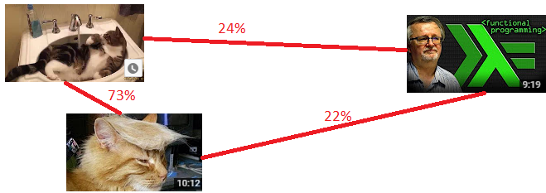
Comparing Videos
Idea
Calculate the average of all viewers of a video for all feelings
With this data, calculate how similar two videos are
The results can be used, to improve search results
The videos in the search results would get a score, based on how the user rated similar videos.
This score would be used to sort the videos

Slide 7
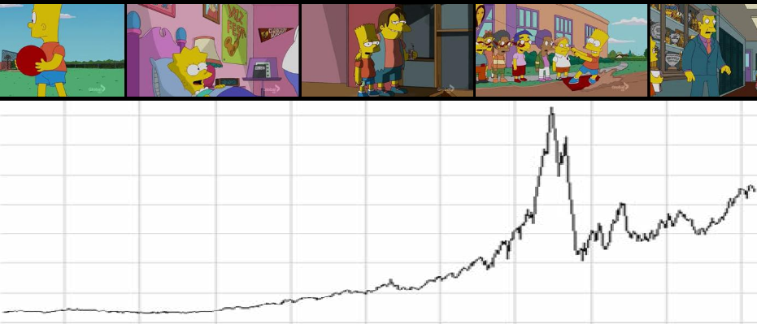
Find important parts of the video
Scan the bci-data for significant parts
for example, does the average excitement of all users suddenly increases?
Analyze the results
Does it work / make sense?
The results …
… can be used to improve the preview in the search results

Slide 8
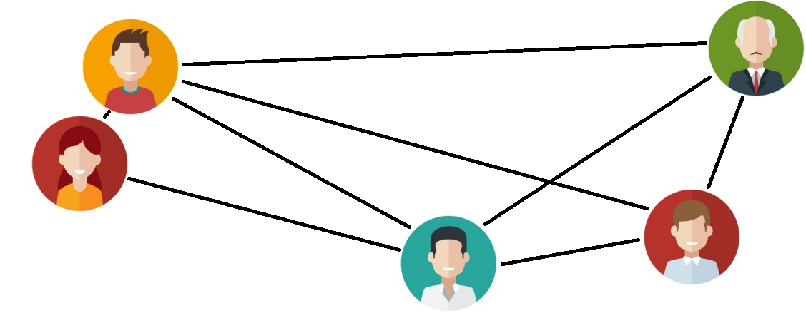
Comparing users
Compare both, eye- and BCI-data for all pairs of users
Jannis and Yessi will explain it for the eye-part in their presentation
The final result will be called „similarity“
The results can be used to improve the searching algorithm
users get videos as search results, which similar users already liked (next sheet)

Slide 9
Search-Algorithm, explained with example (1)
Min has similarity scores for 3 other users:
Daniel: 75%, Mariya: 50%, Benny: 25%
Min searches for „cat“. there are 3 videos for „cat“ (in our data-base):
„ Nyan Cat“, „ Grumpy Cat“, „Simon‘s Cat“
Each of this videos is rated by the other users:
Daniel: {„Nyan Cat“ : „Grumpy Cat“ : „Simon‘s Cat“ : }
Mariya:{„Nyan Cat“ : „Grumpy Cat“ : „Simon‘s Cat“ : }
Benny: {„Nyan Cat“ : „Grumpy Cat“ : „Simon‘s Cat“ : }
Because Daniel more similar to Min, his rating matters more than Benny‘s rating

Slide 10
Search-Algorithm, explained with example (2)
(Copied from previous page):
Similarity: Daniel: 75%, Mariya: 50%, Benny: 25%
Daniel: {„Nyan Cat“ : „Grumpy Cat“ : „Simon‘s Cat“ : }
Mariya:{„Nyan Cat“ : „Grumpy Cat“ : „Simon‘s Cat“ : }
Benny: {„Nyan Cat“ : „Grumpy Cat“ : „Simon‘s Cat“ : }
Scores are calculated, videos sorted by score:
„Grumpy Cat“:( *75% + *50% + *25%) / 150% = 2,9
„Simon‘s Cat“:( *75% + *50% + *25%) / 150% = 2,8
„Nyan Cat“ : ( *75% + *50% + *25%) / 150% = 2,0
„Grumpy Cat“ is the top result, even thought Daniel was the only one who liked it. Because he is most similar to Min!

Slide 11
Summary
Machine learning is not realistic
Most suggestions could be used to improve the search results
We could compare the search-results we get from different attempts
We could try to merge different attempts for one big search function
For example, if similar Users watched a video, we could use this data. But if no similar users watched a video, we could also
We could compare the algorithms for user-classification and user-similarity to those algorithms big webservices like YouTube are using

Slide 12
Why we skip Machine Learning
1. Feed machine with sample data to learn
For example BCI-Data for happy movies and BCI-Data for sad movies
The Computer will learn from this sets, maybe also try to find patterns
2. Once the machine is done learning, you can use
The machine will try to classify given input
In our example, it would try to tell, if a BCI-Data sample is from a happy or sad movie
Problems:
You need much sample-data to teach the machine.

Slide 13
Why we skip Classifying Users
Problems:
Impossible to evaluate the results
Privacy of test-subjects

