Slide 1
EEG and Eye-Tracking Team

Slide 2
Analysis Similarity
Eye-Tracking = A
EEG = B
Combination = C
Determine the weight of the parameters
x*A+ y*B+ z*C = result

Slide 3
Analysis Similarity: Eye Tracking
3 Trailer
9 Participants (8 valuable data sets)
What kind of data do we have?
Fixations
Fixations overlapping (time and location)
Duration of overlapping fixations
Take datasets of two users who watched the same video

Slide 4
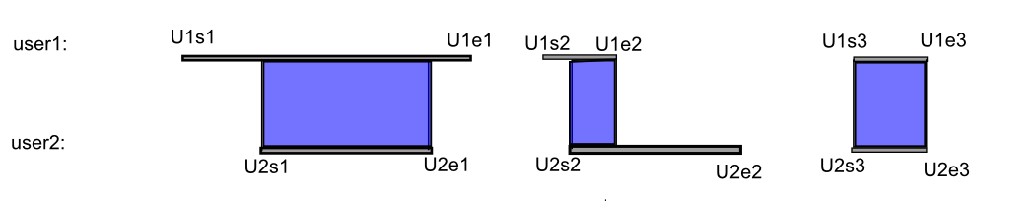
Analysis Similarity: Eye Tracking
min(end1, end2) – max(start1,start2)
Grafik Fixation overlapping
case1: min(U1e1, U2e1) – max(U1s1, U2s1)
case2: min(U1e2, U2e2) – max(U1s2, U2s2)
case3: min(U1e3, U2e3) – max(U1s3, U2s3)

Slide 5
Analysis Similarity: Eye Tracking
User1 & User2 | GotG2 | NLMG | Conj
#overlap | 83 | 42 | 47
overlap_duration | 36,115s | 12,867s | 19.129s
…
Threshold 0
Fixation distance up to 50 px

Slide 6
Analysis Similarity: Eye Tracking
User1 & User2 | GotG2 | NLMG | Conj
#overlap | 41 | 14 | 13
overlap_duration | 26,328s | 6,950s | 9,444s
…
Threshold 0.5
Fixation distance up to 50 px

Slide 7
Analysis Similarity: Eye Tracking
Paper
First step for similarity of users
Overlaps
Compare all data sets
Fetching streamed data
Improve similarity measurement

Slide 8
Analysis Similarity: Emotion-based

Slide 9
Major recorded emotional states
Engagement
Excitement
Interest
Relaxation
Stress
Focus

Slide 10
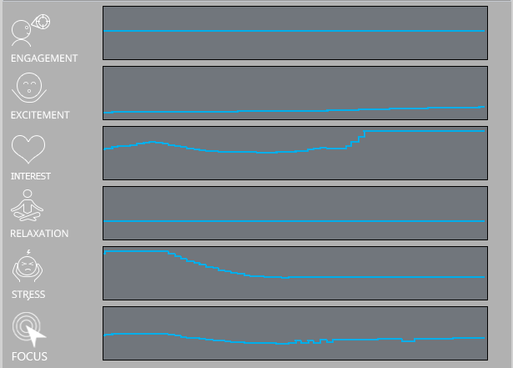
Emotion dynamics example

Slide 11
Dependencies among emotional labels
 | Engagement | Relaxation | Stress | Excitement | Interest | Focus
Engagement | 1 | 0 | 0,11 | 0,07 | 0,11 | 0,46
Relaxation | 0 | 1 | 0,05 | 0,04 | 0,5 | 0,5
Stress | 0,06 | 0,53 | 1 | 0,35 | 0,53 | 0,35
Excitement | 0,1 | 0,24 | 0,21 | 1 | 0,68 | 0,38
Interest | 0,1 | 0,03 | 0,47 | 0,59 | 1 | 0,55
Focus | 0,48 | 0,22 | 0,22 | 0,48 | 0,59 | 1

Slide 12
Input parameters
The output for each emotion is a floating point number between zero and one.
Precision measures run between 65% and 100% depending on the emotion.
Low value emotion indications do not give relevant information for similarity measurement or tagging.

Slide 13
Emotion-based video-tagging
Approach
Define most significant emotions, that are:
In total are most common during the video.
Exceeding the threshold (borderline value 0.5)
Tag video (multiple or all emotions possible).
Videos are recommended based on the relative emotion tags. (same as genre)
Emotional tags displayed in the player in the information about video as a continuous variable.

