Slide 1
HOW MUCH $ CAN YOU EARN ?
Monica, Danny, Harper

Slide 2
INTRODUCTION
Can we learn from workers characteristics data?
Can we predict wages?
Can we find a classifier by gender or race?

Slide 3
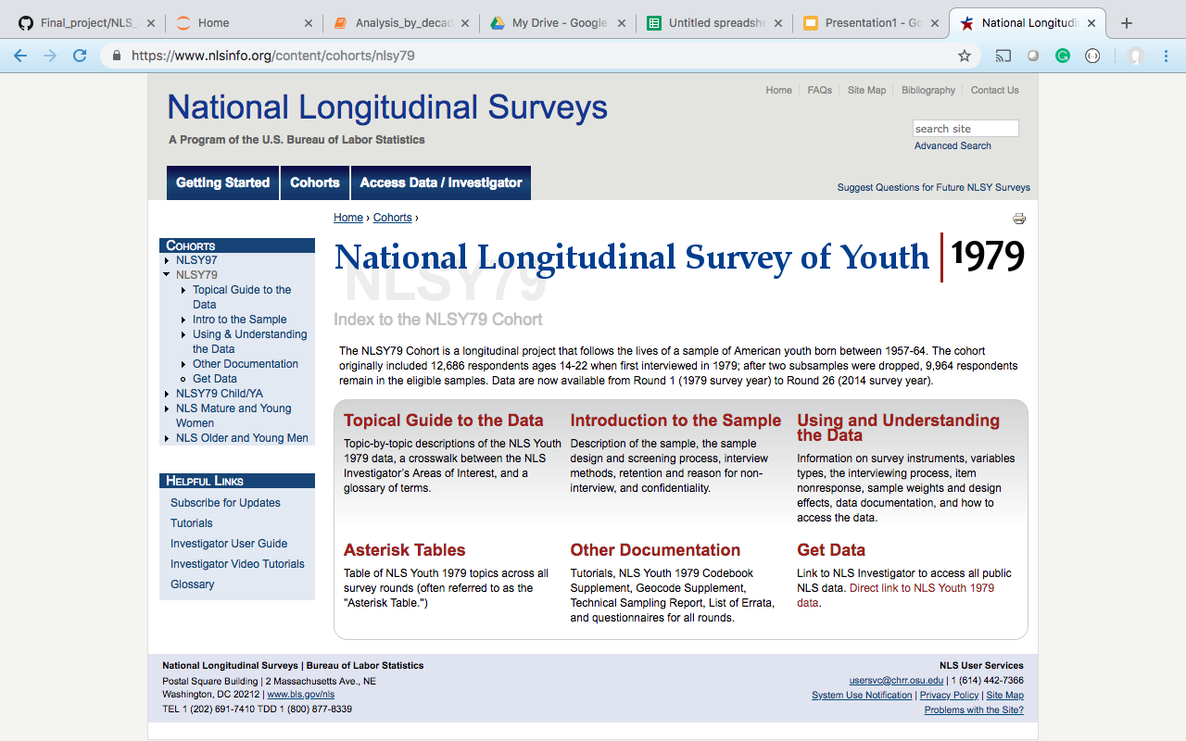
DATA SOURCE

Slide 4
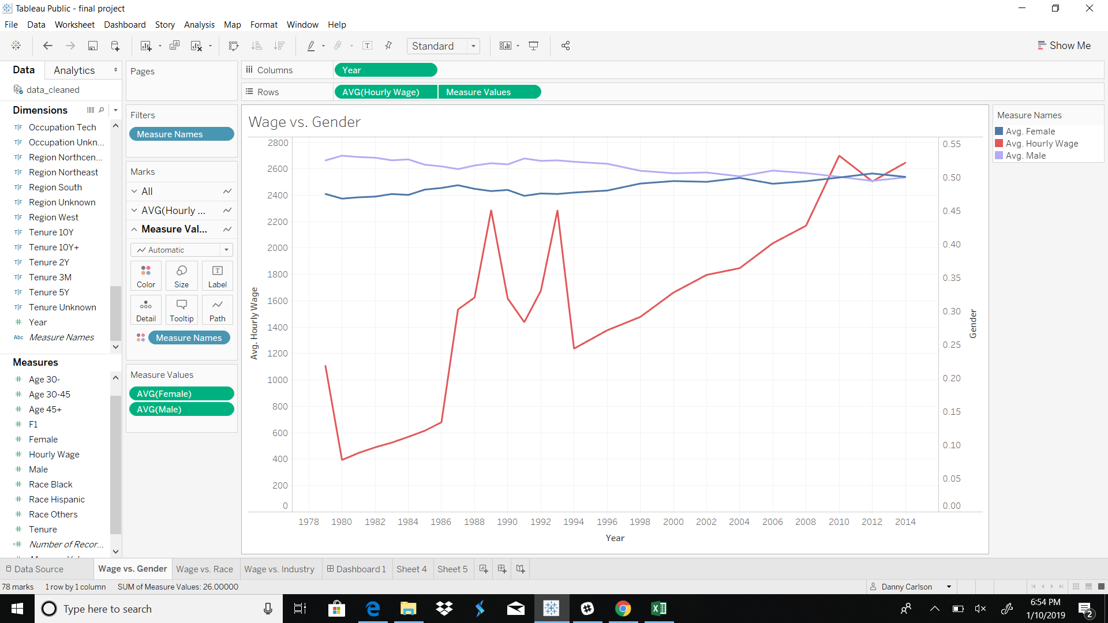
DATA INTERPRETATION

Slide 5
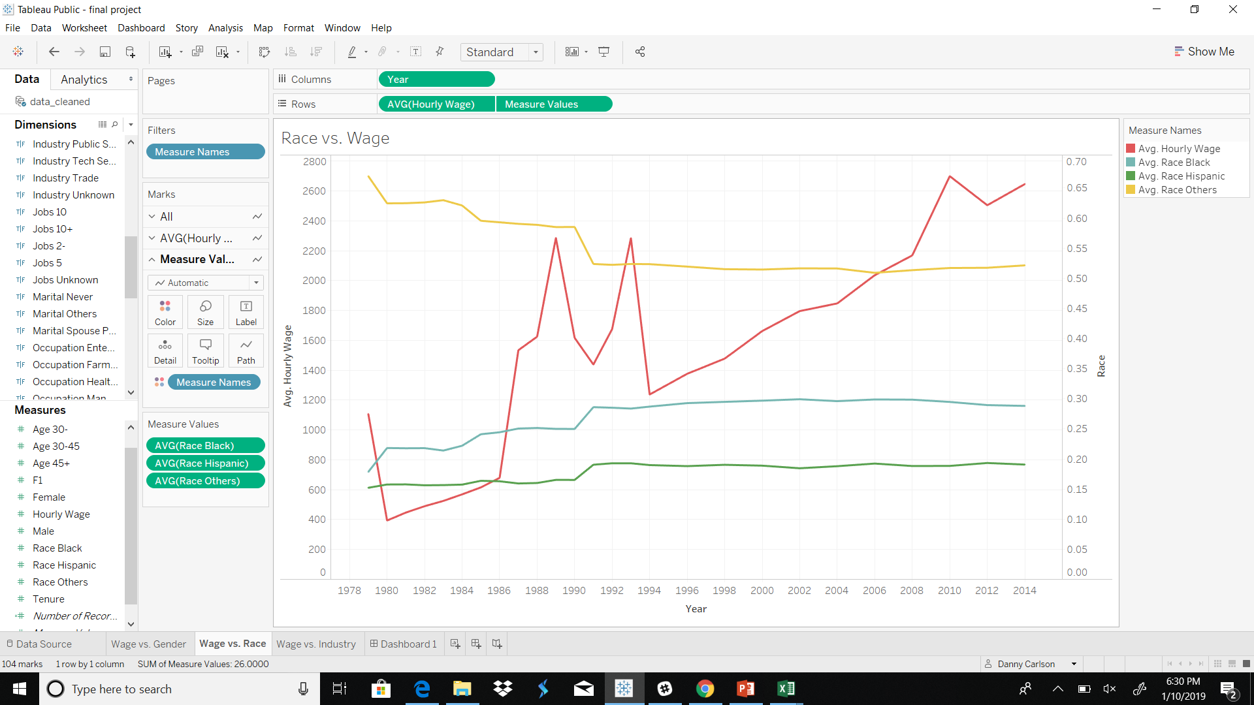
DATA INTERPRETATION

Slide 6

DATA PREPARATION
Original Features:

Slide 7
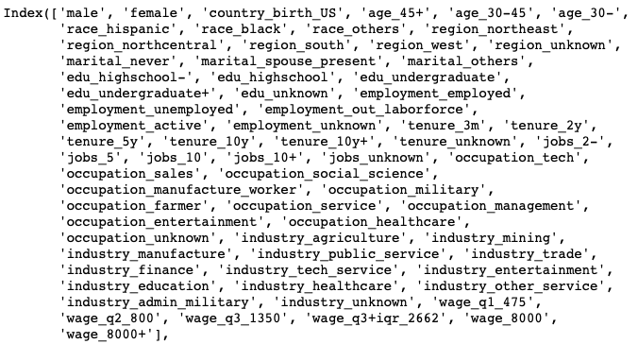
One-hot Encoded Features:

Slide 8
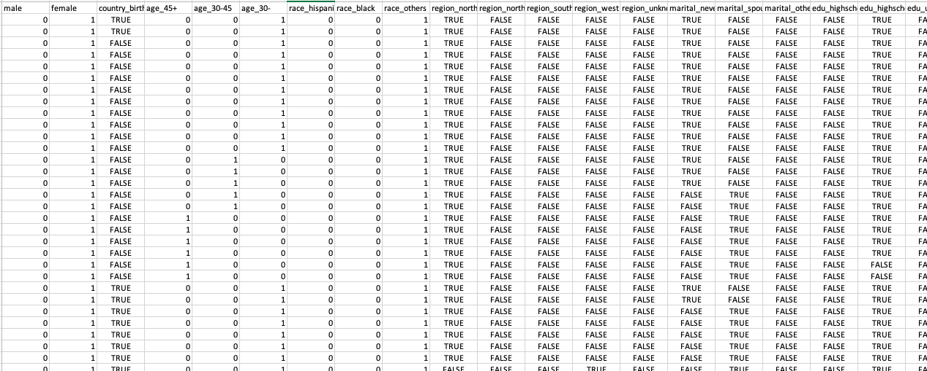
The Sexiest Picture for a Data Scientist

Slide 9
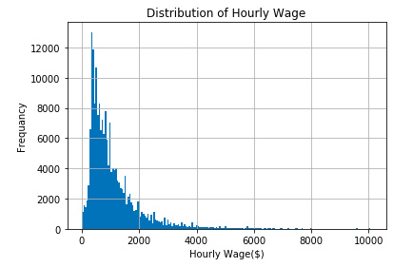
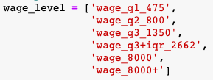
EXPECTED OUTPUTS

Slide 10
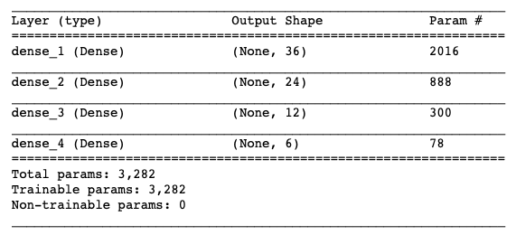
PREDICTION MODEL
Deep-learning
Neural
Network

Slide 11
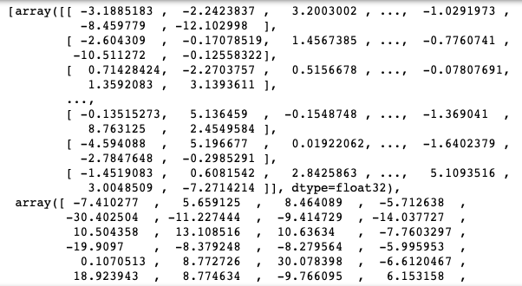
PREDICTION WEIGHTS
Deep-learning
Neural
Network

Slide 12
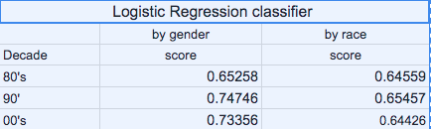
Discrimination ?

Slide 13
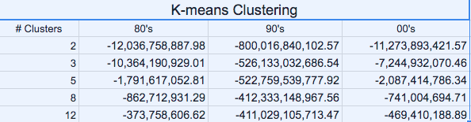
Clustering

Slide 14
SUMMARY & LIMITATIONS
Assuming the full-time working hours per year:
40 h * 48 w = 1920
Median wage per year: $ ?
1) SOURCE DATA QUALITY
2) MODEL PREDICTION ACCURACY
3) OTHERS

