Slide 1
HUMAN COMPUTER INTERACTION

Slide 2
INTRODUCTION
The programming tools for the design of user interface give implementation support for the levels of services for programmers. These include the windowing systems that provide the core support for separate and simultaneous user-system activity. They enable easy programming of the application and the control of dialogue between the system and the user. The interaction toolkits for example, bring programming closer to the level of user perception while the user interface management systems control the relationship between the presentation and functionality.

Slide 3
How Human Computer Interaction affects the programmer
Advances in coding have elevated programming through hardware that specifically improves upon the programmer's Interaction-technique.
The layers of development tools, as earlier mentioned, also contribute to how human computer interaction affects the programmer.
These tools incorporate the windowing systems, the interaction toolkits and the user interface management systems as exemplified in the following:
Layers of development tools
• windowing systems
• interaction toolkits
• user interface management systems

Slide 4
Levels of programming support tools
Windowing systems
device independence
multiple tasks
Paradigms for programming the application
read-evaluation loop
notification-based
Toolkits
programming interaction objects
UIMS
conceptual architectures for separation
techniques for expressing dialogue

Slide 5
Implementation and Evaluation:
Implementation
1. Implementation is the execution of a plan, method or any design, idea, model, specification for doing something or to achieve something.
2. It is an act of implementing something or execute something.
1.1 Implementation Support:
Implementation support is a planned approach to support in implementing a plan or design to ensure success of overall system.
The programming support that is provided for the implementation of an interactive system are:
Programming Tools
Windowing System
Interaction Toolkits
User interface management system (UIMS)
Levels of programming supports tools

Slide 6
1.1.1 Programming Tools:
A programming tool is an application that helps developers create, test, optimize, debug, and maintain other programs. It is designed to assist programmers in various tasks throughout the software development life cycle. Programming tools can be part of a larger single program called an IDE (Integrated Development Environment) or run by themselves from the command line.
Programming tools are categorized as different types based on their functions and purpose, but the most basic are compilers, interpreters, and source code editors (like Notepad++ and Atom). Some tools, like debuggers and profilers, are made with a specific purpose.

Slide 7
List of programming tools
The following list contains several examples of applications that are considered to be programming tools.
Text editors - Text editors are uncomplicated tools designed for editing source code.
Lint software - Lint software identifies syntax errors, deviations from industry standard syntax, common programming errors, and potentially incorrect constructs. It is specific to the programming language it's checking.
Debuggers - Debugging tools help programmers identify and fix errors (bugs) in their code.
Version Control Systems - VCS tools, such as Git, help developers manage changes to source code over time. They enable collaboration by allowing team members to track and revert each other's changes using a system of pushes and pulls.
Compilers and interpreters - Compilers translate source code to machine code or some intermediate form, while interpreters can execute code directly. Examples include GCC (GNU Compiler Collection), a compiler, and Python, an interpreted language.
Performance profilers - These tools help developers analyze the performance of their code by identifying bottlenecks and resource-intensive areas.
Database management tools - Tools like MySQL assist in the development, querying, and management of databases.

Slide 8
WINDOWING SYSTEMS
A windowing system is a computing term. It refers to a way a computer operating system (OS) displays computer programs on a computer screen. It is a type of graphical user interface (GUI) using windows, menus, and a pointer. Microsoft Windows is a popular OS that uses a windowing system.
Functions of Windowing Systems (as Programming Support Tools)
Device independence – hiding some of the differences between different IO devices
Resource sharing – allowing multiple applications to use the same keybaord, screen, etc.
Application management – swopping control between applications and various cross-application functions such as cut and paste

Slide 9
1. Device Independence
Definition: Device independence means hiding the differences between various input/output (I/O) devices so that programs can run without needing to be rewritten for each type of hardware.
Explanation: Developers don’t have to worry whether the program runs on a touchscreen, keyboard, or mouse-based system. The windowing system acts as a middle layer that handles these differences.
Example: A drawing program works the same whether the user has a stylus, a mouse, or a touchpad because the windowing system interprets all these inputs in a standard way.

Slide 10
2. Resource Sharing
Definition: Resource sharing refers to the ability of multiple applications to use the same physical devices, such as the keyboard, mouse, and screen, at the same time (in a controlled manner).
Explanation: Instead of giving one program full control of the keyboard or screen, the windowing system ensures that all open applications can receive input/output when appropriate. It manages input focus (which window gets keyboard input) and output (which window is drawn on top).
Example: You can write a report in a word processor while listening to music from a media player—both are using the same screen and keyboard, managed by the windowing system.

Slide 11
3. Application Management
Definition: Application management involves switching control between applications and providing cross-application services like copy-paste or drag-and-drop.
Explanation: The windowing system allows users to switch between open applications (alt-tab, mouse click) and enables interactions between applications.
Cross-Application Functions Include:
Cut/Copy/Paste: Copy text from a browser and paste it into a word processor.
Drag and Drop: Move a file from the desktop to an email client window.
Clipboard Management: Temporarily stores data to share between apps.
Example: You can copy a paragraph from a PDF reader and paste it into a presentation app. The windowing system handles the transfer of data between the two.

Slide 12
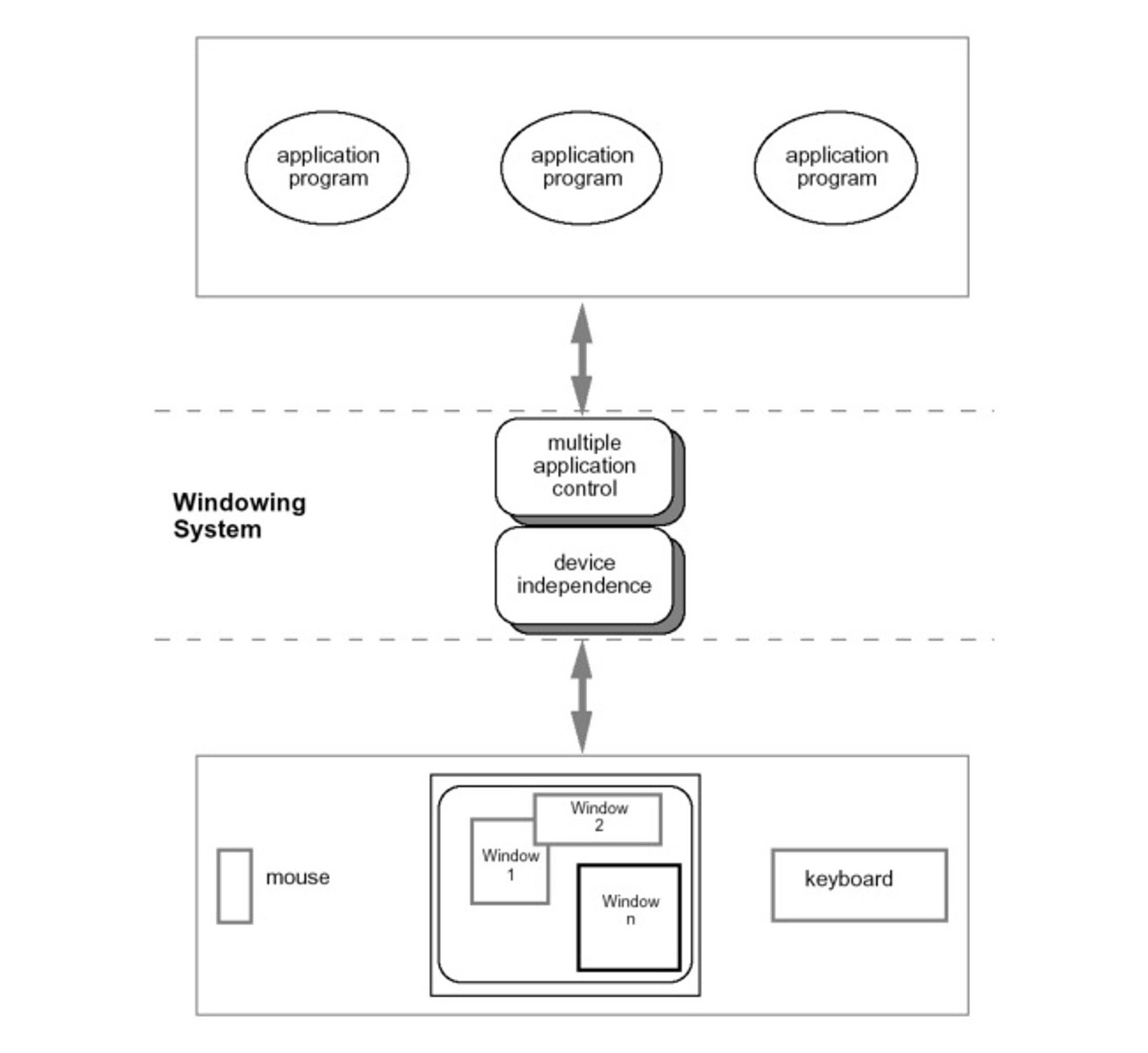
Role of a windowing system
As shown in the diagram above, the windowing system comprising the multiple application control and the device independent control enables the interface between the application programs and the user

Slide 13
The Architectures of windowing systems
The Architectures of windowing systems are analyses through three possible software architectures. if we all assume device driver is separate and know how they differ and how the multiple application management is implemented.
The three possible software architectures are in the following forms: 1.When each application manages all processes. Here, everyone worries about synchronization and reduces portability of applications
2.When management role within kernel of operating system ensures that applications are tied to operating system, and
3.When management role as separate application ensures maximum portability

Slide 14
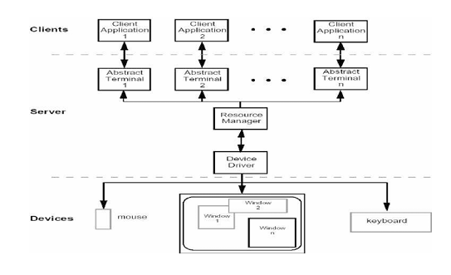
The client-server architecture

Slide 15
X Windows architecture
The X Windows architecture comprises the Pixel imaging model with some pointing mechanism and the X protocol that defines the server-client communication.
The architecture also contains a separate window manager client that enforces policies for input and output.
Policies on how to change input focus, how the tiled windows compare with overlapping windows and policies on inter-client data transfer. See the pictorial illustration below.

Slide 16
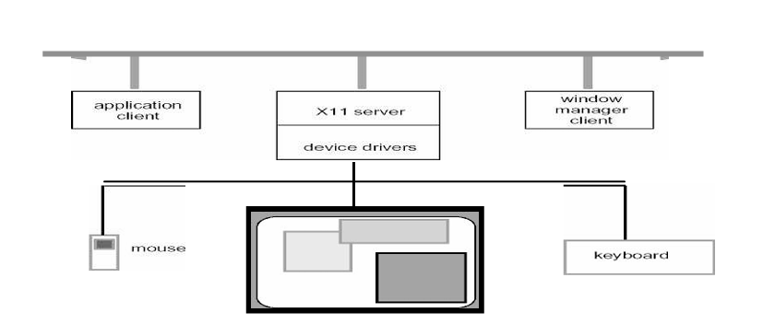

Slide 17
Paradigms for programming the application
In Human-Computer Interaction (HCI) and application development, different paradigms for programming applications influence how users interact with software systems. Two such paradigms are:
read-evaluation loop
notification-based

Slide 18
1. Read-Evaluation Loop (REPL)
The Read-Evaluation Loop is a programming model often used in command-line environments. In this paradigm, the system follows a continuous cycle that involves four main steps:
Read – The system waits for the user to input a command or expression.
Evaluate – The input is processed or executed by the system.
Print – The result of the execution is displayed to the user.
Loop – The system returns to step one and waits for the next input.
This loop continues indefinitely until the user exits the program.
This model is highly interactive and gives immediate feedback. It is most commonly used in interpreters for programming languages like Python, Lisp, and MATLAB. Because of its interactive nature, it’s very helpful in learning environments and during software testing or prototyping. Users can test small code snippets without writing a full program.

Slide 20
The diagram shows a typical Read-Evaluation Loop model implemented in a Client-Server architecture. It demonstrates how a client application continuously interacts with a user, communicates with a server, and indirectly interacts with a device through that server.
1. Client Application (Main Loop)
This is where the user interacts directly. It contains the main control loop of the program:
a. Start
Marks the beginning of the application execution.
b. Read Input
The application waits for the user to enter some input (e.g., typing a command or pressing a button).
c. Process Input
After receiving the input, the application processes it.
Processing may include validating the input, deciding what to do next, and possibly preparing a request to send to the server.
d. Quit? Decision
The system checks whether the user wants to quit the application.
Yes: The program ends.
No: It loops back to "read input" and continues.
This loop is a classic Read-Evaluate-Print Loop (REPL) structure.

Slide 21
2. Server
Acts as a middle layer between the client and the device.
The client may send commands or requests to the server after processing input.
The server handles more complex operations or acts as a gateway to external devices.
3. Device
Represents an external physical or virtual device (e.g., a printer, sensor, actuator).
The server communicates with the device based on the client's instructions.

Slide 22
Interaction Pattern
The client application continuously waits for and responds to user input.
The server acts as a central processor or manager of tasks, forwarding data to/from the device.
The device executes actual tasks or provides data in response to commands from the server.
This is an example of a command-driven model, based on a read-evaluation loop. It shows a layered architecture: User → Client → Server → Device. The client only stops running when the user chooses to quit. The server and device interaction is abstracted away from the user, promoting separation of concerns.

Slide 23
2. Notification-Based Programming (Event-Driven Programming)
Notification-based programming is a paradigm where the application waits for specific events to occur. These events can come from the user (like clicking a button, typing a key, or moving the mouse) or from the system (such as a timer reaching a certain value or a sensor detecting a signal).
Unlike the REPL model where the user continuously gives commands, in this paradigm the program stays idle until something happens. When an event occurs, the system notifies the application, and the application responds by running a handler function that is specifically written for that event.
This is how most graphical user interfaces (GUIs) work. Buttons, menus, and forms don’t do anything until the user interacts with them. The program doesn’t follow a fixed sequence but instead waits and reacts to inputs, giving users more control over how and when they interact with the application.
Example Scenario: In a weather app, when the user clicks the “Refresh” button, the program receives a click event, and then runs a function that fetches the latest weather data and updates the screen.This paradigm is extremely useful in applications that require flexibility, responsiveness, and real-time interactions.
The Notification-Based Paradigm is more like setting up a system of listeners that respond whenever something happens. It is commonly used in GUI-based applications and systems that rely on user interactions or external triggers.

Slide 24
The diagram you’ve shared illustrates the Notification-Based Programming Paradigm, commonly used in event-driven systems such as GUIs or real-time applications. Let’s walk through and explain each part of the diagram step by step.

Slide 25
This flowchart represents how an application works together with a notifier (or event handler system) using callbacks to handle input and trigger actions.
The system is divided into two parts:
Application – The main program logic.
Notifier – The system that listens for events (like user actions) and dispatches them.
1. Start
The application begins execution.
2. Register Callbacks with Notifier
The application defines callback functions—special functions designed to respond to certain types of events (e.g., mouse click, key press).
These callbacks are registered with the notifier.
This means the notifier now "knows" which function to call when a specific event occurs.

Slide 26
3. Call Notifier
The application hands over control to the notifier.
From this point, the notifier handles all user input or events and decides which callback should be executed.
Notifier’s Role (Event Loop)
Now the notifier continuously waits for input and handles it as follows:
4. Read Input
The notifier listens for user input or external events (e.g., button click, network signal).
5. Send to Appropriate Callback
Based on the type of event, the notifier identifies and calls the correct callback function that was registered earlier by the application.

Slide 27
6. Callback Request Quit?
The callback function may signal a request to quit (for example, the user presses a “Close” button).
If yes, the process terminates.
If no, control continues, and the notifier waits for the next event.
7. Process Event (Application)
Once a callback is called and an action is completed, the application may perform additional logic as needed (e.g., updating the interface, saving data).
Then, it returns control to the notifier.

Slide 28
Continuous Loop
This process repeats:
The notifier waits for events.
On event, it calls the relevant callback.
The callback may do some work, optionally ask to quit.
The application may process further, then the cycle continues.
This diagram clearly represents the notification-based (event-driven) model, which:
Is asynchronous: things happen when events occur.
Uses callbacks to respond to specific events.
Is used in interactive applications, especially in GUIs, web apps, and real-time systems.
Example in Real Life: In a mobile app, you tap a button.The system (notifier) reads the tap (input) and calls the function (callback) that was linked to the button.The callback may show a message or perform some task.This repeats until you exit the app.

Slide 29
User Interface Toolkits
Toolkits used with particular windowing systems add another level of abstraction by combining input and output behaviors to provide the programmer with access to interaction objects from which to build the components of the interactive system. Toolkits are amenable to external dialog control by means of callback procedures within the application.
A user interface (UI) kit is a collection of graphic files (usually PSD) and resources that can help designers with the task of building UIs for their applications.
UI kits typically include the user interface components that convey meaning and provide functionality to users – think buttons, widgets, checkboxes, progress bars, and navigation buttons. Some kits may also provide a framework to underpin your site or app’s layout.
Essentially, UI kits include all of the components of a user interface that you may not need to be spending time designing yourself.

Slide 30
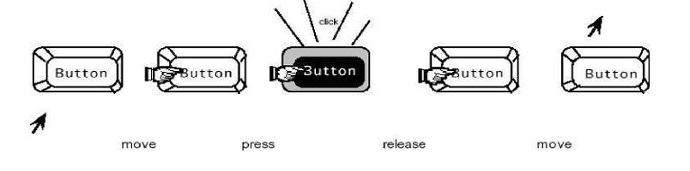
Example of behavior of a button interaction object
we show an example of how input and output are combined for interaction with a button object. As the user moves the mouse cursor over the button, it changes to a finger to suggest that the user can push it. Pressing the mouse button down causes the button to be highlighted and might even make an audible click like the keys on some keyboards, providing immediate feedback that the button has been pushed. Releasing the mouse button unhighlights the button and moving the mouse off the button changes the cursor to its initial shape, indicating that the user is no longer over the active area of the button.

Slide 31
User interface management system (UIMS):
User interface management systems are the final level of programming support tools. It allows the designer and programmer to control the relationship between presentation object of a toolkit with their functional meaning in the actual application.
There are many good arguments to support this sepration of concerns:
1. Portability : To allow the same application to be used on different systems is best to consider.
2. Reusability: component can be reused in order to cut development costs.
3. Customization: The user interface can be customized by both the designer and the user to increase its effectiveness without having to alter application.

Slide 32
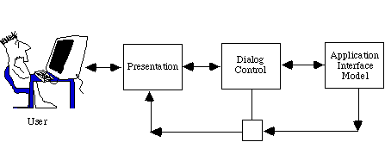
Conceptual architecture of a User Interface Management System (UIMS)

Slide 33
Logical Components of UIMS:
Presentation Component
Purpose: Manages how information is displayed to the user.
Function: Responsible for the visual appearance of the interface, including windows, buttons, menus, and layout.
Example: Drawing text on screen, showing a dialog box.
Dialog Control Component
Purpose: Controls the sequence and logic of interaction between the user and the system.
Function: Manages how the system responds to user inputs, and how different UI elements interact.
Example: If a user clicks "Submit", the dialog control determines what happens next (e.g., check if form is filled correctly).
User Interaction Component (Input/Output Handling)
Purpose: Handles user inputs (like mouse, keyboard, touch) and outputs (displaying messages).
Function: Detects and processes user actions and sends them to the dialog controller.
Example: Detecting a button click or mouse movement.
Application Interface Component
Purpose: Connects the UI with the application logic or back-end.
Function: Translates UI events into actions that the core application understands, and returns results to the UI.
Example: Sending a login request to the authentication module after the user enters credentials.

Slide 34
User Interface Management Systems (UIMS)
What is UIMS (User Interface Management System)?
A UIMS is an additional software layer that sits on top of a UI toolkit.
Its goal is to make it easier to design and manage user interfaces.
It abstracts away the programming details and gives simpler tools for interaction management.
Functions of a UIMS:
Manages input and output communication
Maps user actions to system responses
Separates interaction logic from application logic
Helps maintain consistency and structure in complex interfaces

Slide 35
UI Development System (UIDS)
A UI Development System (UIDS) is a software framework or toolkit that helps developers and designers create user interfaces (UIs) more easily—often without needing to write a lot of code. The purpose of a UIDS is to simplify the design and development process by offering pre-built tools, visual editors, and interactive components that can be used to build an interface quickly.
In traditional development, programmers often use low-level toolkits (like Java Swing, Tkinter, or Windows API) that require writing detailed code to create even basic interface elements like buttons or text boxes. This can be time-consuming and challenging, especially for people who are not experienced in coding.

Slide 36
A UIDS changes this by offering a more user-friendly way to build interfaces. Instead of coding every UI element, a designer or developer can use a graphical editor to:
Drag and drop components (like buttons, sliders, menus, etc.)
Adjust properties (such as size, color, position) using settings panels
Link actions (such as "when this button is clicked") to responses using visual workflows or simple scripts
Because of this visual and simplified approach, UIDS tools are very helpful in situations where speed and usability are important, and where non-programmers (like designers or business analysts) are involved in UI creation.

Slide 37
Examples of UIDS tools:
MIT App Inventor – used to build Android apps by dragging and dropping blocks.
Microsoft PowerApps – used to create business apps without heavy programming.
Delphi RAD Studio – an older but powerful rapid UI development tool.
Key Features of a UIDS:
Component libraries: Pre-designed UI elements ready to use.
Visual layout editors: Arrange elements using a GUI, not code.
Property and event editors: Set behavior and appearance through menus or panels.
Preview and testing tools: See how the interface looks and works instantly.
Why UIDS is Useful:
Makes UI development faster and less error-prone
Encourages collaboration between designers and developers
Helps non-programmers contribute directly to UI design
Promotes consistency by reusing components and templates
In short, a UI Development System (UIDS) makes the process of creating user interfaces more accessible, visual, and efficient—especially in environments where speed and usability matter more than full control over the underlying code.

Slide 38
UI Development Environment (UIDE)
A UI Development Environment (UIDE) is a specialized software platform that helps developers and designers build, test, and manage user interfaces (UIs) in an interactive and visual way. It combines graphical tools, code editors, and debugging utilities all in one place — much like an Integrated Development Environment (IDE), but focused specifically on designing user interfaces.
In a UIDE, developers don’t have to write everything from scratch. Instead, they can use visual layout editors to drag and drop components like buttons, text fields, and images onto a screen. The environment often provides a design view, where the interface is created visually, and a code view, where advanced users can fine-tune the behavior using programming code.
One of the key advantages of a UIDE is that it allows the designer to see immediate feedback. As soon as you make a change — like resizing a button or changing its color — you can preview it instantly. Some UIDEs also simulate how the interface will look and behave on different screen sizes or devices, which is very useful for designing mobile or responsive apps.

Slide 39
What Does a UIDE Typically Include?
A typical UIDE includes:
Visual Editor – A drag-and-drop interface for placing UI components.
Code Editor – An area to write or modify the source code if needed.
Component Palette – A collection of UI elements like buttons, labels, checkboxes, etc.
Property Inspector – A panel to edit properties such as size, color, text, and events.
Preview/Simulator – Allows you to run or simulate the UI without deploying it.
Debugger – Helps find and fix errors in the interface logic.
Examples of UIDE Tools:
Android Studio – for building Android apps with XML layout and a visual designer.
Xcode Interface Builder – for designing iOS/macOS interfaces.
Visual Studio (Windows Forms/WPF) – for designing desktop apps visually.
Unity UI Editor – for designing game interfaces with a scene view and inspector.

Slide 40
Why Use a UIDE?
Using a UIDE speeds up interface development because it lets you design and test at the same time. It also makes it easier for teams to collaborate — for example, a designer can handle the layout and style, while a programmer adds the logic behind it.
Unlike low-level programming where every button must be written in code, UIDE tools make UI building visual, modular, and efficient. And unlike a simple UIDS (UI development system), which might focus only on drag-and-drop creation, a UIDE offers both design and development features, making it a complete environment.
UI Development Environment (UIDE)
A UIDE is a complete software environment for creating and managing user interfaces.
It includes visual tools and code tools to support both designers and developers.
It makes UI development faster, easier, and more accurate, with live previews and testing.
It is especially useful in modern software projects where interface quality and user experience are crucial

Slide 41
Implementation of UIMS
Techniques for Dialogue Controller Design
A dialogue controller is a part of a user interface system that manages how users interact with the system — the flow of commands, inputs, and system responses. It defines the structure of interaction, like what can happen next, based on what just happened.
To build or design a dialogue controller, several modeling techniques are used. Each of these techniques represents the flow of interaction in a different way, depending on the kind of interface being developed.
1.Menu Networks
This technique is based on menus, where users select options from lists. Each menu leads to another screen or sub-menu. The dialogue is structured as a network of menus, where each menu is a node and choices are links.
Useful for systems with limited user input or predefined paths (e.g., ATMs, kiosks).
Easy to implement, but may limit flexibility.
Represents a tree or graph structure of choices.
Example: In a banking app: Main Menu → Account Info → Balance → Back to Main Menu.

Slide 42
2. Grammar Notations
In this method, interaction is modeled using formal grammar rules, similar to how languages are defined. It describes how valid sequences of user actions are structured.
Inspired by BNF (Backus-Naur Form) used in programming languages.
It defines valid syntax of commands or inputs.
Useful for command-line interfaces or structured input systems.
Example: <command> ::= print <file> <file> ::= filename.txt | filename.pdf
This tells the system what valid input "sentences" look like.

Slide 43
State Transition Diagrams
Here, the user interface is represented as a set of states and transitions between those states, based on user input or system events.
Each state represents a specific screen or situation.
Transitions represent events or actions that cause the state to change.
Useful for modeling flow, especially in interactive systems like games, apps, and forms.
Example: State: Login Screen → Event: User submits credentials → State: Dashboard
Event Languages
An event language is used to define the interaction between events and responses in a structured format. It allows designers to specify what happens when certain events occur, like mouse clicks, keystrokes, or system signals.
It helps define how components respond to user actions.
Often used in GUI toolkits and event-driven programming environments.
Can define event-action rules like: "If button is clicked → show confirmation box."
Example:ON Click(Button1) DO SubmitForm

Slide 44
Declarative Languages
Unlike procedural programming (which says how to do something), declarative languages specify what the interface should be like, and the system figures out how to make it happen.
Focus is on what should appear or happen, not how.
Examples include HTML for structure, CSS for style, and XAML for UI in .NET.
Easier to describe static layouts and constraints.
Example
In HTML:<input type="text" placeholder="Enter name">
This declares that a text box should be shown — no code for rendering it is needed.

Slide 45
Constraints
Constraints are rules or conditions that define how interface elements can behave or interact. Instead of writing procedural logic, designers specify conditions like size limits, alignment, or relationships between objects.
Widely used in layout managers, form builders, and responsive UIs.
Helps maintain consistency and structure.
Often used with declarative or visual languages.
Example: "Button must always stay below the text field and centered horizontally.“
Graphical Specification
This method uses visual modeling tools to define interaction. It may include diagrams, flowcharts, or GUI mockups where the designer can draw the dialogue structure.
Great for non-programmers or designers.
Often supports drag-and-drop design and simulation of user flows.
Used in tools like Android Studio (design mode), Storyboard editors, or Sketch tools.
Example: Drawing boxes for screens and arrows to show user navigation from one screen to another.

Slide 46
Each of these techniques offers a different way to model user interaction:
Technique | Best For
Menu Networks | Simple menu-based systems
Grammar Notations | Structured command inputs
State Transition Diagrams | Interactive flows and behaviors
Event Languages | Defining event-response logic
Declarative Languages | Describing static layouts
Constraints | Managing layout rules and relationships
Graphical Specification | Visual design and flow modeling
These techniques help UI designers and developers create interfaces that are well-structured, intuitive, and easy to maintain.

Slide 47
Universal Design:
Universal design is an approach for designers to make products and services accessible and usable for the largest possible audience without needing adaptation or specialized design. Designers use its seven principles to create a solution catering to as many users as possible.
Why Does Universal Design Matter?
Universal UX design is rooted in 1970s’ architecture. Ron Mace, who coined the term “universal design,” advocated for the design of environments that all individuals can access, regardless of their abilities. A group at The Center for Universal Design at North Carolina State University developed the concept further in 1997.
Universal design is closely related to accessibility. The belief that accessibility and usability go hand in hand is the foundation of universal design. Flexibility, adaptability, and simplicity are vital parts of it. As a designer, you can stretch these to the greatest extent in products or services everyone should be able to access and use. The question of the users’ ability and background shouldn’t matter.

Slide 48
Universal Design, Inclusive Design, and Design for All: What’s the Difference?
Universal design, inclusive design, and design for all share common ground. Universal design and inclusive design are often confused. In universal design, you create a single solution to accommodate a wide range of users, including many factors to satisfy the most users possible. Additionally, you incorporate insights about the users’ physical and cognitive abilities, age, gender, race, and ethnicity into the design of one experience. This will be a product or service that they all can access, use and enjoy.
In design for all, you build accessible features into your design from early in the design process. It’s an approach that considers the needs of all users and allows for variations of one design so as to reach them all. By including users with disabilities early on, you ensure you consider their needs and cater to them in full, rather than revisit them later with adjustments to your initial release. On the other hand, inclusive design goes further. In inclusive design, you go the extra mile to target the needs and experiences of groups that “mainstream” design often marginalizes or excludes. When you set out to create an inclusive design, you especially account for the diverse perspectives and backgrounds of your users. In your design process, you include users from different ethnicities, genders, and/or with cultural differences, varying language abilities and preferences, and more. Inclusive design results in products and services that all users find accessible, usable, culturally sensitive, and welcoming. However, you may provide multiple design solutions—not just one—per project to cater to different user groups.

Slide 49
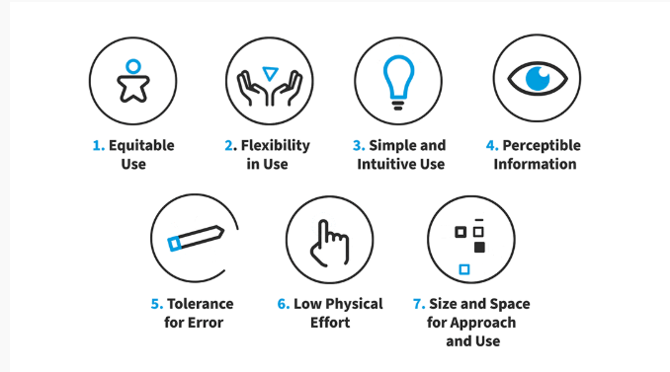
The 7 Principles of Universal Design and How to Apply Them

Slide 50
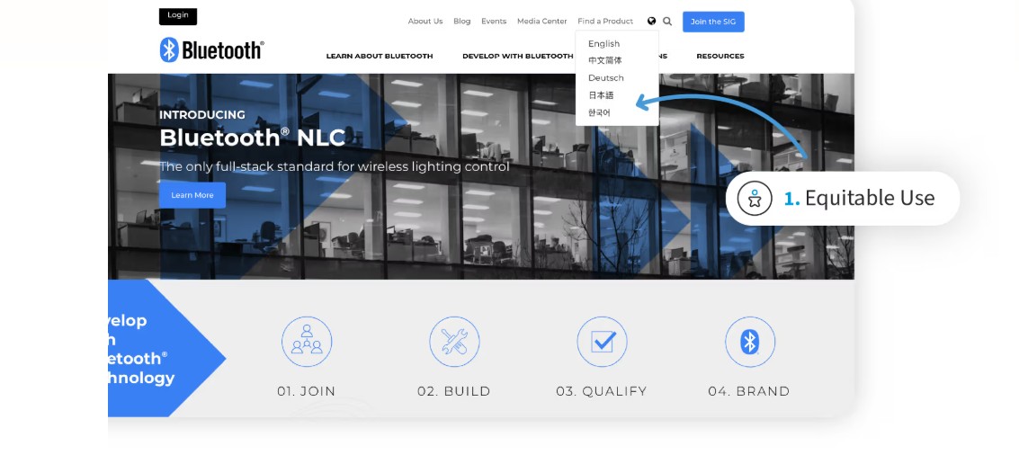
Equitable Use: Design products and services that people of all ages, sizes, and abilities can use.
Bluetooth’s homepage has an option to select the language (world icon, top right). The equitable use is that users can enjoy the experience on the site even if they do not speak English.

Slide 51
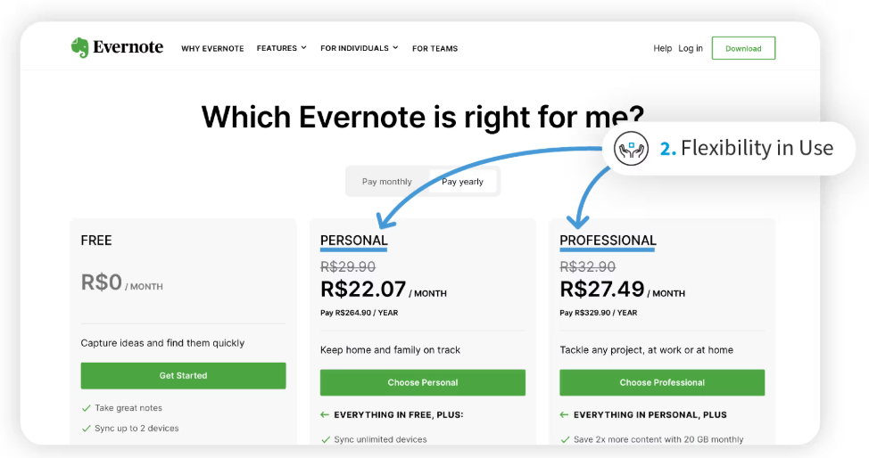
Flexibility in Use: Design products and services that users can use in multiple ways to accommodate different user preferences and abilities.
Evernote’s homepage offers flexibility in use via options to select. Users can approach Evernote in different contexts, for personal projects or for professional, team-based ones.

Slide 52
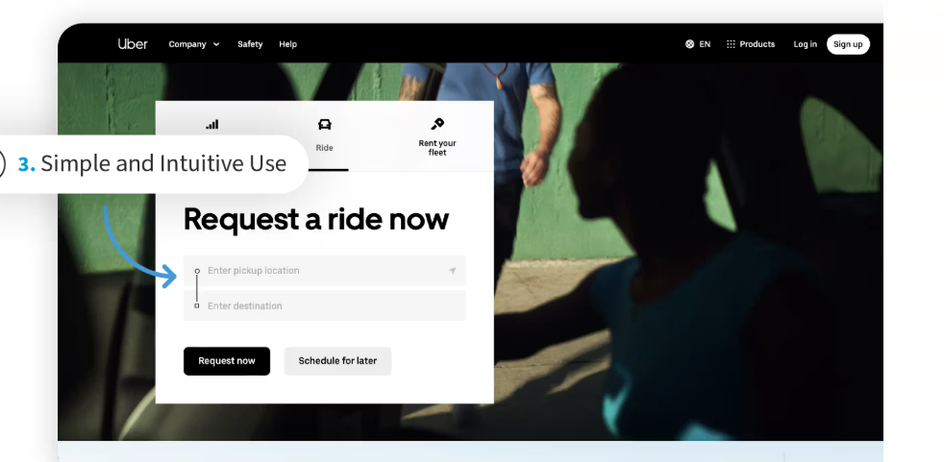
Simple and Intuitive Use: Design products and services with an intuitive interface that users find easy to understand and use.
Uber’s ultra-easy Ride section offers users the quick convenience of pickup location and destination.

Slide 53
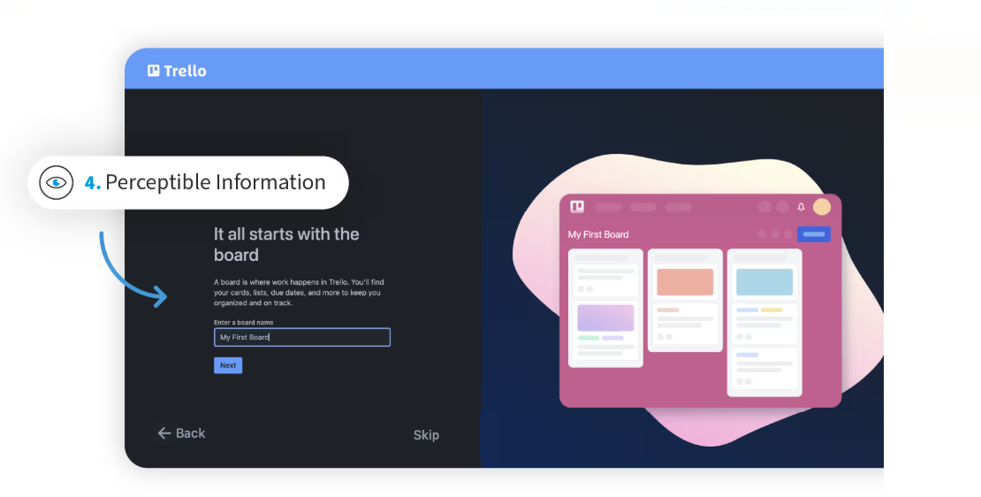
Perceptible Information: Design products and services with clear communication to ensure users have the information they need to use the product successfully.
Trello clearly informs users what to do to get started.

Slide 54
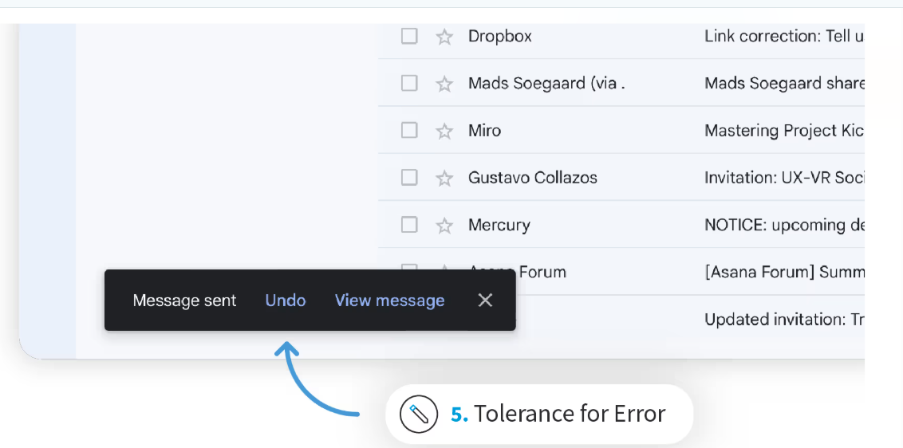
5. Tolerance for Error: Design products and services with built-in safeguards. Help prevent users from making mistakes or encountering unexpected results.
Google’s Gmail offers an Undo feature; for a few seconds, users can recall messages.

Slide 55
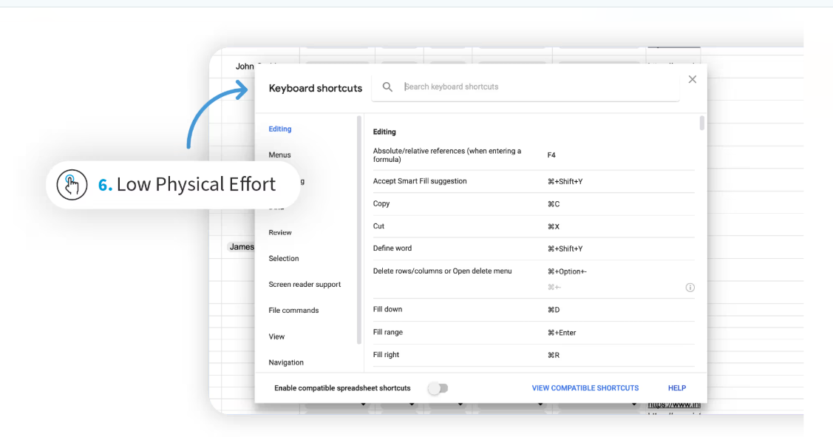
Low Physical Effort: Design products and services that demand minimal physical effort to use.
Google Docs offers Keyboard shortcuts for users to work with Google Sheets more efficiently.

Slide 56
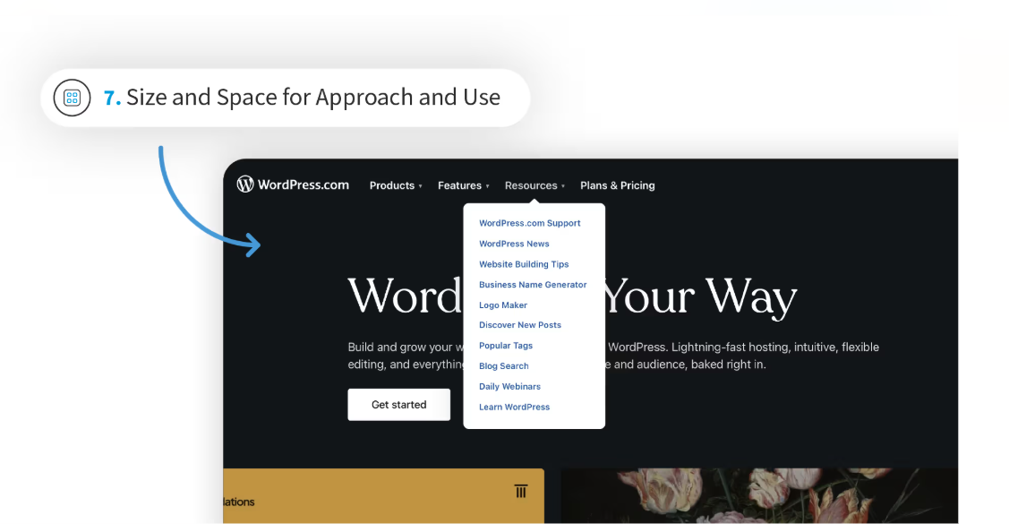
Size and Space for Approach and Use: Design products and services with enough size, space, reach range, or manipulation area for a variety of user needs and abilities.
WordPress’s homepage offers users generous amounts of space to access desired dropdowns (at the top of the webpage).

Slide 57
END

