Slide 1
Analysis on the esports industry
UC Davis Bootcamp Final Project
Monica Wang

Slide 2
Content
Q’s asked
01
02
Model
Prediction
03
04
Problems
Challenges
05

Slide 3
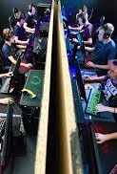
Questions Ask of the Data
What decides the influence of an esports championship/tournament?
How does the attention on one esports convention change with the popularity of the game?
Possible application of the model

Slide 4
Model Components
Active Players Count
Publish Date
Game Duration
Total View Count

Slide 5
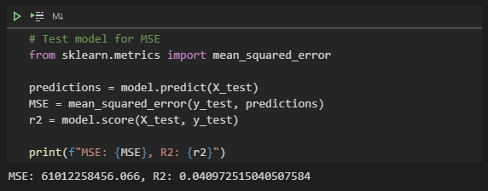
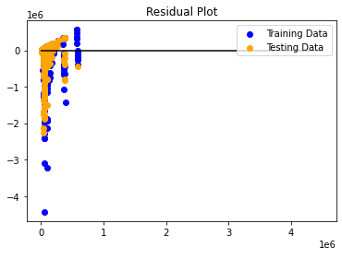
Prediction quality
?
Good prediction?
NO!

Slide 6
Possible Problems
1
Invalid Data Clean Up
2
Inaccurate Data
3
Lack of Information

Slide 7
Challenge
Scraping Data
Looking for player counts information
Adding player counts accordingly

Slide 8
Thank you！

