Slide 1
JENKINS TUTORIAL

Slide 2
Installation

Slide 3
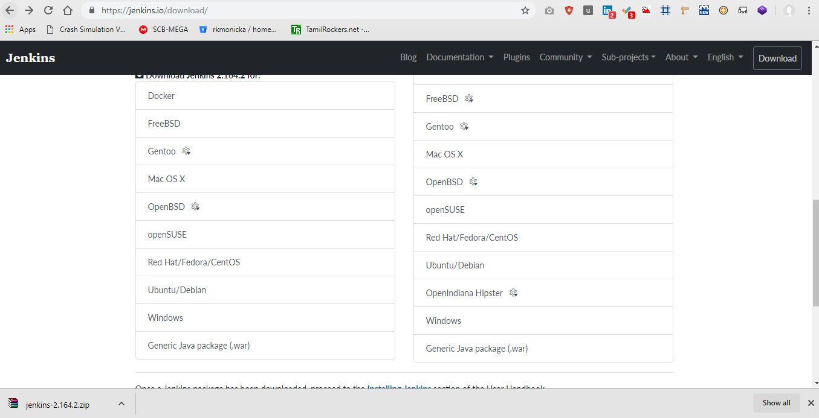
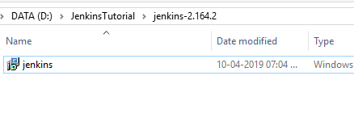
https://jenkins.io/download/

Slide 4
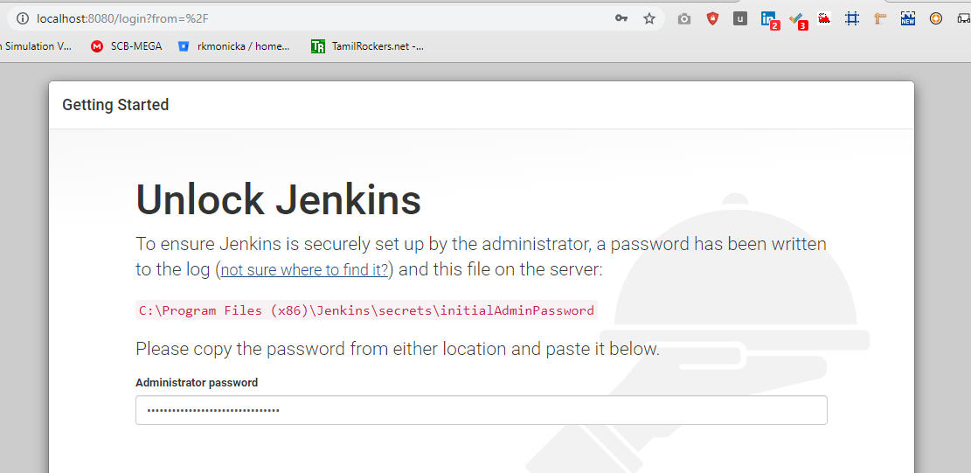
Jenkins Login Credentials

Slide 5
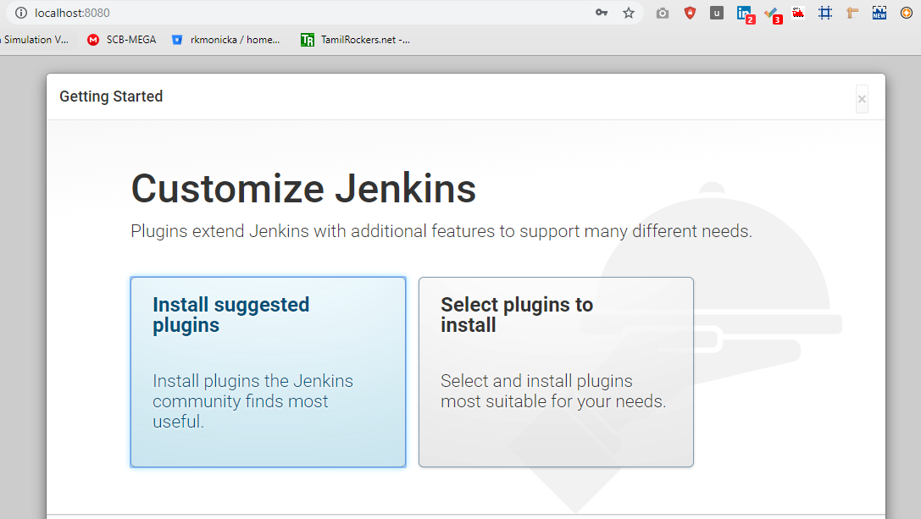
Jenkins Setup

Slide 6
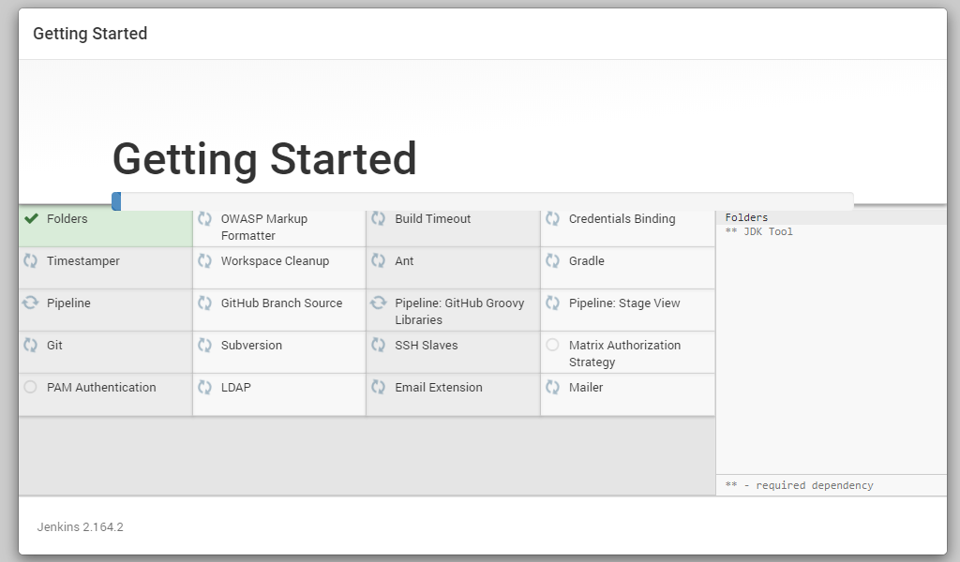
Install Suggested Plugins

