Slide 1
JENKINS TUTORIAL

Slide 2
Installation

Slide 3
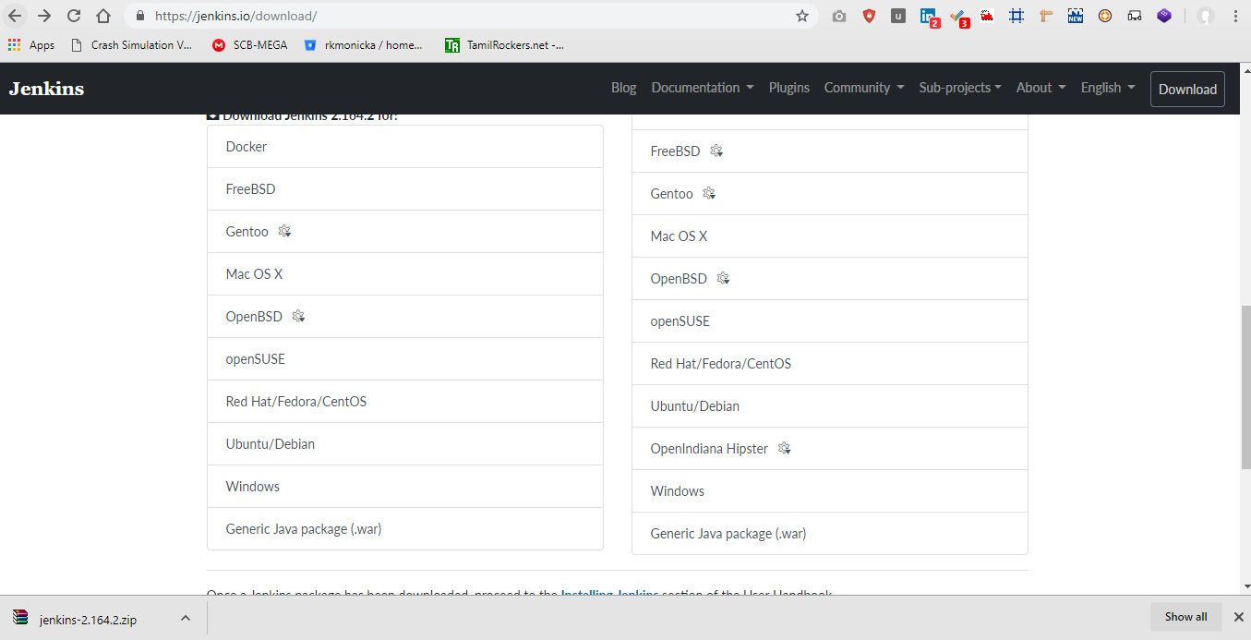
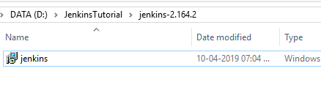
https://jenkins.io/download/

Slide 4
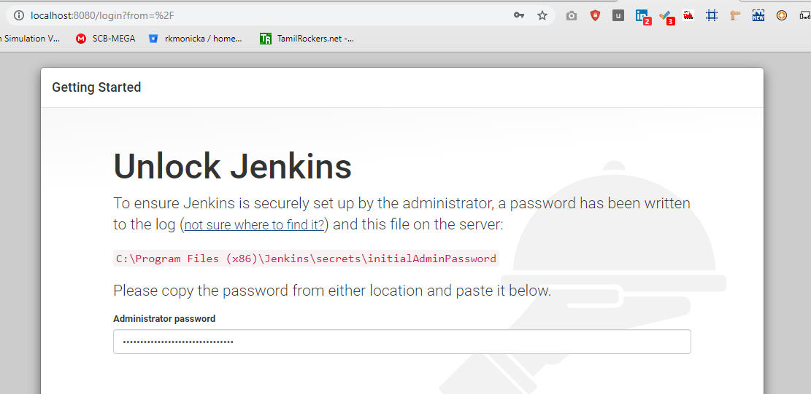
Jenkins Login Credentials

Slide 5
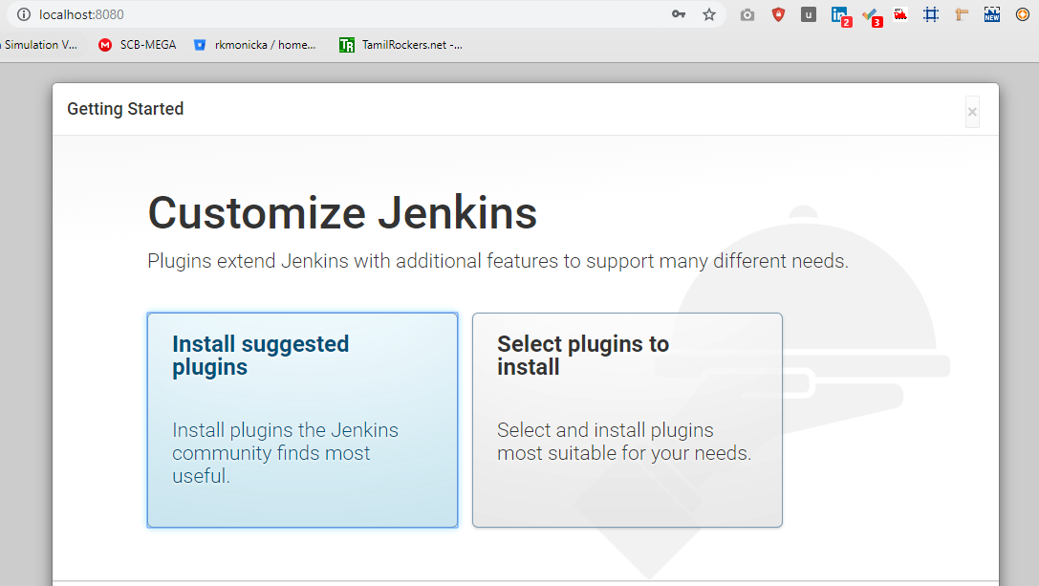
Jenkins Setup

Slide 6
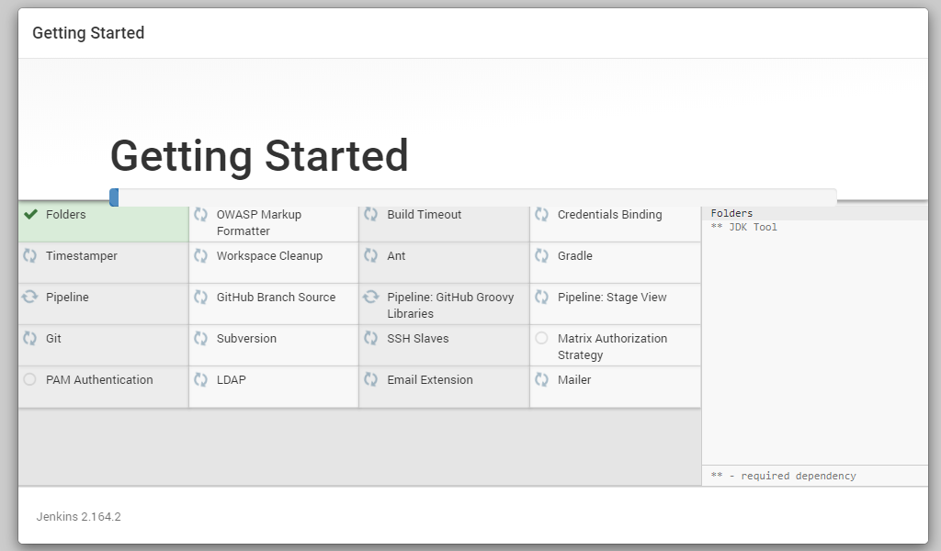
Install Suggested Plugins

Slide 7
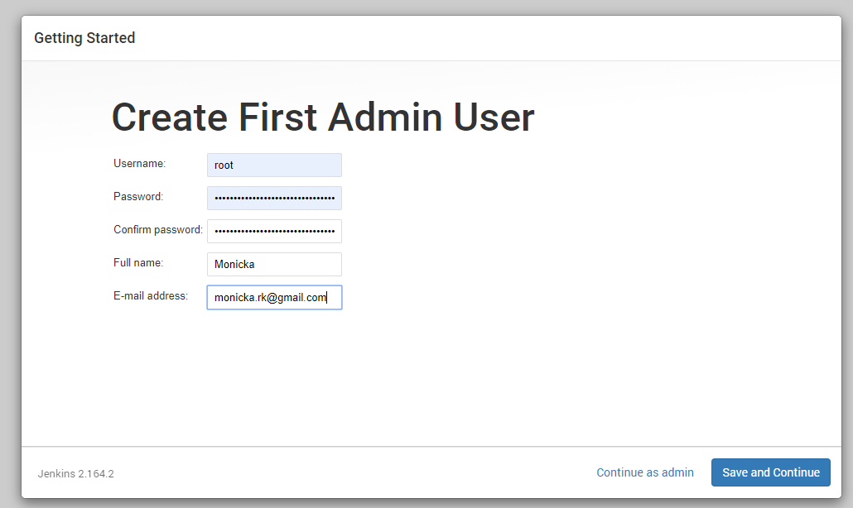
Setup Admin User

Slide 8
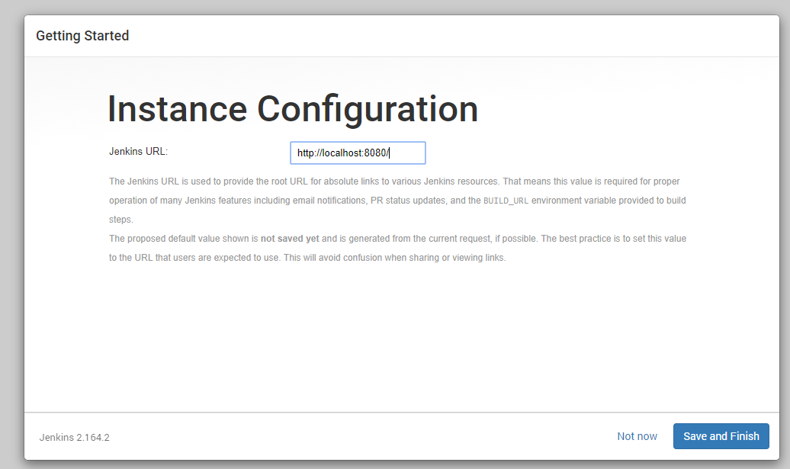
Instance Configuration

Slide 9
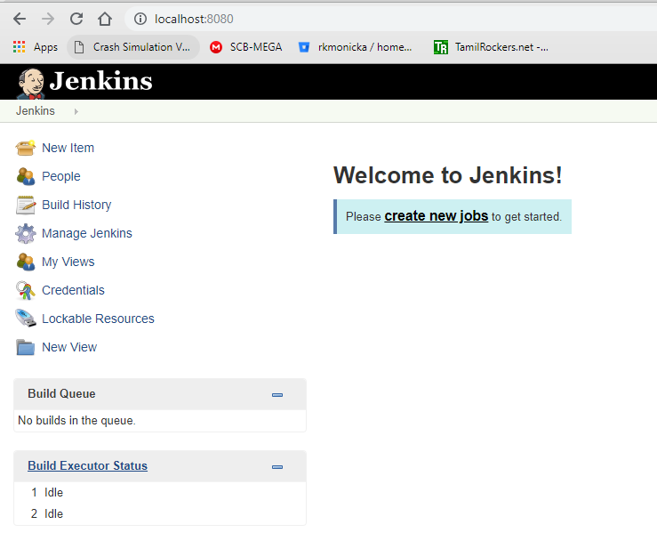
Empty Dashboard

Slide 10
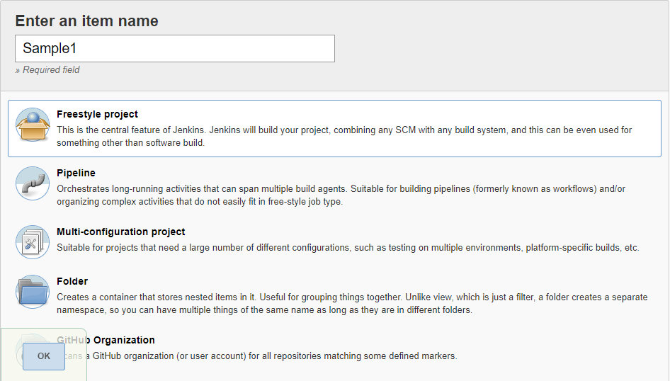
First Job Creation

Slide 11
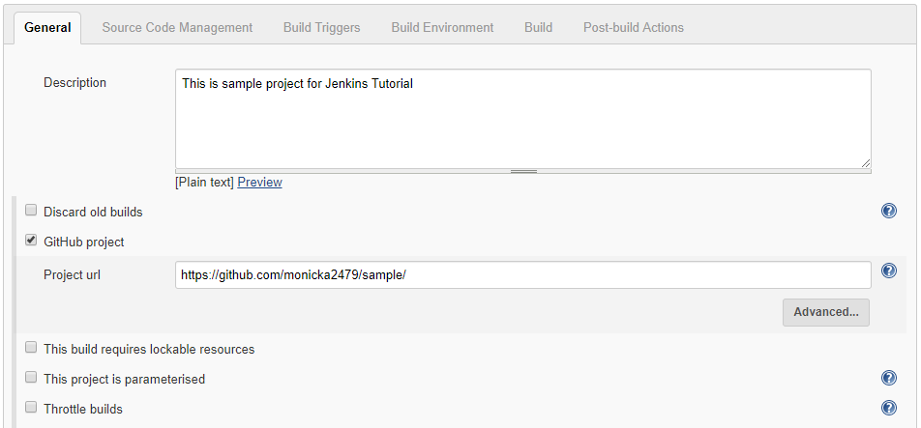
First Job Creation - General

Slide 12
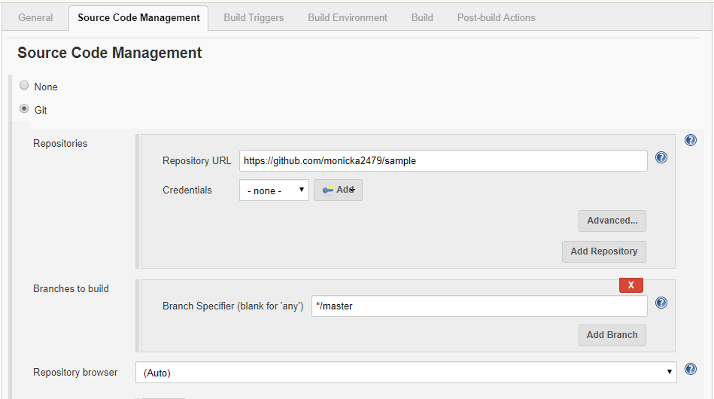
First Job Creation – Source Code Management

Slide 13
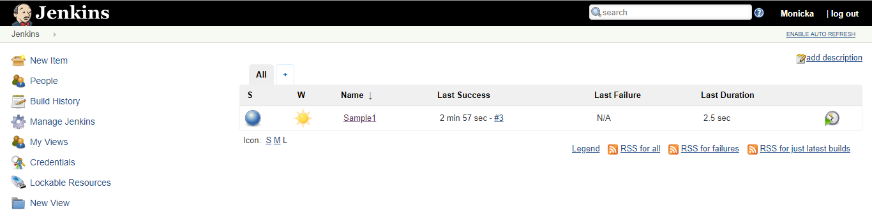
Dashboard after job creation

Slide 14
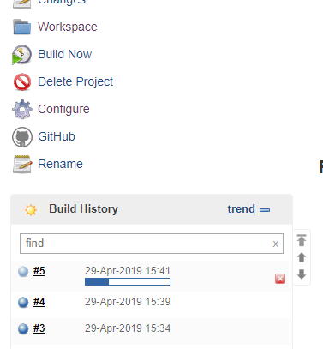
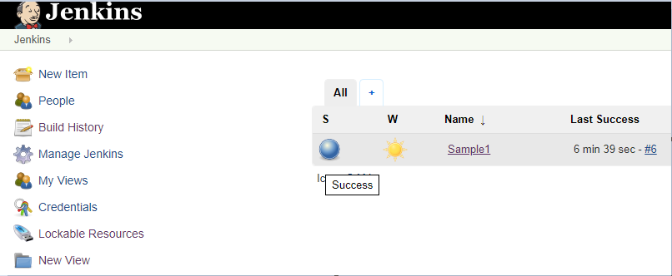
Build Job

Slide 15
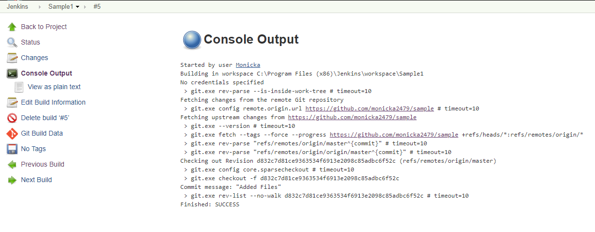
Build Console Output

Slide 16
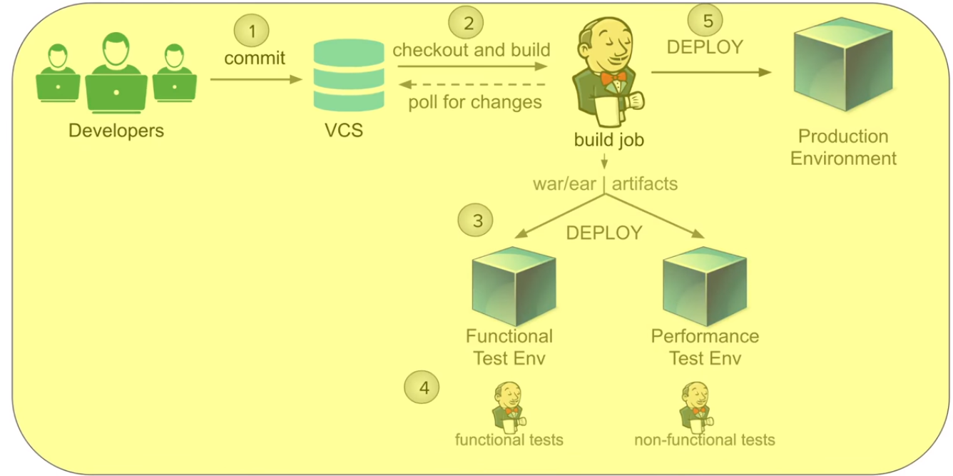
Continuous Deployment

Slide 17
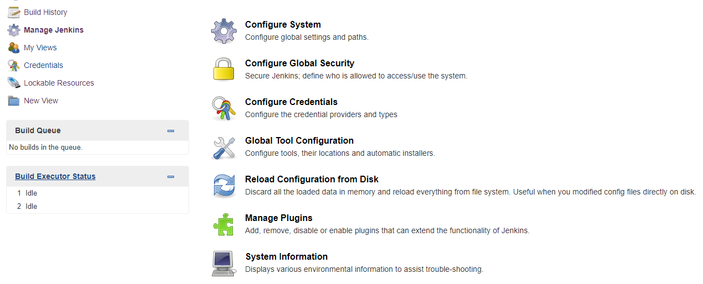
Install Plugins

Slide 18
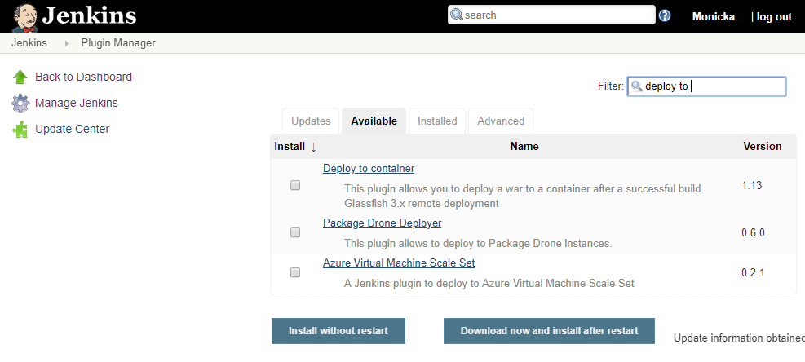
Select Plugin

Slide 19
Create a Build job in Jenkins

Slide 20
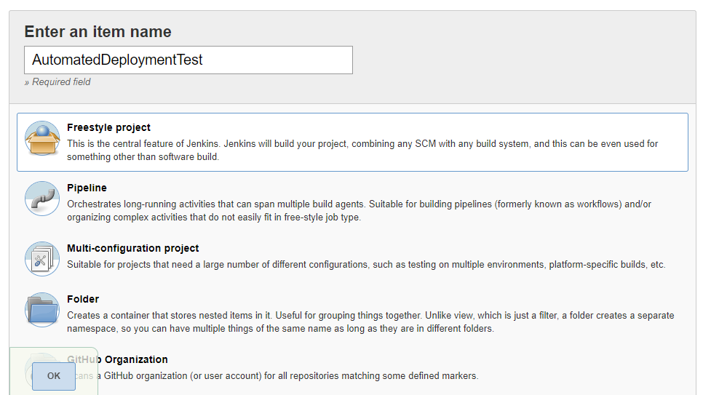
New Item for Deployment

Slide 21
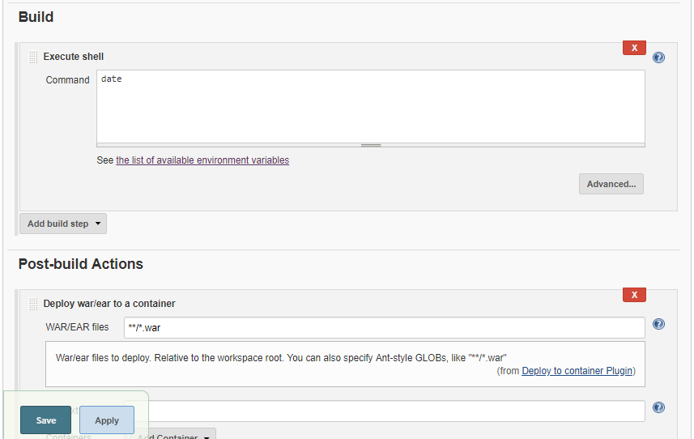
New Item for Deployment - Build

Slide 22
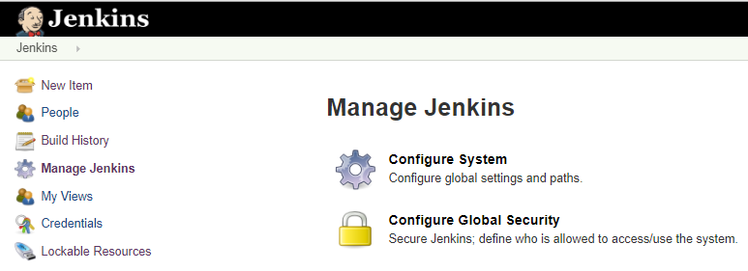
Manage Jenkins – Configure System

Slide 23
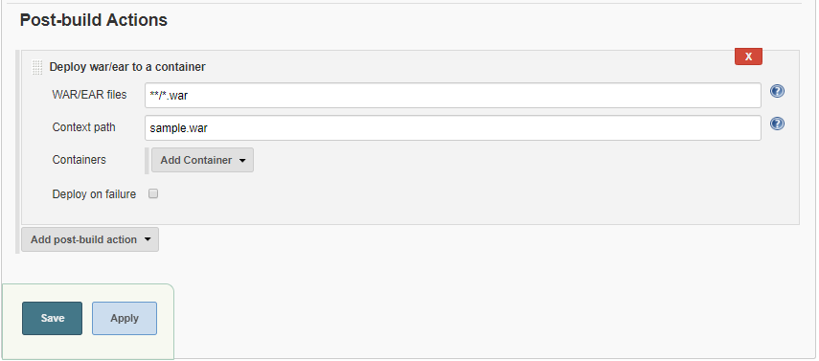
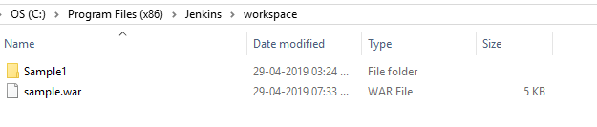
War file location path

