Slide 1
JENKINS TUTORIAL

Slide 2
INTRODUCTION
Jenkins is a powerful application that allows continuous integration and continuous delivery of projects.
It is a free source that can handle any kind of build or continuous integration.
You can integrate Jenkins with a number of testing and deployment technologies.

Slide 3
Installation

Slide 4
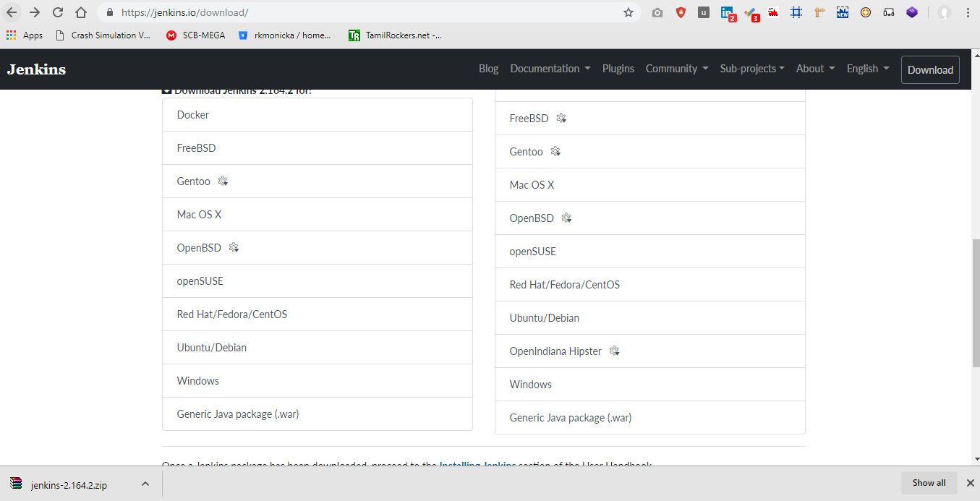
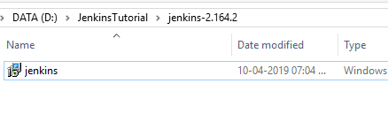
https://jenkins.io/download/

Slide 5
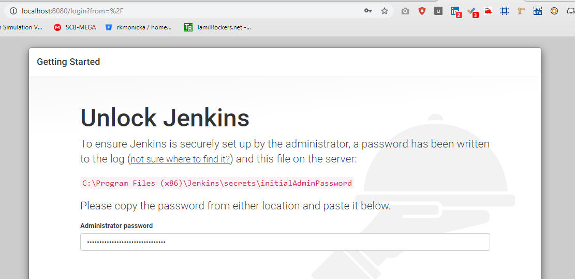
Jenkins Login Credentials

Slide 6
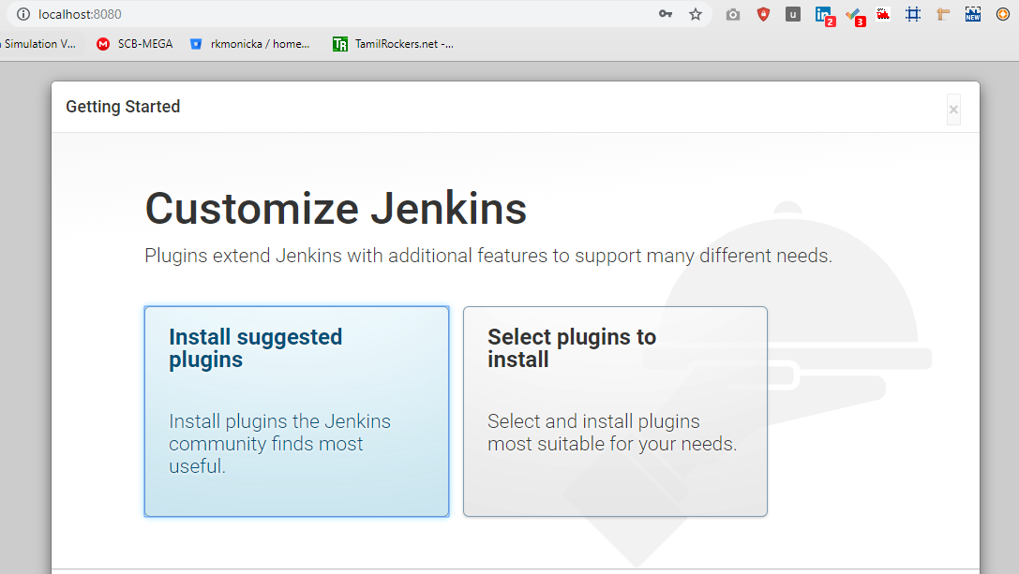
Jenkins Setup

Slide 7
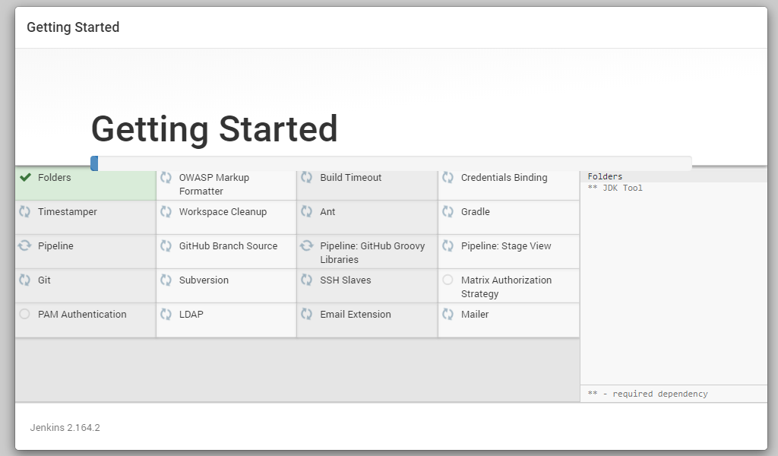
Install Suggested Plugins

Slide 8
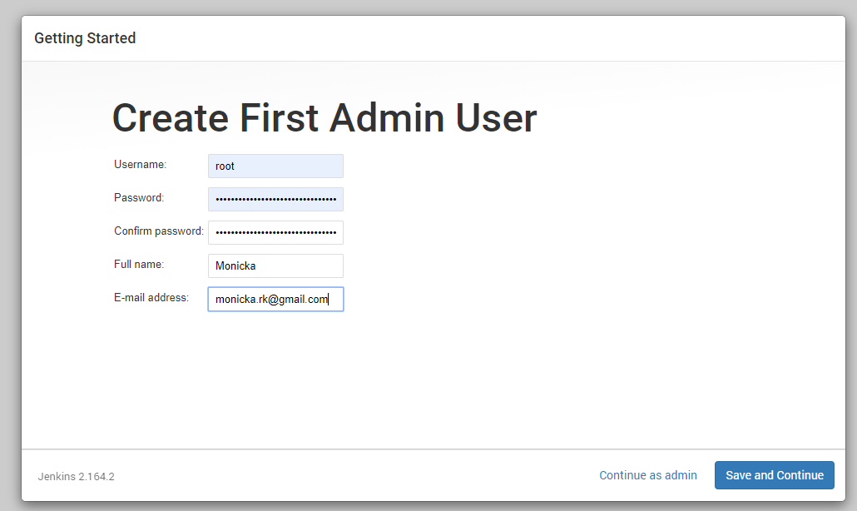
Setup Admin User

Slide 9
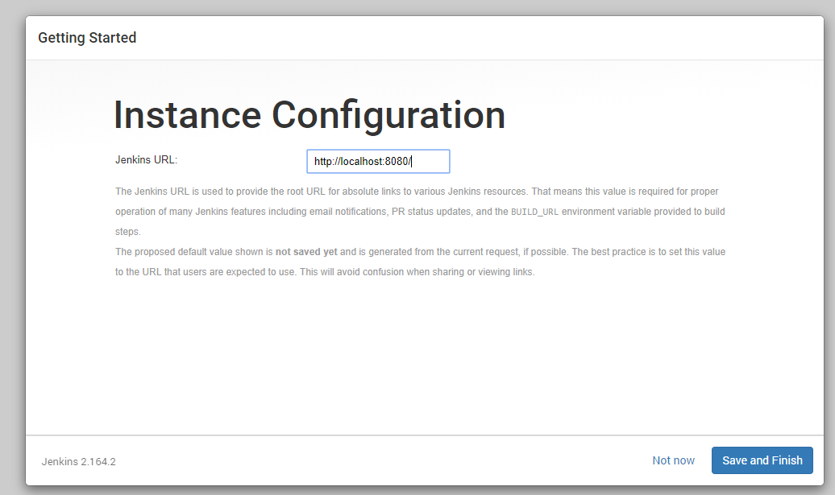
Instance Configuration

Slide 10
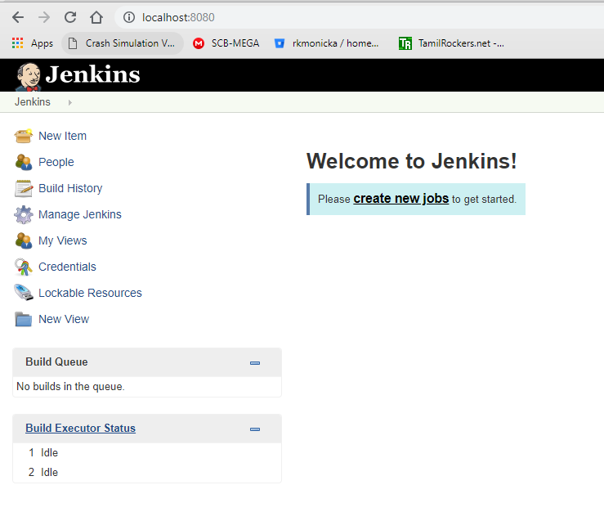
Empty Dashboard

Slide 11
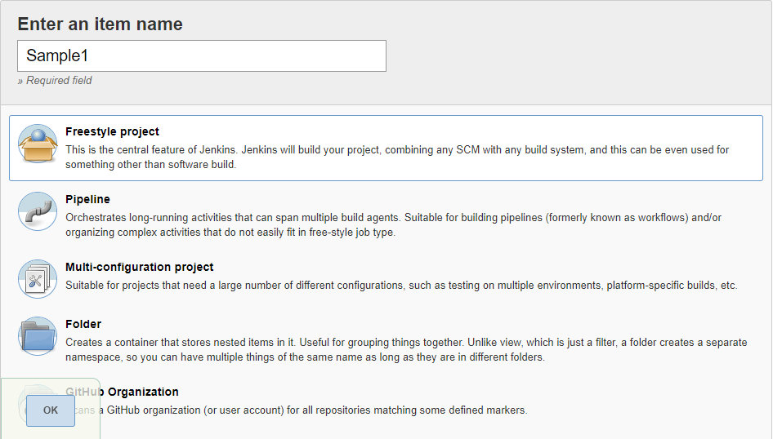
First Job Creation

Slide 12
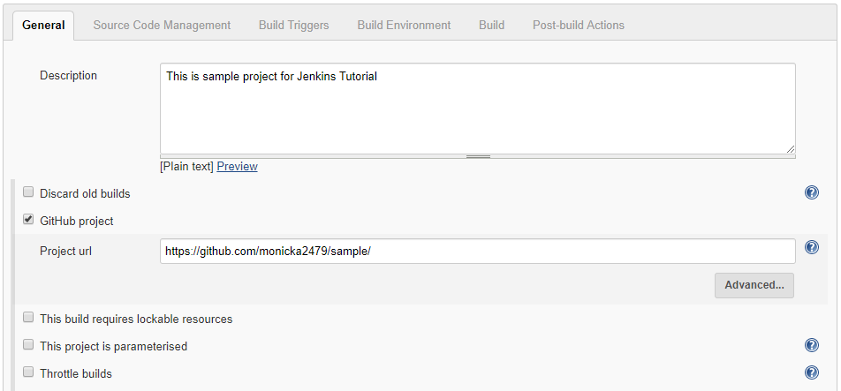
First Job Creation - General

Slide 13
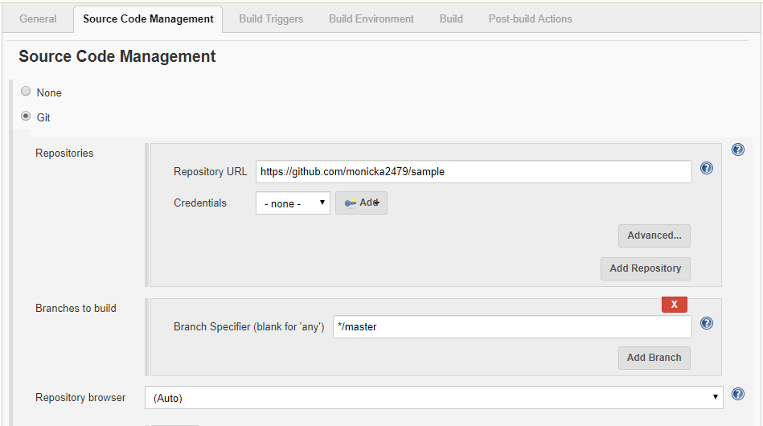
First Job Creation – Source Code Management

Slide 14
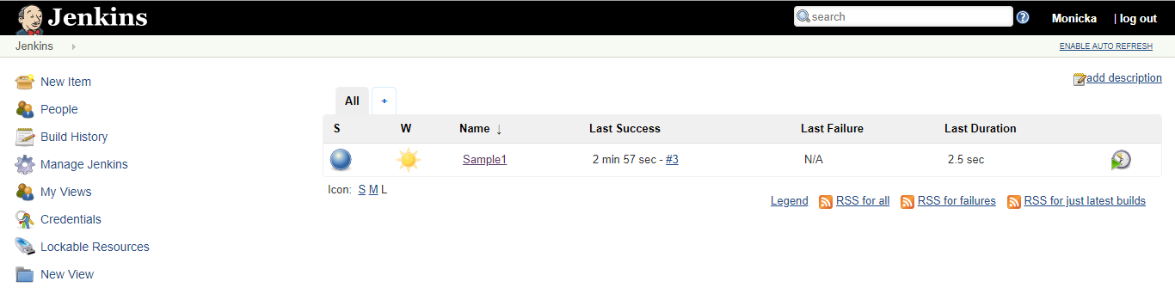
Dashboard after job creation

Slide 15
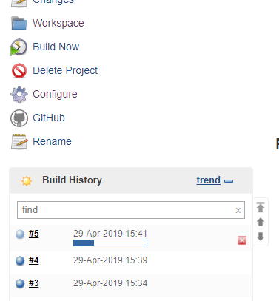
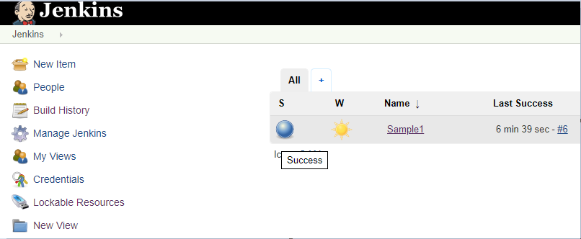
Build Job

Slide 16
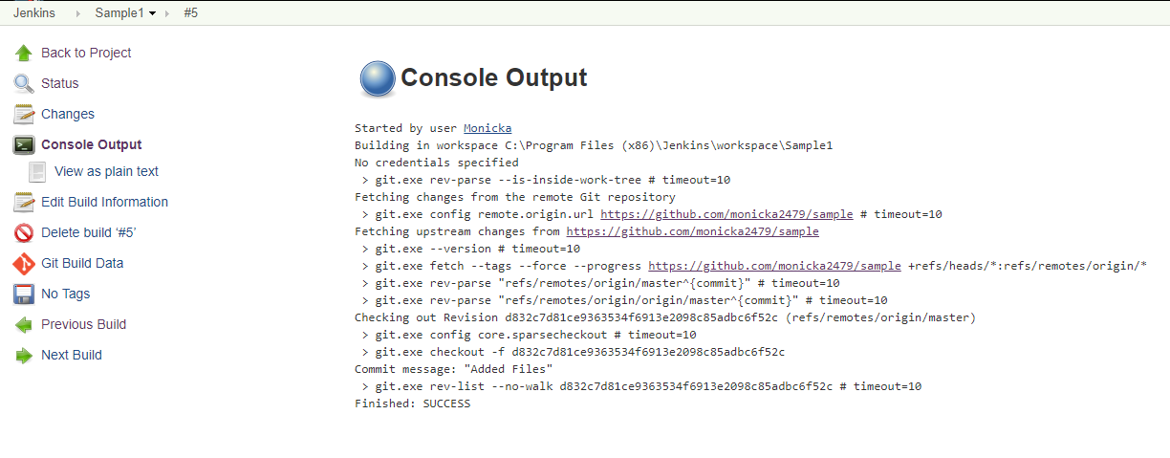
Build Console Output

Slide 17
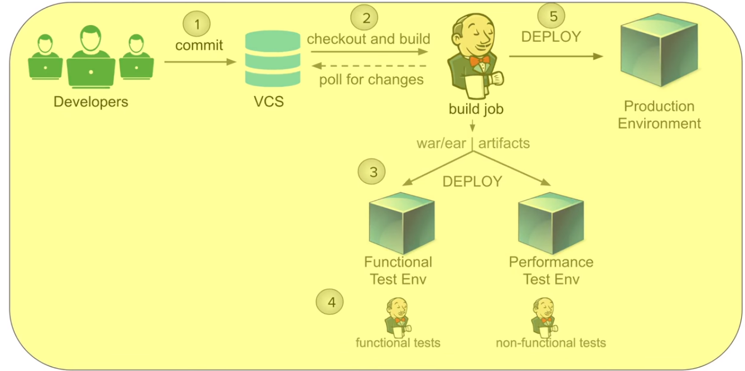
Continuous Deployment

Slide 18
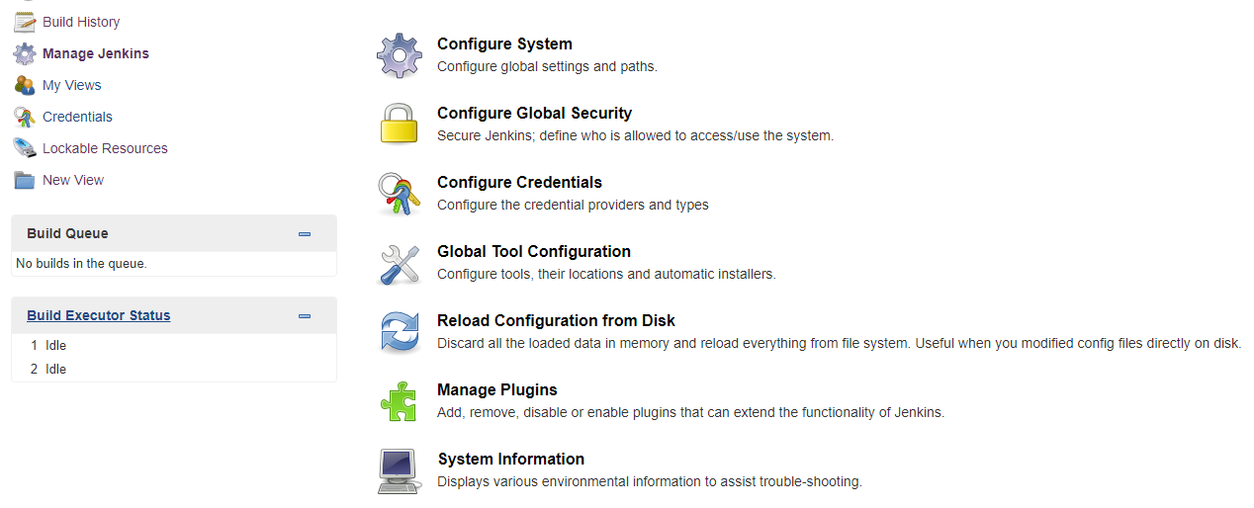
Install Plugins

Slide 19
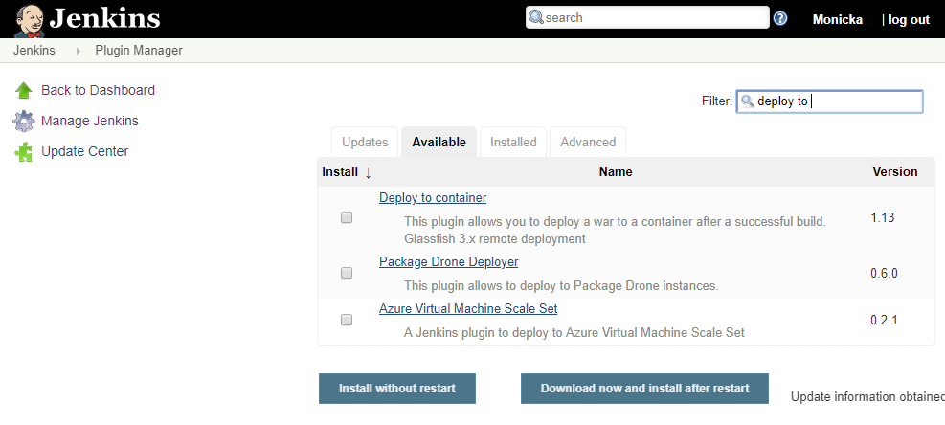
Select Plugin

Slide 20
Create a Build job in Jenkins

Slide 21
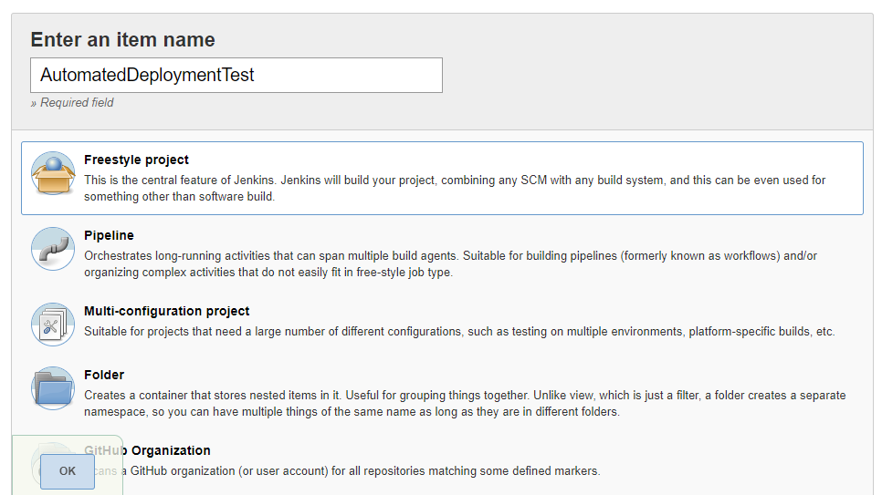
New Item for Deployment

Slide 22
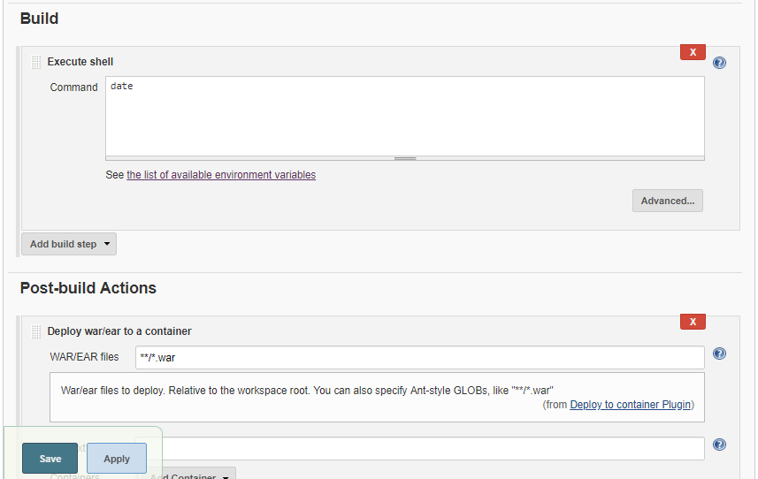
New Item for Deployment - Build

Slide 23
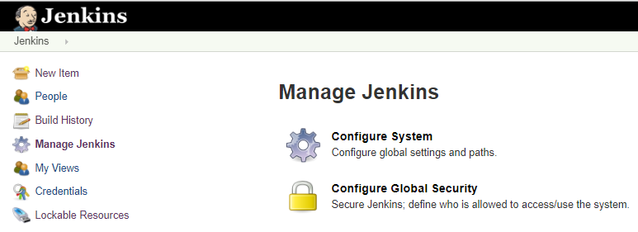
Manage Jenkins – Configure System

Slide 24
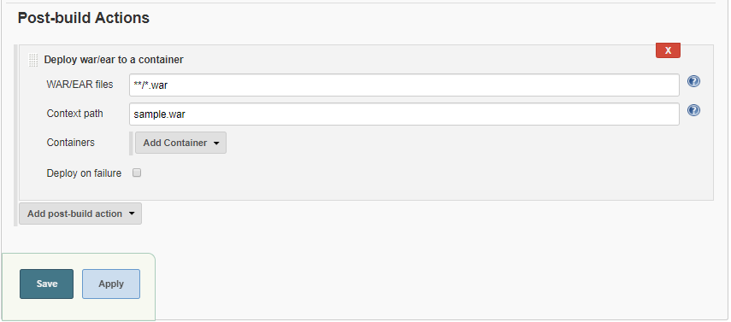
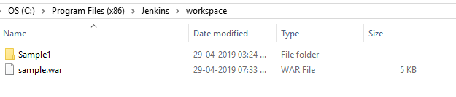
War file location path

