Slide 1

Using Python to Analyze British Columbia COVID-19 Data
Monideep Chakraborti
Align MS in Computer Science
Northeastern University - Vancouver
CS 5001: Project Presentation
December 16, 2020

Slide 2
Overview
GOAL OF THE PROJECT:
Analyze the BC COVID-19 Data using 3 Factors:
Age
Region
Gender
Using Flask and HTML, create a webpage:
has a search bar that can filter out any data of interest
has updated COVID-19 statistics of Canada using API

Slide 3

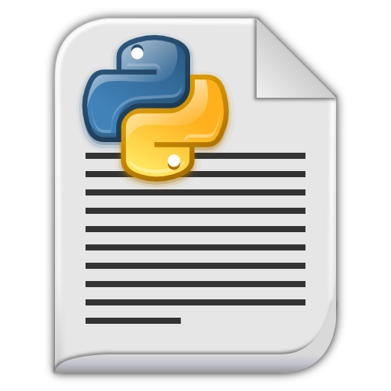



Project Design for BC COVID-19 Analysis
covidapi.py
-Live statistics in Canada
main.py
-Filter data from file
User
HTML Templates
app.py
data_analysis.py
-analysis of the BC COVID-19 data
FRONT END
BACK END

Slide 4
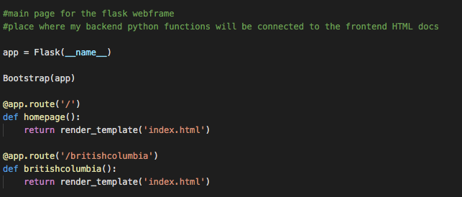
Working with Flask and HTML
FLASK:
A lightweight framework that can use Python to create web applications
Runs a web server

Slide 5
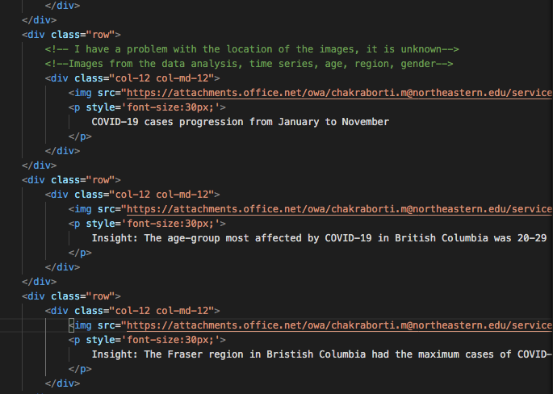
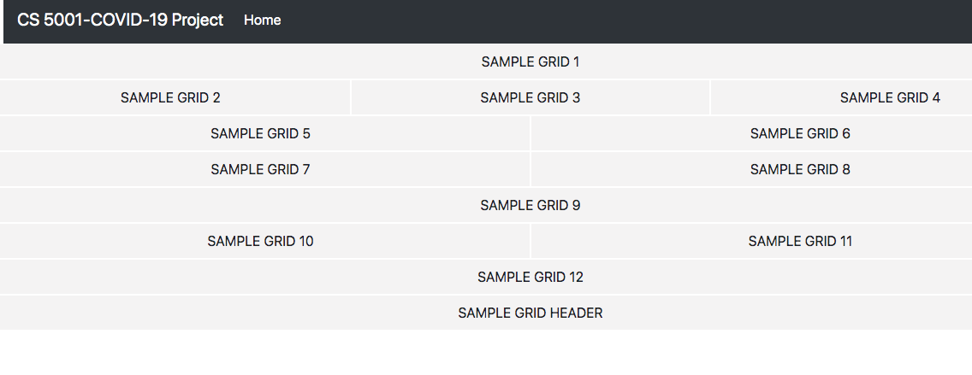
Working with Flask and HTML
HTML:
Used to provide structure to a webpage and its content

Slide 6
COVID-19 live statistics Python module
Used API (Application Programming Interface) to run the program
I think of them as plug/connector that allow applications to communicate with each other
Benefit for my module:
Think about how tedious it would be to download and upload a CSV file everyday ☹
Acts as a self updating file for my module
JSON Format:
Imagine how hard life would be if every API had its own format? ☹
JSON is the standard format for any API
Format is like Python dictionary (key-value pairs)

Slide 7
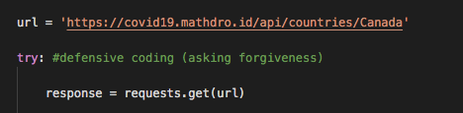
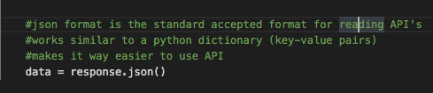
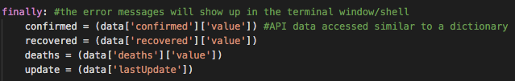
COVID-19 live statistics Python module
Step 1 : Request the API
Step 2 : Convert to JSON Format
Step 3 : Use like a dictionary

Slide 8
Filter Python module
Used the concept of Modularity for the first time:
Benefits:
Made the code easy to understand
Most important: Very easy for debugging
age.py
gender.py
date.py
region.py
main.py

Slide 9

Filter Python module
main.py:
Current homepage for the function
All other modules are imported into it
Eventually want to connect this to the search bar on my webpage
age.py
gender.py
date.py
region.py
main.py

Slide 10
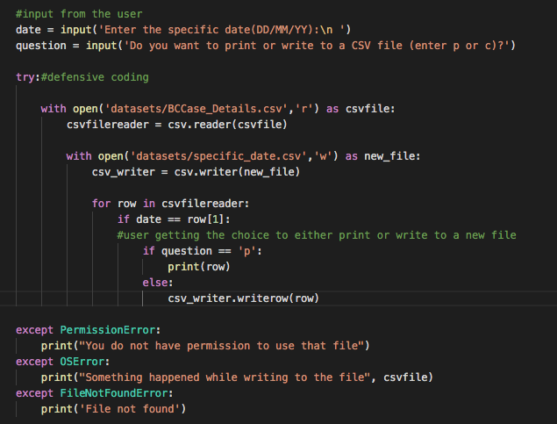
Filter Python module
Other modules:
Step 1 : Take in user input when called by main
Step 2 : User choice to either print or write to file
Print
Write to CSV file

Slide 11
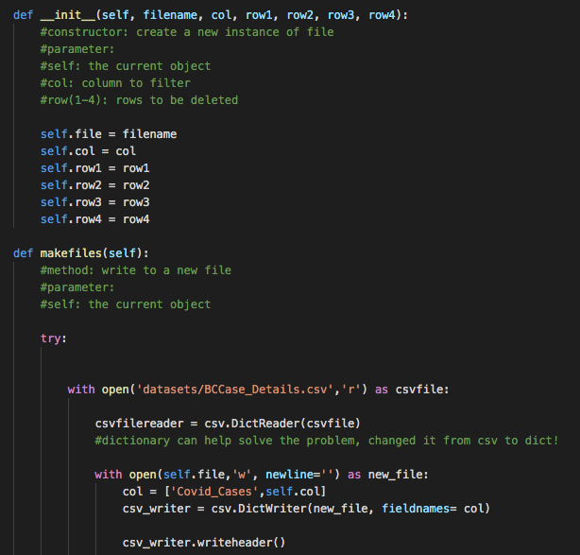
Data Analysis Python module
Most challenging part of the project
Finally managed to perform the data analysis without Pandas library ☺
Step 1 : Broke down big CSV file into smaller manageable CSV files using Class
Why breakdown in smaller files?
Found it easier when I needed to make the plots for my data analysis
Learned about csvDictReader and DictWriter:
Problem with normal csv: saved everything as strings with comma in between
DictReader and DictWriter: key-value pairs easy to work with for data analysis

Slide 12
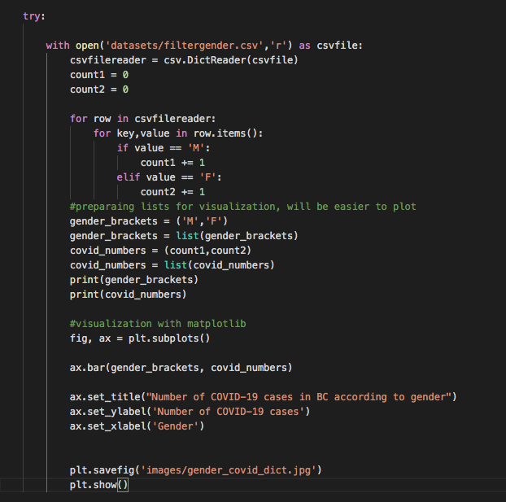
Data Analysis Python module
Step 2 : DictReader allowed the file to be used as a dictionary
Step 3 : Added up all repeat terms such as “M” and “F” in the screenshot

Slide 13
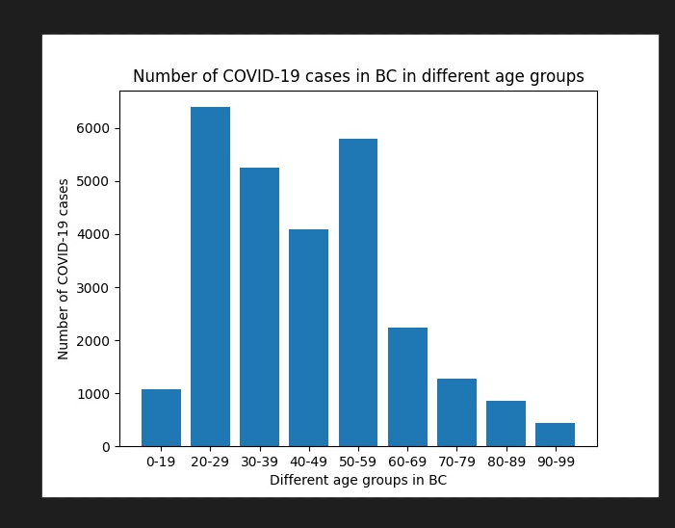
Data Analysis Python module
Step 4: Converted to a list
Step 5 : Visualized the data using Matplotlib library
Step 6 : Added it to the index.html page

Slide 14
Review Code
Now, let’s briefly walk through the code!

Slide 15
Future Goals
Get the website functioning with the search bar and the live statistics from API
Add more factors to the BC COVID-19 data such as household incomes, mask use, hospitalization rate
Build a predictive model to estimate COVID-19 cases in BC
STAGE 2: Repeat the above process for all provinces in Canada
STAGE 3: Comparative study of COVID-19 response between developed and emerging nations

