Slide 1
A Low-power Carry Cut-Back Approximate Adder with Fixed-point Implementation and Floating-point Precision
Vincent Camus
Jeremy Schlachter
Christian Enz
Ecole Polytechnique Fédérale de Lausanne (EPFL)
Integrated Circuits Laboratory (ICLAB)
Switzerland

Slide 2
Outline
State-of-the-Art
CCBA Circuit
CCBA Arithmetic
Results and Comparison
DAC’16

Slide 3
Approximate Circuits, a New Dimension
Energy
High speed high energy, large area
Low speed low energy, small area
Delay
Inexactness
Fast and low energy
approximate result
DAC’16

Slide 4
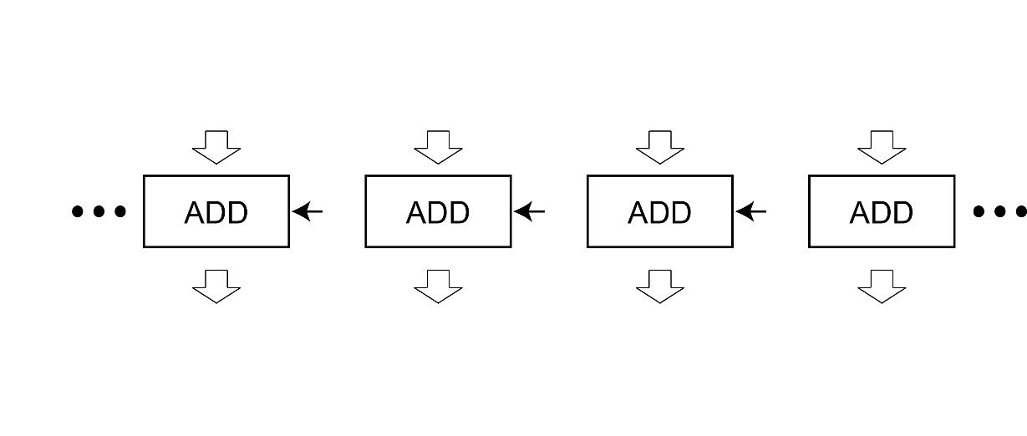
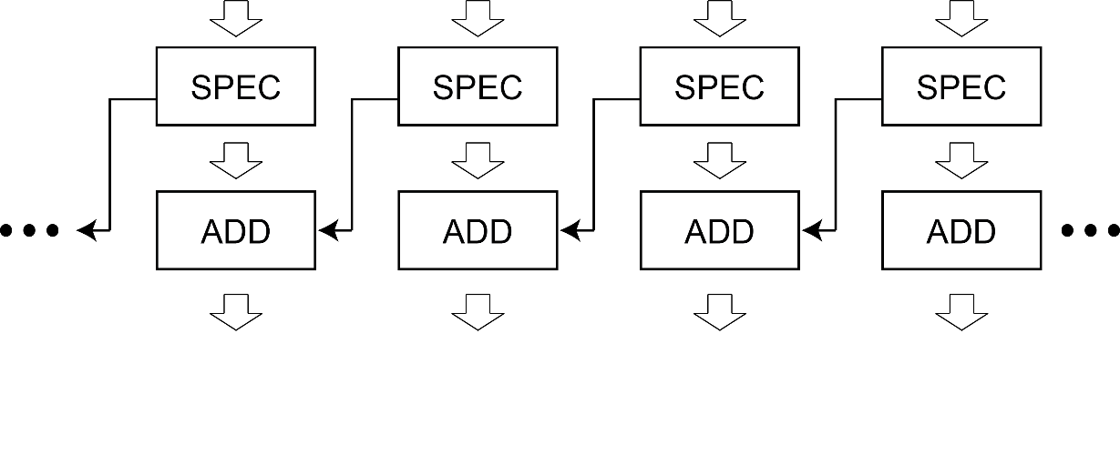
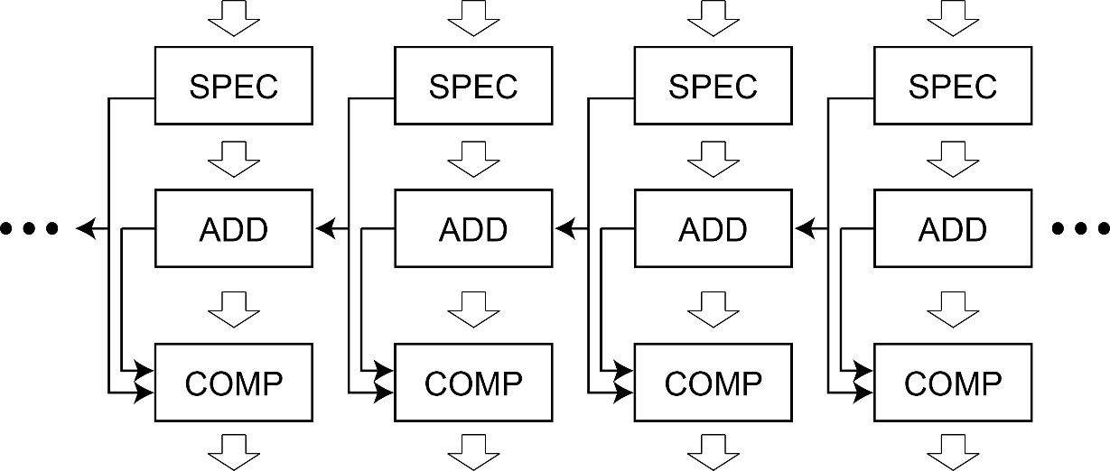
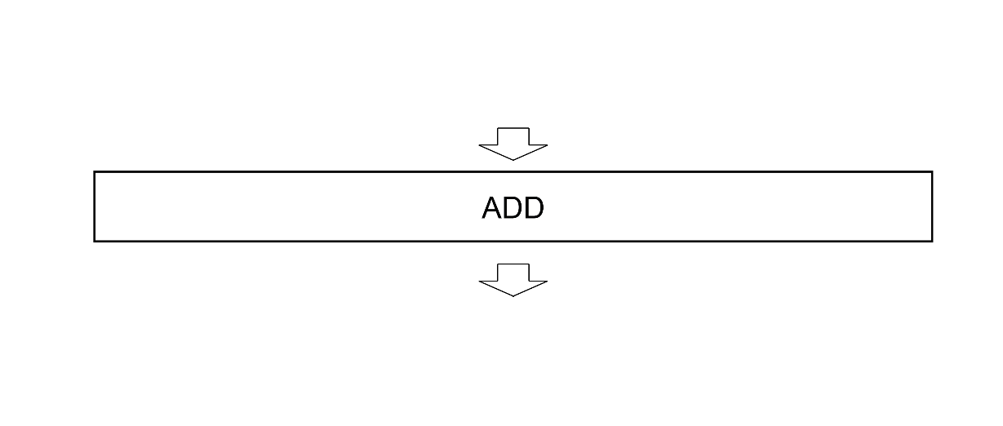
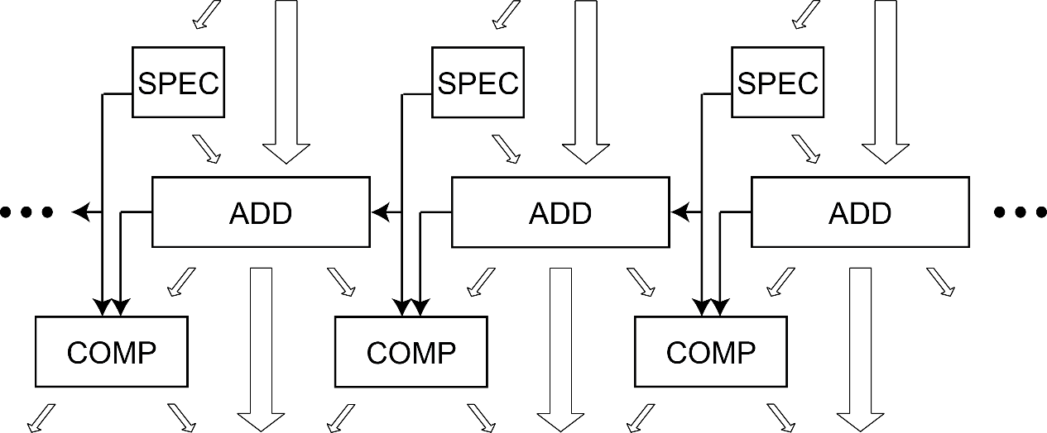
1. State-of-the-Art – Speculative Adders
Principle
Sliced structure
Speculated carry
Error compensation
Advantages
High speed
Worst-case error control
Drawbacks
Hardware overhead
Delay overhead
ETBA, Weber 2013
ISA, Camus 2015
DAC’16

Slide 5
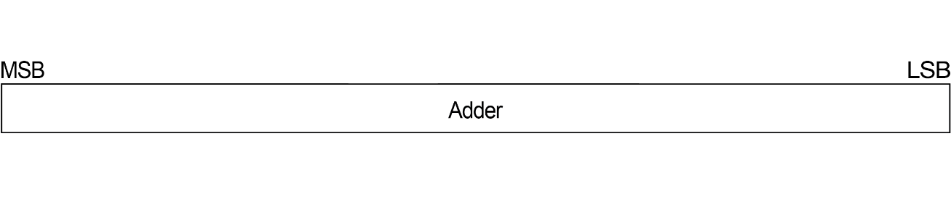
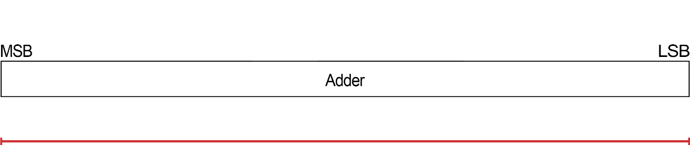
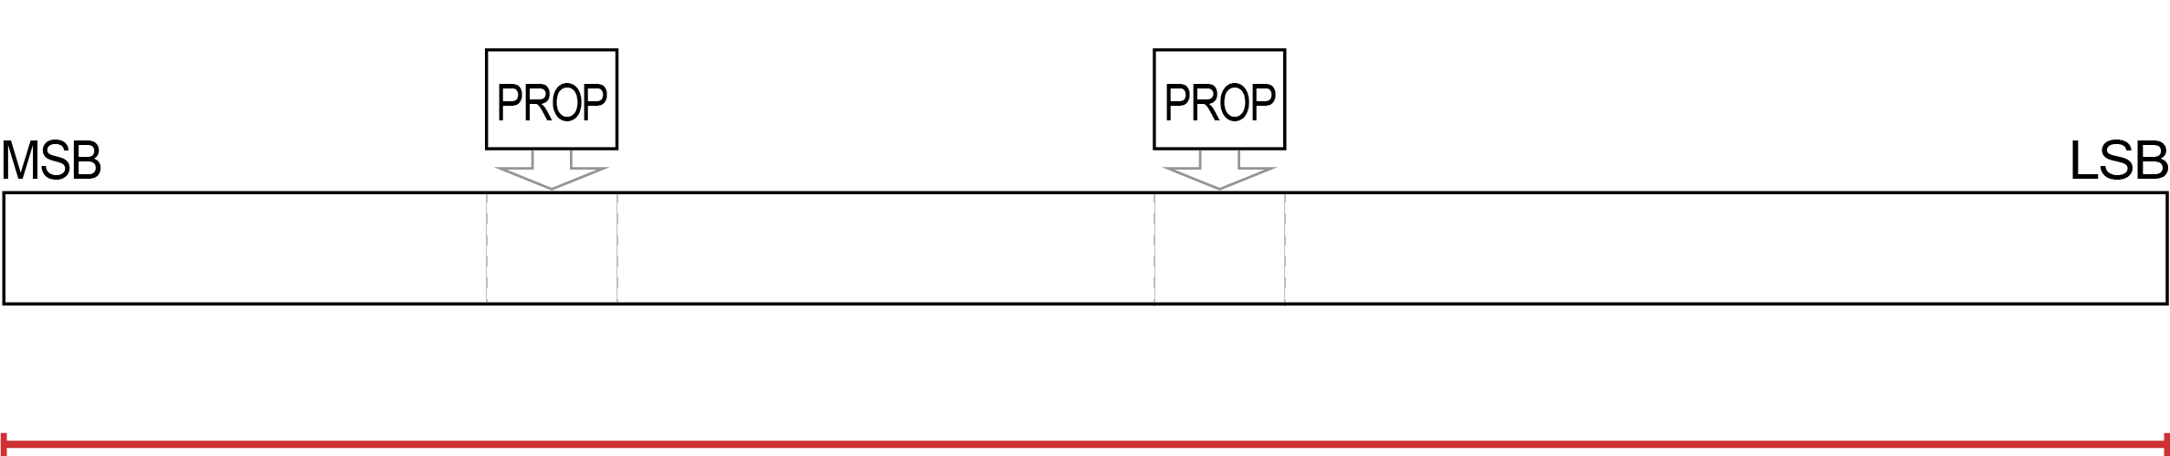
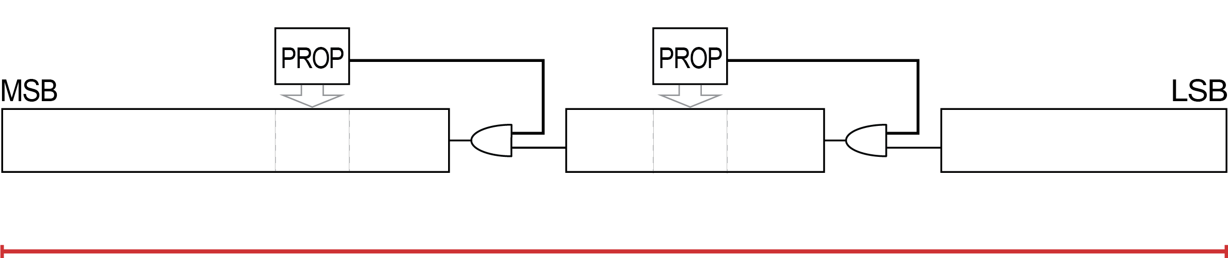
2. CCBA Circuit – Principle
1
0
Principle
– Monitoring high-significance carry stages
– Cutting the carry chain at low-significance positions
if there is a risk of long propagation along the adder
Carry propagation
– Naturally doesn’t propagate
– Propagates (risk of long propagation)
→ no cut
→ force a cut
DAC’16

Slide 6
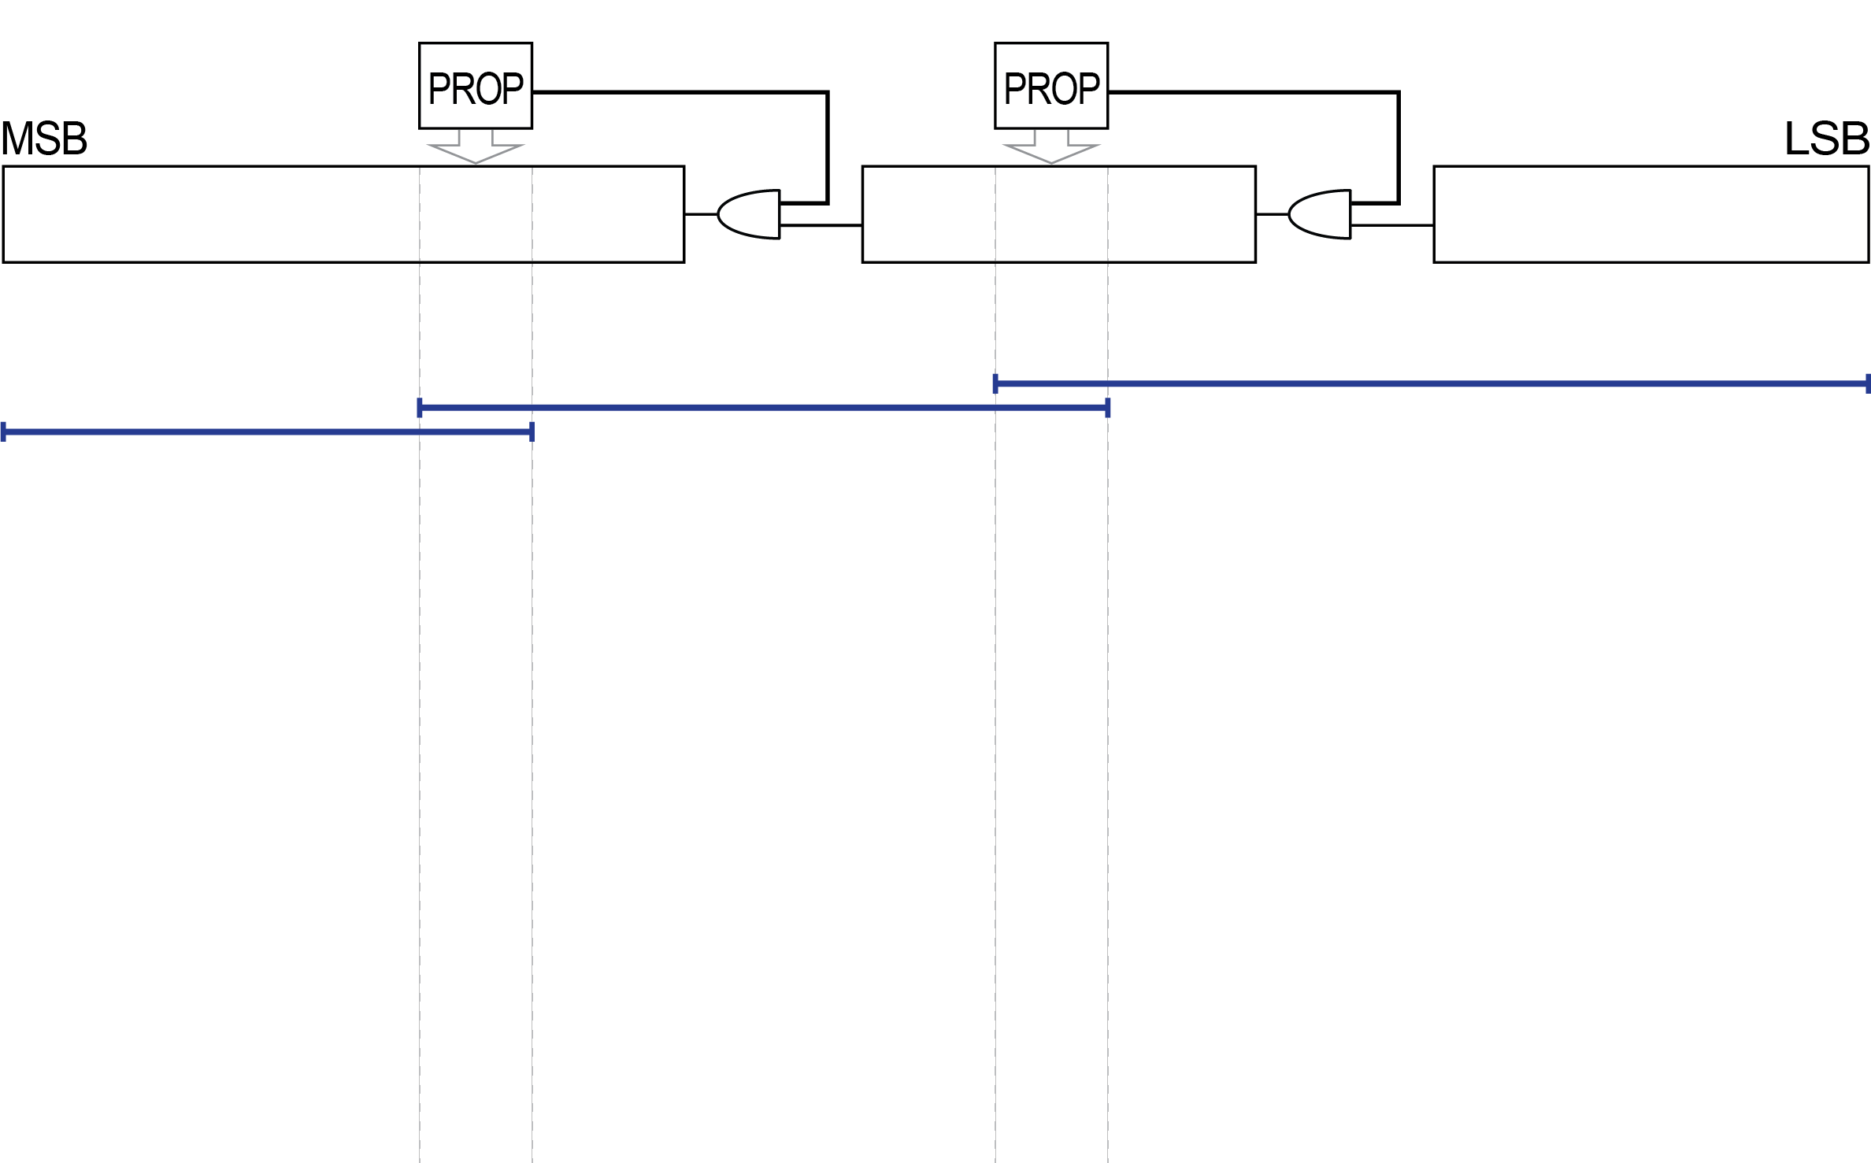
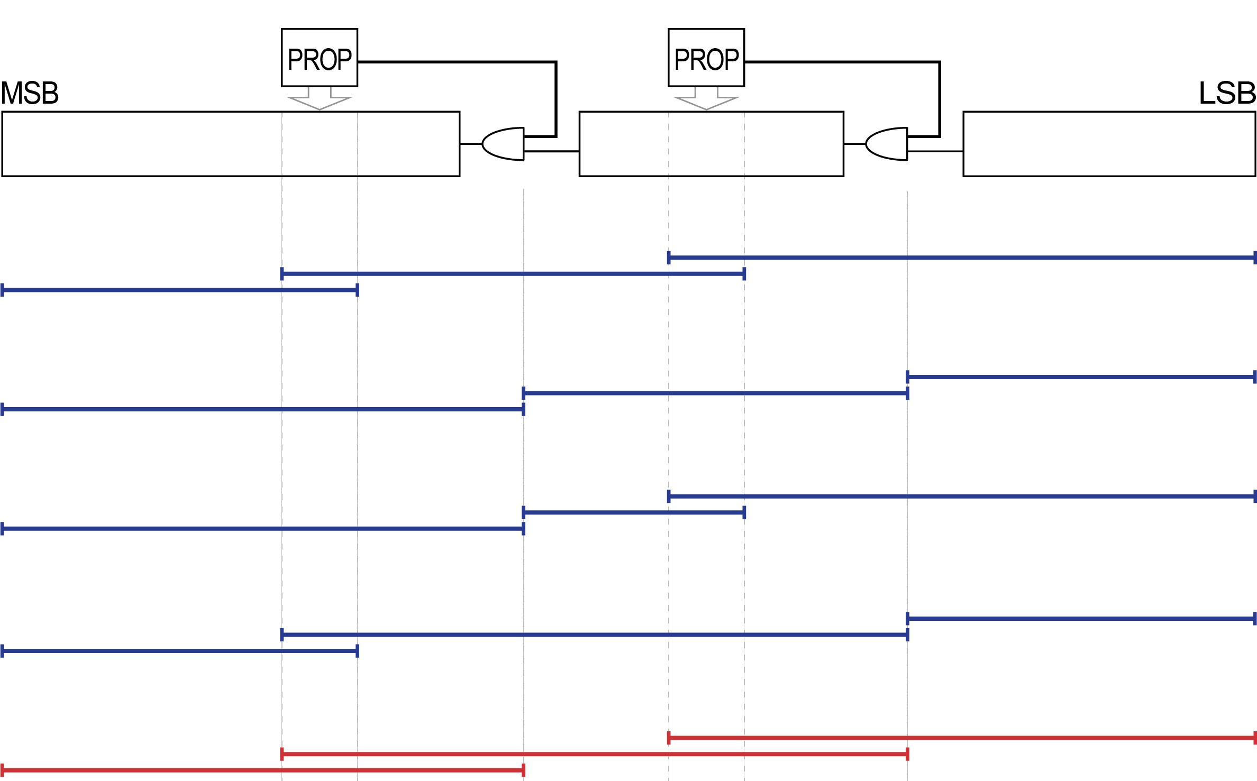
2. CCBA Circuit – Permitted Propagations
OR
OR
OR
=
DAC’16

Slide 7
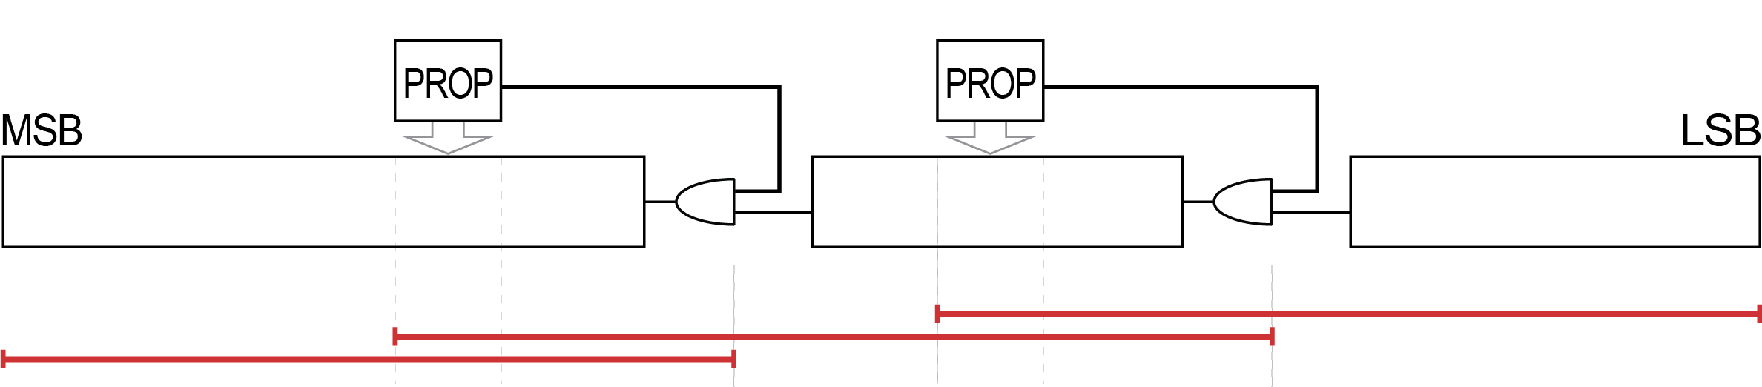
2. CCBA Circuit – Permitted Propagations
but is never stimulated !
The full carry chain exists…
Carry chain transformed into a false-path
Strong timing relaxation
Improved performance and efficiency
False-path engineering
Non-recognized by regular timing analysis
Requires a timing-exception script
DAC’16

Slide 8
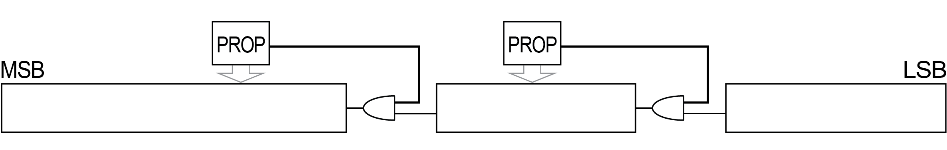
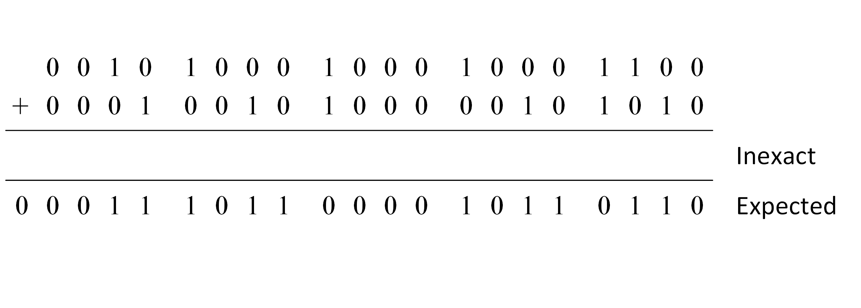
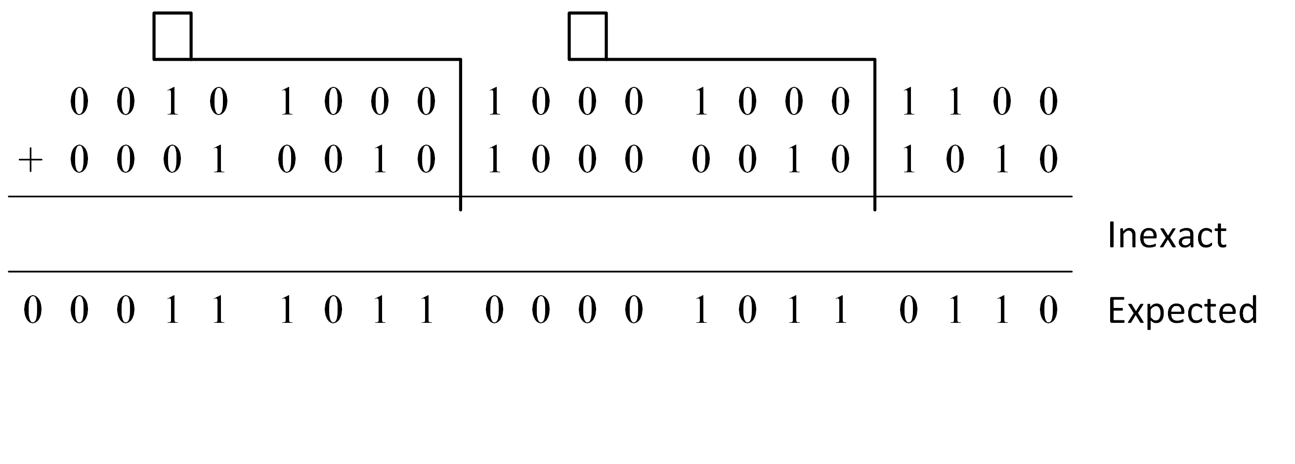
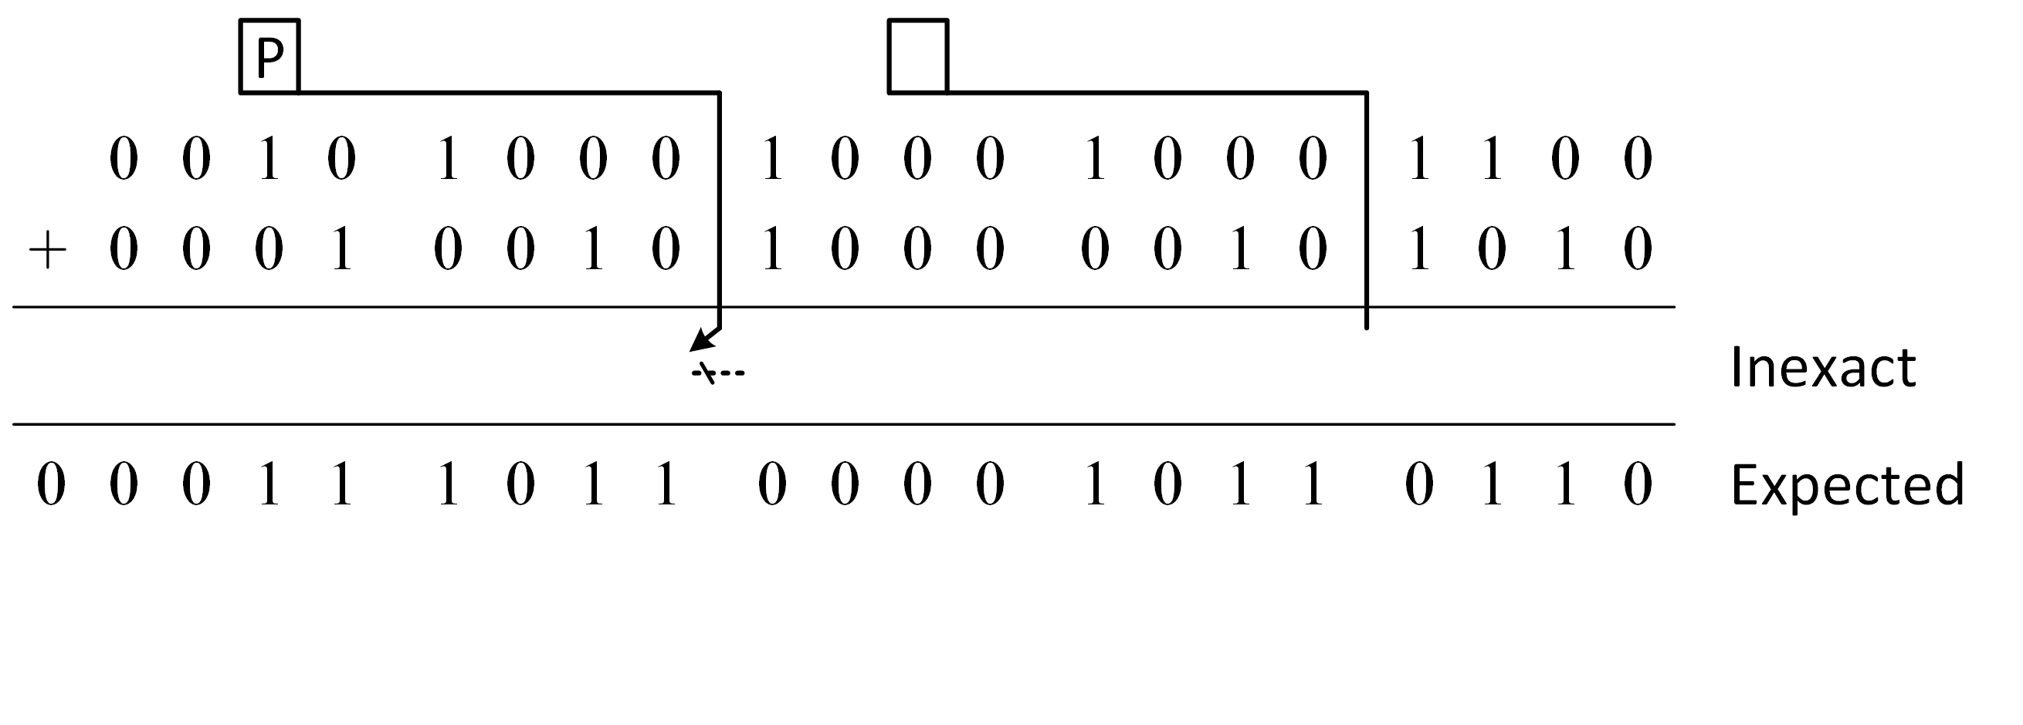
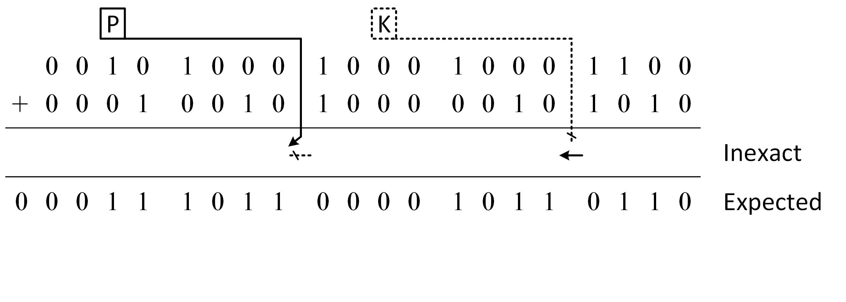
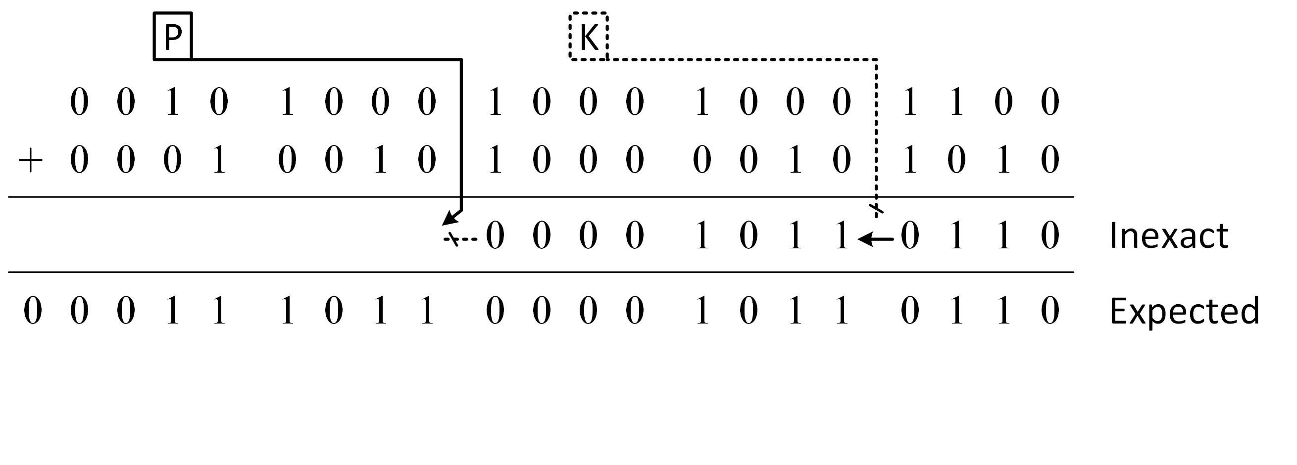
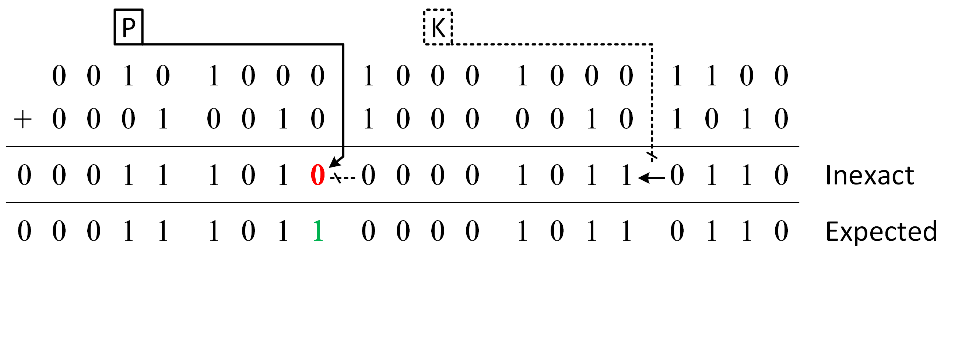
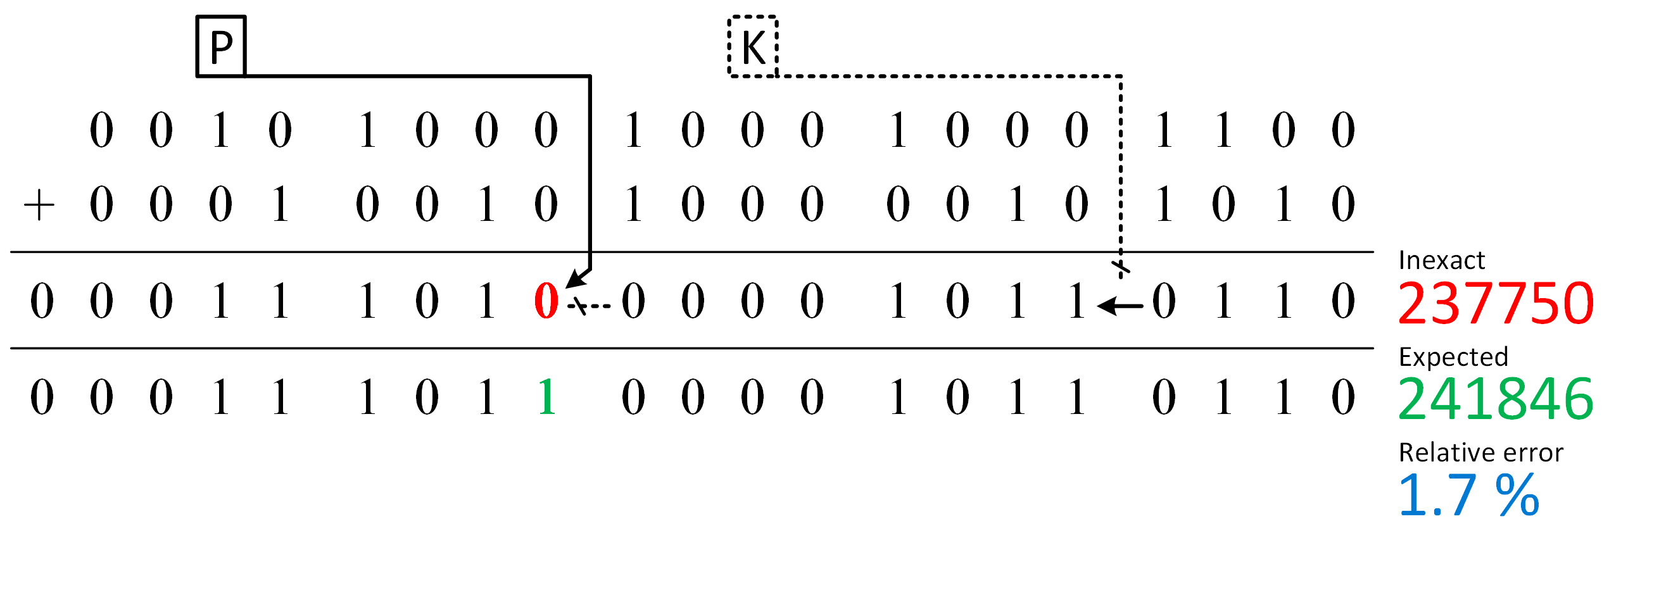
3. CCBA Arithmetic
Arithmetic principle
DAC’16

Slide 9
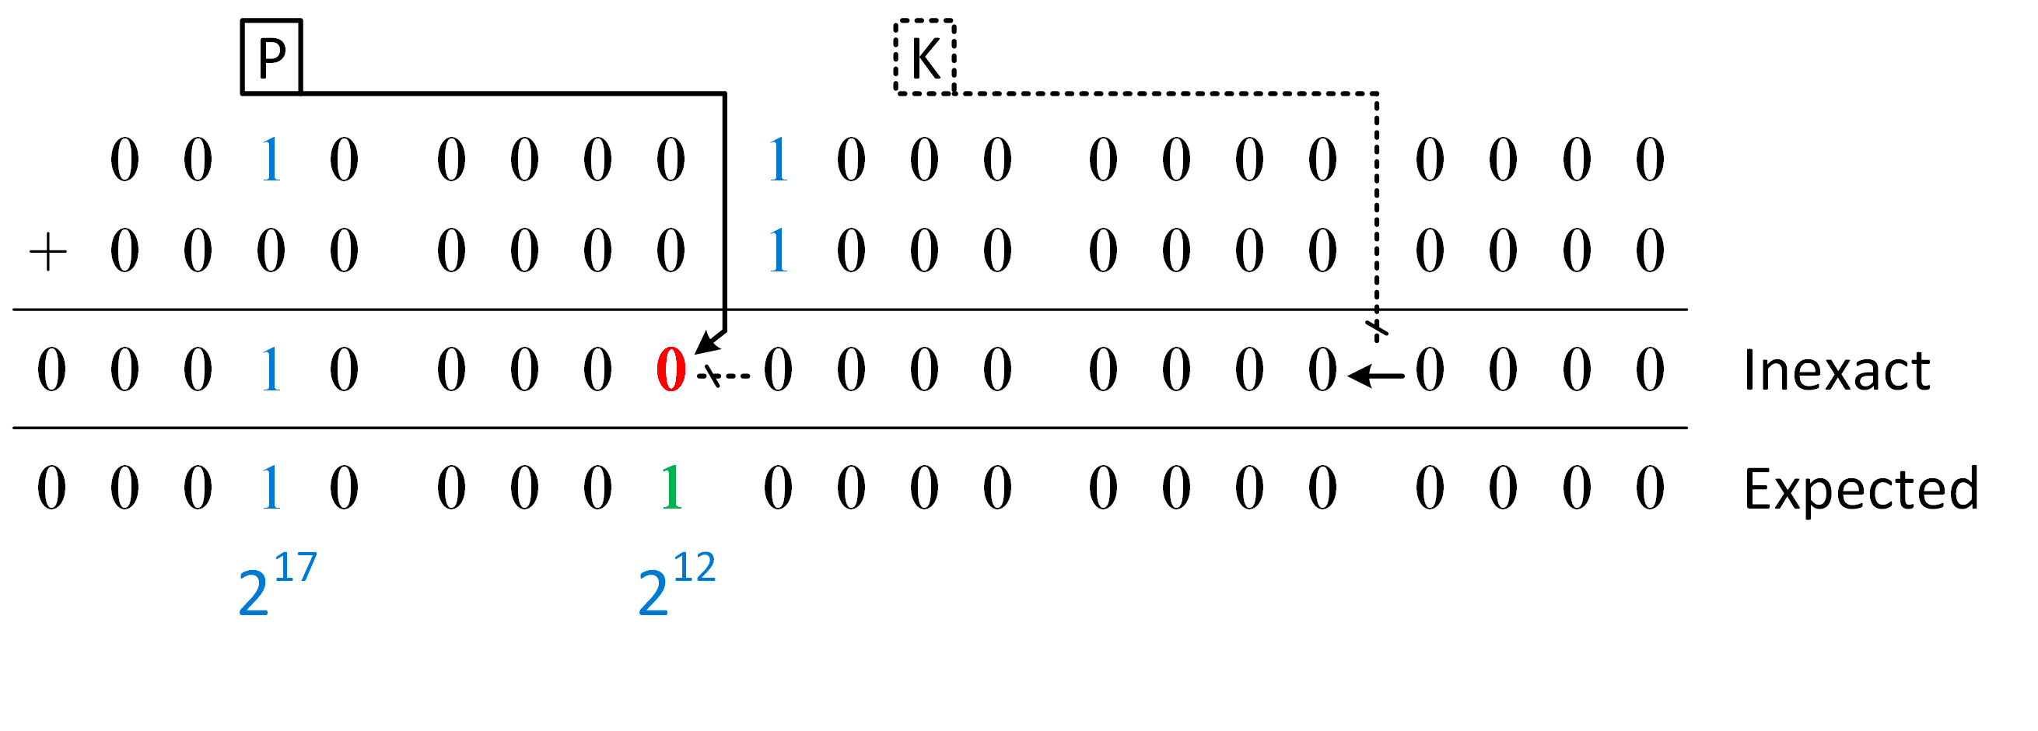
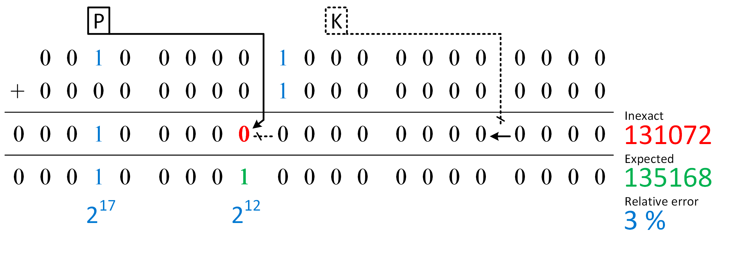
3. CCBA Arithmetic
Worst-case error
(floating-point-like due to the cut back)
DAC’16

Slide 10
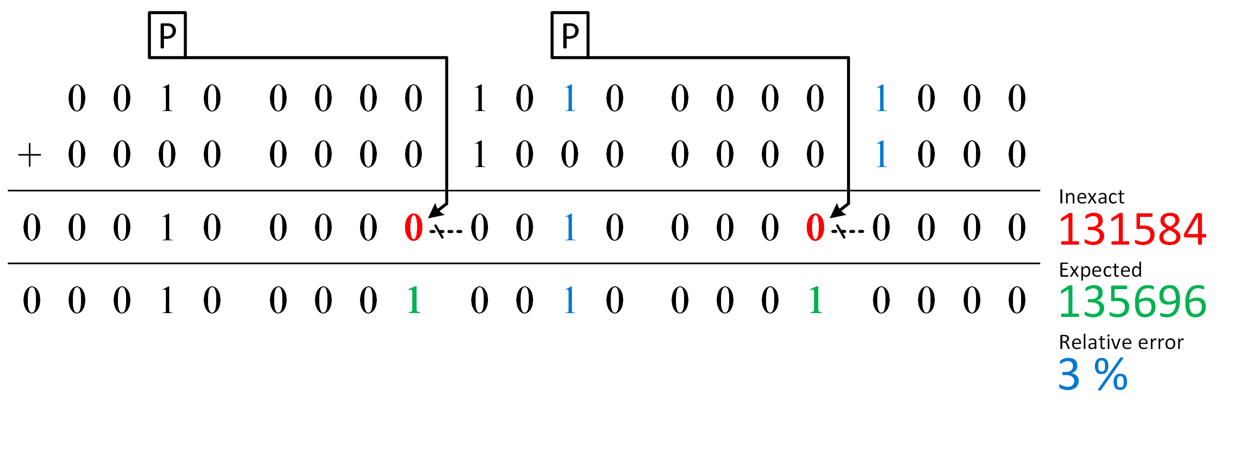
3. CCBA Arithmetic
Multiple errors
(do not increase worst-case error)
DAC’16

Slide 11
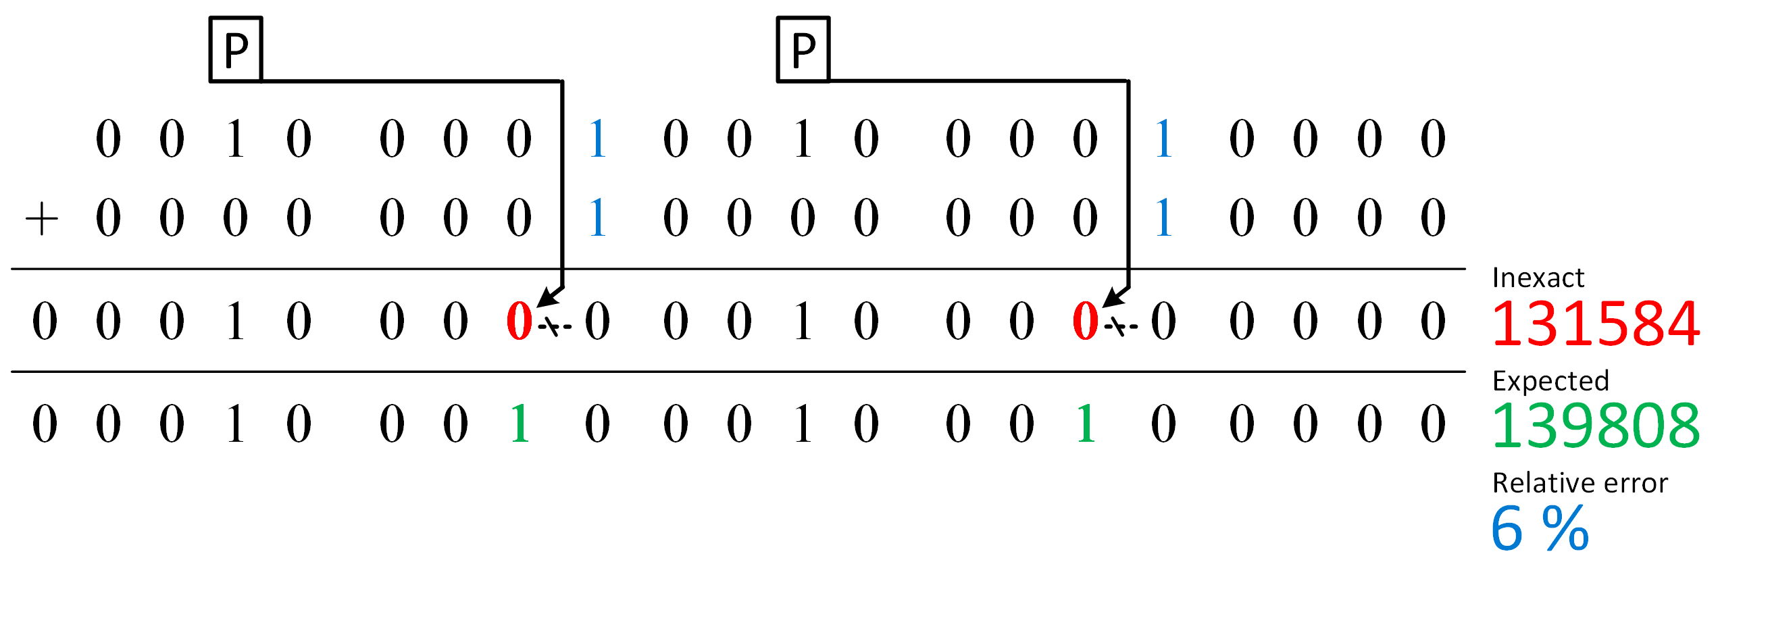
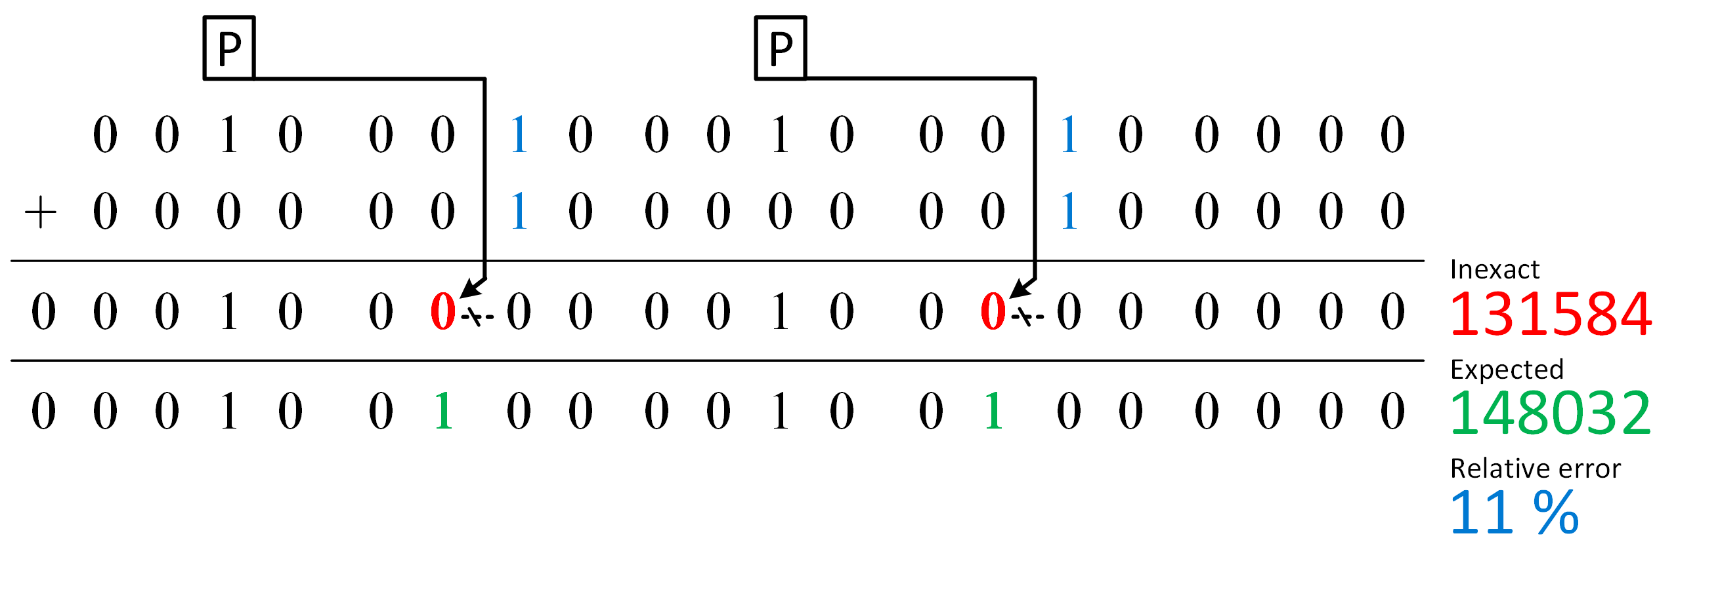
3. CCBA Arithmetic
Error control (varying the cut-back length)
DAC’16

Slide 12

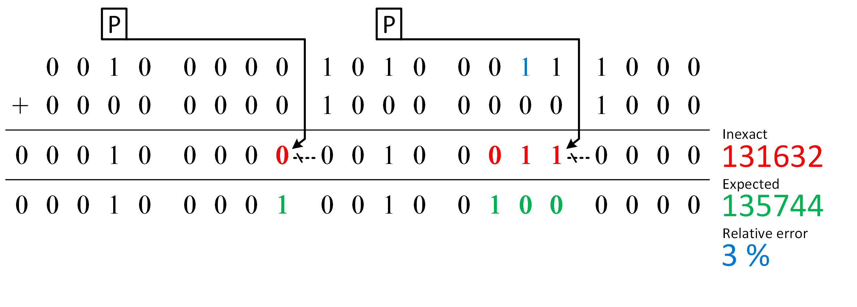
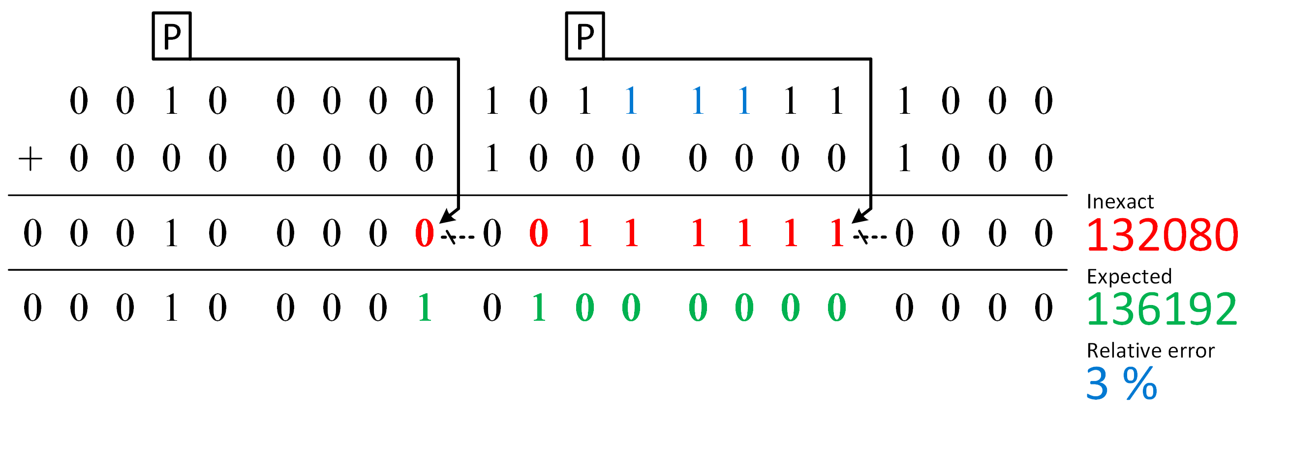
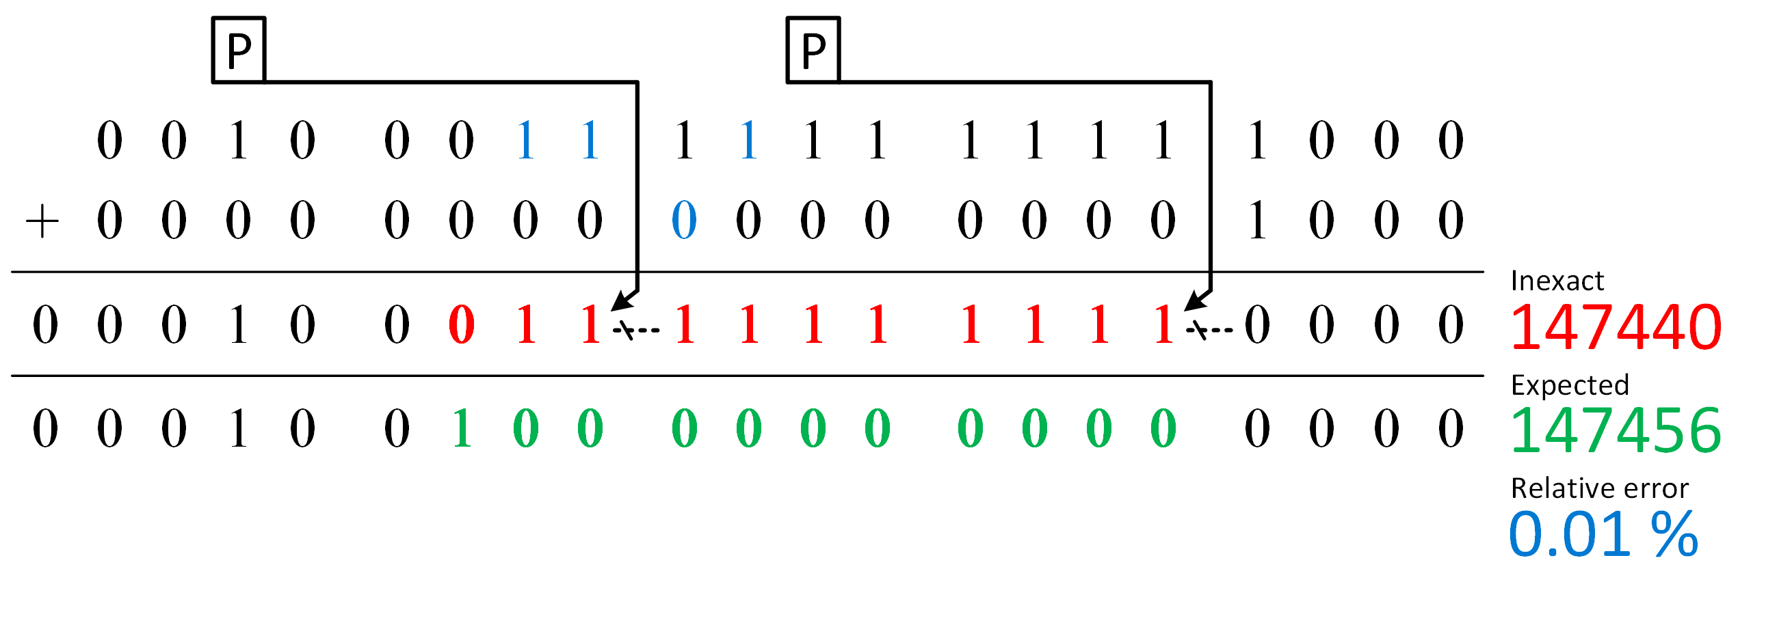

3. CCBA Arithmetic
(2 bits…)
(3 bits…)
(without increasing the error value)
Propagating error
(even if overlapping!)
DAC’16

Slide 13


4. General Implementation
Simple example
General architecture
General architecture
Multiplexers (offer more error control)
Speculation blocks (reduce error rate, optimize delay)
DAC’16

Slide 14

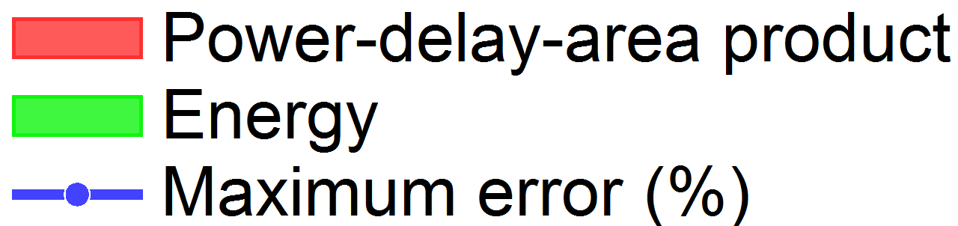
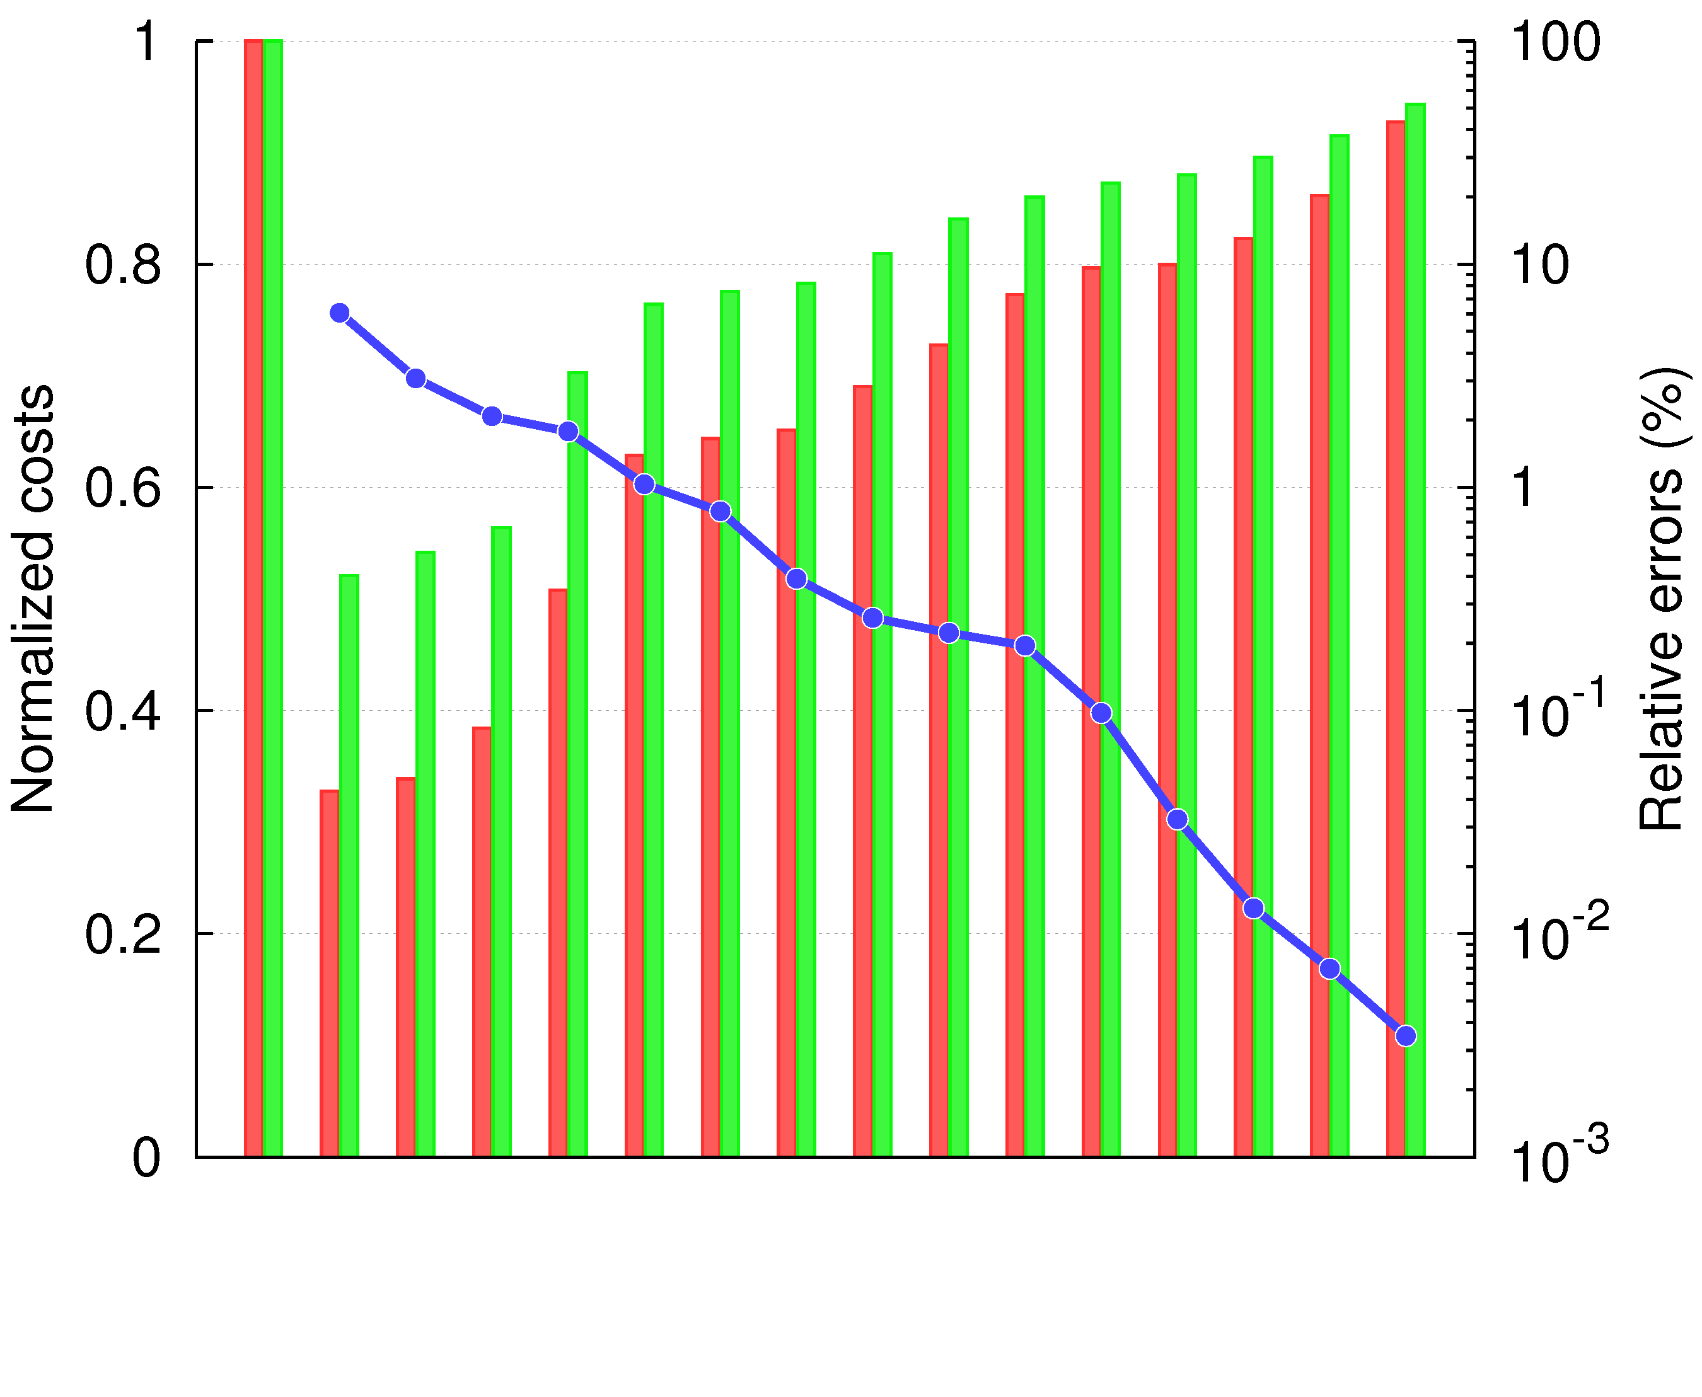
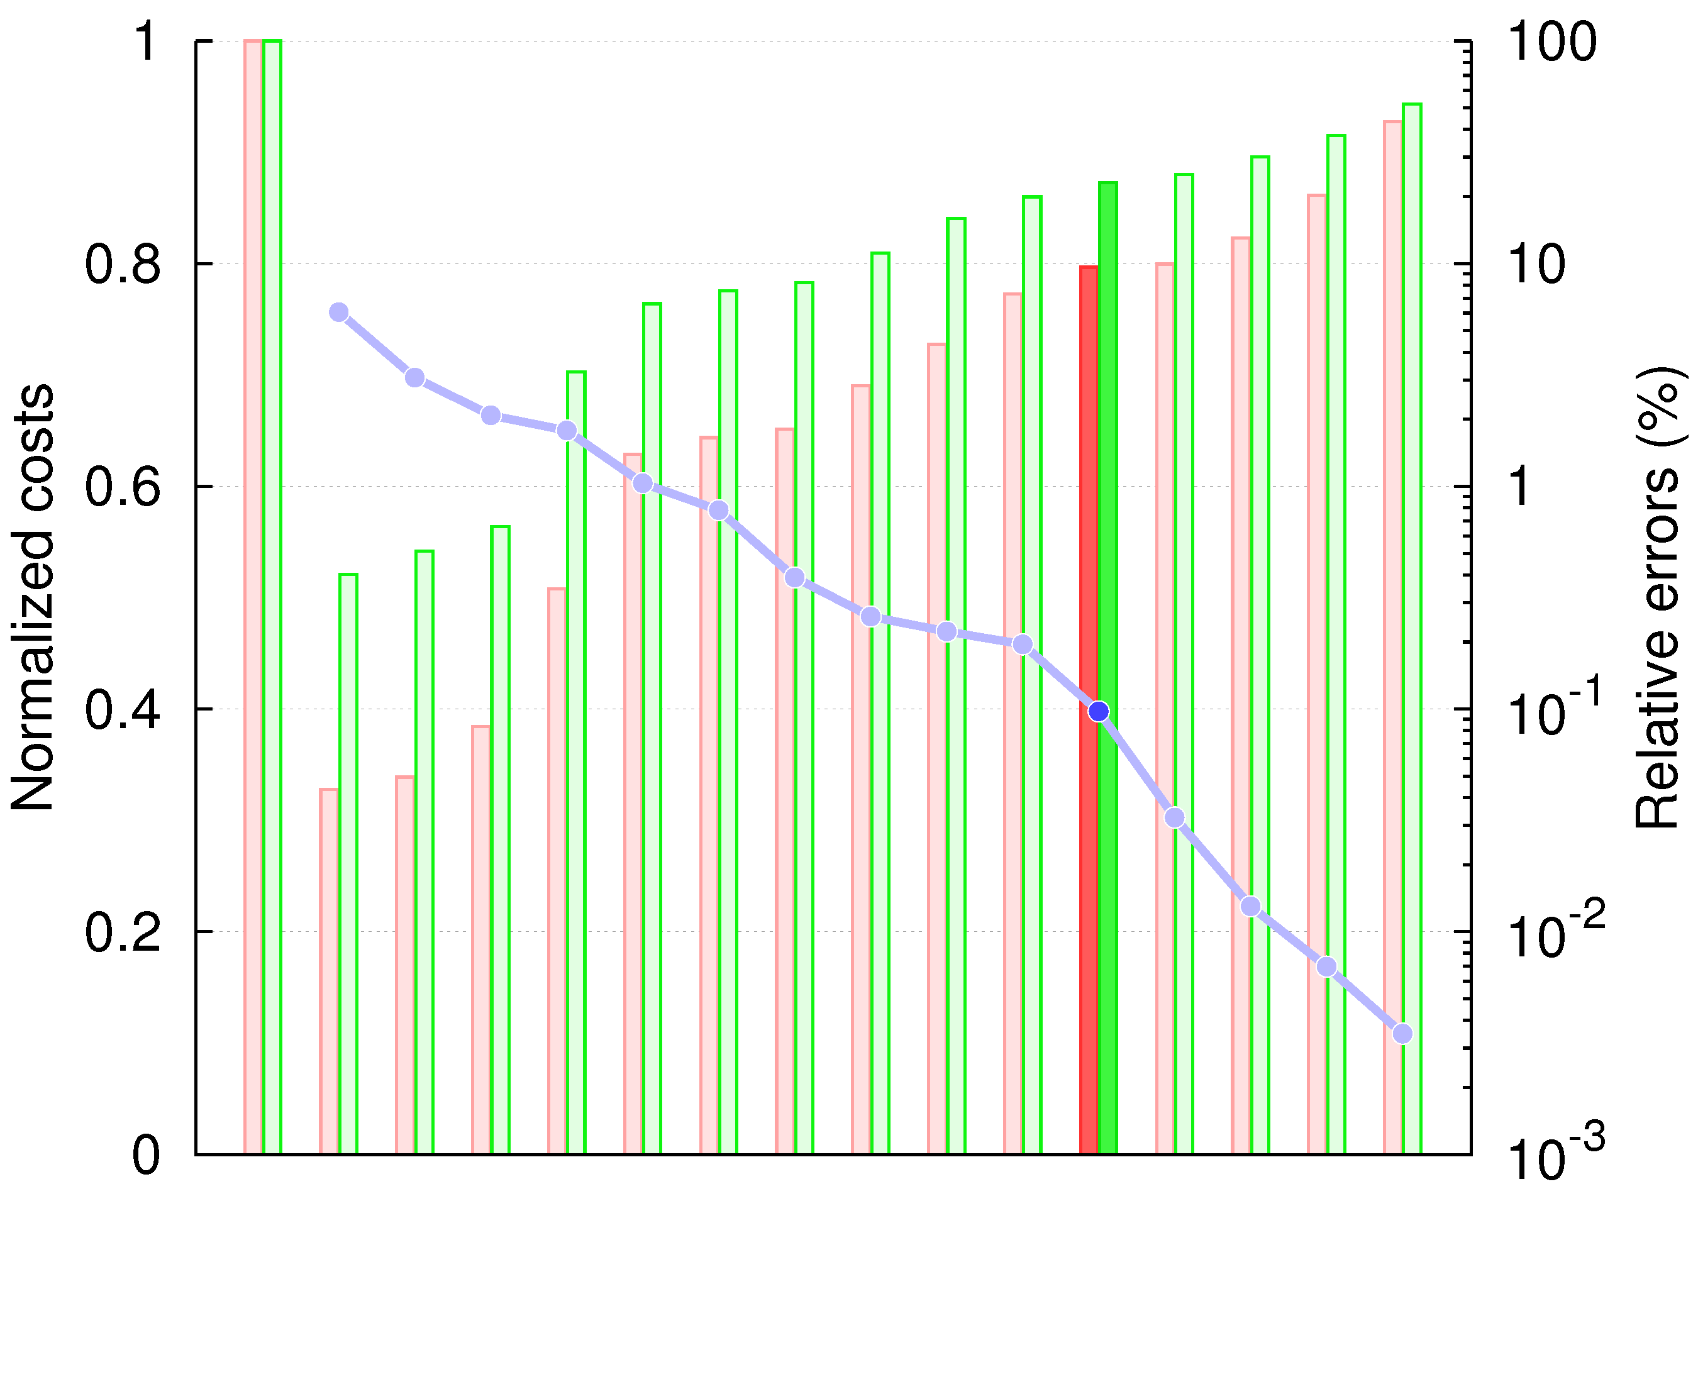
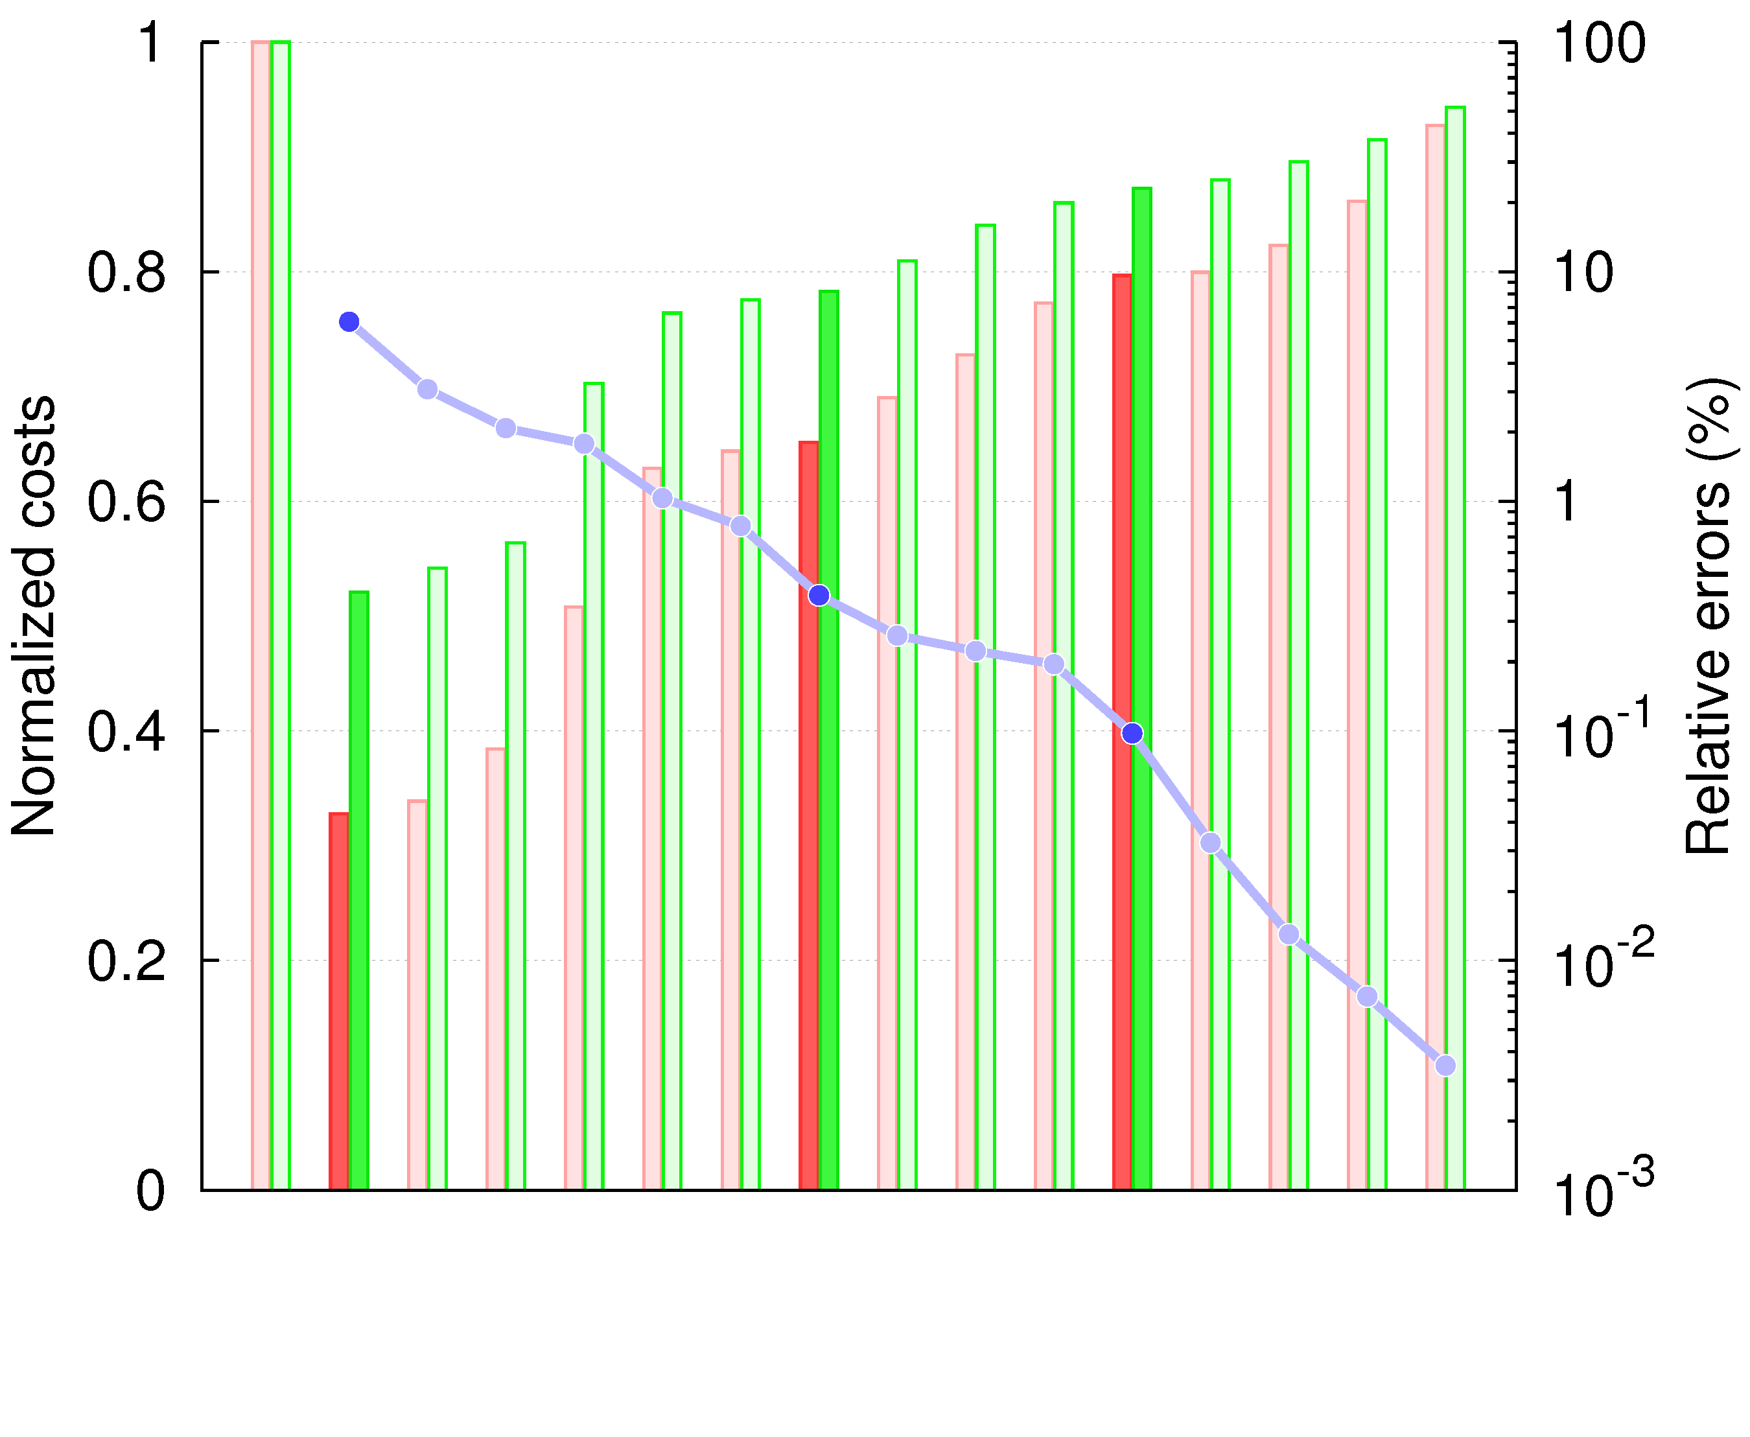
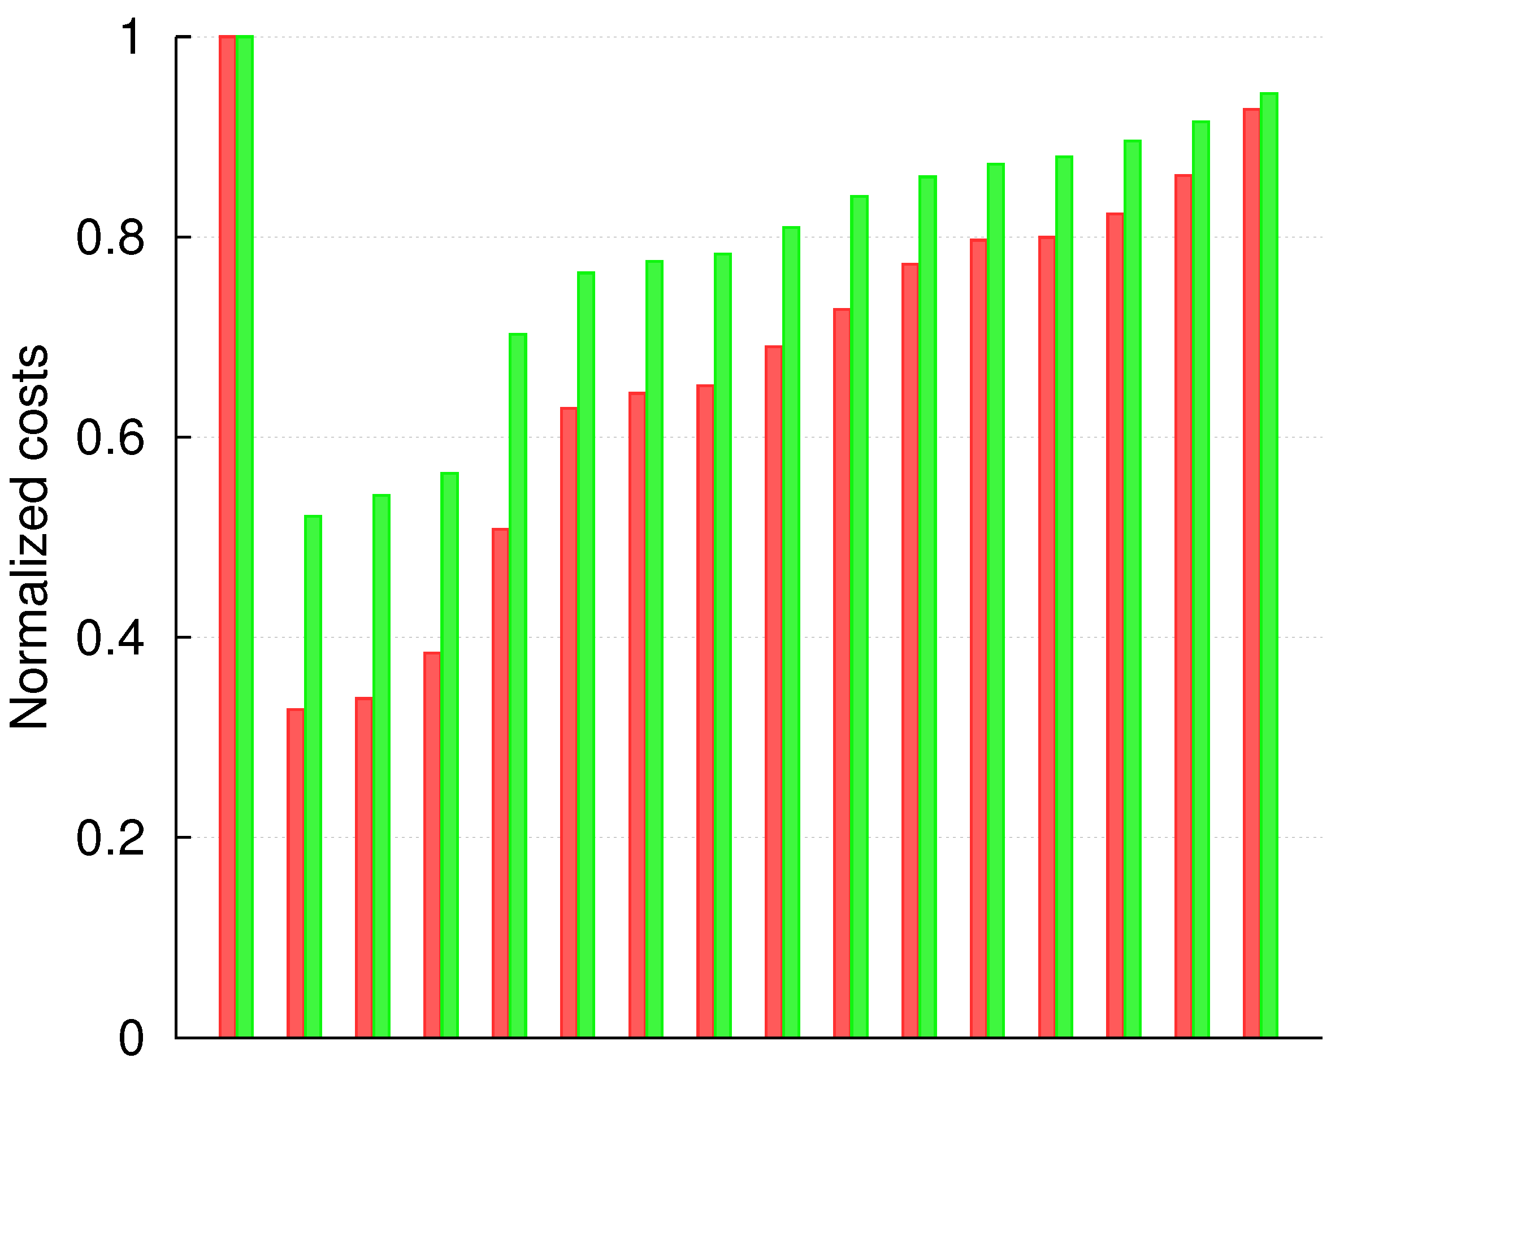
4. Results
Implementations
– 32 bits
– 65 nm techno
– 800 MHz
Metrics
– Energy
– PDAP
– Max error
Savings
– - 14 % energy
– - 22 % PDAP
– 0.1 % max error
CCBA (1)
CCBA (2)
CCBA (3)
32-bit CCB adders compared to exact adder
DAC’16

Slide 15
4. Comparison
Comparison of 32-bit adders (800 MHz, 65 nm techno)
Architecture | Max error (%) | Energy (fJ) | PDAP
Exact | 0 | 79 | 100
ETBA | 6 | 50 | 59
ISA |  | 49 | 47
CCB adder |  | 41 | 33
ETBA | 0.4 | 82 | 117
ISA |  | 69 | 83
CCB adder |  | 62 | 68
ISA | 0.2 | 78 | 99
CCBA (3) | 0.1 | 68 | 78
Architecture | Max error (%) | Energy (fJ) | PDAP
Exact | 0 | 79 | 100
ETBA | 6 | 50 | 59
ISA |  | 49 | 47
CCB adder |  | 41 | 33
ETBA | 0.4 | 82 | 117
ISA |  | 69 | 83
CCBA (2) |  | 62 | 68
Architecture | Max error (%) | Energy (fJ) | PDAP
Exact | 0 | 79 | 100
ETBA | 6 | 50 | 59
ISA |  | 49 | 47
CCBA (1) |  | 41 | 33
-18 %
-45 %
-16 %
-30 %
-24 %
-42 %
-10 %
-18 %
-13 %
-21 %
State-of-the-Art
Medium savings
Inefficient for low errors due to high overheads
CCBA
High savings
Decent savings for low errors thanks to marginal overheads
DAC’16

Slide 16
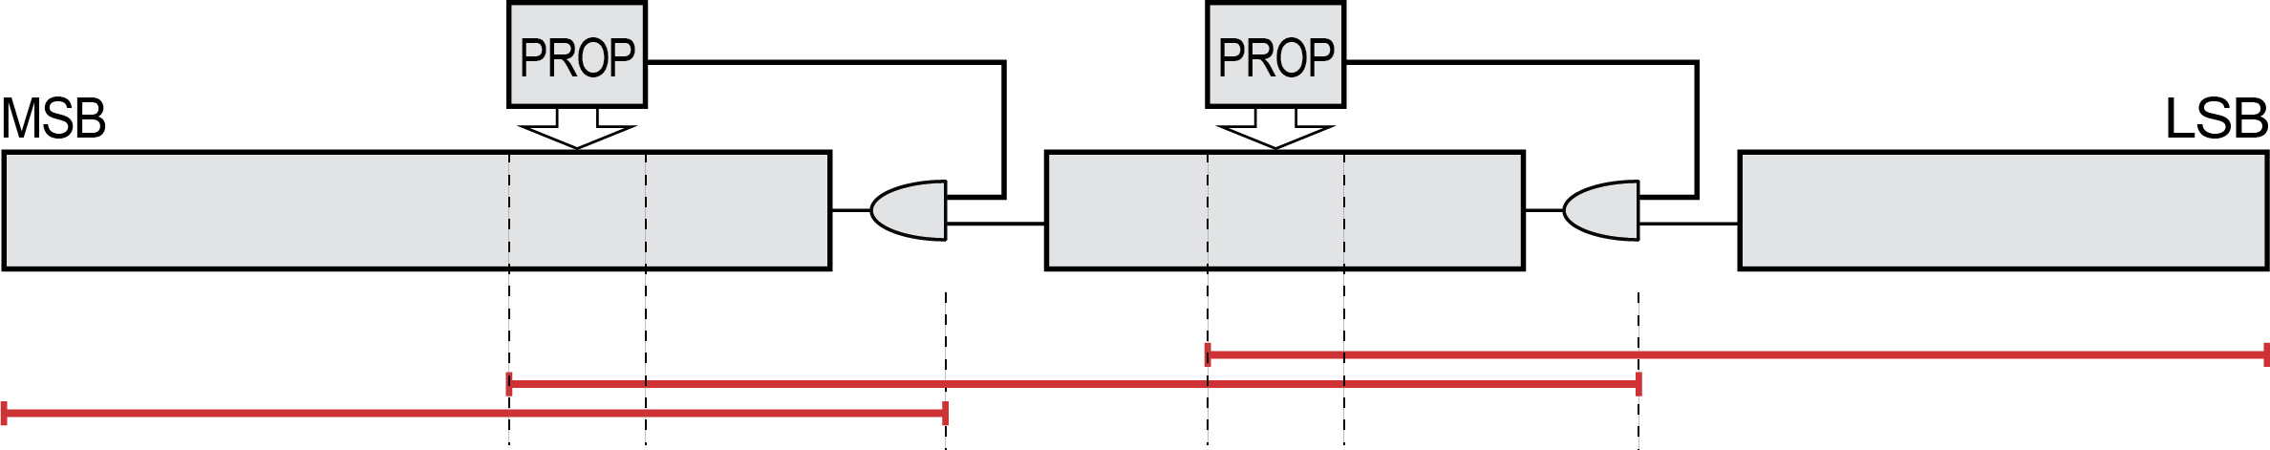
Carry Cut-Back Adder – Summary
Principle
Monitor some carry stages
Cut chain at lower position if risk of long carry propagation
Floating-point-type precision
Results
Up to 45 % better than existing
22 % PDAP savings for 0.1 % worst-case error
(IEEE half-precision equivalent)
New concept
Circuit functionality and timing co-designed by fabrication of artificial false timing paths
DAC’16
Cutting the carry chain at low-significance positions
if there is a risk of long propagation along the adder

Slide 17


Thank you !

