Slide 1


Slide 2
Viking Quest VR
Get The Assets:
<Link>
Mark Schoennagel – Marks@Unity3d.com

Slide 3
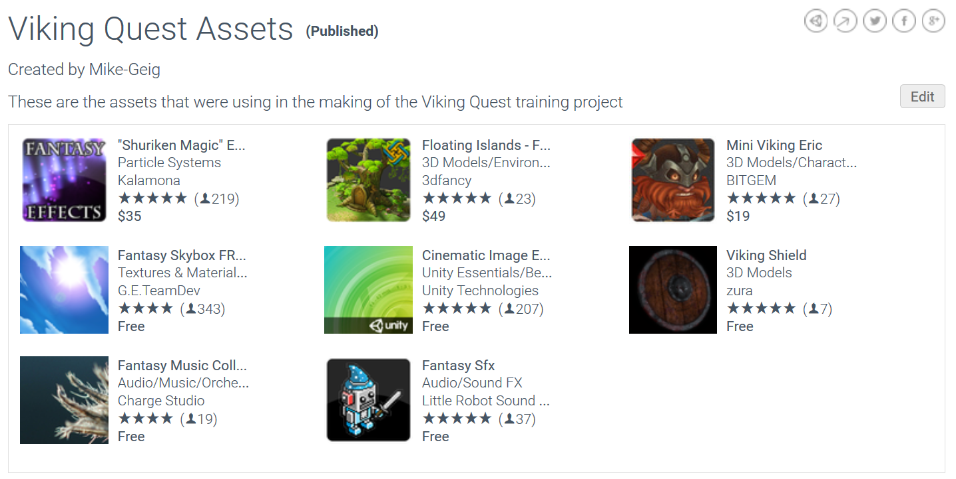
The Assets
http://bit.ly/2aMyQep

Slide 4
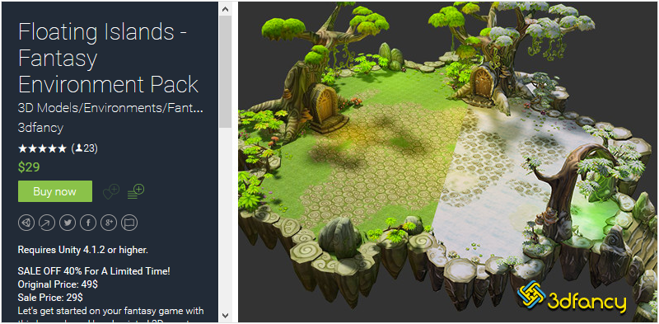
Environment – 3DFancy

Slide 5
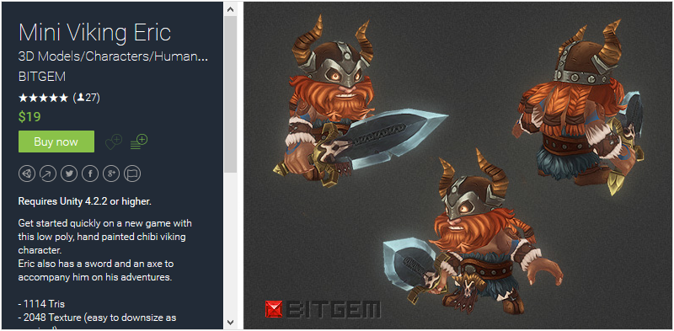
Character - BITGEM

Slide 6
Objectives
CREATE a game using content from the Asset Store
CONSTRUCT a game with integrated VR
DEMONSTRATE how to use the various tools of the Unity Editor
IDENTIFY good design practices when building for VR

Slide 7
Step 01: The Project
Unzip content folder to Desktop or somewhere handy.
Launch Unity, add project
Open Start Scene

Slide 8
Step 02: Bake Lighting
Open Lighting panel,
Turn off Auto
Press Build

Slide 9
Step 03: The Viking
Drag the Viking model into the scene
Add a Capsule Collider to the Viking Center Y=1 Height=2
Add a Rigidbody to the Viking
Drag the Player_FullControl script onto the Viking
Set the Ground layer on the What Is Ground property
Play W A S D to move SPACE to Jump

Slide 10
Step 04: World Boundaries
Freeze the X, Y, and Z Rotation Constraints of the Rigidbody component on the Viking
Drag the WorldColliders prefab into the Hierarchy window
Click the Layers button in the upper-right of the editor and click the Eye icon next to the WallColliders layer
On the Camera, uncheck the WallColliders layer on the camera’s Culling Mask
Test the game in Play mode

Slide 11
Step 05: Integrating VR
Add an Empty game object to the Main Camera named Camera Control Rig
Un-parent the Camera Control Rig from the Main Camera
Parent the Main Camera under the Camera Control Rig
Remove any rotation from the Camera Control Rig
Add the Camera Editor Control script to the Main Camera and check Mouse Control if not testing with a VR Headset
Go to VR->Enable VR if testing with a VR Headset

Slide 12
Step 06: Animating a Character
Add CameraFollow script to the Camera Control Rig and set the Viking as the Target and set Speed to 1
Drag the Idle, Run, and Jump animations onto the Viking
Open the Animator window to see the animations on the Viking

Slide 13
Step 07: Animation Transitions – Part 1
In the Animator, create a Float parameter named Speed, a Trigger named Jump, and a Bool named Grounded
Create the transitions between Idle <-> Run, Run <-> Jump, and Idle <-> Jump
On each transition uncheck Has Exit Time
Set the transition from Idle to Run as “Speed Greater .01”
Set the transition from Run to Idle as “Speed Less .01”

Slide 14
Step 07: Animation Transitions – Part 2
Set the transition from Idle to Jump as “Jump”
Set the transition from Jump to Idle as “Speed Less .01” AND “Grounded = true”
Set the transition from Run to Jump as “Jump”
Set the transition from Jump to Run as “Speed Greater .01” AND “Grounded = true”
Adjust the blends on the transitions as needed

Slide 15
Step 08: Collectables
Tag the Viking as Player
Turn the Viking into a prefab by dragging it from the Hierarchy window into the Prefabs folder
Drag Collectable prefab into scene
Add Collectable script to the Collectable and click Apply in the top right of the Inspector

Slide 16
Step 09: Spawning Collectables
Delete Collectable object from scene
Add the CollectableSpawner script to the Spawn Points game object
Add the Collectable prefab to the Collectable Prefab property on the CollectableSpawner script

Slide 17
Step 10: The Game Manager
Drag the Game Manager UI prefab into the scene
Drag the Wall game object onto the Wall property of the Game Manager script
Drag the Collect Panel from the Game Manager onto the Viking
Drag the Timer Panel from the Game Manager onto the Environment
Drag the Win and Loss Panels from the Game Manager onto the Camera Control Rig

Slide 18
Step 11: Audio
Add an Audio Source component to the Main Camera
On the Camera check Loop and set the Clip to Forrest Spirit
Examine Audio on the Wall
Examine Audio on Collectable prefab

Slide 19
Step 12: Improving Graphics
Drag Sunny 03B noSun skybox into scene
Open the Lighting window, uncheck Auto, and then click Build
Add camera effects to the Main Camera (personal preference)
Tonemapping
Bloom

Slide 20
Step 13: Build and Deploy
Go to File->Build Settings
Click Add Open Scenes to add current scene to the build
Click Build and Run
Save the game file and enjoy!

Slide 21
Optional Steps

Slide 22
Camera Scaling
Drag World Shrinker 3000 prefab into scene
Drag the Camera Control Rig onto the Cam Controller property of the Camera Scaler script
Open the CameraZoomTesting scene to see the difference between zooming a VR camera and scaling it

Slide 23
Thank you

