Slide 1

NWEN 304 GROUP PROJECT
The coffee Shop
Jordan smith
Willie joe
Monika gill

Slide 2
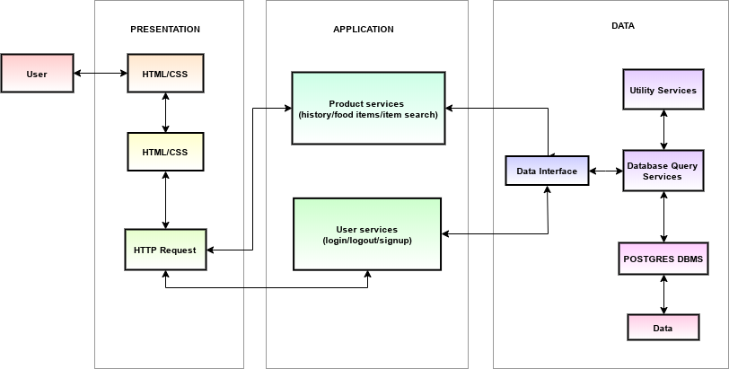
SYSTEM ARCHITECTURE
Partitioned work into discrete layers which lends itself to the MVC pattern
Presentation is the web view itself, where the clients interact
Application is the logic of the application, where credentials are checked, and products are added and removed
Data is where user details and product details are stored

Slide 3
Division of Work
Presentation Layer:
  Monika is working on the presentation layer mainly the front-end along with Jordan.
  Monika working on the visual elements that the user sees and interact with.
Application Layer:
  Jordan is working on the application layer, including retrieving product information and user login/creation.
Database:
  Willie setting up database tables and the NodeJS interface for other components to access.

Slide 4
Current State of Progress:
Database has been set up on Heroku.
Application layer is able to access the database.
Connected the Database Tier to Application Tier.
The base homepage for the Coffee shop has been setup.
Implementation of salted password hashing in the web server for secure user account management
Basic restful interface has been created.

