Slide 1

NWEN 304 GROUP PROJECT
The coffee Shop
Jordan smith
Willie joe
Monika gill

Slide 2
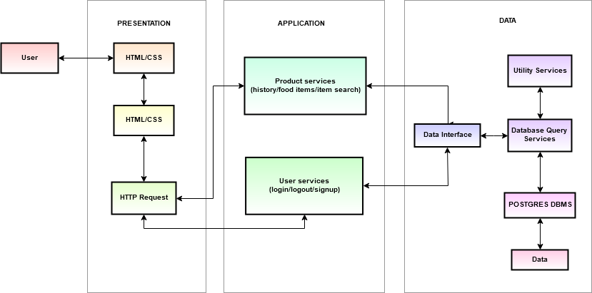
SYSTEM ARCHITECTURE, 3-Tier

Slide 3
Division of Work
We decided to divide the work by keeping different components that will make up a website and the services each component or the website will provide in whole. We considered factors like Technical constraints such as server, storage and communication interfaces.
Functional aspects such as the type of services or processes the website will provide.
Visual appearance i.e. the user interface, color, buttons and other visual design elements.
Security parameters i.e. how the website will ensure secure access control and transactions.
To divide the work, we decided to follow the three-tier architecture.
Presentation Tier:
Monika is working on the presentation layer mainly the front-end along with Jordan.
Monika working on the visual elements that the user sees and interact with.
Application Tier:
Jordan is working on the application functionality by performing detailed processing.
Working on server-side application logic and integration.
Data Tier:
Willie is working on the database for the website.
Interface for communication with the Application tier.
Building database tables and queries for the database.

Slide 4
Current State of Progress:
Database has been set up on Heroku.
Application layer is able to access the database.
Connected the Database Tier to Application Tier.
The base homepage for the Coffee shop has been setup.
Implementation of salted password hashing in the web server for secure user account management
Basic restful interface has been created.

