Slide 1
BLOOD BANK
1. MONIK RUPARELIYA
2. RAJ PAMPANIYA
3.RAVI GOHEL

Slide 2
1. Project Profile
1.1 Definition :-
→ Blood Bank Management system is a browser based solution that is designed to store, process, retrieve and analyze information concerned with the administrative, inventory management und Clinical aspects of providing services within a blood bunk.
→ The main goal of the Blood Bank Management System Project is to monitor Blood Bank data, Blood Stock, Donor List. It manages all the Blood Bank, Donor, Blood Stock data. → Blood bunks collect, Store and provide collected blood to the Patients who are in need of blood.

Slide 3
1. Project Profile
1.2 Scope:-
→The scope of the project is that in a very she Spun It Provides user with many Facilities. It Provides an elegant management of blood, list Of hospitals, blood bank and donors online.
→ The main purpose of this project is to interconnect on the blood banks, hospitals, donors into a single network, validation. Store various data and information of blood and health of ed individual.
→ This system is used to Store data over a Centralized Server which consist of database where the Individual's information cannot be accessed by a third Party.

Slide 4
1. Project Profile
3 modules are there.
1. Admin
2. Donors
3. Acceptors

Slide 5
1. Project Profile
1.3 objective:-
→ The main objective of the Blood Bank Management System is to manage the details of Blood, Donor, Blood Group, Blood Bank, Stock. It manages all the information about Blood, Stock, Blood.
-> The Project is totally built at administrative and thus only the administrator is guaranteed. the access.
-> The Purpose of the project is to build an web. application program to reduce the manual work for managing the Blood, Donor, Blood Group.
→ The all details about the Blood Group, Blood Bunk, Stock.

Slide 6
2 System Analysis and Specification
2.1 Existing system:-
-> eRaktKosh link:-
https://www.eruktkosh.in
2.2 Limitations of Existing System
→ No knowledge of toll free troubleshooting. Support.
→ Manual document and dater entry.
2.3 Feasibility Soudy.
-> Feasibility study is test of a system Proposal according to its workability, impact on the organization, ability to meet user needs and effective use of resources. All the project are Feasible given unlimited resources and infinite. time 1 Ergo, Feasibility study means an evaluation of benefits versus costs incurred in developing Projects, where cost Includes manpower, time, resources and money

Slide 7
2 System Analysis and Specification
Operational Feasibility
-> Operational Feasibility measures how well the Solution will work in the organization and how will end-user a management feels about the System. Proposed system is helpful for all the users associated with the organization.
Schedule Feasibility
→ Projects are initiated with specific deadline need to evaluate whether the deadlines are mandatory or desirable. Time is the one of the critical in the development of any system bur kind of feasibility is hardly Perfect in any System

Slide 8
2 System Analysis and Specification
2.4 Need Of New System.
-> The Purpose of the online Blood Bank Management System is to collect data about donors and Seekers who are interested in blood or who require it.
2.5 Front End & Backend Tools
FrontEnd Tools
HTML:-
CSS :-
Java Script :-
PHP:
=> PHPMYADMIN:-

Slide 9
3 System Requirement Specification
3.1 Proposed system and Advantages
Proposed system:-
→ The project blood bunk management System is known to be a pilot project that is designed for the blood bunk to gather blood from various Sources and distribute it to the needy People who high requirements for it.
1. Admin
2. Donors
3. Acceptors

Slide 10
3 System Requirement Specification
3.2 Development Strategy Model
Feasibility & Requirement Analysis :-
=> Advantages :- 1. Easy to understand and implement. 2. Testing in each phase. 3. Documentation Available after each phase. 4. Mast Suitable for single projects where work. Products are well definded and their functioning is understood. => Disadvantages:- 1. Once detecting error at any face it may be requires that the precede Subsidy Faces may change. 2. Very difficult to manage changes blw the phases there are possibility of blocking which can slow down the Productivity and efficiency of the process. 3. Risk is not addressed in this model

Slide 11
4 System Design
4.1 Data Flow Diagram
0 Level
4.2 E R Diagram
4.3 Class Diagram
4.4 Use Case Diagram
4.5 Sequence Diagram
4.6 Activity Diagram
4.7 Data Dictionary

Slide 12
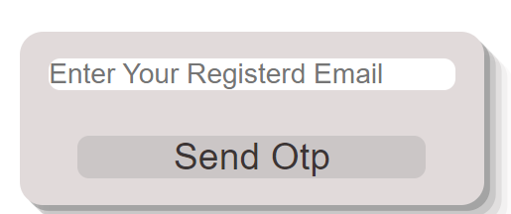
5 Screen Design
Log in-

Slide 13
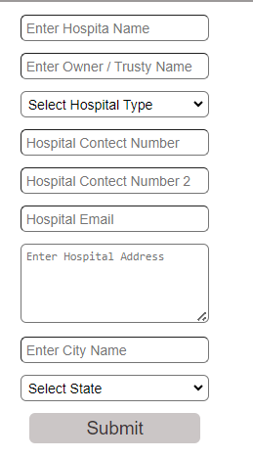
5 Screen Design
Hospital Registration Fprm :-

Slide 14
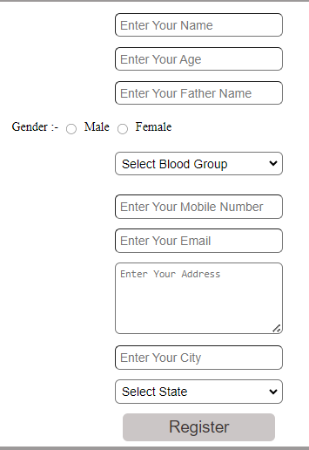
5 Screen Design
USER Registration Fprm :-

Slide 15
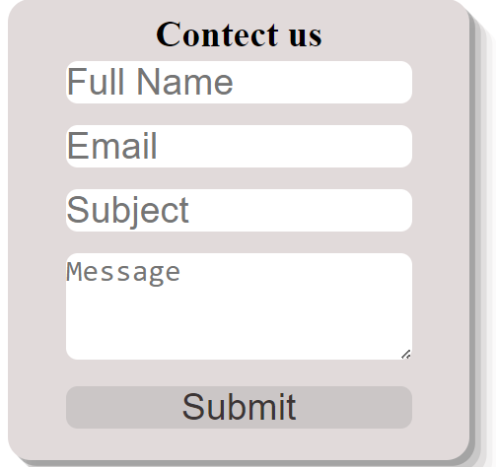
5 Screen Design
Contect Us:-

Slide 16
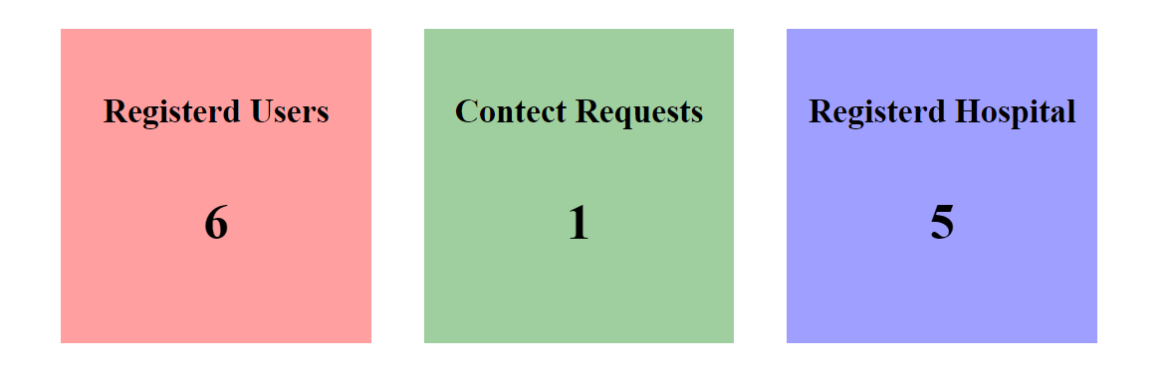
5 Screen Design
Admin Ui

Slide 17
7 Testing
->Some of the basic testing Principles:-
7.1 → (a) White Box Testing :-
7.2 Test Case

Slide 18
8 Enhancements
8.1
- >Easy Trucking :-
->Fuster Help:-
->Donor Help
-> Less mistakes:-
8.2 Limitation or your Project:
-> Technology Dependence
-> Data Accuracy

Slide 19
9 References
Google
youtube
→ websites:- https: // www.eruktkash.in
https://www.w3school.com

