Slide 1
Purple bit logic
Group Members:
Ryan Anand, Mohammad Mubashir, Monika Munagapati, Yao-Hui Tseng

Slide 2
Introduction
Background:
A Non-Banking Financial Company (NBFC) is experiencing a decline in profitability due to a rise in defaults within the vehicle loan category. In response , the company wants to construct a prediction model by this dataset to predict the likelihood of a client defaulting on their vehicle loan payment.
Objective:
Our objective for this project is to visualize pattern difference between the defaulted customers and non default customers on some of the variables to verify what variables can be kept and what can be removed for the further model-building process, in order to minimize noise during the model-building process
Dataset:

Slide 3
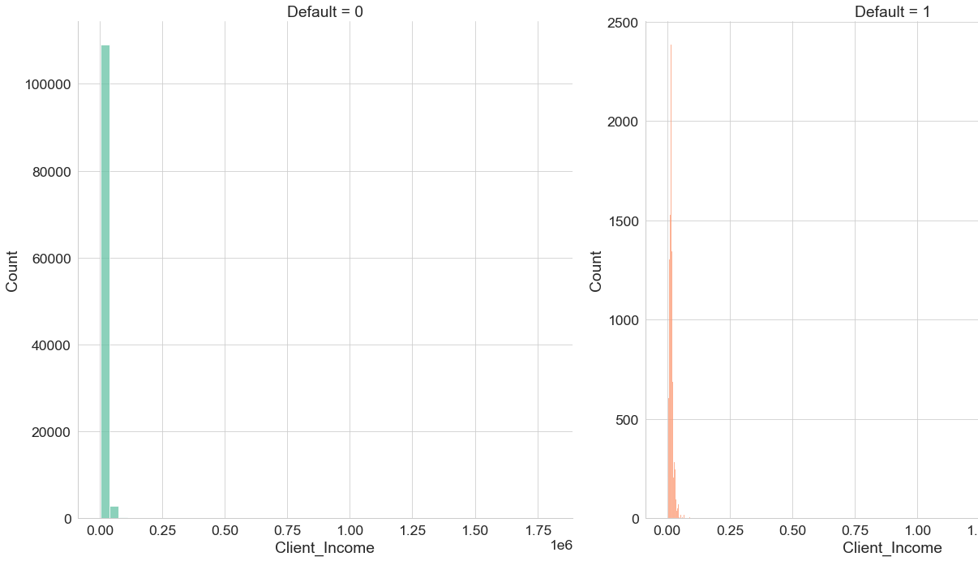
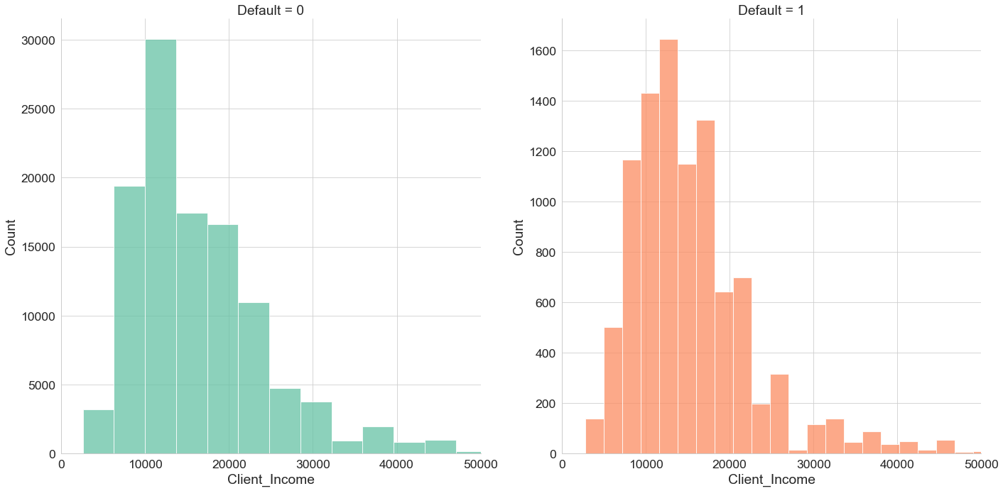
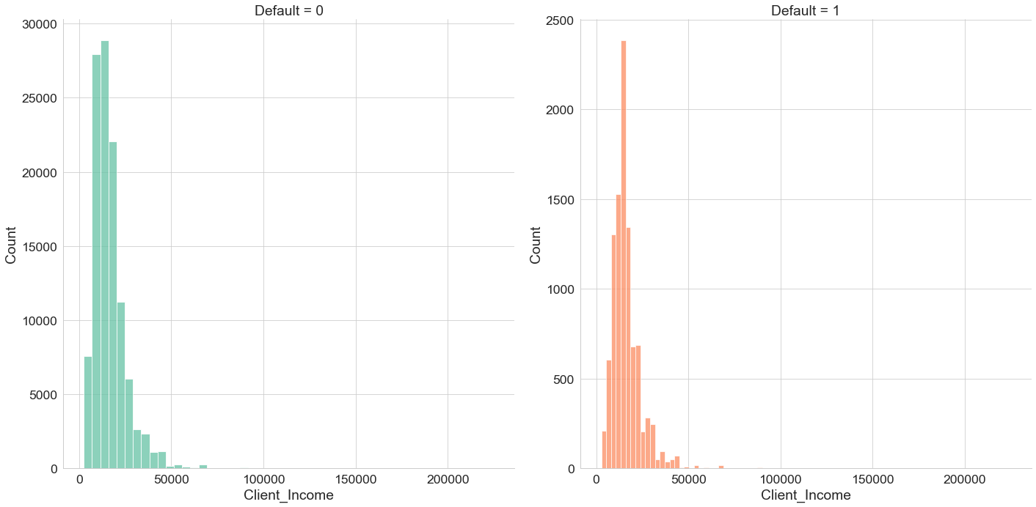
Histogram visualization
$250K cut-off value to exclude outliers from index
These histograms involve client income
Stagnant difference between defaulted and non defaulted clients
Notes:
plt.figure(figsize=(12,6),dpi=200)
sns.set(style="whitegrid")
sns.set_context("paper",font_scale=2)
a = sns.FacetGrid(data= loan, col = 'Default',height=10,aspect=1, sharey=False,hue='Default',palette="Set2")
a.map_dataframe(sns.histplot, x= 'Client_Income',bins=50)
Adapt 250k cut-off value to exclude the outliers
outlier =loan[loan['Client_Income']>250000].index
no_outlier = loan.drop(outlier,axis=0)
no_outlier['Client_Income'].max()
Then plot again
plt.figure(figsize=(12,6),dpi=200)
a = sns.FacetGrid(data= no_outlier, col = 'Default',height=10,aspect=1, xlim=(0,50000), sharey=False,hue='Default',palette="Set2")
a.map_dataframe(sns.histplot, x= 'Client_Income',bins=60)
From above histograms, we have some findings:
The total numbers of two groups: Defaulted and Non Default clients, have large difference.
Even we focus on the certain scale of income, we still can see the left-skewed of the distribution, this could be explained by the background of this dataset, since the dataset is from the NBFI, we can assume that most customers of NBFI are the customers that rejected by the Bank, the income may be a reason.
The distribution between two groups have little difference, that means with only income factor, we can not tell the difference between two groups.
As a result, we would like to see if we combine the income factor with other variable, can we find some patterns between two groups?

Slide 4
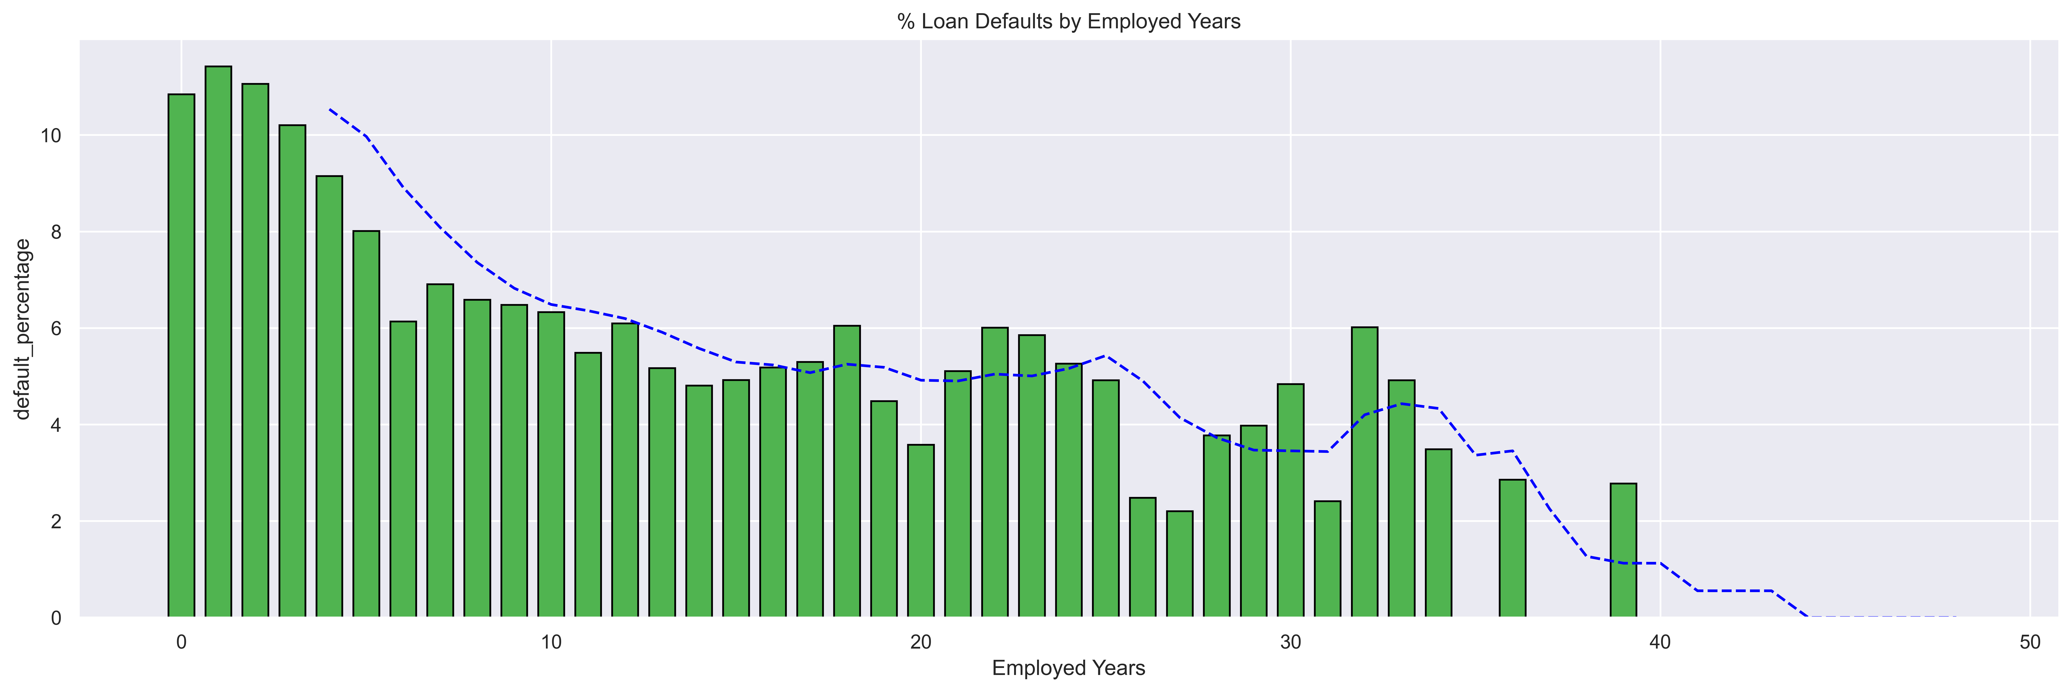
Bar chart visualization
The line chart on top of bar chart indicates moving average of default percentage
Drastic loan default declines after employed # of years 6 and 25
Notes:
We now look at relation between Employed_Year and Default Columns In order to investigate the relationship between the length of time a customer has been employed and their likelihood of defaulting, we created a new dataset called employed_yrs_distribution.
This dataset includes a column indicating the percentage of customers who defaulted for each employed year group.
We will visualize this data with a bar chart. We also plot a line chart on top indicating the moving average value of default_percantage on top of the bar chart to show the trend
# group the data by employed_years and default, and calculate the count and sum for each group
employed_yrs_distribution=(loan.groupby('Employed_Years')['Default']
.agg(['sum', 'count'])
.rename(columns={'sum': 'number_defaults', 'count':'number_customers'})).reset_index()
#divide sum by count to get percentage of defaults
employed_yrs_distribution['default_percentage'] = (employed_yrs_distribution['number_defaults'] / employed_yrs_distribution['number_customers']) * 100
CODE FOR BAR CHART LINE CHART ON TOP
import matplotlib.pyplot as plt
plt.figure(figsize=(20, 6),dpi=600)
# add labels and title
plt.xlabel('Employed Years')
plt.ylabel('default_percentage')
plt.title('% Loan Defaults by Employed Years')
# create a bar plot with y=default_percentage and x=Employed_Years
plt.bar(employed_yrs_distribution['Employed_Years'],employed_yrs_distribution['default_percentage'] ,
width =0.7, color=(80/255, 180/255, 80/255), edgecolor='black')
moving_avg = employed_yrs_distribution['default_percentage'].rolling(window=5).mean()
plt.plot(employed_yrs_distribution['Employed_Years'], moving_avg, color='blue', linestyle='--', label='Moving average')
plt.show()
The aforementioned graph demonstrates a clear and consistent relationship between the number of employed years and the likelihood of defaulting. As Employed_Years increase, we observe a sharp decline in the percentage of defaulting customers until reaching a plateau at around 6 years, followed by a gradual decrease and another sharp decline after the 25-year mark.
Based on this pattern, we can confidently state that employed years play a significant role in predicting a customer's probability of defaulting. By integrating this feature into our models, we can effectively enhance their predictive accuracy.
2nd bar chart
For the bar chart, we have following findings:
Some income types do not have defaulted client, the reason might because the numbers of these type are extremely low, they might be considered outliers, but we are not going to do anything on them since we are only doing visualization.
To some degree, the income type reflect the average income correctly, but not totally based on common sense, such as student and Maternity leave have highest average income, same as above point, this might because the numbers of these type are extremely low.
The black stick on top of each bar represents the standard deviation, for most categories the variance are high, except for the defaulted unemployed and retired groups.
In this graph, we can have a clear pattern on the income factor that in each income type, defaulted group has lower average income than non default group.

Slide 5
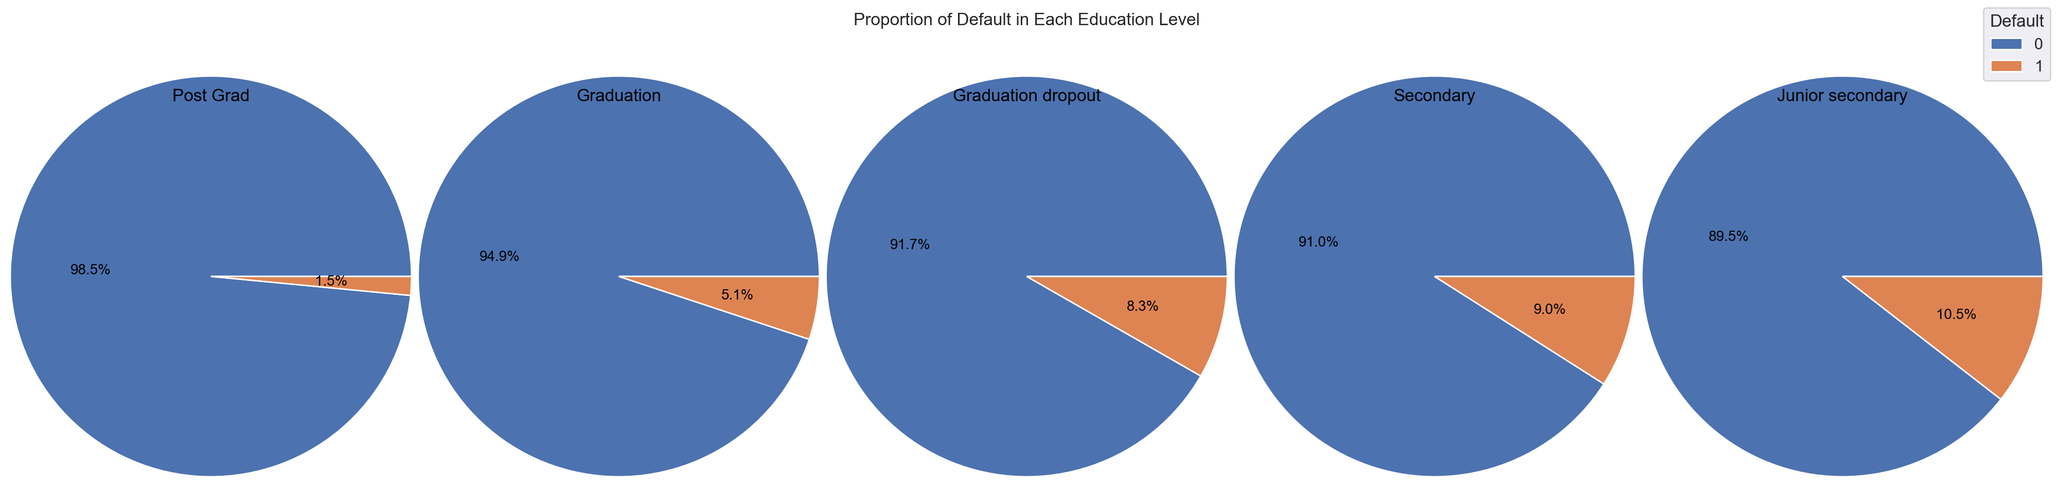
Pie chart
The higher education level one has, the less likely they are to default on their loan
This is evidenced by the percentages
Notes:
We aim to investigate whether car ownership has any effect on a customer's likelihood of defaulting. To achieve this, we will plot two pie charts, one for the case where Car_Owned equals 0 and another for the case where Car_Owned equals 1.
To avoid code duplication, we define a function that will take a dataset, subplot, and the Car_Owned value as arguments. The function will then calculate the percentage of customers who defaulted and who did not for the given Car_Owned value. Finally, the function plots a pie chart to visualize the calculated percentages.
Above Plot
As we can see from above plots, the difference between default_percentages for the two cases is not that much different
The difference is only 1.3\
Based on the above pie charts, we observe that the difference between the default percentages for the two cases is quite small, with only a 1.3% difference between them. This small difference suggests that owning a car may not be a significant factor in determining a customer's likelihood of defaulting.
This small amount of difference indiactes that Car_Owned might not be a signifcant factor that can influence a customers likelihood for defaulting
2nd Pie Charts
For the pie chart, we want to see if the education level has any correlation with default.
As we can see above pie chart, with higher education level, the proportion of Default client is getting lower.

Slide 6
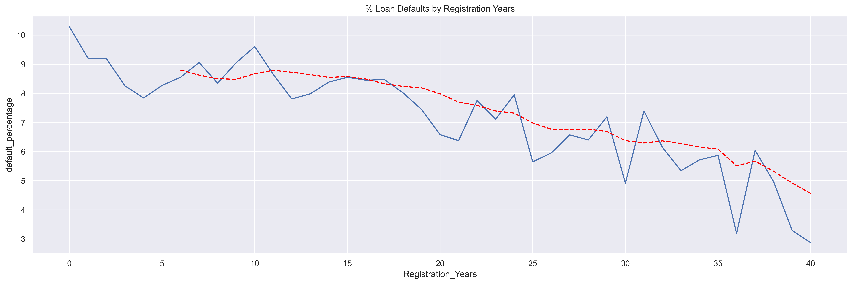
Line plot
Created new dataset (reg_yrs_distribution) to check if duration of registration had impact on defaults
Inverse relationship between likelihood of defaulting and number of registration years
Improved predictive power
Notes:
Next, we examine the correlation between the Registration_Years and Default Columns.
To investigate whether the duration of registration has an impact on customer defaulting behavior, we created a new dataset called reg_yrs_distribution.
This dataset includes a column indicating the percentage of customers who defaulted for each registration year group.
We will visualize this data with a line chart to see the trend of default percentage against registration years.
We noticed that some groups in the Registration_Years column have very few entries. This can result in a noisy plot that is difficult to interpret. To address this issue, we have decided to exclude groups with fewer than 150 entries. This will help us obtain a more accurate and reliable trend of default percent against registration years.
Based on the above graph, we observe that there is a clear trend indicating that the likelihood of defaulting decreases as the number of registration years increases. Therefore, we can conclude that registration years can be considered a significant factor in predicting a customer's likelihood of defaulting. This feature can be incorporated in our models to improve their predictive power.
2nd line plot
Age vs loan duration
For the above line chart:
It's quiet interesting that older people would have longer loan Duration
For the client younger than 55, the defaulted group has shorter loan Duration, but for the client older than 55, the default group would have longer loan Duration
The steep curve of the loan Duration after about 65 is making sense, since neither bank nor NBFI would offer long-term loan to elder people.

Slide 7
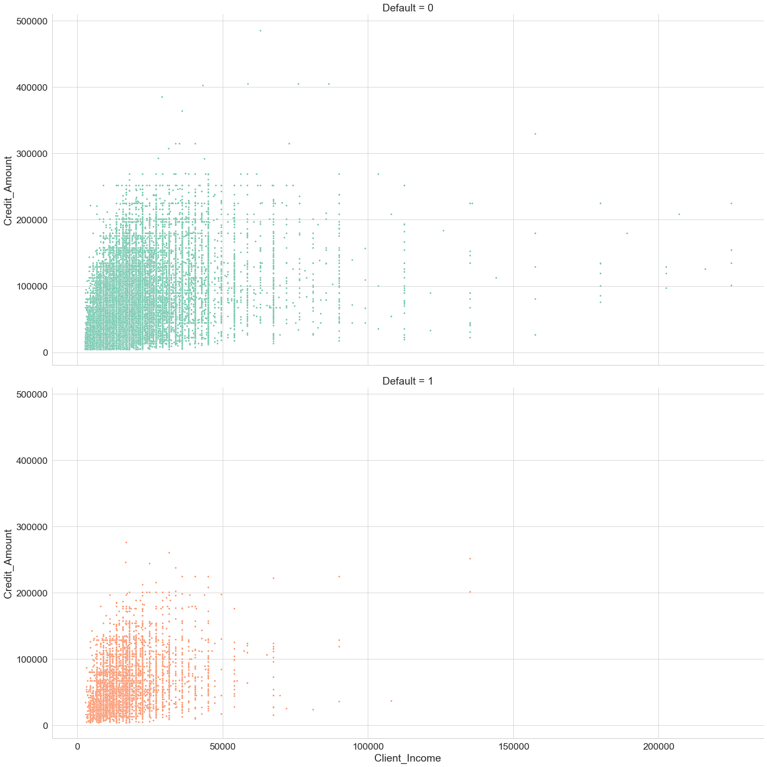
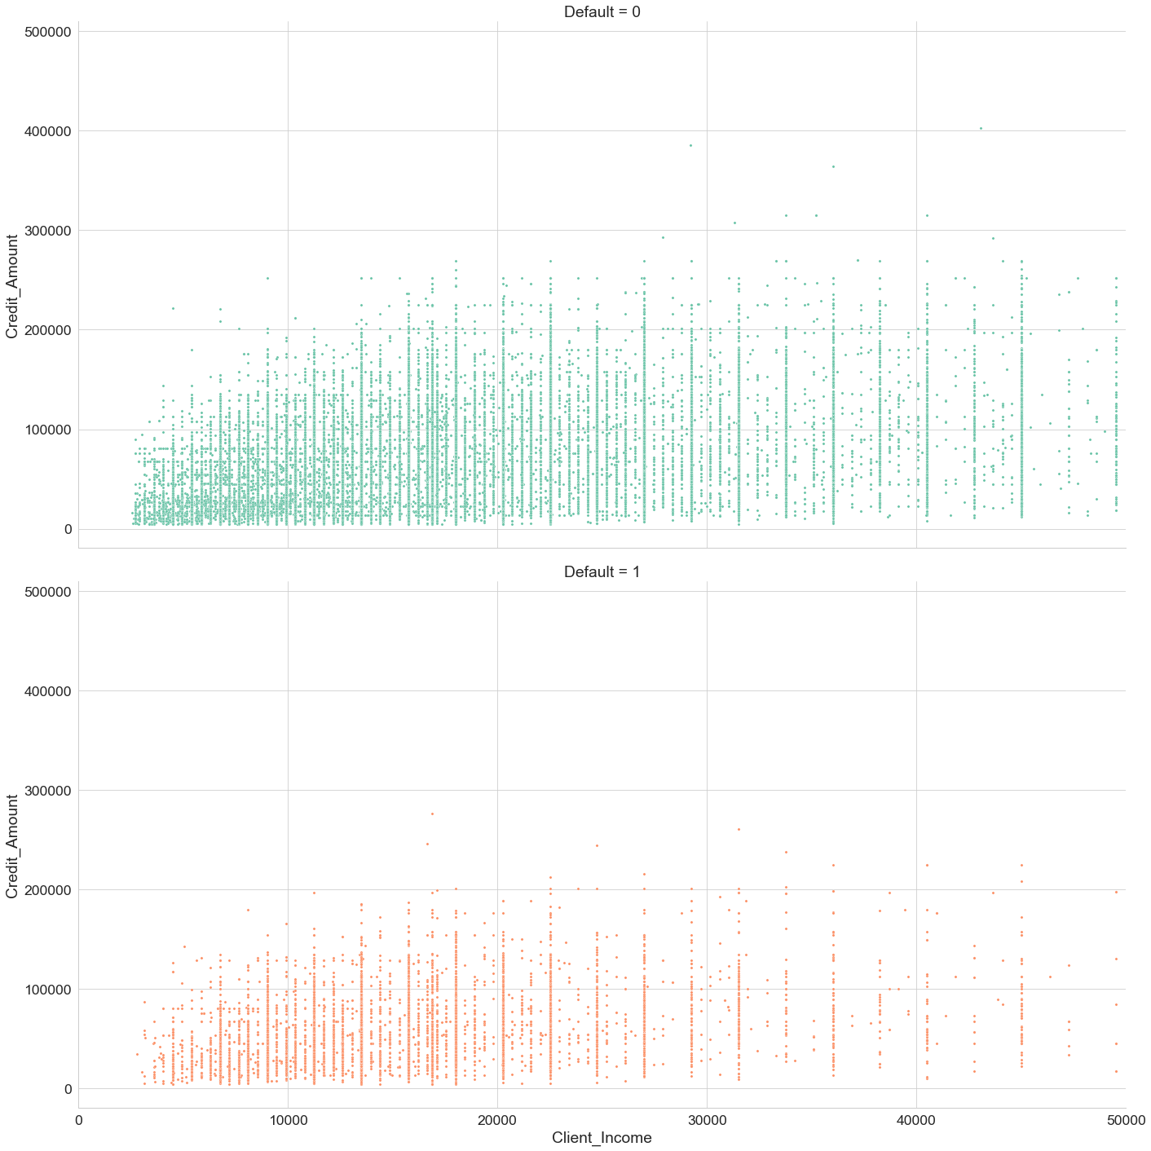
Scatterplot visualization
Utilized python data visualization library’s Seaborn to create these scatterplots
Direct correlation between client income and credit amount
Notes:
Credit_Amount vs Client_Income
This code utilizes the Python data visualization library seaborn to create a scatterplot of the relationship between Client income and credit income
The plt.figure() function creates a new figure with the specified size and resolution. In this case, the figure size is set to 12 inches by 6 inches with a resolution of 200 dots per inch (dpi).
The sns.FacetGrid() function creates a grid of plots, where each plot represents a different subset of the data. It takes several arguments:
data: the dataset to be plotted
col: the column in the dataset used to define subsets
height and aspect: the size and aspect ratio of each plot in the grid
xlim: the limits of the x-axis
hue: the column in the dataset used to color the subsets
palette: the color palette used to color the subsets
The b.map_dataframe() function applies a plotting function to each subset of the data in the grid. In this case, the plotting function is sns.scatterplot, which creates a scatterplot of two variables. The x and y arguments specify the variables to be plotted, and the s argument sets the size of the markers.
Finally, sns.set() is used to customize the style of the plot, such as the background color, grid style, and font sizes.
Overall, this code creates a grid of scatterplots, where each plot represents a different subset of the data based on the 'Default' column. The x-axis shows 'Client_Income', and the y-axis shows 'Credit_Amount'. The size of the markers is set to 10, and the subsets are colored using the 'Set2' color palette. The resulting plot will be 12 inches wide by 6 inches tall, with a resolution of 200 dpi.
plt.figure(figsize=(12,6),dpi=200)
b = sns.FacetGrid(data= no_outlier, col = 'Default',height=10,aspect=2,xlim=(0,50000),hue='Default',palette="Set2")
b.map_dataframe(sns.scatterplot, x= 'Client_Income',y='Credit_Amount',s=10)
sns.set()
From above Scatter Plot, we have some findings:
We may see a lot of dots that forms a vertical line, that shows when gathering the income data, the numbers are in aprroximate form, instead the accurate number such as the numbers show on the tax filing.
There is a little pattern between income and credit amount: With more income, there will be more credit amount. But the weak correlation also make sense since the credit amount is directly affected by the price of the vehicle that clients want to buy.
Except for the non default group has wider range and distribution (high variance), we can't not tell any significant difference between group.

Slide 8
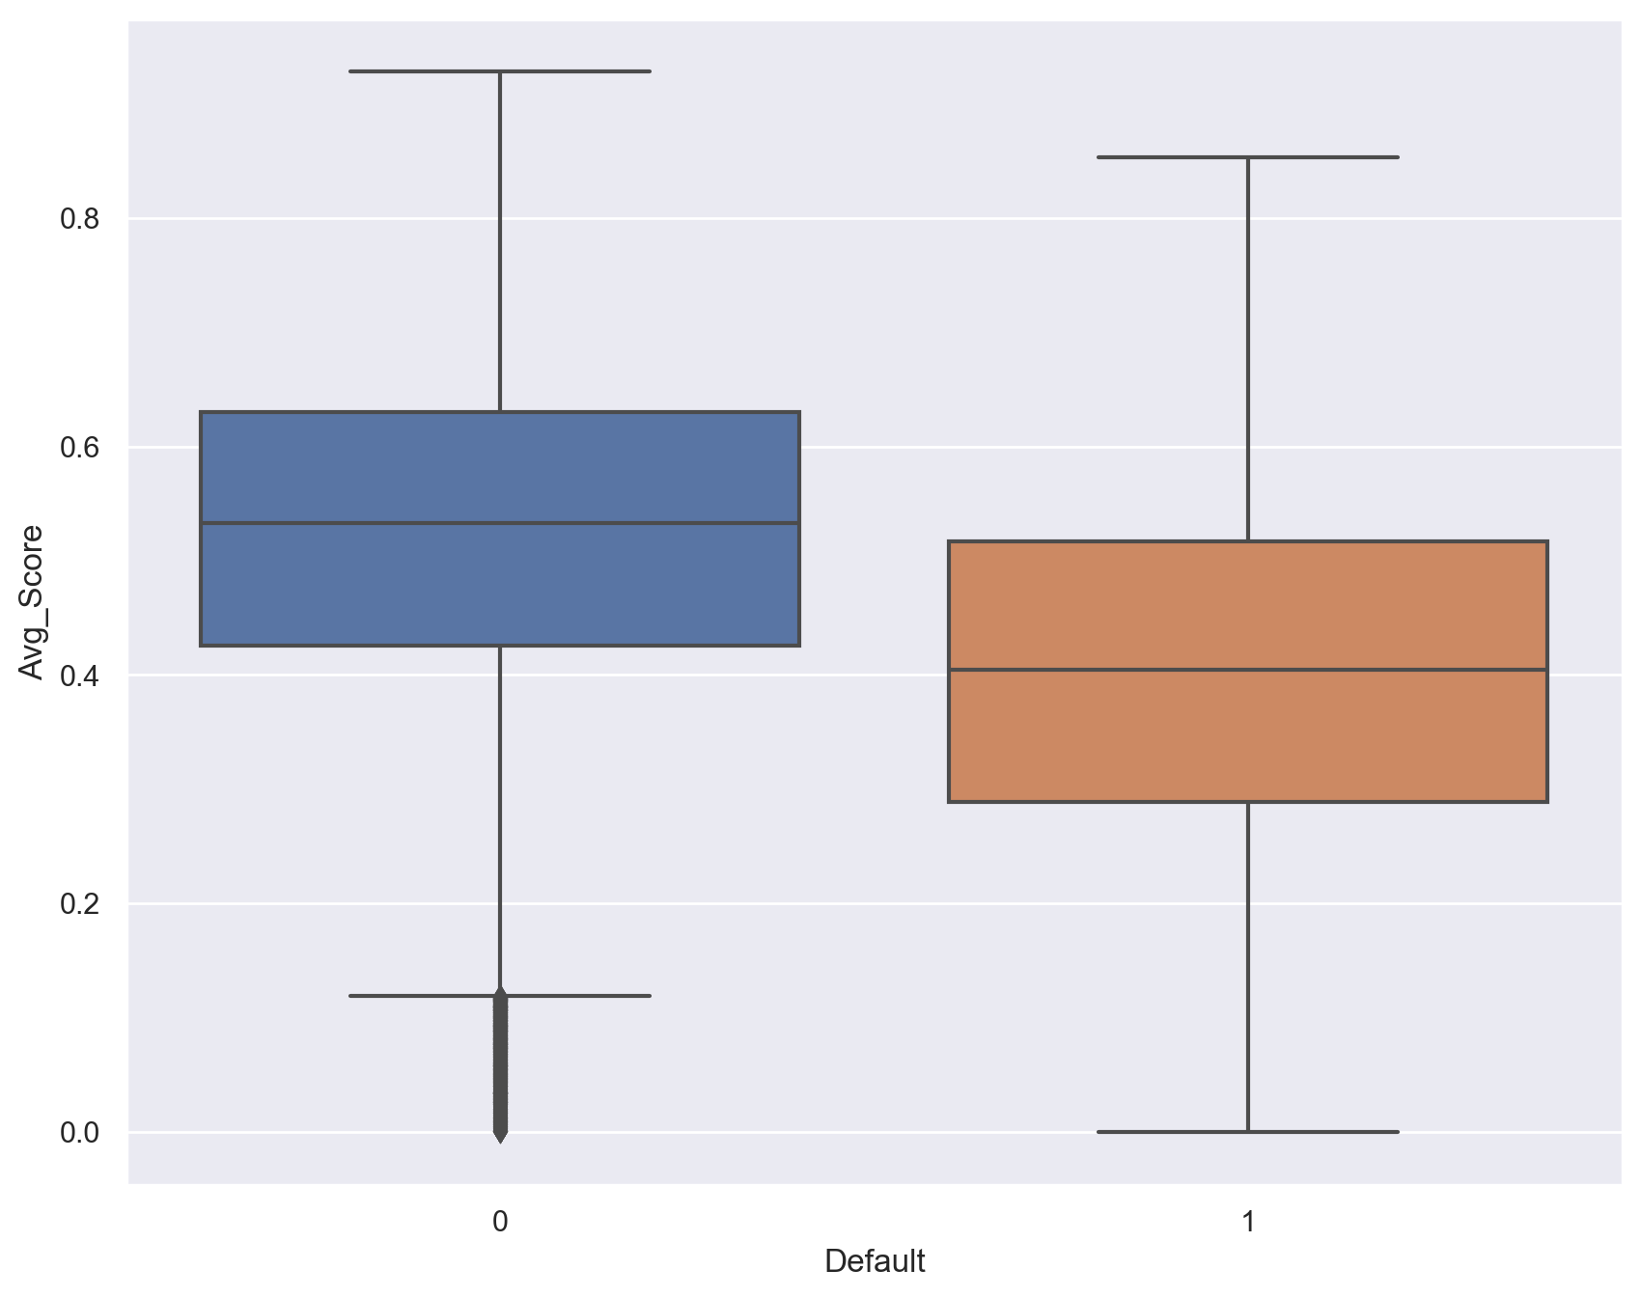
Box plot
The average credit score plays a huge role in customer defaults
Regardless of which scale (min, max, median, etc), defaulted customers had lower credit score
Notes:
Verifying relationship of credit score and default
The average credit score might be the most intuitive factor to reflect the default or not, as we can see that the defaulted group has lower credit score for not matter in which scale, the minimun, maximun, upper or lower quartile and even medain.

Slide 9
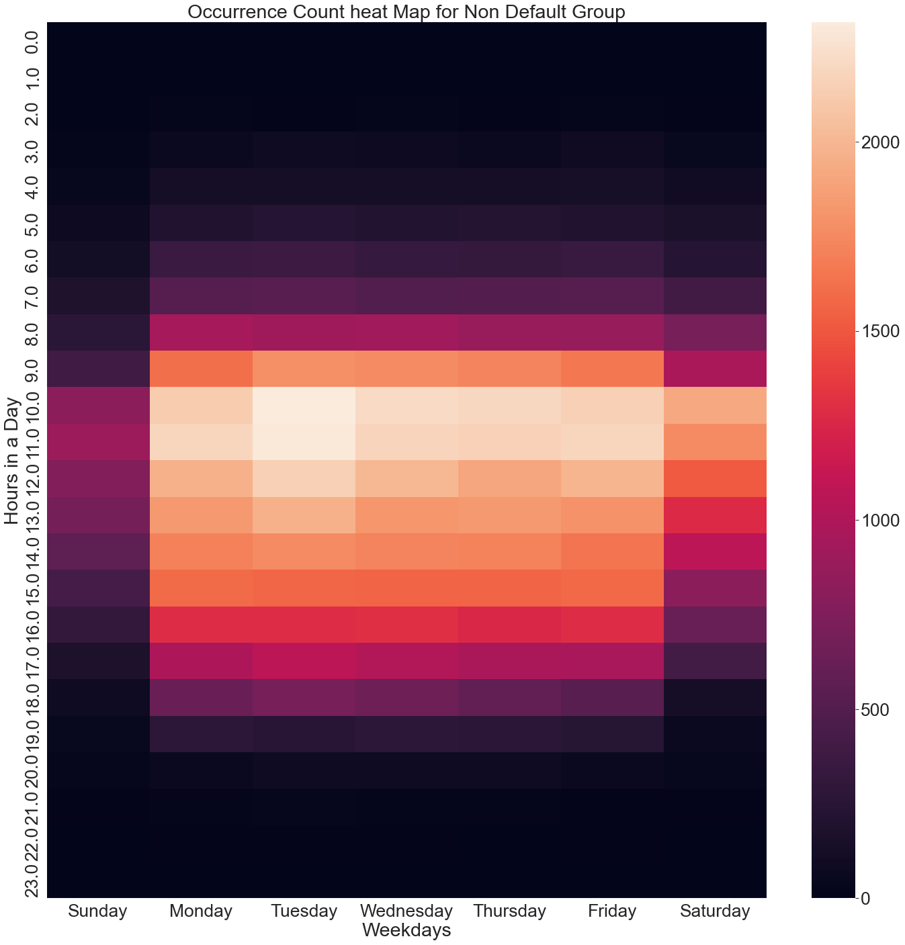
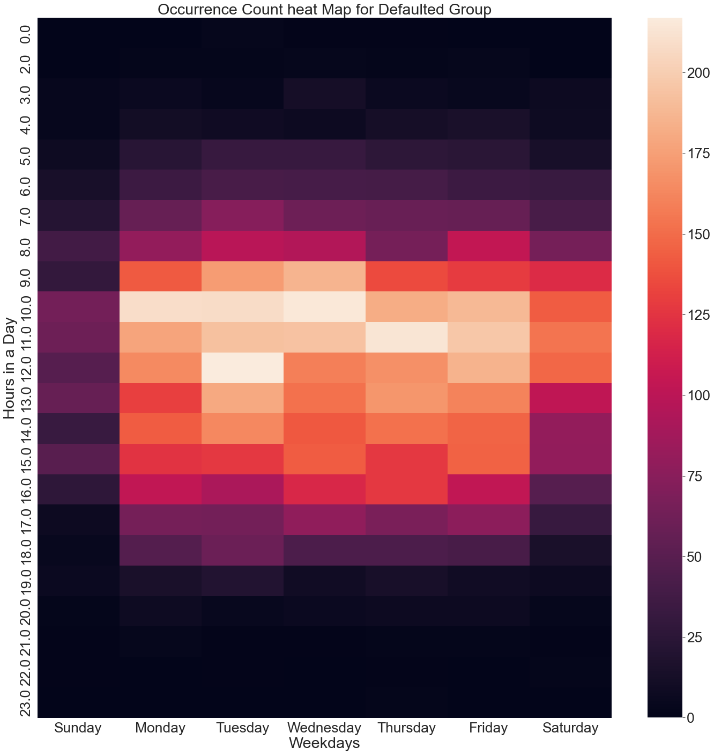
Heat map
Notes:
Application process day analysis
he dataset gathered the application process day and hours, which indicates in which week day and what hour in a day that a client applied the loan , which trigger our curious is there any necessity that we should gather these data to make the machine learning prediction model. So we use the heat map to verify is there any pattern on the occur times between two groups on these variables.
From these two heat map:
It does show a good normal distribution that most people apply their loan around noon and on Tuesday and Wednesday, and the occurance drop down slowly when its not office hour.
But we can't see any differnet pattern between two groups, thus these two variables might be useless for the analysis.

Slide 10
Conclusion
Key variables include:
Client_Income
Client_Income_Type
Credit_Amount
Load_Annuity
Client_Education
Age_Date
Employed_Days
Registration_Days
Removed Variables:
Application_Process_Day
Application_Process_Hour
Car_Owned
Notes:
Based on the findings from above graphics, we can conclude the retention and removal of variables that we verified:
Kept Variables:
Client_Income & Client_Income_Type: Although solely by the Client_Income we can not find significant pattern difference between the defaulted and non default customers, but with Client_Income_Type, we still can see the pattern difference, thus it's kept.
Credit_Amount and Loan_Annuity: These two variables are dependent and by calculating them we can get the Loan Duration information, which we can tell the pattern difference between defaulted and non default customers combining the age data.
Client_Education: With the pie chart, we find that the the percentage of defaulted customer in each education level of Client_Education is different, so this variable may help us on building the prediction model.
Age_Date: By converting the Age_Date to Age, we then utilize the age data and find out that combining the age data and loan Duration there is pattern difference between defaulted and non default customers.
Score_Source_1 to 3: With the average credit score from these three score source, we find out that defaulted customers has lower score than non default customers, thus we consider this variable can help us on building the prediction model.
Employed_Days: The bar graph between Employed_Years vs Default shows a noticeable trend that indicates a negative correlation between the number of employed years and the probability of defaulting. Thus, we can infer that employed days can be considered an important factor in predicting a customer's chance of defaulting.
Registration_Days: The line graph between Registration_Years vs Default shows a noticeable trend that as Registration_Years increases, the likelihood of defaulting decrease. Thus, we can infer that registration days can be considered an important feature.
Removed Variables:
Application_Process_Day & Hour: we use these two variables plotting a heatmap of occurrence on each weekday and hour, but the occurance of both defaulted and non default group are good normal distribution and can not find significant pattern difference, thus we consider these two variables do not have predictability and will remove from dataset for further model-building process.
Car_Owned: The pie charts indicate a minimal difference between default percentages for the two Car_Owned cases, with only a 1.3% gap. This suggests that owning a car may not play a significant role in determining a customer's likelihood of defaulting, hence we will remove this variable

Slide 11
Recommendation
More detailed description in the Data Dictionary
Annual Percentage Rate (APR)
Vehicle Type or Specs
Notes:
: With more detailed data description, we can have more precise analysis on the outcome, for example, in the data description, it only states that Client_Income is the income of client, but in what period of time? Month or Year? Since the variance of data is huge, we need more detailed description to expand our story.
: Since this is a car loan dataset, if the APR data for each customer can be collected, it might helps us to have more findings and more predictable variable.
: When applying the car loan, financial institution would consider some information related to the car client is going to buy, thus if there are some data related to Vehicle Type or Specs, we might have some findings on this perspective.
More detailed data descriptions allow for more precise analysis. For example, specifying the time period for Client_Income can help with data interpretation due to the large variance.
Collecting APR data for each customer in the car loan dataset can lead to more findings and a more predictable variable.
Financial institutions consider information about the car being purchased during the loan application process. Data related to Vehicle Type or Specs could lead to new insights.

