Slide 1
EMPLOYEE MANAGEMENT SYSTEM
Full Stack Web Development Mini Project
Submitted By: Monika B
Submitted To: Prime Vector Private Limited

Slide 2
Project Overview
What is it? A comprehensive, modern web-based application designed to manage employee data, streamline administrative tasks, and provide dedicated self-service portals for both Admins and Employees. Key Benefits: • Replaces manual record-keeping with automation.
• High data security & role-based privacy.
• Centralized MySQL database for quick access.

Slide 3
Modules Completed
Requirement Analysis & Project Planning UI/UX Design using HTML, CSS & Bootstrap Frontend Development with JavaScript Backend Development using Node.js Database Design & Integration (MySQL) Employee Registration & Management Module Authentication & Role-Based Access Control Deployment & Cloud Hosting (Vercel)

Slide 4
Technology Stack
Frontend
Backend
HTML5, CSS3
Bootstrap, JS
Node.js
Express.js
Database
Hosting
MySQL
Relational DB
Vercel (Frontend)
Render (Backend)
Aiven (Database)

Slide 5
System Architecture Flow
Client Browser
(Vercel)
REST API
--->
Backend API
(Node.js)
Queries
--->
MySQL DB
(Database)

Slide 6
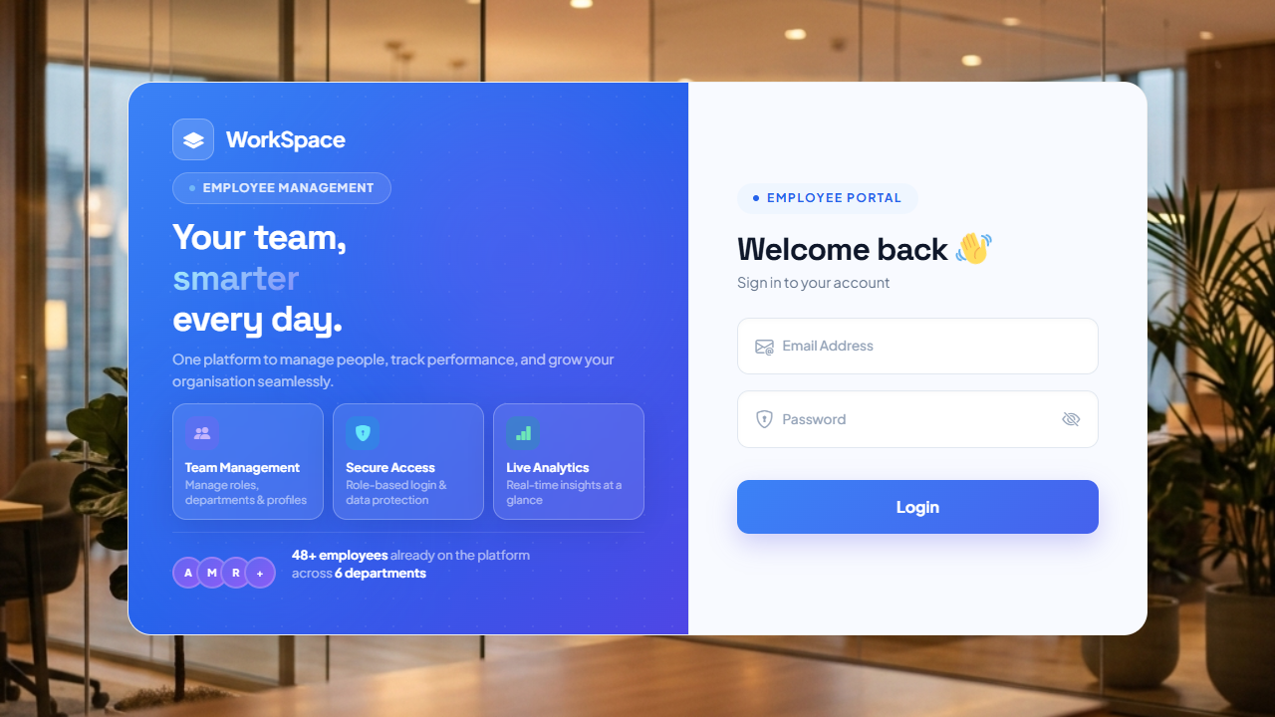
Secure Login System
Secure AuthenticationRole-Based Access (Admin / Employee)Database-driven validationPrevents unauthorized access

Slide 7
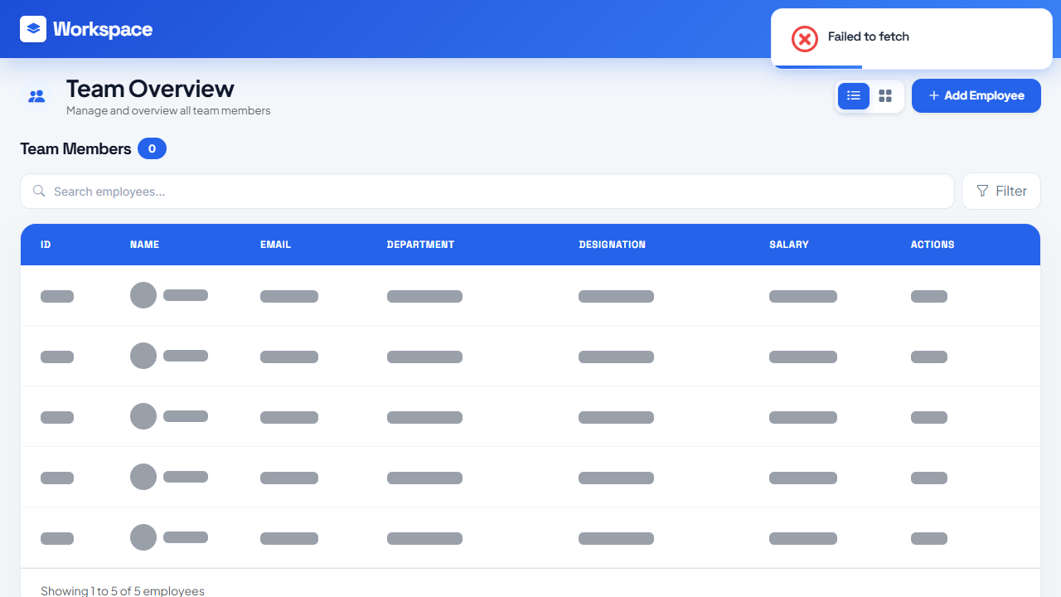
Admin Dashboard
Centralized Control PanelManage complete workforceTrack total employee metricsResponsive Bootstrap Layout

Slide 8
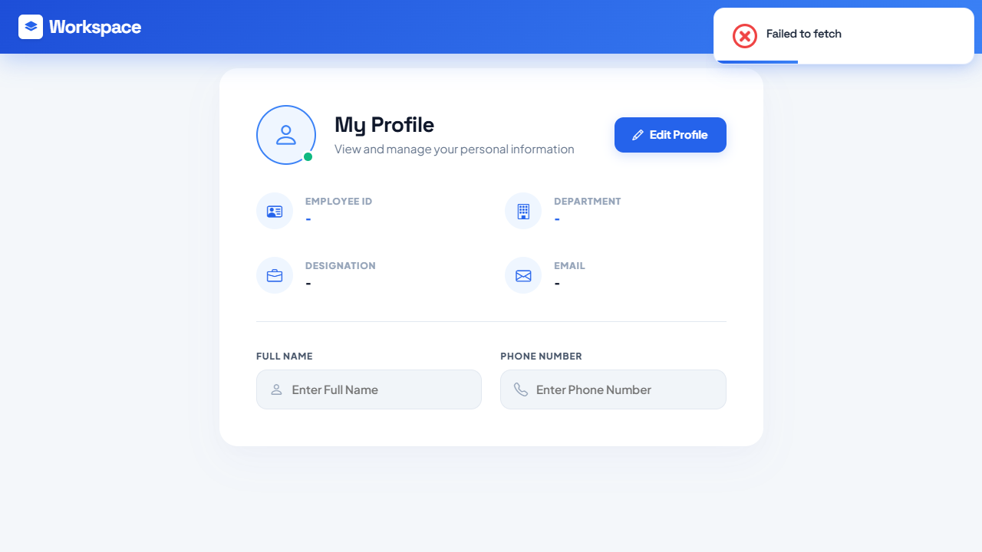
Employee Self-Service Portal
Dedicated personal portalView job profile securelyRestricted access boundariesSecure session management

Slide 9
Backend API Architecture
Node.js & Express API: • Modular Routing (Auth, Employees)
• Secure RESTful endpoints
• Middleware for JWT Token Verification
• Password hashing using bcryptjs
• CORS enabled for Frontend communication

Slide 10
Database Design (MySQL)
Centralized Cloud Database (Aiven): • Table 1: `users` (id, name, email, password, role)
• Table 2: `employees` (id, employee_id, name, phone, dept...)
• Foreign Keys for relational integrity
• Prepared Statements to prevent SQL Injection

Slide 11
Deployment Strategy
Frontend Hosting (Vercel): • Continuous Integration from GitHub • Global CDN for fast access Backend Hosting (Render): • Auto-scaling Node.js server
• Environment variable protection (.env)

Slide 12
Thank You!
Any Questions?
Future Scope:
Payroll System Integration • Advanced Attendance Tracking

