Slide 1

AI GENERATIVE PERSONALISED INTERVIEW PREPARATION PLATFORM
PRESENTED BY
ARUNKUMAR B
2022179045 MCA-ss
GUIDED BY
Dr.M.VIJAYALAKSHMI
(Professor)

Slide 2
Project Domain: Generative AI
Description: The ”AI Generative Personalised Interview Preparation Platform” is designed to revolutionize the interview preparation process for job seekers. By analyzing resumes, it identifies key skills and generates personalized interview questions, ensuring targeted and comprehensive preparation. Additionally, the platform uses advanced NLP techniques to create engaging self-introductions, helping candidates make memorablefirstimpressions. It also features an aptitude test generator that tailors questions to the user’s preferences, offering immediate scoring and performance insights.

Slide 3
Problem Statement:
In today's competitive job market, individuals often struggle with interview preparation and career advancement. Existing resources for interview practice and skill development are fragmented and lack personalized support.
The aim of this project is to address these issues by developing an integrated platform that streamlines interview preparation and career development

Slide 4
Literature Survey
Title | Author | Description | Year
Chat with document with large language model IJARIIE Vol- 9 Issue - 6 | Pathan, raykar Vaishnavi, swati, Kadam Arjun, Pandarkar Vaiibhav | Unlike traditional keyword based searches, this approach enables users to engage in chat like conversations with large language model (LLM). | 2023
An Effective Query System Using LLMs and Langchain Ijert – Vol. 12 Issue 06 | Adith Sreeram A A, Pappuri Jithendra Sai | The methodology focuses on leveraging advanced NLP techniques provided by LLM and integrating them with a web application framework like streamlit. | 2023

Slide 5
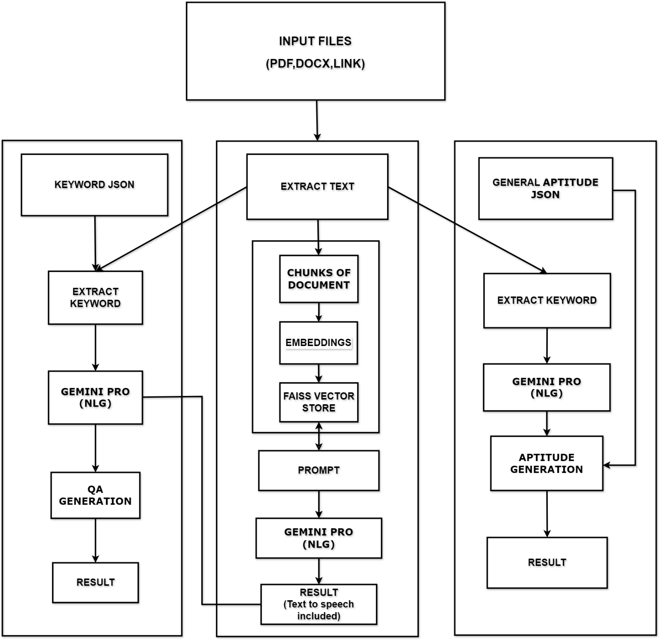
DETAILED ARCHITECTURE:
Semantic Search
STORE

Slide 6
MODULE DESCRIPTION
Generate about yourself
Generate Question and Answer
Generate Aptitude
Generate about yourself
Input
PDF FILE: Using Fitz to open the extracted pdf temp file and then read the entire text
DOCX FILE: If user gave docx file means, it convert the docx to pdf first then using pypdf2 it extracts text
GOOGLE DRIVE LINK: If user gave a drive link means, it split the drive link gets the link split [-2] and the using that link split [-2] it sends response content (Bytes object) and store in temporary file and using the magic library to find the extensions of the content and do either pdf or docx process to extract the text
2. Extract the text, splitted as chuncks and then embed and store it in vector base.
3.Based on the text it generate about yourself and other questions using Gemini-pro
4.Using gttx convert text to speech and using pygame we can play the generated text in audio format
5.Apart from the generate about yourself the remaining answer and the extracted text transferred to the Q&A module

Slide 7
Generate Q&A
Store the text which is extracted from the previous modules.
From those stored text generate Q&A using gemini-pro.
And then matches those text with keyword json file and gets the extracted skills keyword (java,python….). Using those skills keywords gemini pro generates and Q&A
Generate Aptitude
Store the text which is extracted from the previous modules.
And then matches those text with keyword json file and gets the extracted skills keyword (java,python….). Using those skills keywords gemini-pro generates and Aptitude Question with options and correct answer
Aprat from the skills aptitude, it also generate general aptitude using aptitude json file
Using those two aptitude module, mixed up and give aptitude question based on the number of questions prompt
We can also check the score while submitting the text and also we can see the correct answers
Retest option is also possible

Slide 8
TOOLS AND TECHNOLOGIES:
Python: Primary programming language for development.
Streamlit: Python library for building interactive web applications.
LangChain: Framework for integrating language-related functionalities.
Gemini-pro: Using gemini pro generate Q&A based on prompt.
Vector Database (e.g., Faiss): Library for managing and querying large-scale vector data efficiently.
Faiss: A library for efficient similarity search and nearest neighbor search in large vector spaces, suitable for semantic search functionalities.
Gtts: Using gttx we can convert text to speect
Pygame: Using pygame we can initiate the audio

Slide 9
References:
[1] Pathan Simran, Raykar Vaishnavi, Pandarkar Vaibhav, Kadam Arjun, and Bhosale Swati S. Chat with documents using large language model (llm). 2023.
[2] Joko Siswanto, Sinung Suakanto, Made Andriani, Margareta Hardiyanti, and Tien Fabrianti Kusumasari. Interview bot development with natural language processing and machine learning. 2023.
[3] Sumit Maheshwari, Abhishek Sainani, and P Krishna Reddy. An approach to extract special skills to improve the performance of resume selection. Hyderabad, India, 2010. Centre for Data Engineering, International Institute of Information Technology.
[4] Adith Sreeram A S and Pappuri Jithendra Sai. An effective query system using llms and langchain. 2023.

Slide 10
Thankyou!

