Slide 1
DRIVER DROWSINESS DETECTION USING CUSTOM DEEP LEARNING HYBRID MODEL
Team Member: 1. Monika D (2023PECCS280)
2. Monika J G (2023PECCS281)
Guide: Ms.Jenifer
Coordinator:DR.Valarmathi K,DR.Sangeetha K
Department: Computer Science & Engineering
Domain: Deep Learning
Batch No: C11
SDG Goal: SDG 3 – Good Health and Well-Being
Target 3.1: Helps in early detection of drowsiness reducing accidents for each driver and passengers

Slide 2
BASE PAPER DETAILS
Title: A Novel Hybrid Approach for Driver Drowsiness Detection Using a Custom Deep Learning Model(D3-CDLM)
Author(s): Muhammad Ramzan,Adnan Abid,
Journal/Conference: IEEE Access
Year: 2024
Publisher: IEEE
Summary:
Achives 99.6% accuracy on the yawDD dataset for real time Driver Drowsy detection
Integrate into Iot -based driver monitoring systems to enhance road safety

Slide 3
ABSTRACT
Problem Statement:
Driver drowsiness is a major cause of road accidents, resulting in serious injuries, fatalities, and economic losses.
Objectives:
Develop a hybrid deep learning model combining CNN feature extraction with advanced processing
Ensure real-time,accurate detection of driver drowsiness.
Significance:
Contributes to SDG 3,9 ,11 goals.
Provides timely alerts to reduce accidents and enhance road safety.

Slide 4
SOCIAL RELEVANCE
How it Benefits Society:
Road Safety Improvement:Detecting it in real time can significantly reduce crash rates.
Saving Lives: Early alerts help prevent loss of life for both drivers and passengers.
Link to UN SDGs:
Supports SDG 3 –Good health and well-being.
SDG 9: Industry,Innovation and infrastruture.
2. Helps achieve Target 3.1.
Importance in Solving Real-world Problems:
Broader Safety Culture: Encourages responsible driving and adoption of smart safety technologies in vehicles.

Slide 5
INTRODUCTION
Background:
Drowsiness is a major cause of road accidents; deep learning enables real-time, non-intrusive detection.
Motivation:
Build an accurate system to reduce crashes and improve road safety.
Contribution:
Proposes a hybrid deep learning model (HOG + PCA + CNN) trained on YawDD for high-accuracy alerts.

Slide 6
LITERATURE SURVEY
Year & Publication | Author(s) | Paper Title | Technology Used | Key Outcome
2024 – IEEE | Patel & Singh | CNN-based Eye State Classification | CNN | High accuracy in eye state classification; effective under controlled conditions
2024 – Springer | Nguyen et al. | Transfer Learning Approaches for Drowsiness Detection | Transfer Learning (VGG16, ResNet) | Improved feature extraction and accuracy using pre-trained models
2024 – Elsevier | Ahmed et al. | IoT-Enabled Driver Safety Monitoring | IoT + Cloud Sensors | Enabled remote monitoring and real-time alerts
2023 – IEEE | Sharma et al. | EfficientNet-based Lightweight Model for Drowsiness Detection | EfficientNet | Better accuracy with fewer parameters; lightweight for deployment
2023 – WHO Report | WHO | Global Report on Fatigue-related Road Accidents | Statistical Analysis | Found 20–30% of road accidents are fatigue-related; stresses importance of early detection
2022 – Springer | Li et al. | LSTM-based Temporal Monitoring for Driver Fatigue | LSTM (Temporal Deep Learning) | Modeled eye-blink sequences; improved temporal pattern recognition
2022 – IEEE | Kumar et al. | Hybrid CNN + Haar Cascade for Face and Eye Detection | CNN + Haar Cascade | Enhanced detection pipeline for eye state monitoring
2021 – Elsevier | Mehta & Rao | IoT with Wearable Sensors for Fatigue Tracking | IoT + Wearable Sensors | Collected physiological signals; integrated IoT dashboard for fatigue alerts

Slide 7
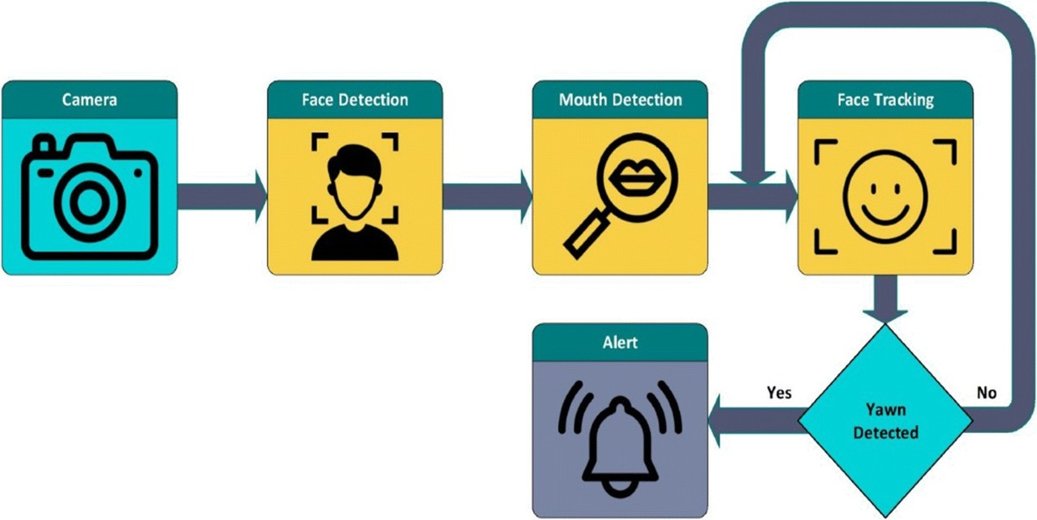
ARCHITECTURE DIAGRAM

Slide 8
HARDWARE/SOFTWARE SPECIFICATIONS
Hardware
Processor: Processor: Intel Core i5 (or equivalent) and above
RAM: Minimum 8 GB (16 GB recommended for deep learning training)
Storage: 500 GB HDD / 256 GB SSD
Camera: HD Webcam / IR Camera for real-time driver monitoringr
Software & Tools
Programming Language: Python 3.8+
Libraries: Pandas, NumPy, Scikit-learn,TensorFlow,Keras, Matplotlib, Seaborn
Framework: OpenCV (Image processing and feature extraction)
IDE/Editor: VS Code, Jupyter Notebook, PyCharm
Database: MySQL / SQLite
OS: Windows 10/11 or Linux

Slide 9
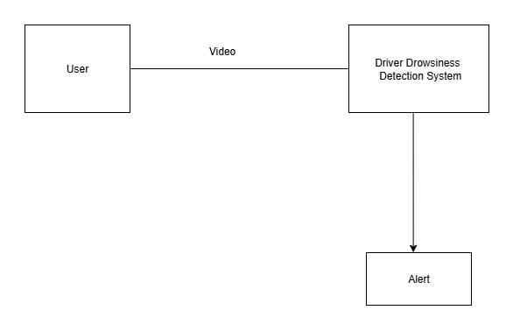
CONTEXT DIAGRAM
LEVEL 0

Slide 10
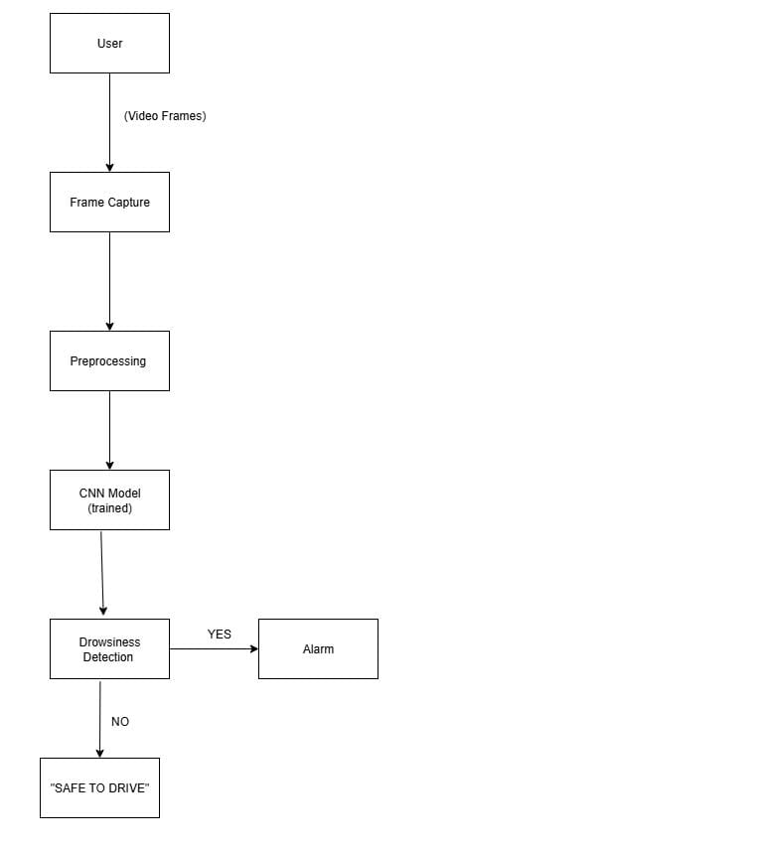
DATA FLOW DIAGRAM
LEVEL 1

Slide 11
MODULES EXPLAINATION
Functional Description of Each Module
Data Collection: Captures driver images/videos and facial features (eyes, yawning, head pose) for training/testing.
Data Preprocessing: Cleans data, detects face/eyes, and converts images into structured inputs for the model.
Model Training: Uses CNN/EfficientNet/Transfer Learning to learn drowsiness patterns and optimize accuracy.
Real-time Video Processing: Streams and analyzes video to detect facial landmarks like eye closure and yawning.
Drowsiness Detection Logic: Evaluates drowsiness level and decides alerts.
Alert Module: Triggers immediate audio, visual, or vibration warnings to prevent accidents.

Slide 12
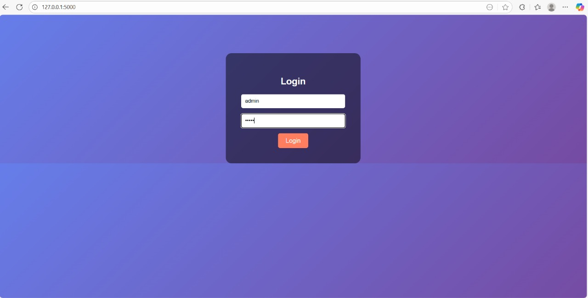
LOGIN

Slide 13
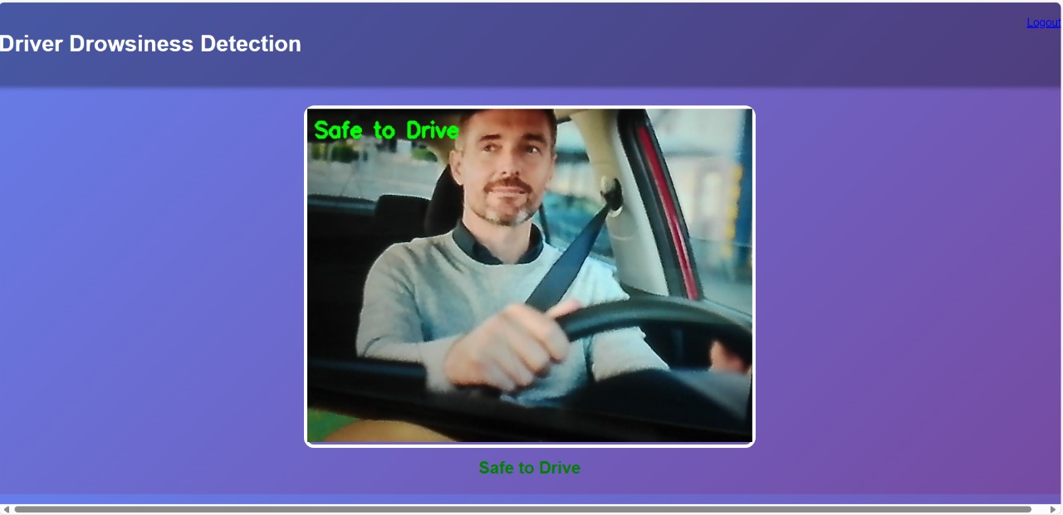
SAFE TO DRIVE/SCREENSHOT

Slide 14
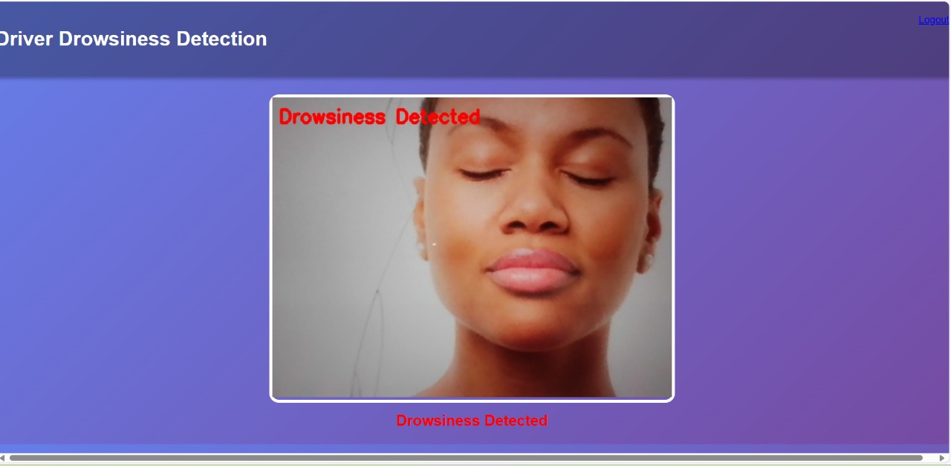
DROWSINESS DETECTION

Slide 15
CONCLUSION & FUTURE SCOPE
Conclusion:
The D3-CDLM system accurately detects driver drowsiness in real time, achieving 99.6% accuracy, and provides timely alerts to enhance road safety and prevent accidents.
Future Scope:
1. IoT & Vehicle System Integration – Connect the detection system with onboard vehicle safety mechanisms for automatic interventions.
2. Lightweight Deployment – Develop a mobile app or embedded hardware version for real-time use in any vehicle.

Slide 16
REFERENCES
Patel & Singh, “Machine Learning Approaches for Driver Fatigue Detection,” IEEE .Transactions on Intelligent Transport Systems, 2024.
Nguyen et al., “Deep Learning Models for Real-Time Driver Drowsiness Detection,” Springer Journal of AI Applications, 2024.
Ahmed et al., “IoT-Enabled Driver Safety Monitoring Systems,” Elsevier –Transportation Research, 2023.
Kumar et al., “CNN Architectures for Eye State Classification,” IEEE Access, 2024.
WHO, “Global Status Report on Road Safety 2024,” World Health Organization Report,2024.
Mehta et al., “Facial Landmark Detection for Fatigue Monitoring in Drivers,” IEEE Conference on Computer Vision and Pattern Recognition (CVPR), 2023.

Slide 17
Thank you

