Slide 1
A Thematicity-based Prosody Enrichment Tool for CTS
System Demonstration

Slide 2
Motivation
The communicative intention of the speaker is mainly conveyed by prosody.
How content is packaged affects the listeners’ cognitive effort in understanding an utterance.
The information structure--prosody interface is reported in theoretical studies to be strongly related and contribute to better understanding of the utterance in human communication^{1,2}.
Previous approaches³ that implement this correspondence suffer from:
lack of formal representation of information structure;
one-to-one mapping of intonation patterns to acoustic parameters.

Slide 3
Terminology
"Truth-conditionally equivalent sentences encoded in different information packaging instructions are, therefore, not mutually interchangeable in a given context of utterance preserving felicity. It is this context-sensitivity that has traditionally placed information packaging within the scope of pragmatic inquiry.“ -- Enric Vallduví (1999)
Information Structure: how content is structured for efficient communication
Thematicity: communicative segmentation of meaning
Theme: what the utterance is about
Rheme: what is being uttered about it
Example taken from (Steedman, 2000)⁴
Q: I know what Marcel SOLD to HARRY.
But what did he GIVE to FRED?
A: (Marcel GAVE) (a BOOK) (to FRED.)
L+H* LH- H* LL%

Slide 4
Fundamentals
Communicative Organization in Natural Language (Mel’čuk, 2001)⁵
Levels of Representation:
Communicative Structure
Dimensions:
SemR
Abstract Ontological Concepts
SyntR
Dependency Trees
MorphR
Temporatily Order String of Phonemes
PhonR
Linearized Chain of Lexemes
Thematicity
Givenness
Focalization
Perspective
Emphasis
Presupposedness
Unitariness
Locutionality
NATURAL LANGUAGE GENERATION
SemCommS
DSyntCommS
Communicative Structure

Slide 5
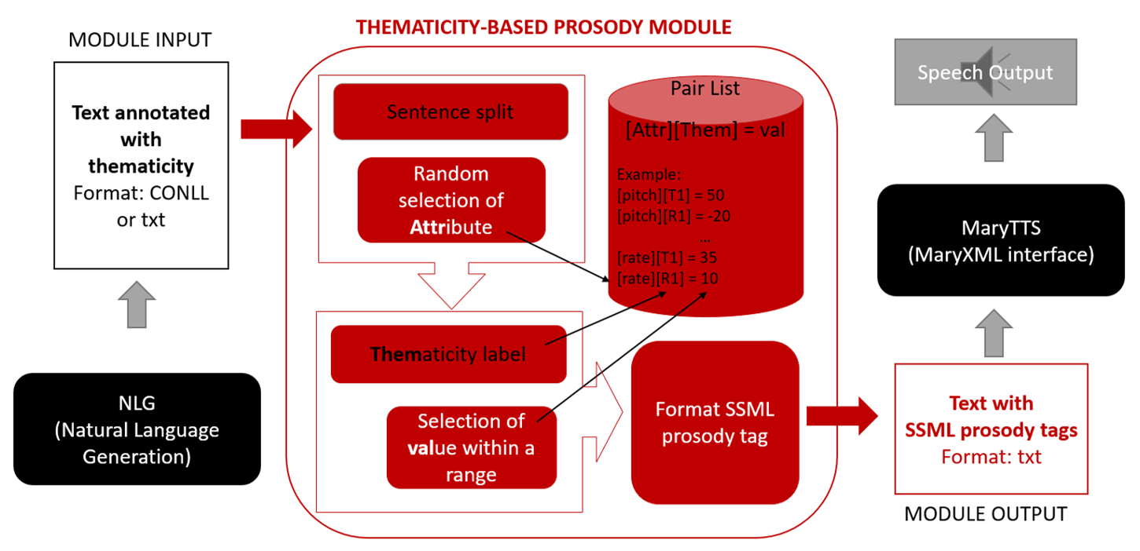
Thematicity-based Prosody Enrichment

Slide 6
Specifications
Requirements
Input: text annotated with thematicity
Format: TXT or CONLL
Conversion Script: them2ssml.py
Available from:
https://github.com/TalnUPF/themacitytoSSML/
MaryTTS: MaryXML Interface
Local version
Online version
Natural Language Text Generation module (able to generate thematicity labels in CONLL).
Corpus annotated with thematicity following the guidelines in (Bohnet et al. 2013).
Other TTS applications complying with SSML prosody tags can be used*.
* Some minor format adjustments may be required in the script for thematicity-based prosody enrichment

Slide 7

Example 1
Sentence: The luxury auto maker last year sold 1,214 cars in the U.S..
Default output:
Input: [The luxury auto maker]T1 [last year sold 1,214 cars in the U.S.]R1 .
Them2SSML: <prosody pitch=”+30%”>The luxury auto maker</prosody> <prosody pitch=”+10%”>last year sold 1,214 cars in the U.S..</prosody>
Output:

Slide 8


Example 2
Sentence: For its employees to sign up for the options, a college also must approve the plan.
Default output:
Input: [For its employees]T1(T1) [to sign up for the options]R1(T1) , [a college]T1(R1) [also must approve the plan]R1(R1) .
Them2SSML: <prosody rate=”+15%”>For its employees </prosody><prosody rate=”+5%”>to sign up for the options,</prosody><prosody rate=”+10%”>a college</prosody><prosody rate=”-10%”>also must approve the plan.</prosody>
Output:

Slide 9

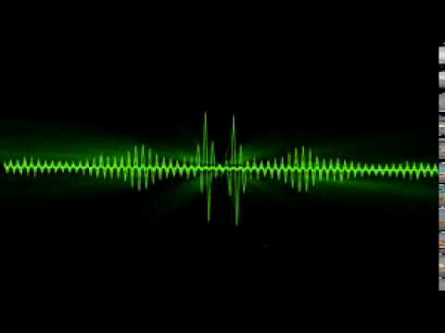
Example 3
Sentence: Men who have played hard all their lives aren't about to change their habits, he says.
Default output:
Input: [Men {who have played hard all their lives}P2]T1 [aren't about to change their habits]R1 , [he says]SP1 .
Them2SSML: <prosody volume=”+25%”>Men who have played hard all their lives</prosody><prosody volume=”-5%”>aren’t about to change their habits, </prosody><prosody volume=”-10%”>he says.</prosody>
Output:

Slide 10
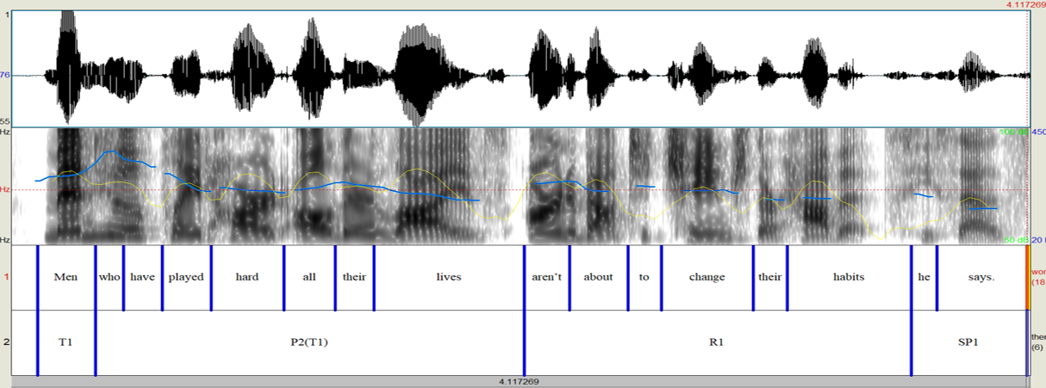
Human Speech Sample

Slide 11
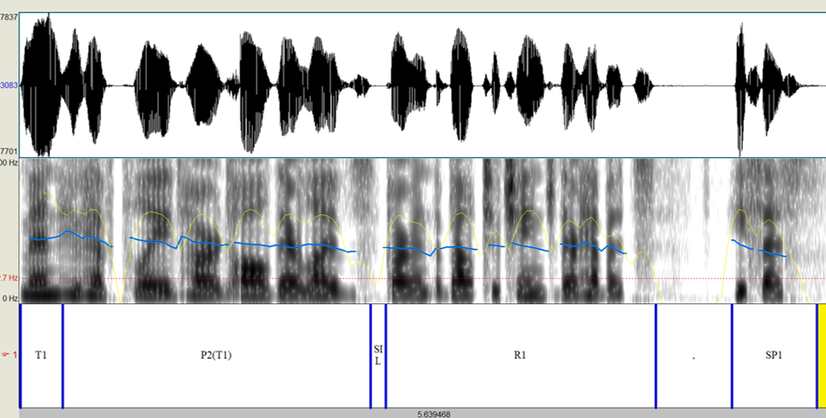
Synthesized Speech Sample

Slide 12
Conclusions
Contribution:
Limitations:
Further research in implementation of other communicative dimensions and prosody modeling is essential.
Based on a formal representation of thematicity.
Data-driven parametric approach to prosody generation.
Improvement over the default output is modest.
The modified output is still far from resembling natural human speech samples.

Slide 13
References
1 Vanrell, M., Mascaró, I., Torres-Tamarit, F., and Prieto, P. (2013). Intonation as an Encoder of Speaker Certainty: Information and Confirmation Yes-No Questions in Catalan. Language and Speech, 56(2):163–190.
2 Meurers, D., Ziai, R., Ott, N., and Kopp, J. (2011). Evaluating Answers to Reading Comprehension Questions in Context: Results for German and the Role of Information Structure. In Proceedings of the TextInfer 2011 Workshop on Textual Entailment, TIWTE ’11, pages 1–9, Stroudsburg, PA, USA. Association for Computational Linguistics.
3 Prevost, S. (1996). An information structural approach to spoken language generation. In Proceedings of the 34th annual meeting on Association for Computational Linguistics, pages 294–301, Morristown, NJ, USA. Association for Computational Linguistics.
4 Steedman, M. (2000). Information structure and the syntax-phonology interface. Linguistic inquiry, 31(4):649–689.
5 Mel’čuk, I. A. (2001). Communicative Organization in Natural Language: The semantic-communicative structure of sentences. Benjamins, Amsterdam, Philadephia.
Publication:
Domínguez, M., Farrús, M., and Wanner, L. (2017). A Thematicity-based Prosody Enrichment Tool for CTS. In Accepted to show and tell demonstrations at INTERSPEECH17, Stockholm, Sweden.

Slide 14



Acknowledgements
https://www.upf.edu/web/mdm-dtic http://kristina-project.eu/en/ https://www.upf.edu/web/taln
My contact details:
E-mail: monica.dominguez@upf.edu
Twitter: @monikaUPF
LinkedIn: monikadominguezbajo

