Slide 1
Shapes Recognition
Monika Bansal
Heema Maniar
Armin Faroughi
Bharath Hemashekar
September 24, 2018

Slide 2
Agenda
Objective
Data source
Exploratory Analysis
Classification Techniques
Classifier Design
Classifier Evaluation
Visual Examination
Separated smaller Images from Larger
New Classifier Design
Large Image Classification
Small Image Classification
2D Point cloud for Small images
Feature Alignment
Result
Further Reduction
Conclusion
Unsupervised ML Algorithm

Slide 3
Objective
Implement a classifier for detecting objects in the shapes dataset and classify them into Triangle, Square and Pizza.
Applications
Quality Analysis and Inspection of products in manufacturing industries
Cookies, Chips
Coin identification and separation
Traffic signal detection

Slide 4
Data source – Shapes dataset
www.numericinsight.com/downloads.html
Training set – 60,000 x 784
Test set – 10,000 x 784
Notes:
The "shapes dataset" consisting of a training set of 60,000 examples, and a test set of 10,000 examples. Each example is a 784-dimensional vector, which when reformatted as an image has the appearance of one of 3 shapes - triangle, square or pizza.
Four flat binary data files are available on this site:
Shapes_1_1_Train_Features.dat: training set features (47040000 bytes)
Shapes_1_1_Train_Labels.dat: training set labels (60000 bytes)
Shapes_1_1_Test_Features.dat: training set features (7840000 bytes)
Shapes_1_1_Test_Labels.dat: training set labels (10000 bytes)
Once we import a feature file by reading in all the bytes, we partition the data into lists of 784 elements. Each of these lists can be viewed as an image of shape objects by reformatting it as a 28x28 matrix.

Slide 5
Exploratory Analysis
Raw images of shapes object
2D Point cloud (Training set)
Histogram
Numeric structure of a shape object in 28 x 28 matrix
Shape object represented as feature vector

Slide 6
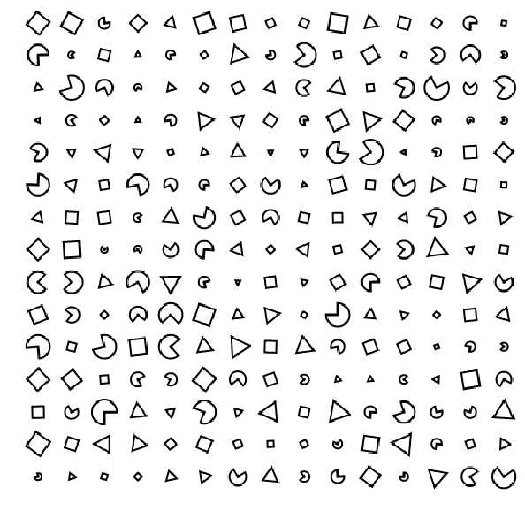
Raw images of shapes object
Triangle
Square
Pizza

Slide 7
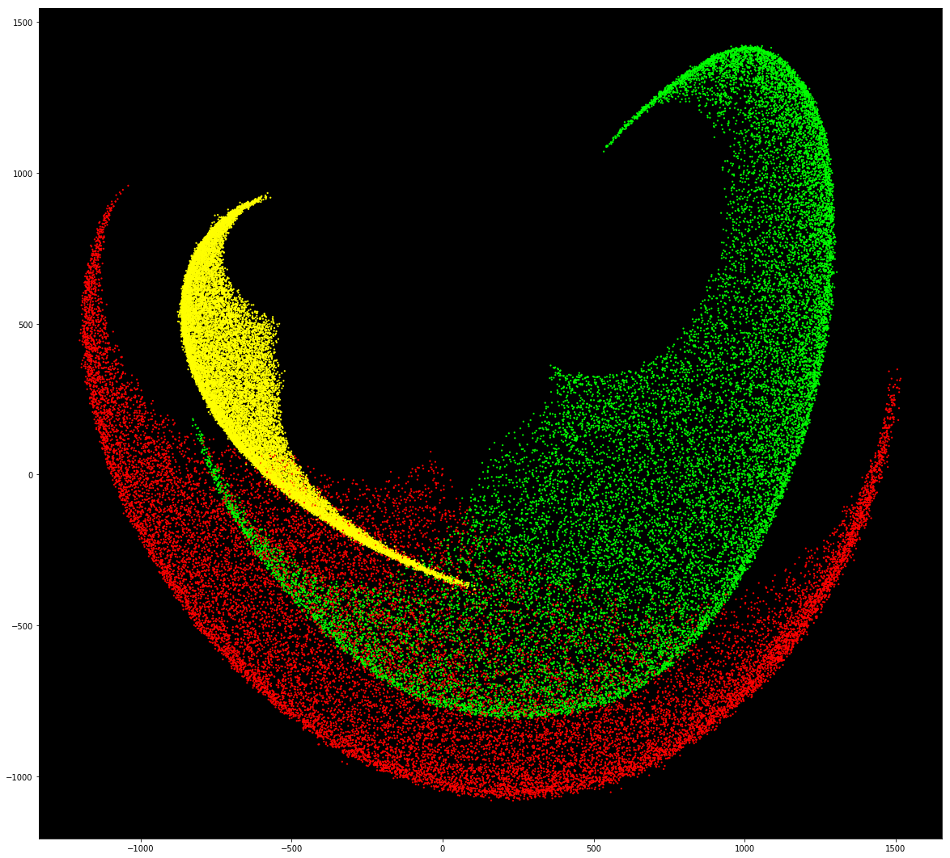
2D Point cloud (Training set)
Triangle : 19983 Square : 20128
Pizza : 19889
Total : 60,000

Slide 8
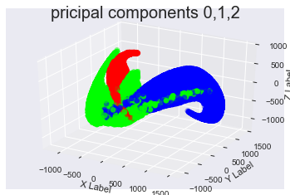
Scatter plot of first 3 PCA Components

Slide 9
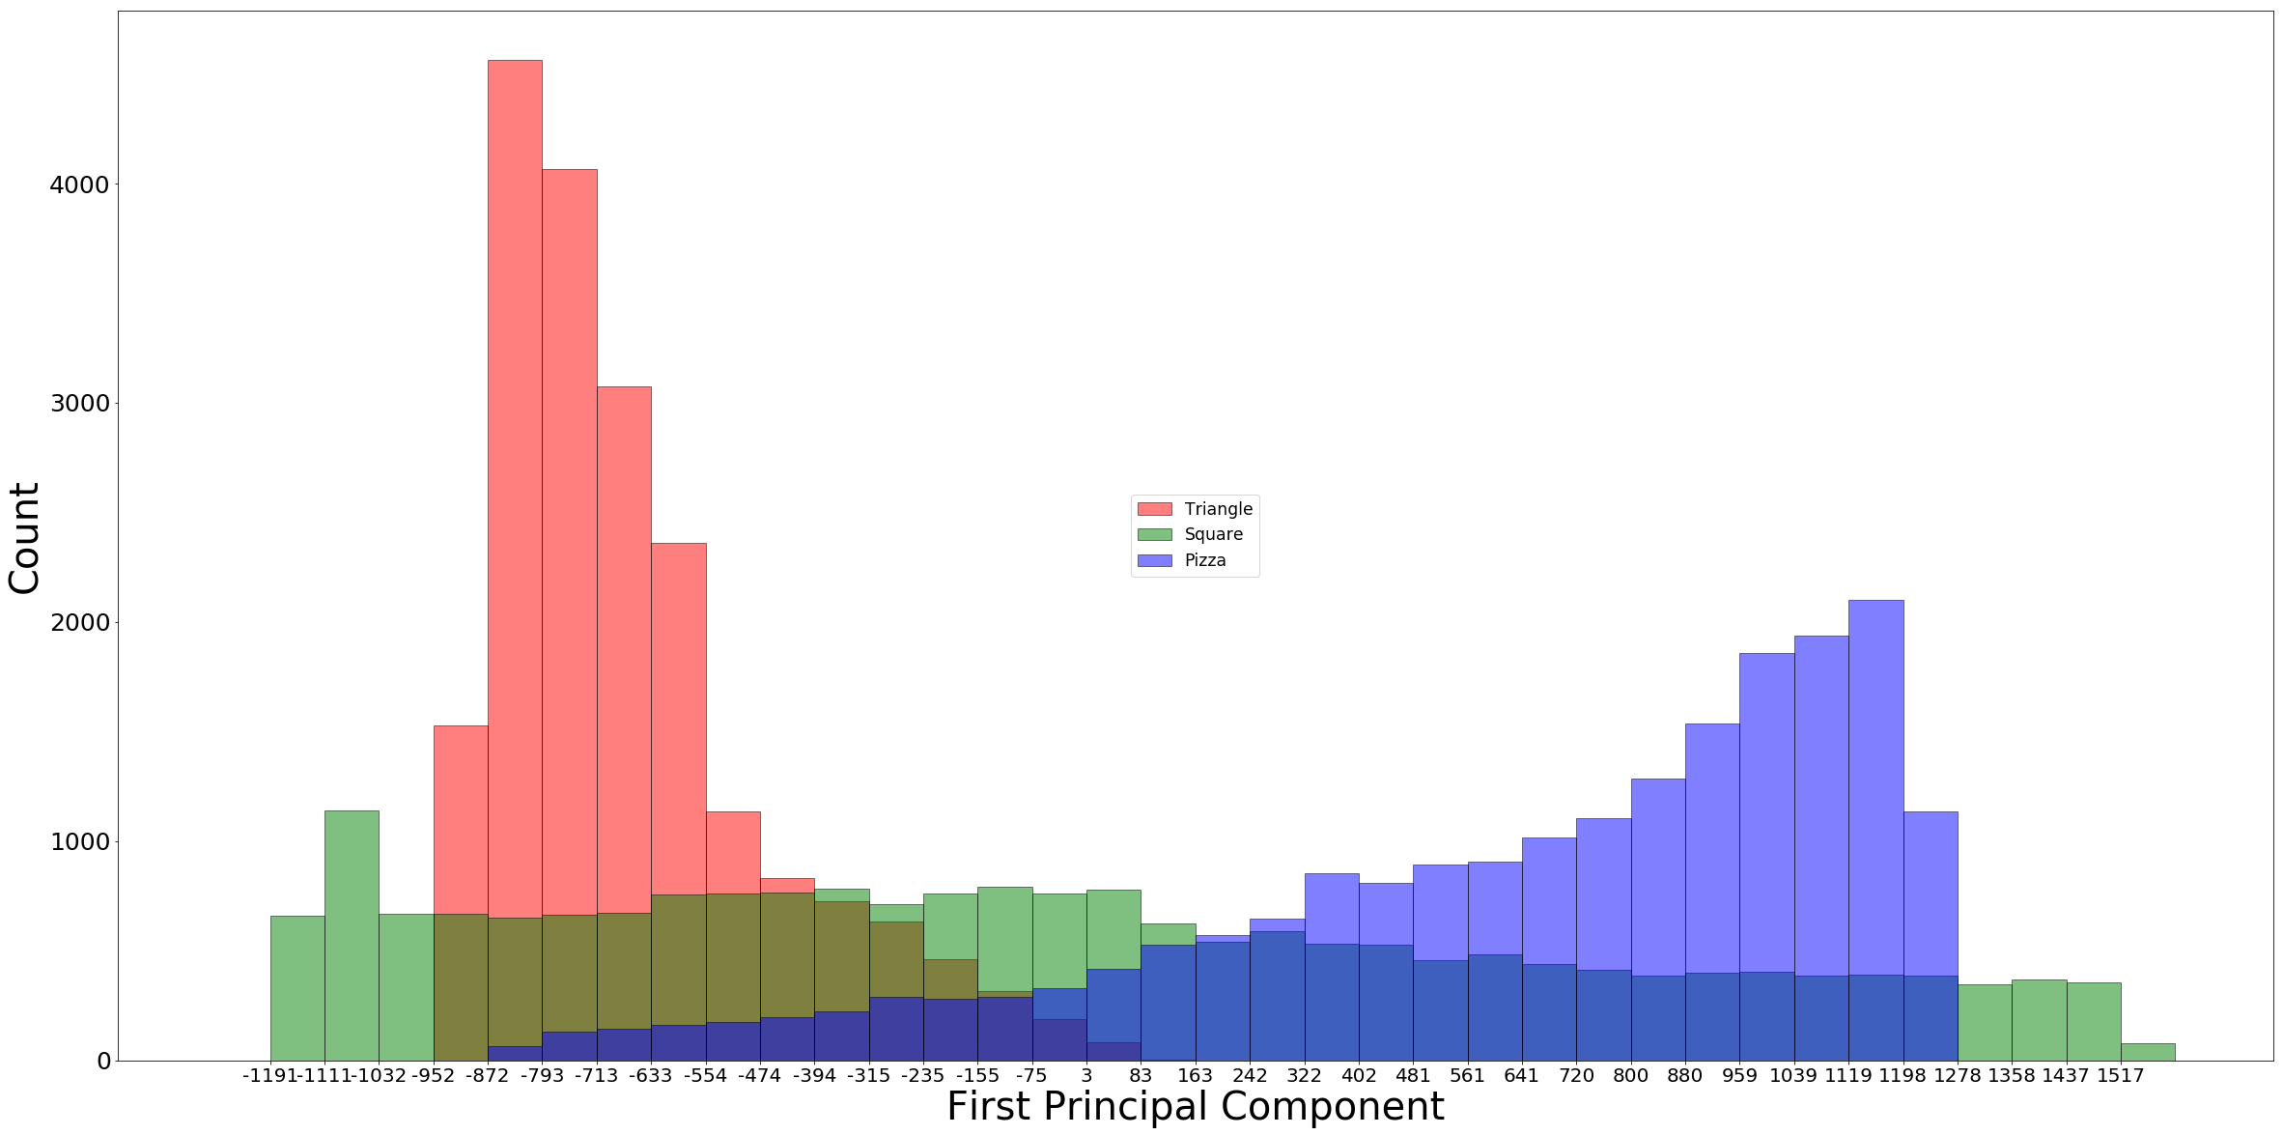
Histogram
Histogram using One PCA Component

Slide 10
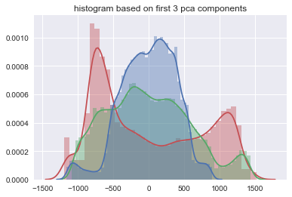
Histogram using 3 PCA

Slide 11

Numeric structure of a shape object
28 x 28 matrix
255 | 255 | 255 | 255 | 255 | 255 | 255 | 255 | 255 | 255 | 255 | 255 | 255 | 255 | 255 | 255 | 255 | 255 | 255 | 255 | 255 | 255 | 255 | 255 | 255 | 255 | 255 | 255
255 | 255 | 255 | 255 | 255 | 255 | 255 | 255 | 255 | 255 | 255 | 255 | 255 | 255 | 255 | 255 | 255 | 255 | 255 | 255 | 255 | 255 | 255 | 255 | 255 | 255 | 255 | 255
255 | 255 | 255 | 255 | 255 | 255 | 255 | 255 | 255 | 255 | 255 | 255 | 255 | 255 | 255 | 255 | 255 | 255 | 255 | 255 | 255 | 255 | 255 | 255 | 255 | 255 | 255 | 255
255 | 255 | 255 | 255 | 255 | 255 | 255 | 255 | 255 | 255 | 255 | 255 | 255 | 255 | 255 | 255 | 255 | 255 | 255 | 255 | 255 | 255 | 255 | 255 | 255 | 255 | 255 | 255
255 | 255 | 255 | 255 | 255 | 255 | 255 | 255 | 255 | 255 | 255 | 255 | 255 | 255 | 255 | 255 | 255 | 255 | 255 | 255 | 255 | 255 | 255 | 255 | 255 | 255 | 255 | 255
255 | 255 | 255 | 255 | 255 | 255 | 255 | 255 | 255 | 255 | 255 | 255 | 255 | 255 | 255 | 255 | 255 | 255 | 255 | 255 | 255 | 255 | 255 | 255 | 255 | 255 | 255 | 255
255 | 255 | 255 | 255 | 255 | 255 | 255 | 255 | 255 | 255 | 255 | 255 | 255 | 255 | 255 | 255 | 255 | 255 | 255 | 255 | 255 | 255 | 255 | 255 | 255 | 255 | 255 | 255
255 | 255 | 255 | 255 | 255 | 255 | 255 | 255 | 255 | 255 | 255 | 255 | 255 | 255 | 255 | 255 | 255 | 255 | 255 | 255 | 255 | 255 | 255 | 255 | 255 | 255 | 255 | 255
255 | 255 | 255 | 255 | 255 | 255 | 255 | 255 | 255 | 255 | 255 | 255 | 255 | 255 | 255 | 175 | 96 | 255 | 255 | 255 | 255 | 255 | 255 | 255 | 255 | 255 | 255 | 255
255 | 255 | 255 | 255 | 255 | 255 | 255 | 255 | 255 | 255 | 255 | 255 | 255 | 191 | 63 | 0 | 0 | 175 | 255 | 255 | 255 | 255 | 255 | 255 | 255 | 255 | 255 | 255
255 | 255 | 255 | 255 | 255 | 255 | 255 | 255 | 255 | 255 | 255 | 215 | 79 | 0 | 0 | 7 | 0 | 48 | 255 | 255 | 255 | 255 | 255 | 255 | 255 | 255 | 255 | 255
255 | 255 | 255 | 255 | 255 | 255 | 255 | 255 | 255 | 230 | 96 | 0 | 0 | 15 | 135 | 238 | 24 | 0 | 159 | 255 | 255 | 255 | 255 | 255 | 255 | 255 | 255 | 255
255 | 255 | 255 | 255 | 255 | 255 | 255 | 255 | 120 | 7 | 0 | 7 | 112 | 238 | 255 | 255 | 175 | 0 | 24 | 247 | 255 | 255 | 255 | 255 | 255 | 255 | 255 | 255
255 | 255 | 255 | 255 | 255 | 255 | 255 | 255 | 127 | 0 | 24 | 222 | 255 | 255 | 255 | 255 | 255 | 48 | 0 | 142 | 255 | 255 | 255 | 255 | 255 | 255 | 255 | 255
255 | 255 | 255 | 255 | 255 | 255 | 255 | 255 | 247 | 24 | 0 | 175 | 255 | 255 | 255 | 255 | 255 | 183 | 0 | 24 | 247 | 255 | 255 | 255 | 255 | 255 | 255 | 255
255 | 255 | 255 | 255 | 255 | 255 | 255 | 255 | 255 | 142 | 0 | 48 | 255 | 255 | 255 | 255 | 255 | 255 | 63 | 0 | 112 | 255 | 255 | 255 | 255 | 255 | 255 | 255
255 | 255 | 255 | 255 | 255 | 255 | 255 | 255 | 255 | 247 | 24 | 0 | 167 | 255 | 255 | 255 | 215 | 79 | 0 | 0 | 31 | 247 | 255 | 255 | 255 | 255 | 255 | 255
255 | 255 | 255 | 255 | 255 | 255 | 255 | 255 | 255 | 255 | 175 | 0 | 24 | 247 | 230 | 104 | 0 | 0 | 15 | 127 | 238 | 255 | 255 | 255 | 255 | 255 | 255 | 255
255 | 255 | 255 | 255 | 255 | 255 | 255 | 255 | 255 | 255 | 255 | 48 | 0 | 72 | 7 | 0 | 7 | 112 | 230 | 255 | 255 | 255 | 255 | 255 | 255 | 255 | 255 | 255
255 | 255 | 255 | 255 | 255 | 255 | 255 | 255 | 255 | 255 | 255 | 175 | 0 | 0 | 0 | 88 | 222 | 255 | 255 | 255 | 255 | 255 | 255 | 255 | 255 | 255 | 255 | 255
255 | 255 | 255 | 255 | 255 | 255 | 255 | 255 | 255 | 255 | 255 | 255 | 72 | 72 | 207 | 255 | 255 | 255 | 255 | 255 | 255 | 255 | 255 | 255 | 255 | 255 | 255 | 255
255 | 255 | 255 | 255 | 255 | 255 | 255 | 255 | 255 | 255 | 255 | 255 | 247 | 255 | 255 | 255 | 255 | 255 | 255 | 255 | 255 | 255 | 255 | 255 | 255 | 255 | 255 | 255
255 | 255 | 255 | 255 | 255 | 255 | 255 | 255 | 255 | 255 | 255 | 255 | 255 | 255 | 255 | 255 | 255 | 255 | 255 | 255 | 255 | 255 | 255 | 255 | 255 | 255 | 255 | 255
255 | 255 | 255 | 255 | 255 | 255 | 255 | 255 | 255 | 255 | 255 | 255 | 255 | 255 | 255 | 255 | 255 | 255 | 255 | 255 | 255 | 255 | 255 | 255 | 255 | 255 | 255 | 255
255 | 255 | 255 | 255 | 255 | 255 | 255 | 255 | 255 | 255 | 255 | 255 | 255 | 255 | 255 | 255 | 255 | 255 | 255 | 255 | 255 | 255 | 255 | 255 | 255 | 255 | 255 | 255
255 | 255 | 255 | 255 | 255 | 255 | 255 | 255 | 255 | 255 | 255 | 255 | 255 | 255 | 255 | 255 | 255 | 255 | 255 | 255 | 255 | 255 | 255 | 255 | 255 | 255 | 255 | 255
255 | 255 | 255 | 255 | 255 | 255 | 255 | 255 | 255 | 255 | 255 | 255 | 255 | 255 | 255 | 255 | 255 | 255 | 255 | 255 | 255 | 255 | 255 | 255 | 255 | 255 | 255 | 255
255 | 255 | 255 | 255 | 255 | 255 | 255 | 255 | 255 | 255 | 255 | 255 | 255 | 255 | 255 | 255 | 255 | 255 | 255 | 255 | 255 | 255 | 255 | 255 | 255 | 255 | 255 | 255

Slide 12
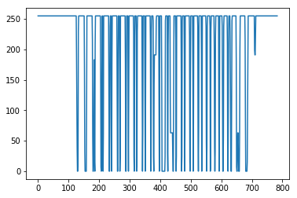
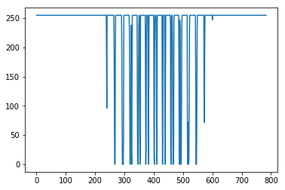

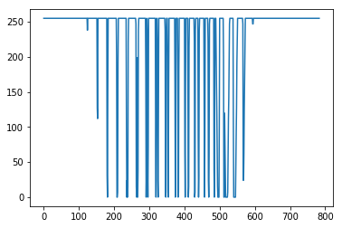

Shape object represented as feature vector

Slide 13
Classification Techniques
Unsupervised
EM for Gaussian Distribution
K-Means
Supervised
Linear Classifier (multiclass)
Perceptron
Logistic Regression
Neural Network

Slide 14
Classifier Design
Data
Training
PCA
Logistic Regression PerceptronEM
Test
PCA
Predict
Result
Accuracy Time
Visualize
Result

Slide 15
Unsupervised Expectation Maximization
Dimensions | Accuracy | Time
2 | 26% | 35 secs
3 | 52% | 45 secs
10 | 32% | 60 secs
784 | Indeterminate | Indeterminate

Slide 16
Logistic Regression
Dimensions | Training Time | Confusion Matrix | Accuracy | Sensitivity | Precision
784-Dimension | 16.779 s | [[2099 27 1264] [ 413 2130 750] [ 0 2 3315]] | 75.44 % | 75.51 % | 81.47%
2-Dimension | 0.279 s | [[2285 553 552] [1519 876 898] [1079 595 1643]] | 48.04 % | 47.73 % | 47.85 %
95%Variance (133-Dimension) | 3.302 s | [[2037 1353 0] [ 607 2686 0] [ 0 236 3081]] | 78.04 % | 78.18 % | 79.96 %
90% Variance (86 Dimension) | 2.336 s | [[1826 396 1168] [ 958 1706 629] [ 0 0 3317]] | 68.49 % | 68.56 % | 70.54 %
85% Variance (63 Dimension) | 1.766 s | [[1684 504 1202] [1168 1464 661] [ 0 0 3317]] | 64.65 % | 64.71 % | 65.82 %

Slide 17
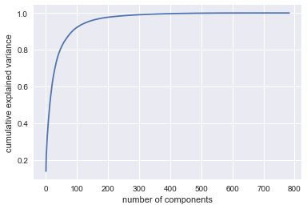
PCA Analysis

Slide 18
Supervised Perceptron
Dimensions | Accuracy | Time
2 | 45% | 0.1 sec
3 | 49% | 0.1 sec
10 | 50% | 0.1 sec
784 | 79.00% | 0.8 sec

Slide 19
Classifier Evaluation
 | Classifier | Accuracy | Time | PCA
1 | Expectation Maximization | 59% | 65 sec | 10 Dim
2 | Logistic Regression | 78% | 74 sec | 133 Dim
3 | Perceptron | 79% | 0.8 sec | 784 Dim

Slide 20
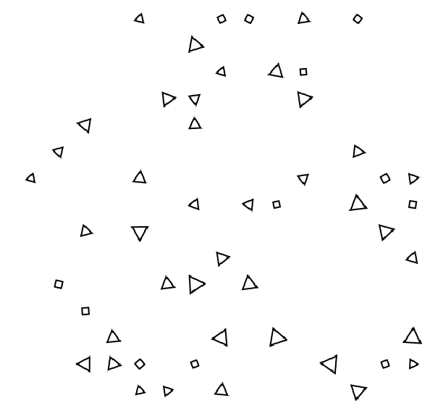
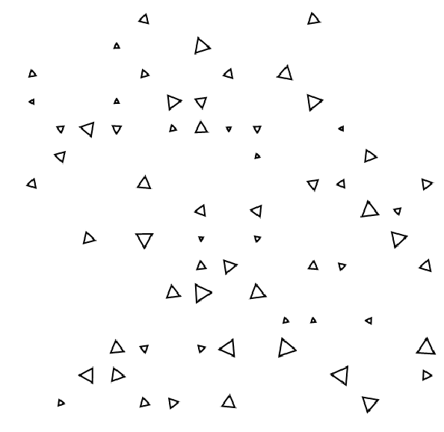
Visual Examination Perceptron Classification - Triangle
Checking multiple training vectors by plotting images for class: 0 Be patient: T.shape (10000,)
Prediction Actual
Notes:
Upon Visual examination of Triangle class, we see that larger triangles are classified correctly, where as few smaller square images are predicted as triangles.

Slide 21


Perceptron Classification - Square
Checking multiple training vectors by plotting images for class: 0 Be patient: T.shape (10000,)
Prediction Actual
Notes:
Upon Visual examination of Square class, we see that larger squares are classified correctly, where as few smaller triangle images are predicted as squares.

Slide 22
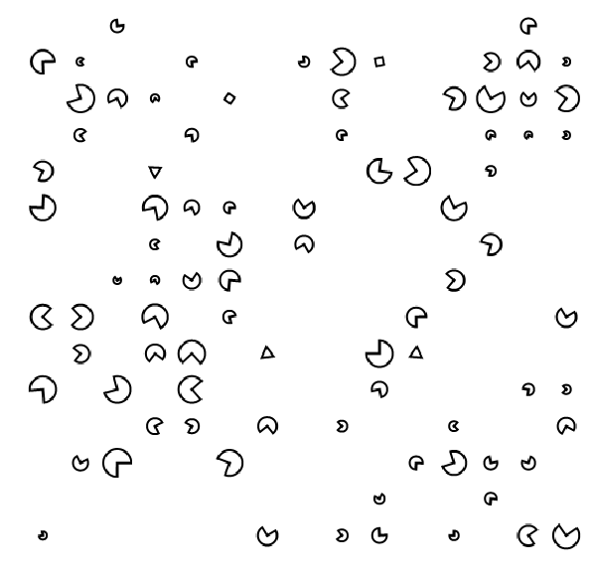
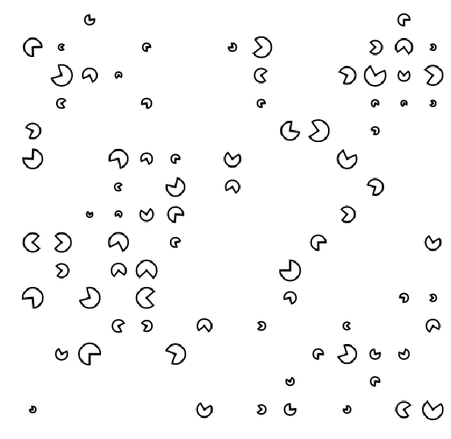
Perceptron Classification - Pizza
Checking multiple training vectors by plotting images for class: 0 Be patient: T.shape (10000,)
Prediction Actual
Notes:
All larger pizzas are correctly classified, except for few smaller square/triangles are predicted incorrectly as pizzas.
Visual examination of all 3 classes shows that, bigger images are classified correctly and smaller ones are not.
Upon further analysis, by classifying images in 5 classes, it was observed that:
Class 1 – classified as biggest squares
Class 2 – small triangle, square and pizza
Class 3 – slightly bigger triangle, square and pizza
Class 4 – biggest triangle, square and pizza
Class 5 – biggest pizzas
From this analysis, we can see that size of images is playing significant role in classification of images.

Slide 23

Separated smaller images from larger ones
Small image
Large image
Notes:
Small images are identified by the total number of blank rows and columns. When number of blank rows > 12 and columns are > 12, the image is considered as small image.

Slide 24
New Classifier Design
Larger images are classified separately from smaller images
Data
Training
Large Training
Classifier
(Large Image)
Test
Large Test
Small Training
Classifier
(Small Image)
Small Test
Notes:
Training set was divided into Smaller and Larger images.
Test set was divided into Smaller and Larger images.

Slide 25
Large image classification
Large Image Classification | Accuracy | Time | PCA
Logistic Regression on Large Image dataset | 48% | 70 sec | 134 Dim
Perceptron on Large Image | 99% | 0.1 sec | 784 Dim
Notes:
Large image classification accuracy is increased to 99% in comparison to 79% for the combined set.

Slide 26
Small image classification
Small Image Classification | Accuracy | Time | PCA
Logistic Regression on Small Image dataset | 35% | < 1 min | 30 Dim
Perceptron on Small Image dataset | 42% | 0.1 sec | 784 Dim
Accuracy low. Model is not good,
due to insufficient observations of small
images in Training set
0.012% small images
in Training set (717/60,000)
41% small images
in Test set (4121/10,000)
Training and Test sets are reversed
Small Image Classification | Accuracy | Time | PCA
Logistic Regression on Small Image dataset (Reversed) | 48% | < 1 min | 80 Dim
Perceptron on Small Image dataset (Reversed) | 84% | 0.1 sec | 784 Dim
Accuracy improved, when Test set is used
to train the model.
Training set used for Testing
Notes:
Small image classification accuracy is reduced to 42% in comparison to 79% for the combined set.
This is due to insufficient number of observations in the Training set – only 0.01% of small images in Training set (717 out of 60,000)
Where as Test set contains 41% of small images which is 4121 out of 10,000.
The Training set and Test sets are reversed for analyzing the behavior of our classifier towards smaller images. This resulted in accuracy improvement to 84%.
Still we were not satisfied with the accuracy %

Slide 27
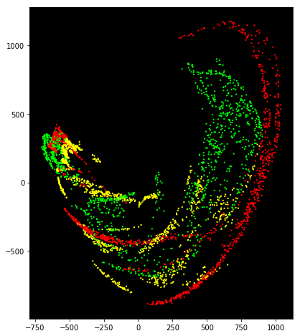
2D Point Cloud for Small images in Test set
Triangle : 3390
Square : 3293
Pizza : 3317
Total : 10,000

Slide 28
Feature Alignment
Original Small image in 28 x 28 matrix
255 | 255 | 255 | 255 | 255 | 255 | 255 | 255 | 255 | 255 | 255 | 255 | 255 | 255 | 255 | 255 | 255 | 255 | 255 | 255 | 255 | 255 | 255 | 255 | 255 | 255 | 255 | 255
255 | 255 | 255 | 255 | 255 | 255 | 255 | 255 | 255 | 255 | 255 | 255 | 255 | 255 | 255 | 255 | 255 | 255 | 255 | 255 | 255 | 255 | 255 | 255 | 255 | 255 | 255 | 255
255 | 255 | 255 | 255 | 255 | 255 | 255 | 255 | 255 | 255 | 255 | 255 | 255 | 255 | 255 | 255 | 255 | 255 | 255 | 255 | 255 | 255 | 255 | 255 | 255 | 255 | 255 | 255
255 | 255 | 255 | 255 | 255 | 255 | 255 | 255 | 255 | 255 | 255 | 255 | 255 | 255 | 255 | 255 | 255 | 255 | 255 | 255 | 255 | 255 | 255 | 255 | 255 | 255 | 255 | 255
255 | 255 | 255 | 255 | 255 | 255 | 255 | 255 | 255 | 255 | 255 | 255 | 255 | 255 | 255 | 255 | 255 | 255 | 255 | 255 | 255 | 255 | 255 | 255 | 255 | 255 | 255 | 255
255 | 255 | 255 | 255 | 255 | 255 | 255 | 255 | 255 | 255 | 255 | 255 | 255 | 255 | 255 | 255 | 255 | 255 | 255 | 255 | 255 | 255 | 255 | 255 | 255 | 255 | 255 | 255
255 | 255 | 255 | 255 | 255 | 255 | 255 | 255 | 255 | 255 | 255 | 255 | 255 | 255 | 255 | 255 | 255 | 255 | 255 | 255 | 255 | 255 | 255 | 255 | 255 | 255 | 255 | 255
255 | 255 | 255 | 255 | 255 | 255 | 255 | 255 | 255 | 255 | 255 | 255 | 255 | 255 | 255 | 255 | 255 | 255 | 255 | 255 | 255 | 255 | 255 | 255 | 255 | 255 | 255 | 255
255 | 255 | 255 | 255 | 255 | 255 | 255 | 255 | 255 | 255 | 255 | 255 | 255 | 255 | 255 | 175 | 96 | 255 | 255 | 255 | 255 | 255 | 255 | 255 | 255 | 255 | 255 | 255
255 | 255 | 255 | 255 | 255 | 255 | 255 | 255 | 255 | 255 | 255 | 255 | 255 | 191 | 63 | 0 | 0 | 175 | 255 | 255 | 255 | 255 | 255 | 255 | 255 | 255 | 255 | 255
255 | 255 | 255 | 255 | 255 | 255 | 255 | 255 | 255 | 255 | 255 | 215 | 79 | 0 | 0 | 7 | 0 | 48 | 255 | 255 | 255 | 255 | 255 | 255 | 255 | 255 | 255 | 255
255 | 255 | 255 | 255 | 255 | 255 | 255 | 255 | 255 | 230 | 96 | 0 | 0 | 15 | 135 | 238 | 24 | 0 | 159 | 255 | 255 | 255 | 255 | 255 | 255 | 255 | 255 | 255
255 | 255 | 255 | 255 | 255 | 255 | 255 | 255 | 120 | 7 | 0 | 7 | 112 | 238 | 255 | 255 | 175 | 0 | 24 | 247 | 255 | 255 | 255 | 255 | 255 | 255 | 255 | 255
255 | 255 | 255 | 255 | 255 | 255 | 255 | 255 | 127 | 0 | 24 | 222 | 255 | 255 | 255 | 255 | 255 | 48 | 0 | 142 | 255 | 255 | 255 | 255 | 255 | 255 | 255 | 255
255 | 255 | 255 | 255 | 255 | 255 | 255 | 255 | 247 | 24 | 0 | 175 | 255 | 255 | 255 | 255 | 255 | 183 | 0 | 24 | 247 | 255 | 255 | 255 | 255 | 255 | 255 | 255
255 | 255 | 255 | 255 | 255 | 255 | 255 | 255 | 255 | 142 | 0 | 48 | 255 | 255 | 255 | 255 | 255 | 255 | 63 | 0 | 112 | 255 | 255 | 255 | 255 | 255 | 255 | 255
255 | 255 | 255 | 255 | 255 | 255 | 255 | 255 | 255 | 247 | 24 | 0 | 167 | 255 | 255 | 255 | 215 | 79 | 0 | 0 | 31 | 247 | 255 | 255 | 255 | 255 | 255 | 255
255 | 255 | 255 | 255 | 255 | 255 | 255 | 255 | 255 | 255 | 175 | 0 | 24 | 247 | 230 | 104 | 0 | 0 | 15 | 127 | 238 | 255 | 255 | 255 | 255 | 255 | 255 | 255
255 | 255 | 255 | 255 | 255 | 255 | 255 | 255 | 255 | 255 | 255 | 48 | 0 | 72 | 7 | 0 | 7 | 112 | 230 | 255 | 255 | 255 | 255 | 255 | 255 | 255 | 255 | 255
255 | 255 | 255 | 255 | 255 | 255 | 255 | 255 | 255 | 255 | 255 | 175 | 0 | 0 | 0 | 88 | 222 | 255 | 255 | 255 | 255 | 255 | 255 | 255 | 255 | 255 | 255 | 255
255 | 255 | 255 | 255 | 255 | 255 | 255 | 255 | 255 | 255 | 255 | 255 | 72 | 72 | 207 | 255 | 255 | 255 | 255 | 255 | 255 | 255 | 255 | 255 | 255 | 255 | 255 | 255
255 | 255 | 255 | 255 | 255 | 255 | 255 | 255 | 255 | 255 | 255 | 255 | 247 | 255 | 255 | 255 | 255 | 255 | 255 | 255 | 255 | 255 | 255 | 255 | 255 | 255 | 255 | 255
255 | 255 | 255 | 255 | 255 | 255 | 255 | 255 | 255 | 255 | 255 | 255 | 255 | 255 | 255 | 255 | 255 | 255 | 255 | 255 | 255 | 255 | 255 | 255 | 255 | 255 | 255 | 255
255 | 255 | 255 | 255 | 255 | 255 | 255 | 255 | 255 | 255 | 255 | 255 | 255 | 255 | 255 | 255 | 255 | 255 | 255 | 255 | 255 | 255 | 255 | 255 | 255 | 255 | 255 | 255
255 | 255 | 255 | 255 | 255 | 255 | 255 | 255 | 255 | 255 | 255 | 255 | 255 | 255 | 255 | 255 | 255 | 255 | 255 | 255 | 255 | 255 | 255 | 255 | 255 | 255 | 255 | 255
255 | 255 | 255 | 255 | 255 | 255 | 255 | 255 | 255 | 255 | 255 | 255 | 255 | 255 | 255 | 255 | 255 | 255 | 255 | 255 | 255 | 255 | 255 | 255 | 255 | 255 | 255 | 255
255 | 255 | 255 | 255 | 255 | 255 | 255 | 255 | 255 | 255 | 255 | 255 | 255 | 255 | 255 | 255 | 255 | 255 | 255 | 255 | 255 | 255 | 255 | 255 | 255 | 255 | 255 | 255
255 | 255 | 255 | 255 | 255 | 255 | 255 | 255 | 255 | 255 | 255 | 255 | 255 | 255 | 255 | 255 | 255 | 255 | 255 | 255 | 255 | 255 | 255 | 255 | 255 | 255 | 255 | 255
Notes:
The smaller images were cut down to 15x15 matrix from 28x28, by removing the blank rows and columns.

Slide 29

Feature Alignment
Small image is reduced to 15x15 matrix from 28x28
255 | 255 | 255 | 255 | 255 | 255 | 255 | 175 | 96 | 255 | 255 | 255 | 255 | 255 | 255
255 | 255 | 255 | 255 | 255 | 191 | 63 | 0 | 0 | 175 | 255 | 255 | 255 | 255 | 255
255 | 255 | 255 | 215 | 79 | 0 | 0 | 7 | 0 | 48 | 255 | 255 | 255 | 255 | 255
255 | 230 | 96 | 0 | 0 | 15 | 135 | 238 | 24 | 0 | 159 | 255 | 255 | 255 | 255
120 | 7 | 0 | 7 | 112 | 238 | 255 | 255 | 175 | 0 | 24 | 247 | 255 | 255 | 255
127 | 0 | 24 | 222 | 255 | 255 | 255 | 255 | 255 | 48 | 0 | 142 | 255 | 255 | 255
247 | 24 | 0 | 175 | 255 | 255 | 255 | 255 | 255 | 183 | 0 | 24 | 247 | 255 | 255
255 | 142 | 0 | 48 | 255 | 255 | 255 | 255 | 255 | 255 | 63 | 0 | 112 | 255 | 255
255 | 247 | 24 | 0 | 167 | 255 | 255 | 255 | 215 | 79 | 0 | 0 | 31 | 247 | 255
255 | 255 | 175 | 0 | 24 | 247 | 230 | 104 | 0 | 0 | 15 | 127 | 238 | 255 | 255
255 | 255 | 255 | 48 | 0 | 72 | 7 | 0 | 7 | 112 | 230 | 255 | 255 | 255 | 255
255 | 255 | 255 | 175 | 0 | 0 | 0 | 88 | 222 | 255 | 255 | 255 | 255 | 255 | 255
255 | 255 | 255 | 255 | 72 | 72 | 207 | 255 | 255 | 255 | 255 | 255 | 255 | 255 | 255
255 | 255 | 255 | 255 | 247 | 255 | 255 | 255 | 255 | 255 | 255 | 255 | 255 | 255 | 255
255 | 255 | 255 | 255 | 255 | 255 | 255 | 255 | 255 | 255 | 255 | 255 | 255 | 255 | 255
Notes:
In smaller images, the blank rows and columns from left, right, top, bottom are removed.
Smaller images are identified by counting maximum number of blank rows > 12 and number of blank columns > 12

Slide 30
Results
Training and Test sets are reversed
Small Image Classification | Accuracy | Time | PCA
Logistic Regression on Small Images | 98% | 1.1 sec | 225 Dim
Perceptron on Small Images | 98% | 0.1 sec | 225 Dim
Notes:
Small image classification accuracy increased to 98% from 84% for the reversed Training and Test set.
For large image classification, the accuracy turned out good – 99%
For small image classification, we need to use Test set for training the classifier, which has 41% of small images
The combined total accuracy of our classifier is 98.5% , which is the average of 98%(small images) and 99%(large images)

Slide 31
First step in Unsupervised Learning, cleanup Uniqueness of Pizza reduced P=67
Solution: Find uniqueness in shape. For Pizza was easy reduced principal components from 133 to 67
Making all pizza pieces same. They have common center off pixel

Slide 32
Further Reduction : Triangles vs squares
If we knew labels we could make any shape same scale and orientation. But that’s not available in Unsupervised learning
First tried: Perimeter Calculation through edge detection, didn’t fly because their histogram counts overlap
Finding top, bottom, left and right edges proved to be difficult, had 100% accuracy with 100 samples, but accuracy dropped with 60K observations
Another strategy:
Applied threshold and created X to be 1 and 0.
Found 4 edge LISTs: left, right, top, bottom view. Removed common edges in top and bottom view based on what I had seen in left and right view. Predicted shape my accuracy is 90% and I can gain another 5% by just call them triangle, I have 5% error which requires more algorithmic work.

Slide 33
Using only 2 principal components
Used EM on training data and testing data get perfect accuracy. Without knowing label my result will be as good as my algorithm currently 95%

Slide 34
Conclusion
Linear classifier – Perceptron gave the best efficiency and performance
By dividing the data into small and large set of images
Prediction accuracy is increased to 98.5%
By Mapping algorithm shapes can have similar scale and rotation and then use 2 principal components in Unsupervised Learning like EM
Future Scope
Accuracy can be improved further
Feature alignment by rotating images. Aligning object edges along x-axis / y-axis

Slide 35
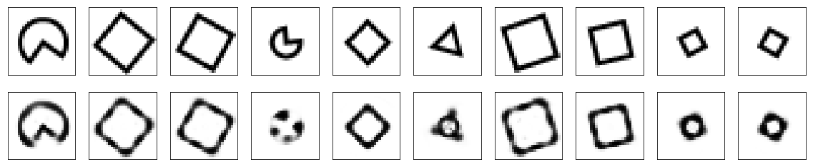
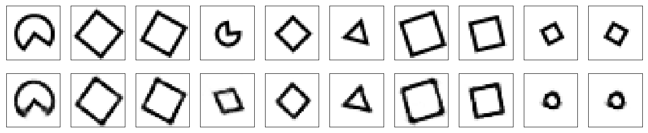
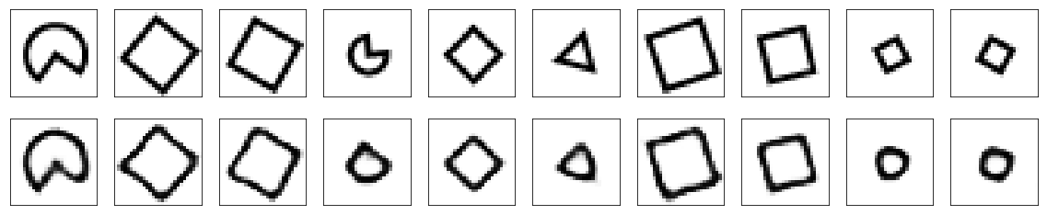
Unsupervised ML Algorithms
Algorithm | Accuracy | Comments
Kmeans Cluster | 49.94%
Kmeans + PCA | 49.95% | Runtime improvement 48.5%
Autoencoder | 48.32% | Dimension reduction = 95%; Compression: 25X
Auto Encoder | Train Loss | Val Loss | Train Class | Test Class | Train Classification
Simple [32] | 12.22 | 11.06 | 68.58 | 44.78
Deep [32] | 8.49 | 13.28 | 67.16 | 46.29
Conv [128] | 9.60 | 9.11 | 68.16 | 45.6

Slide 36

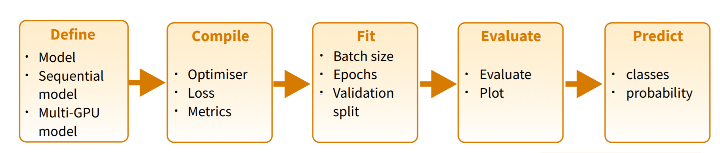
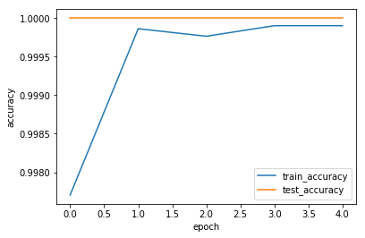
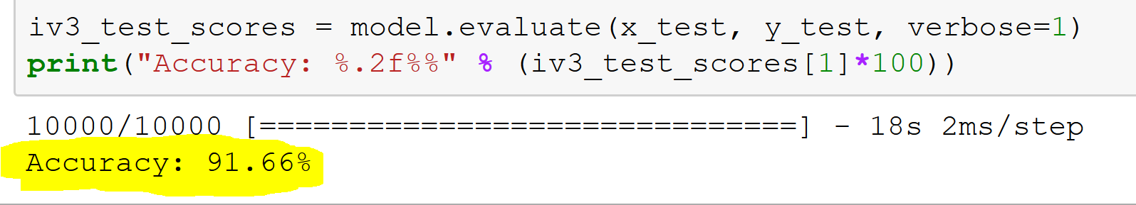
DNN: Keras & TensorFlow
Model
Inceptionv3
Total Model Paraments: 21,802,784
Transfer Learning
Prerequisites
Image channel: 3
Minimum Image Shape (139, 139,3)
Memory requirements: 47 M to 3.5 B values
Training
Prerequisites
Batch Size 64
Epoch 5
Shuffle True
Validation Split 5-15%
Checkpoint
Tensorboard
Evaluate
Test Data
Accuracy 86-92.77%

Slide 37
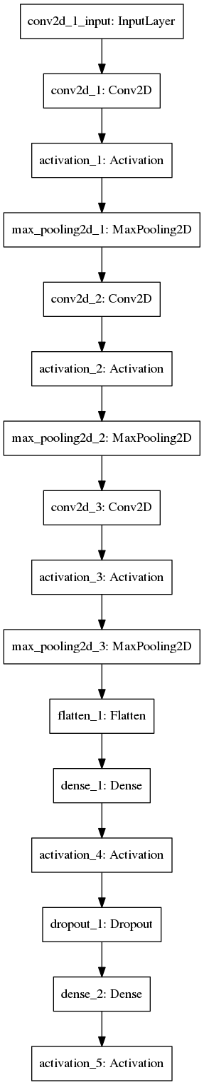
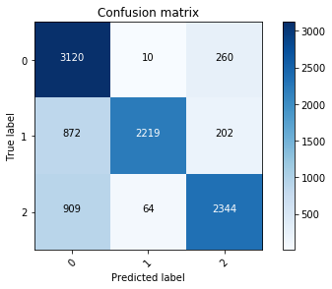
Image Augmentation
Develop Simple Model
Total params: 44,451
Raw Accuracy
76.83%
Image Augmentation
Normalization
Rotation
Width and Height shift
Rescale
Zoom
Horizontal and Vertical shift
New Accuracy
87.88%
3750/3750 [==============================] - 13s 3ms/step - loss: 0.0947 - acc: 0.9689 - val_loss: 10.7723 - val_acc: 0.3317

Slide 38
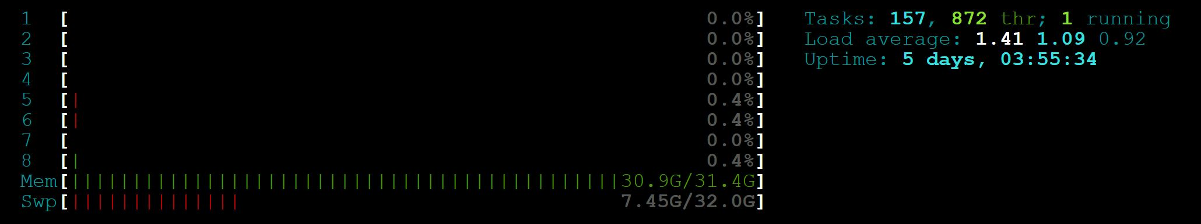
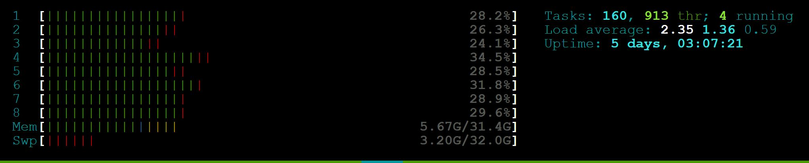
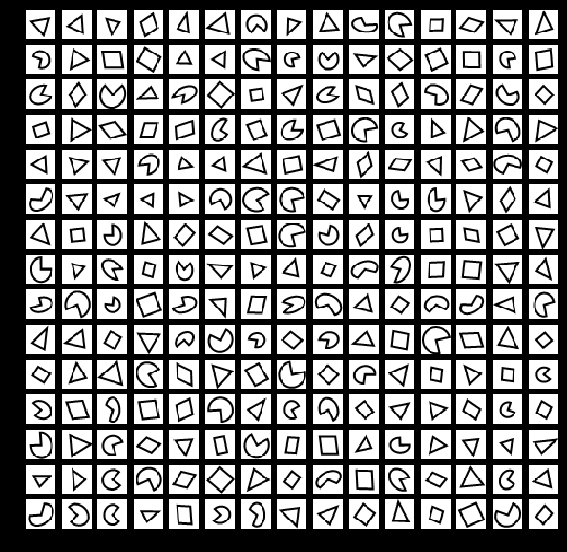
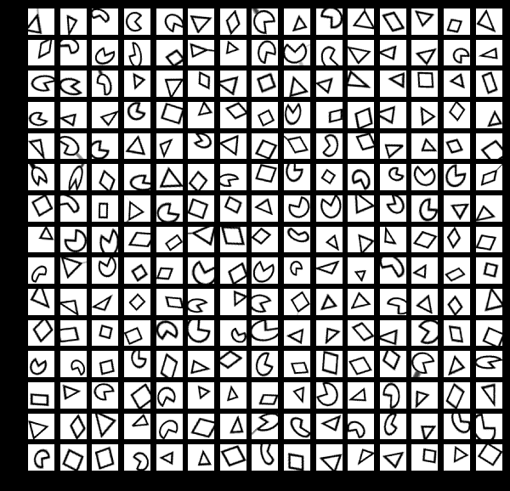
Image Generator
Before
After
92%
99%

Slide 39
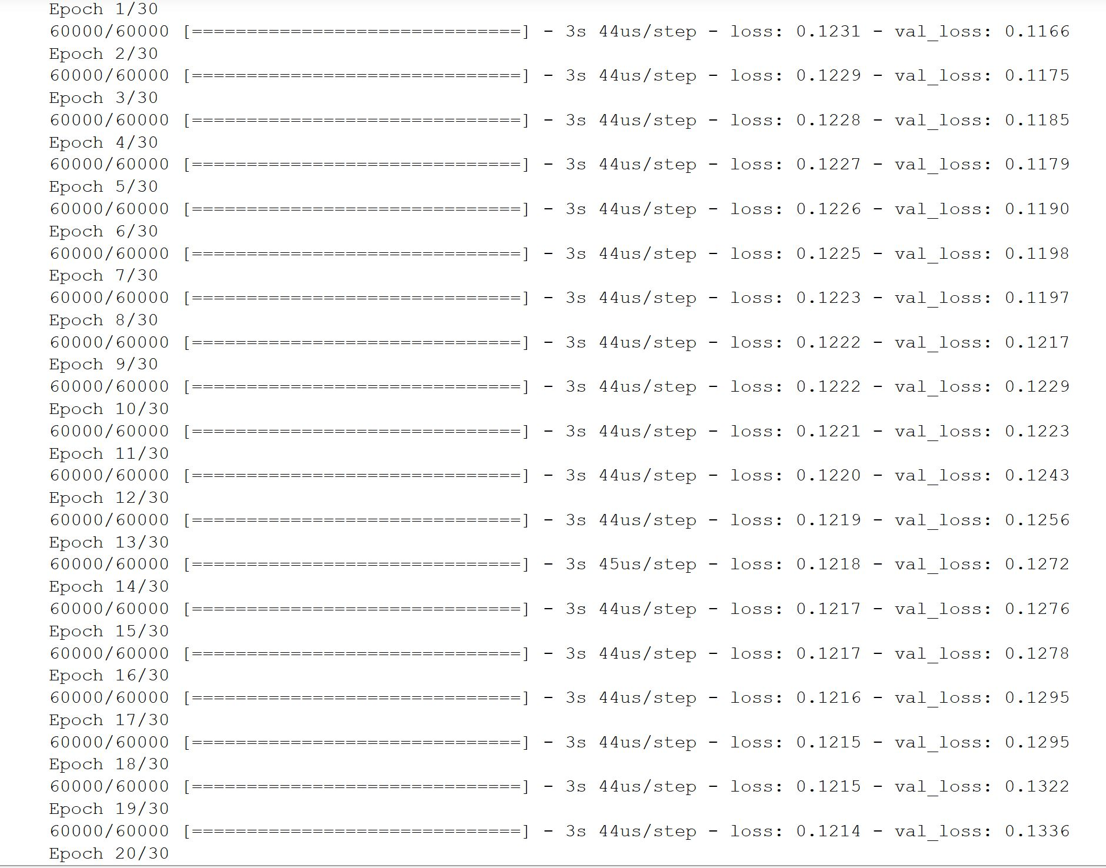
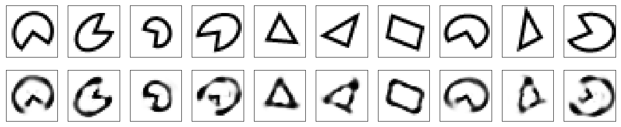
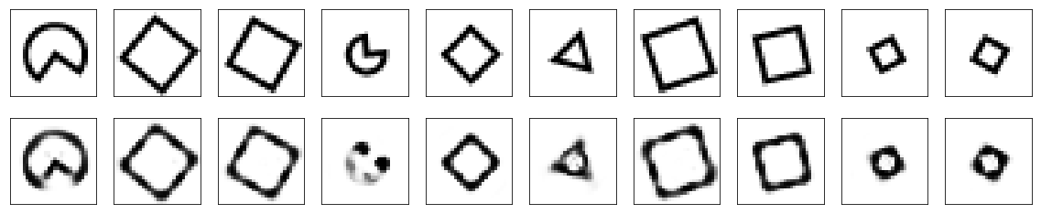
Overtraining Example
Save best model

Slide 40
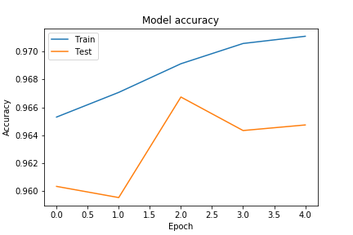
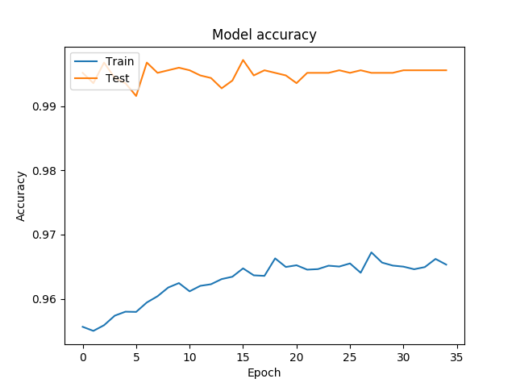
To Conclude
Aggressively add noise
Use data generators for parallelism/efficiently
Use pretrained proven model
Use transfer learning for quick training
Save best model → Checkpoint
Decrease learning rate at runtime
Experiment a lot, know when to stop
Build small model to experiment
Extend Trainable layer eventually

Slide 41

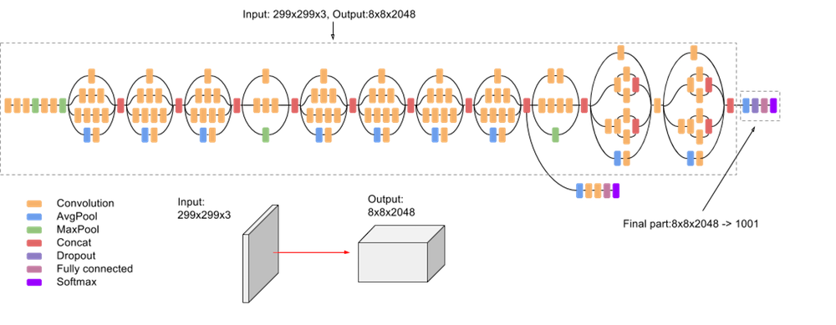
Q&A
Email: sh.bharath@gmail.com
GitHub: https://github.com/shbharath/Shapes
LinkedIn: linkedin.com/in/shbharath
Twitter: @shbharath

