Slide 1



Crime Analysis Dashboard
(India, 2001–2012)
By,
Monika R J (22ADR067)

Slide 2

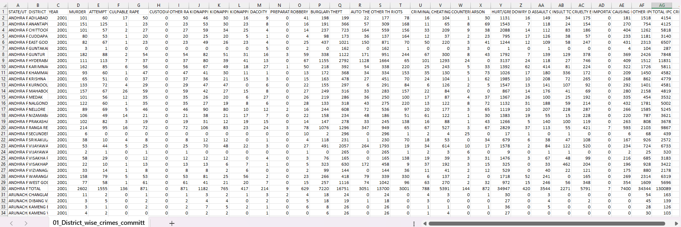
DATASET DESCRIPTION
Dataset Link:
https://www.kaggle.com/datasets/rajanand/crime-in-india
It has 9018 rows and 33 columns with different crime types over the years in the states of India.

Slide 3
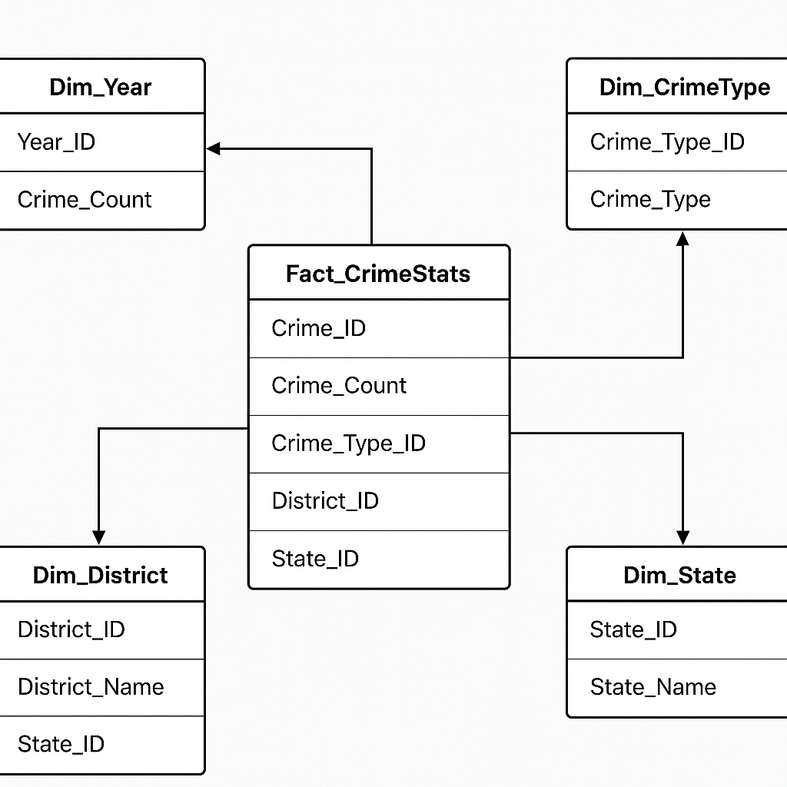
Dimensions used

Slide 4
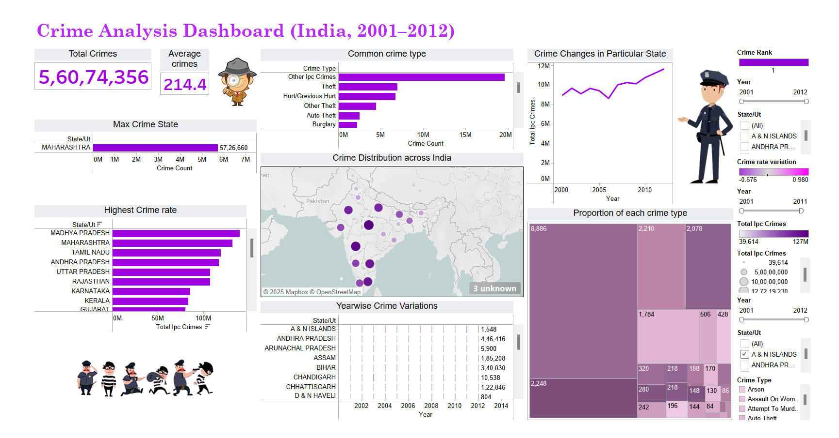
Dashboard

Slide 5
Thank You !!

