Slide 1





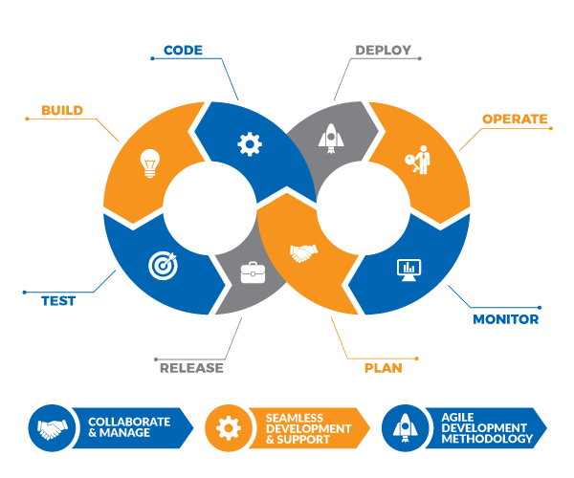

AUTOMATION
KINGPINS
champavath preethi
kankipati mounika keerthana Kannan
BHOYER TEJASHREE

