Slide 1
Customer Satisfaction Prediction

Slide 2
Summary of the dataset
Step 1: Target Column: satisfaction (categorical → needs label encoding)
Categorical Features: Gender, Customer Type, Type of Travel, Class
Numerical Features: Mostly Likert scale scores (1–5), and continuous ones like Age, Flight Distance, Arrival Delay in Minutes
Missing Values: Only in Arrival Delay in Minutes
Columns to Drop: Unnamed: 0, id (no predictive value)
Step2:
visualize satisfaction distribution Explore relationships between key features and satisfaction Check feature correlations

Slide 3
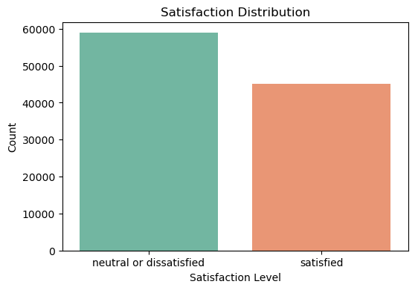
satisfaction distribution
Slight class imbalance: more "neutral or dissatisfied" than "satisfied".
Performed SMOTE Before SMOTE: [47103 36020] After SMOTE: [47103 47103]

Slide 4
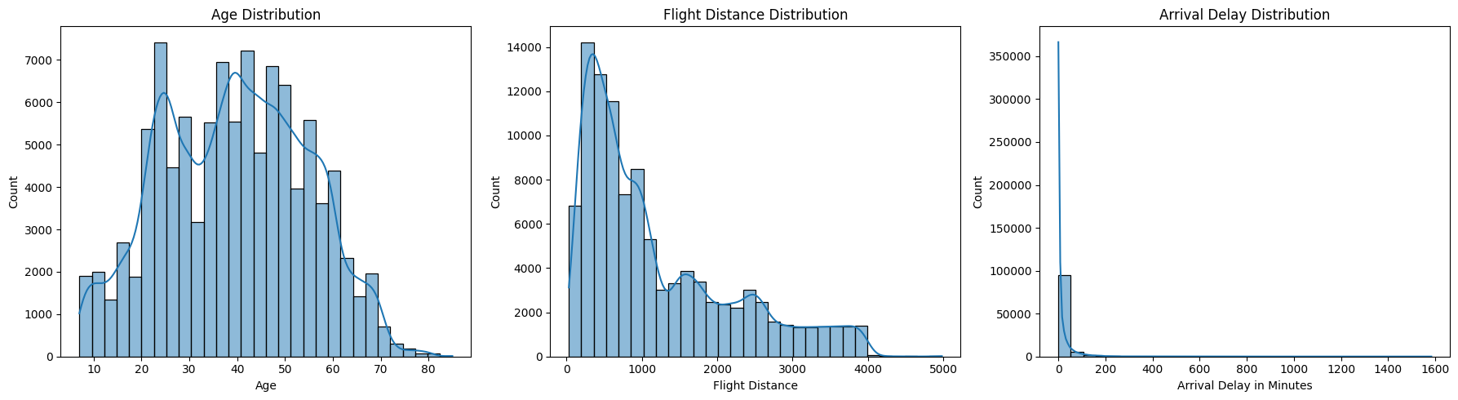
Distribution of Numerical Features
Numeric Feature Insights
Age: Majority of customers fall between young adult to middle age groups, indicating the main customer demographic.
Flight Distance: Most flights are short to medium haul. Longer flights are fewer but could affect satisfaction differently.
Arrival Delay: Most flights arrive on time or with minimal delay; however, larger delays negatively impact satisfaction.

Slide 5
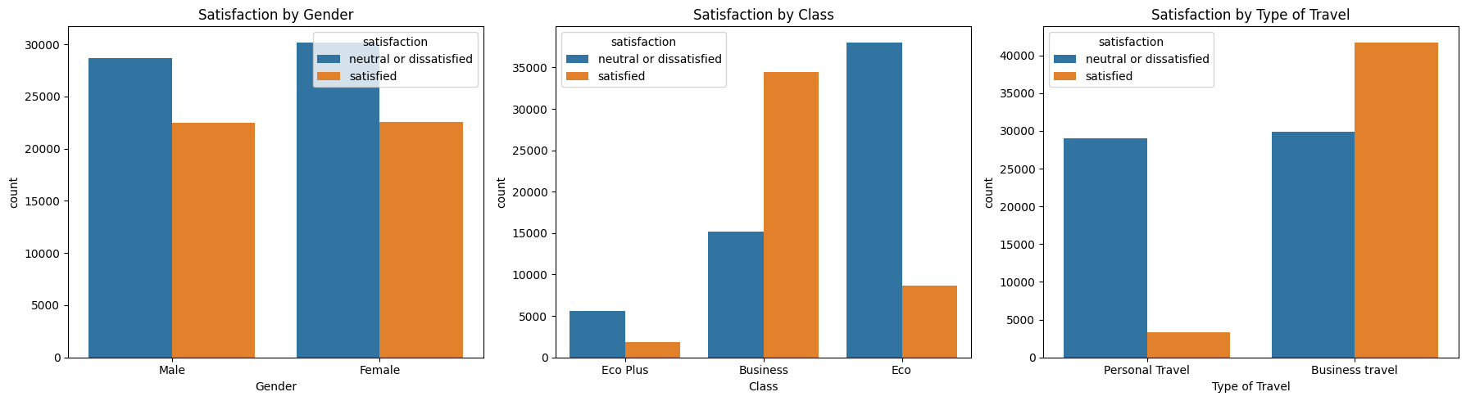
Categorical Feature Impact
Gender: Both male and female customers have similar satisfaction distributions with slight variations.
Customer Type: Loyal customers tend to report higher satisfaction compared to disloyal customers, indicating retention is linked with positive experiences.
Type of Travel: Business travelers generally have higher satisfaction rates compared to personal travelers, possibly due to service expectations.

Slide 6
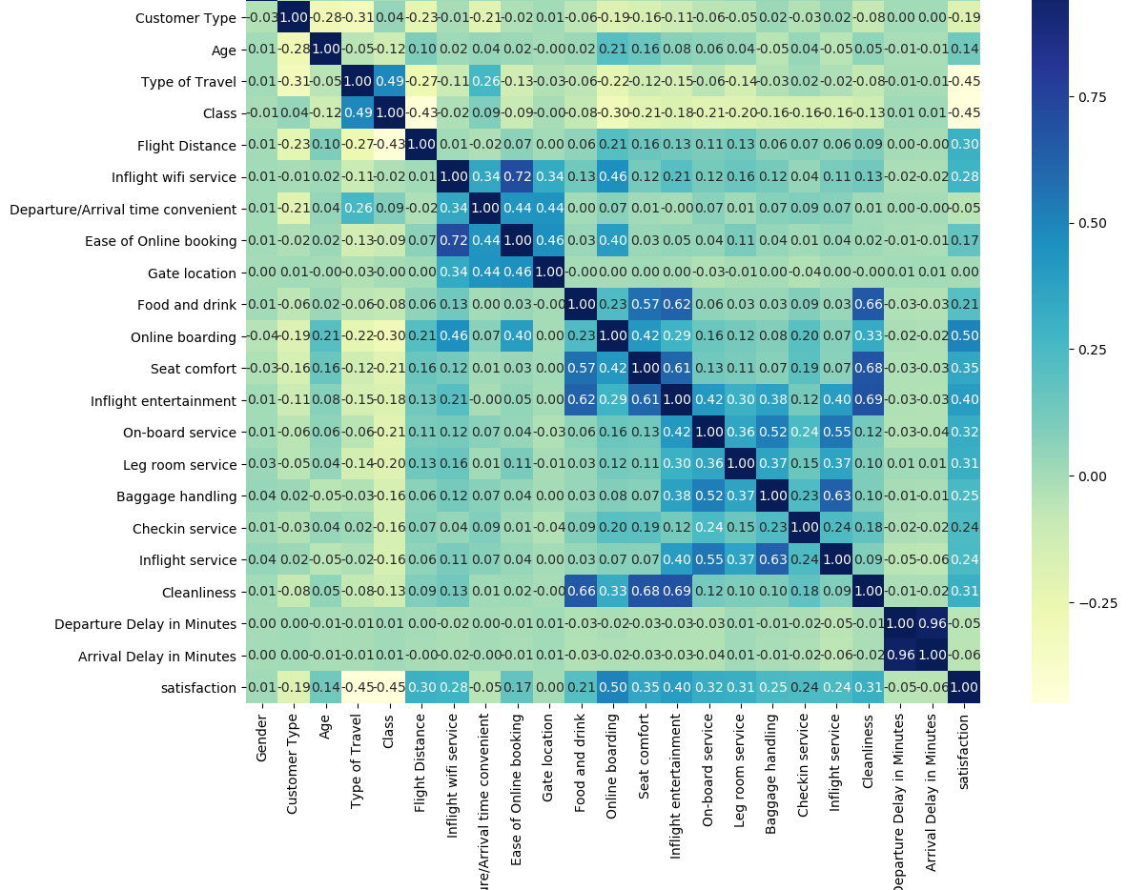
Correlation Heatmap:
Strongly positive correlation with satisfaction:
Inflight entertainment, Online boarding, Seat comfort, Cleanliness
Weak correlation:
Gender, Gate location, Arrival Delay, etc.
This insight suggests focusing on improving inflight experience features could significantly impact customer satisfaction.

Slide 7
Business Recommendations
Improve Key Services: Prioritize enhancing inflight wifi, seat comfort, and cleanliness to drive satisfaction.
Reduce Delays: Operational efforts to minimize delays will directly improve customer experience.
Target Marketing: Develop retention strategies for disloyal customers and customize offers for different travel types.
Personalize Experience: Use demographic and travel purpose insights to tailor customer service.

Slide 8
✅ Model Comparison Summary:
Metric | Logistic Regression | Random Forest | Gradient Boosting
Accuracy | 0.8700 | 0.9629 ✅ | 0.9423
Precision | 0.8416 | 0.9672 ✅ | 0.9344
Recall | 0.8623 | 0.9464 ✅ | 0.9323
F1-Score | 0.8518 | 0.9567 ✅ | 0.9333
Random Forest is the best-performing model overall in terms of all four metrics and confusion matrix results.
Gradient Boosting is a close second and more compact if speed or interpretability matters.
Logistic Regression is significantly weaker in this context, but useful as a baseline.

