Slide 1
Faster deployment few clicks away
Outline:
What is CI/CD ?
What they offer?

Slide 2
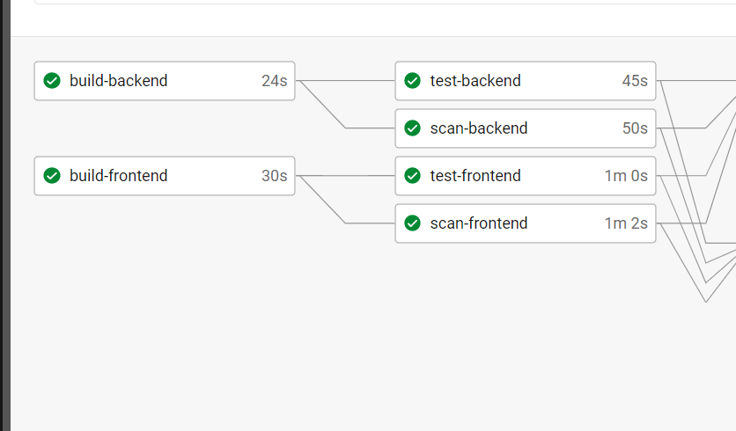
What is CI/CD ?
CI stands for continuous Integration is
a methodology to pack the code
from development team ready to
serve the users
Example for some tasks →
Build code
Run simple tests
Scan Security Vulnerabilities ….
With automated workflow , all the process that we have to go through in order to have an artifact (package ready for deployment )
Fewer mistakes , less time

Slide 3
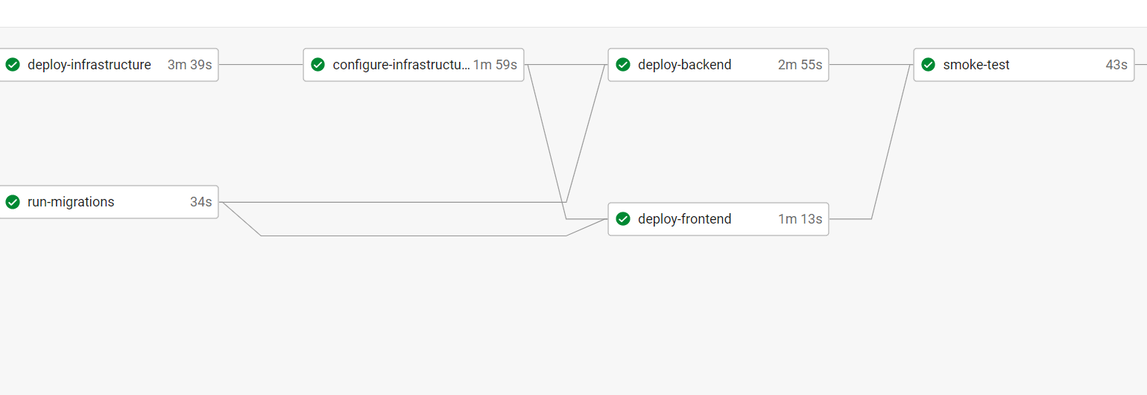
What is CI/CD ?
CD stands for continuous Delivery is a methodology to utilize the
code and deliver the content to the consumer
Example for some tasks →
Create the infrastructure
Prepare it
Deploy the code
Run smoke test
With automated workflow , all the process that we have to go through in order to have an artifact (package ready for deployment )
Less infrastructure costs from unused resources, less time

Slide 4
What CI/CD offers ?
Faster delivery of the new feature as the whole pipeline runs without minimum human interventions
Standardized method to deliver feature / fix make the delivery quicker and easier
Quick Rollback in case of any failure to return production to working state
Minimum downtime at each upgrade
Reduce costs of infrastructure and ability to well track the usage
Keep track of failed deployment , less time to spot the issue , less time to fix them too

